Slide 1
UL BW subfield design in Trigger frame

Slide 2
Introduction
There are several contributions about Trigger frame design in 11be [1-3].
We think that Trigger frame in 11be is designed with the consideration of A-PPDU of HE TB PPDU(s) and EHT TB PPDU(s).
  That means, the Trigger frame can trigger HE STA(s) and EHT STA(s) at the same time if present.
  HE STA receives the Trigger frame as HE Trigger frame. It means the Trigger frame shall be designed with backward compatibility.
  EHT STA receives the Trigger frame aligned with 11be spec, for example, supporting larger BW than 160MHz, 16 spatial streams, and 11be RU/MRU allocation that cannot be understood by HE STA.
Based on the assumption, here we focus on UL BW subfield design of Trigger frame in 11be.

Slide 3
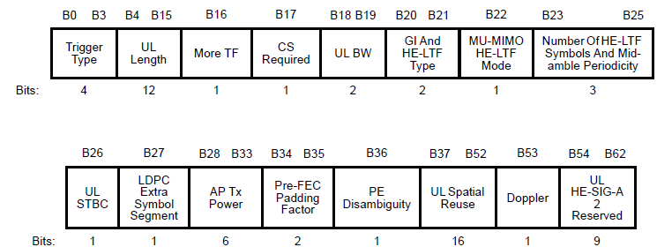
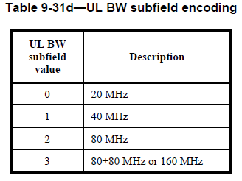
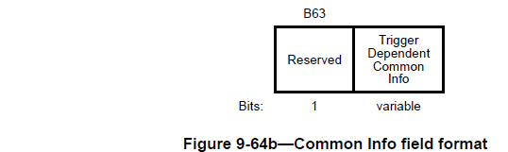
Common info field
  Common Info field of Trigger frame in 11ax
    UL BW subfield is included in B18-19 of Common Info field.
  Common Info field of Trigger frame in 11be
    It can be used for HE STA. So we can’t revise the used subfields for HE STA. We only can touch the reserved bits (B54~B63).
    For EHT STA, Trigger frame has to indicate over 160MHz UL BW.

Slide 4
UL BW subfield design (1/2)
HE STA reads UL BW subfield (B18-19) to transmit HE TB PPDU as in HE Trigger frame.
And there are two ways to indicate UL BW for EHT STA
  Option1: use the same UL BW subfield except 320MHz
    In case of UL BW of TB A-PPDU <=160MHz
      Set ‘Wide UL BW Indication’ subfield (e.g. B63) to ‘0’
      B18~19 indicates the total UL BW of TB A-PPDU
      AP can’t point out each UL BW for HE STA and EHT STA. But there may be no problem because each TB PPDU is transmitted according to the each RU Allocation in User Info field.
    In case of UL BW of TB A-PPDU = 320MHz
      Set ‘Wide UL BW Indication’ subfield (e.g. B63) to ‘1’
      B18~B19 is used for HE STA as in HE Trigger frame
  ‘Wide UL BW Indication’ subfield is needed. It consists of 1 bit (for 320MHz) or 2 bits (for 320MHz and the future extension).

Slide 5
UL BW subfield design (2/2)
There are two ways to indicate UL BW for EHT STA (Cont’d)
  Option2: use two separate UL BW subfields
    B18~19 only indicates ‘HE’ UL BW for HE TB PPDU(s)
    New ‘EHT UL BW’ subfield are defined for EHT TB PPDU(s).
      It indicates BW of EHT TB PPDU or BW of total TB A-PPDU. If the former, it may need the variable size’s BW indication (e.g. (300MHz EHT TB PPDU and 20MHz HE TB PPDU, for total 320MHz TB A-PPDU)
      The EHT UL BW subfield are defined in some reserved bits. We can use B54~62 (UL HE-SIG-A2 reserved) or Extended Common Info field by setting Special AID in User Info field [3].
    AP can announce each own BW for HE STA and EHT STA. But the arrangement rule is needed between HE’s BW and EHT’s BW in total TB A-PPDU’s BW, for example, BW for HE PPDU is primary located and then BW for EHT PPDU is followed.
  It needs two UL BW subfields for HE TB PPDU and EHT TB PPDU, separately, but looks simple to each HE STA and EHT STA.

Slide 6
Conclusion
In this contribution, we discuss how the UL BW of HE/EHT TB PPDU is indicated in Trigger frame in 11be.
We think that the Trigger frame can trigger both of HE TB PPDU and EHT TB PPDU simultaneously.
For that, UL BW subfield of Common Info field shall be defined for HE STA and/or EHT STA.
We slightly prefer option1 to set ‘Wide BW Indication’ subfield for 320MHz BW and reuse the existed UL BW subfield for both of HE TB PPDU(s) and EHT TB PPDU(s).

Slide 7
Reference
[1] IEEE802.11-20/0831r2, “Trigger frame for frequency-domain A-PPDU support”, Jonghun Han
[2] IEEE802.11-20-0840r3, “Backward compatible EHT Trigger frame”, Ming Gan
[3] IEEE802.11-20-1429r3, “Enhanced Trigger frame for EHT support”, Steve Shellhammer
[4] IEEE802.11-20-1808r1, “Backward Compatible EHT Trigger Frame follow-up“, Ming Gan

Slide 8
R1: BW related Information
Common Information for EHT TB PPDU or TB A-PPDU
  Enhanced Trigger frame flag: 1bit [3]
    If it sets to one, EHT STA knows this is an Enhanced Trigger frame, which triggers EHT TB PPDU or TB A-PPDU.
    It presents regardless the presence of the Special AID User Info Field as [3].
  HE/EHT indication: 1~2bits [4]
    If it sets to zero, HE TB PPDU is triggered in the part of whole BW. If one, EHT TB PPDU is triggered. 1~2bits are required by the number of parts.
      The details (How many parts are needed or what parts can include HE TB PPDUs) are R2 issues.
    From the subfield, EHT STA can know whether TB A-PPDU is supported or not in the Trigger frame. If Enhanced Trigger frame flag = 1 and HE/EHT indication = 0 in some parts, TB A-PPDU is supported. According to that, we can interpret UL BW subfield as the two ways in the next page.

Slide 9
R1: BW related Information
  Extended UL BW: 1bit
    STA can know whether the Trigger frame triggers EHT TB PPDU only or TB A-PPDU by Enhanced Trigger frame flag and HE/EHT indication.
      EHT TB PPDU only if Enhanced Trigger frame flag =1, all HE/EHT indications = 1
      TB A-PPDU if Enhanced Trigger frame flag =1, some HE/EHT indication = 0
    The indication of 320_1 or 320_2 is not necessary because
      STAs (even unassociated STA) can know that from Trigger frame (U-SIG or Service field, etc) because if UL BW is 320MHz, BW of Trigger frame will be also 320MHz (as defined in 11ax).
      STAs have to know the location of Primary/secondary before reading RU allocation information.
    So EHT STA interprets the UL BW subfields as below
UL BW (2bits) | Extended UL BW (1bit) | When EHT TB PPDU only | When TB A-PPDU
 |  |  | HE TB PPDU | EHT TB PPDU
0 | 0 | 20MHz | 20MHz | 80MHz (total 320MHz)
1 | 0 | 40MHz | 40MHz | 80MHz (total 320MHz)
2 | 0 | 80MHz | 80MHz | 80MHz (total 320MHz)
3 | 0 | 160MHz | 160MHz | 80MHz (total 320MHz)
0 | 1 | 320MHz | 20MHz | 160MHz (total 320MHz)
1 | 1 | reserved | 40MHz | 160MHz (total 320MHz)
2 | 1 | reserved | 80MHz | 160MHz (total 320MHz)
3 | 1 | reserved | 160MHz | 160MHz (total 320MHz)
Note: We assumes HE TB PPDU and EHT TB PPDU can’t be mixed in a 160MHz. But the we can discuss the details in R2.

Slide 10
R1: Summary
The subfields are added in Common Info field of Trigger frame to support EHT TB PPDU or TB A-PPDU.
  Enhanced Trigger frame flag: 1bit
  HE/EHT indication: 1~2 bits
  Extended UL BW: 1bits

Slide 11
Straw poll 1
Do you agree to add the following text to the TGbe SFD?
  UL BW subfield (B18~19) in Common Info field of Trigger frame indicates 20/40/80/160MHz for HE TB PPDU if the Trigger frame triggers HE TB PPDU, regardless of whether the Trigger frame triggers EHT TB PPDU or not at the same time.
  Y/N/A

Slide 12
Straw poll 2
Do you agree to add the following text to the TGbe SFD?
  Extended UL BW subfield is defined for 320MHz EHT TB PPDU transmission in Common Info field of Trigger frame.
  Y/N/A

Slide 13
Straw poll 3
Do you agree to add the following text to the TGbe SFD?
  1bit Extended UL BW subfield is defined in Common Info field of Trigger frame as below when only EHT TB PPDUs are triggered.
    The interpretation of UL BW subfield and Extended UL BW subfield can be modified for TB A-PPDU in R2.
  Y/N/A
UL BW (2bits) | Extended UL BW (1bit) | When EHT TB PPDU only
0 | 0 | 20MHz
1 | 0 | 40MHz
2 | 0 | 80MHz
3 | 0 | 160MHz
0 | 1 | 320MHz
1 | 1 | reserved
2 | 1 | reserved
3 | 1 | reserved

