Slide 1
LPI PPDU Format
Date: 2020-08-28
Authors:
Name | Affiliation | Address | Phone | Email
Junghoon Suh | Huawei |  |  | junghoon.suh@huawei.com
Yan Xin |  |  |  | yan.xin@huawei.com
Osama Aboul-Magd |  |  |  | osama.aboulmagd@huawei.com

Slide 2
Background
DUP mode is defined for non-punctured 80MHz, 160MHz and 320MHz PPDUs transmitted to a single user, and limited to {MCS0+DCM, Nss=1} [1]
Ref. [1] mainly targets the Low Power Indoor (LPI) PPDU with the range extension
The DUP mode is defined for the payload, which may result in more robust design for the payload than for the preamble
We propose an LPI PPDU Format to make the preamble more robust
2 Symbol U-SIG is more than enough for PHY header in LPI PPDU
Preamble without E-SIG is proposed

Slide 3
80 MHz LPI PPDU from [2]
Legacy
U
-
SIG
EHT
-
preamble
SIG
Legacy
U
-
SIG
EH
preamble
T_
SIG
EHT
-
EHT
LTF
LPI LR Payload
-
Legacy
STF
U
-
SIG
EHT
-
preamble
SIG
Legacy
U
-
SIG
EHT
-
SIG
preamble
LPI PPDU is sent to a single user, and it is a non-OFDMA frame
U-SIG (2 symbols) and E-SIG (1 symbol) are repeated 4 times across 80 MHz, with MCS 0
40 MHz Payload is repeated twice across 80 MHz with MCS0 + DCM

Slide 4
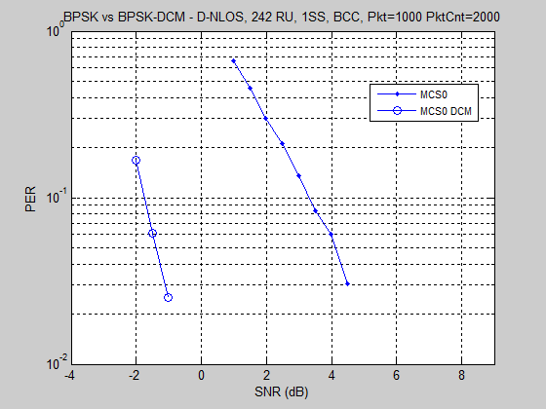
Performance of DCM+MCS0 [3]
5 dB
When the baseline is 20 MHz MCS0, U-SIG achieves 6 dB gain with 4 repetitions
While Payload achieves 3 dB gain with 2 repetitions and 5 dB gains with DCM
Payload is more robust than U-SIG, based on an Intuitive analysis

Slide 5
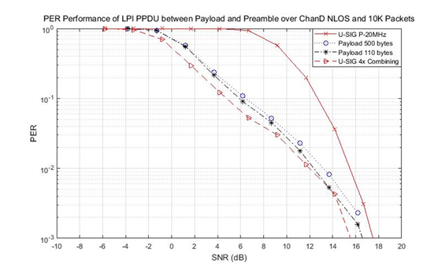
Performance check by Simulation
Indication of LPI PPDU needs to take place before the U-SIG decoding in order to apply the 4x combining to decoding the U-SIG
DCM gain is optimized with the smaller RU size, higher MCS, and with the shorter packet size
Detection SNR range (10% PER) for 80 MHz is about 6 dB higher than the 20 MHz only detection

Slide 6
Proposed 80 MHz EHT LPI PPDU
L-Preamble
/ RL-SIG
U-SIG
RU-SIG
L-Preamble
/ RL-SIG
U-SIG
RU-SIG
EHT-STF/LTF
and Payload
L-Preamble
/ RL-SIG
U-SIG
RU-SIG
L-Preamble
/ RL-SIG
U-SIG
RU-SIG
We propose to repeat U-SIG once in time domain just like RL-SIG, and call it RU-SIG
LPI PPDU is auto-detected with the correlation check between U-SIG and RU-SIG
PPDU type for LPI is not needed to explicitly indicate
The parameters such as Puncturing patterns, PPDU type, EHT-SIG MCS, Payload MCS, Number of EHT-SIG Symbols, EHT-SIG Compression, N_STS bits are not needed for LPI
2 Symbol U-SIG seems good enough for the preamble efficiency. Overflow extra EHT-SIG symbol is not necessary
Auto-detection is good for non-destination STAs to discern LPI frame from the regular frames such as EHT MU PPDU and EHT ER SU type of PPDU

Slide 7
U-SIG contents analysis for LPI PPDU
Field | Category | Subfield | Bits
U-SIG | Version Independent | Version identifier | 3
 |  | UL/DL | 1
 |  | BSS color | 6
 |  | TXOP | 7
 |  | PPDU BW | 3
 | Version Dependent | Punctured channel indication(global for non-OFDMA) | 5
 |  | Reserved | 1
 |  | PPDU format | 1
 |  | Reserved | 6
 |  | EHT-SIG MCS | 2
 |  | Number of EHT-SIG symbols | 5
 |  | EHT-SIG Compression | 2
 | CRC & Tail | CRC in U-SIG | 4
 |  | Tail in U-SIG | 6
 | Total # of Bits in U-SIG |  | 52
EHT-SIG | Version Dependent (U-SIG Overflow) | Spatial reuse | 4
 |  | GI+LTF size | 3
 |  | Number of EHT-LTF symbols and midamble periodicity | 3
 |  | Doppler | 1
 |  | Pre-FEC padding | 2
 |  | LDPC extra symbol segment | 1
 |  | Reserved | 2
 |  | PE disambiguity | 1
 | Total # of Overflow Bits |  | 17
U-SIG & E-SIG contents are given in [4]
The subfields in blue color are not necessary for LPI PPDU, while those in red color may have different bit size
We propose the U-SIG contents for LPI PPDU in the next slide

Slide 8
Proposed U-SIG contents for LPI PPDU
Field | Category | Subfield | Bits
U-SIG | Version Independent | Version identifier | 3
 |  | UL/DL | 1
 |  | BSS color | 8
 |  | TXOP | 7
 |  | PPDU BW | 3
 | Version Dependent | Spatial Reuse | 4
 |  | GI+LTF size | 3
 |  | Doppler & Midamble periodicity | 2
 |  | Pre-FEC Padding | 2
 |  | LDPC Extra symbol segment | 1
 |  | PE disambiguity | 1
 |  | Reserved | 7
 | CRC & Tail | CRC | 4
 |  | Tail | 6
 | Total bits in U-SIG |  | 52

Slide 9
Summary
We proposed to repeat U-SIG to strengthen the Preamble detection
Auto-detection using the correlation between U-SIG and RU-SIG can indicate LPI PPDU. No need to introduce an additional entry in PPDU Type field
Overflow U-SIG into an EHT-SIG is not necessary

Slide 10
SP1
Do you agree to have an auto-classification mechanism for the EHT SU-DUP?
It is TBD to include an EHT-SIG in addition to the U-SIG
It is TBD how/whether to apply the QBPSK and Interleaving for the U-SIG
Following is an example and open for any other proposal
L-Preamble
/ RL-SIG
U-SIG 1
U-SIG 2
EHT-SIG
QBPSK
QBPSK
L-Preamble
/ RL-SIG
U-SIG 1
U-SIG 2
EHT-SIG
QBPSK
QBPSK
EHT-STF/LTF
and Payload
L-Preamble
/ RL-SIG
U-SIG 1
U-SIG 2
EHT-SIG
QBPSK
QBPSK
L-Preamble
/ RL-SIG
U-SIG 1
U-SIG 2
EHT-SIG
QBPSK
QBPSK

Slide 11
Reference
[1] Ron Porat, “6GHz LPI Range Extension” 11-20/965r3, IEEE TGbe
[2] Jianhan Liu, et. al., “DCM for range extension in 6GHz LPI”, 11-20/986r1, IEEE TGbe
[3] Jianhan Liu, et. al., “On Modulation of MCS0 DCM and DCM Capability”, 11-16/655r1, IEEE TGax
[4] Sameer Vermani, “Open Issues on Preamble Design”, 11-20/1238r0, IEEE TGbe

