Slide 1
802.11 Working Group Opening Report
September 2020
Authors:
Date: 2020-09-13

Slide 2
Introduction
This presentation, together with the reports cited herein, forms the opening report of the IEEE 802.11 Working Group for September 2020.
“Mx.y.z” terminology indicates that the item was on the tentative agenda for the Monday 802.11 plenary, and was agenda item x.y.z.

Slide 3
M1.3 Meeting Decorum
%
Please observe proper decorum in meetings; No Photography or recording
Press (i.e., anyone reporting publicly on this meeting) are to announce their presence (Jan 2019 IEEE-SA Standards Board Ops Manual 5.3.3.2)
Laptop speakers, cell phone / tablet ringers off
Mute when not speaking (teleconference)
Use chat window to enter the queue (teleconference)
Wear badges at all times in meeting areas (face to face meetings)
  Help the hotel security staff improve the general security of the meeting rooms
Please see additional meeting details: https://mentor.ieee.org/802.11/dcn/20/11-20-0943

Slide 4
M2.2.1 Summary of Liaisons - Incoming
No new Liaison documents received since July 2020

Slide 5
M2.3 802 EC decisions
March 2020
SENS SG Extension
RCM SG first re-charter
April 2020
RCM SG formation
May 2020
SENS SG first extension (SASB)
July/August
P802.11ba PAR Extension
P802.11ax PAR Extension
P802.11bf PAR, CSD (Sensing)
First SENS SG Re-Charter (July to Nov plenary)
First RCM SG Re-Charter (July to Nov plenary)

Slide 6
M2.3 Upcoming 802 EC actions
October 2020
RCM SG first extension
P802.11REVmd to RevCom
November 2020
P802.11ax to RevCom
P802.11ay to RevCom
P802.11ba to RevCom
RCM PAR/CSD

Slide 7
M2.3 IEEE-SA Standards Board (SASB) decisions
Pending Sept 2020
P802.11ax PAR extension
P802.11ba PAR extension
P802.11bf PAR approval

Slide 8
M3.1 802.11 Working Group Session Documents
WG Session Reports
WG Agenda | https://mentor.ieee.org/802.11/dcn/11-20-0868
Opening report | https://mentor.ieee.org/802.11/dcn/11-20-0869
Snapshot slides | https://mentor.ieee.org/802.11/dcn/11-20-0324
1st vice chair | https://mentor.ieee.org/802.11/dcn/11-20-0944
2nd vice chair | https://mentor.ieee.org/802.11/dcn/11-20-0323
Treasurer | https://mentor.ieee.org/802-ec/dcn/19/ec-20-0115
Chair's Supplementary Material | https://mentor.ieee.org/802.11/dcn/11-20-0867
Motions | https://mentor.ieee.org/802.11/dcn/11-20-0325
Closing report | https://mentor.ieee.org/802.11/dcn/11-20
Previous Session Minutes | https://mentor.ieee.org/802.11/dcn/11-20-0015

Slide 9
M3.2 Joint meetings and Reciprocal Credit
Reciprocal credit is provided to 802.11 voters for attendance at: 802.18 (only .11 credit for .18 attendance), 802.19, 802.24, 802.1, NENDICA Industry Connections Activity**
  Reciprocal credit for 802.1 is for 801.1Qbz, 802.1CF, 802E, 802.1CF
For the Sept 2020 electronic interim, reciprocal credit is given for other WG/TAG meetings which occur during the WG11 plenary session, Monday September, 2020 9am Eastern to Friday, September 18, 2020 11am Eastern
** When meeting

Slide 10
M3.2 802.18 details
Agenda: 18-20/xxx
Meeting times: Thursday 3PM Eastern, see https://www.ieee802.org/18/
Discussion items of interest to 802.11 WG include
  Recent Americas, European ETSI, CEPT and Asia Pacific activities status and discussion
  FCC revisit of 70/80/90 GHz bands

Slide 11
M3.2 802.19 details
Agenda: Not having a 2020 September Interim session
  See https://mentor.ieee.org/802.19/dcn/20/19-20-0022-00-0000-july-2020-wg-agenda.xlsx
802.19.3 (Sub-1GHz Coexistence PAR )
Discussion items of interest to 802.11 WG include
  802.19.3

Slide 12
M4.1.1 Type of Groups
Type of Group | Description
WG | Working Group
SC | Standing Committee
TG | Task Group
SG | Study Group
TIG | Topic Interest Group
AHG | Ad Hoc Group

Slide 13
M4.1.1 IEEE 802.11 Groups
Type | Group | WG & Infrastructure
WG | WG11 | The IEEE 802.11 Working Group
SC | AANI | Advanced Access Networking Interface (AANI)
SC | ARC | Architecture
SC | COEX | Coexistence
SC | PAR | PAR review
802 SC | JTC1 | ISO/IEC JTC1/SC6
Type | Group | Amendments/Revision
TG | AX | High Efficiency Wireless LAN (HEW)
TG | AY | Next Generation 60 GHz (NG60)
TG | AZ | Next Generation Positioning (NGP)
TG | BA | Wake-up Radio
TG | BB | Light Communication (LC)
TG | BC | Enhanced Broadcast Service (BCS)
TG | BD | Enhancements for Next Gen V2X (NGV)
TG | BE | Extremely High Throughput
TG | MD | Revision (REVmd)
Type | Group | New Work
SC | WNG | Wireless Next Generation
SG | SENS | WLAN Sensing
SG | RCM | Random and Changing MAC Addresses
AHG | ITU | ITU Liaison

Slide 14
M4.1.2 PAR Expiration/Renewal Schedule
Project | PAR Expiration Date
AX | 31-DEC-2020
AY | 31-DEC-2021
AZ | 31-DEC-2021
BA | 31-DEC-2020
BB | 31-DEC 2022
BC | 31-DEC 2022
BD | 31-DEC 2022
BE | 31-DEC 2023
802.11 (REVmd) | 31-DEC 2021
http://www.ieee802.org/11/PARs/index.html

Slide 15
M4.1.3 802.11 WG Appointed positions
WG Secretary – Stephen McCann
Treasurer – Jon Rosdahl
ANA Authority – Robert Stacey
WG Technical Editors – Robert Stacey, Peter Ecclesine

Slide 16
M4.1.3 Officers
Cat | Group | Chair | Vice Chair | Technical Editor | Secretary
WG |  | Dorothy STANLEY | Jon ROSDAHL, Robert STACEY | Robert STACEY Peter ECCLESINE | Stephen MCCANN
SC | AANI | Joseph LEVY
SC | ARC | Mark HAMILTON | Joseph LEVY |  | Joseph LEVY
SC | Coex | Andrew MYLES |  |  | Guido HIERTZ
SC | PAR | Jon ROSDAHL | Michael MONTEMURRO |  | Michael MONTEMURRO
SC | WNG | Jim LANSFORD | Lei WANG |  | Lei WANG
TG | MD | Dorothy STANLEY | Mark HAMILTON Michael MONTEMURRO | Emily QI Edward AU (subeditor) | Jon ROSDAHL
TG | AX | Osama ABOUL-MAGD | Alfred ASTERJADHI, Ron PORAT | Robert STACEY | Yasuhiko INOUE
TG | AY | Edward AU | Sang KIM | Carlos CORDEIRO | Jeorge HURTARTE
TG | AZ | Jonathan SEGEV | Assaf KASHER | CC WANG, Roy WANT | Assaf KASHER(Acting)
TG | BA | Minyoung PARK | Yunsong YANG, Eunsung PARK | Po-Kai HUANG | Leif WILHELMSSON
TG | BB | Nikola SERAFIMOVSKI | Tuncer BAYKAS | Volker JUNGNICKEL | Volker JUNGNICKEL
TG | BC | Marc EMMELMANN | Hitoshi MORIOKA, Stephen MCCANN | Carol ANSLEY | Xiaofei WANG
TG | BD | Bo SUN | Hongyuan ZHANG, Joseph LEVY | Bahar SADEGHI
TG | BE | Alfred ASTERJADHI | Laurent CARIOU, Matthew FISCHER | Edward AU | Dennis SUNDMAN
SG | SENS | Tony HAN |  |  | Claudio DASILVA
SG | RCM | Carol ANSLEY
AHG | ITU | Hassan YAGHOOBI
New since last meeting

Slide 17
M4.1.4 IEEE 802.11 Revisions
802.11
-2016
802.11
-2012
802.11
-2007
802.11
-2003
11aa
Video Transport
11k
RRM
11s
Mesh
11e
QoS
MAC
11u
WIEN
11v
Network
Management
11h
DFS & TPC
IEEE
Std
802.11
-1997
11ae
QoS Mgt Frames
11z
TDLS
11i
Security
11d
Intl roaming
11w
Management
Frame
Security
11r
Fast Roam
11f
Inter AP
11af
TV Whitespace
11n
High
Throughput
(>100 Mbps)
11j
JP bands
11a
54 Mbps
5GHz
PHY & MAC
11ac -VHT
>1 Gbps @ 5GHz
11p
WAVE
11y
Contention
Based
Protocol
11g
54 Mbps
2.4GHz
11b
11 Mbps
2.4GHz
11ad - VHT
>1 Gbps @ 60GHz
Notes:
doc.: IEEE 802.11-11/0483r0
May 2011
Bruce Kraemer (Marvell)
Page 17

Slide 18
M4.1.4 IEEE 802.11 Standards Pipeline
MAC
802.11aq
PAD
802.11
-2016
802.11
REVmd
802.11az
NGP
802.11ak
GLK
802.11bc
(BCS)
Random and
Changing MAC
Addresses
(RCM) SG
802.11ba
WUR
802.11ai
FILS
ITU Liaison
(ITU) AHG
WNG
WLAN
Sensing
(SENS)SG
802.11be
TGbe
802.11ax
HEW
802.11ah
< 1Ghz
802.11bd
NGV
802.11ay
NG60
802.11bb
LC
802.11aj
CMMW
Liaison
MAC & PHY
Liaison Topics
Discussion Topics
TIG/Study
groups
TG without
Approved draft
WG
Letter Ballot
SA
Ballot
Published
Amendment
Published
Standard
18
Notes:
doc.: IEEE 802.11-11/0483r0
May 2011
Bruce Kraemer (Marvell)
Page 18

Slide 19
M4.1.5 Summary of ballots and comment collections
Type | Label | Group | Opened (mm-dd) | Dur (d) | # Comments | Ballot Group | Approve | Disapprove | Abstain | Return % | Approve % | Result
T | CC D0.1 | TGbc | 07-20 | 10 | 342
T | CC TR | AANI | 07-30 | 20 | 111
T | SA R1 | TGmd | 08-20 | 15 | 82 | 174 | 136 | 13 | 5 | 88 | 91 | Pass
T | SA R1 | TGax | 09-02 | 15

Slide 20
M4.1.6 Current Membership Status
Data as of 2020-07-21
Status | Number
Aspirant | 187
Potential Voter | 46
Voter | 340
Ex Officio Voter | 11
Definitions:
  Aspirant: a member who has attended 1 qualifying meeting
  Potential Voter: a member who has attended 2 qualifying meetings and will become a voter at the start of the next plenary they attend
  Ex Officio Voter: a voter who has voting rights by virtue of their membership of the 802 EC and has requested to be recorded as an ex officio voter in 802.11

Slide 21
M6.1 Comment Resolution Resources
Comment resolution resources
  See https://mentor.ieee.org/802.11/dcn/13/11-13-0230-03-0000-comment-resolution-tutorial.ppt
  See https://mentor.ieee.org/802.11/dcn/11/11-11-1625-02-0000-comment-resolution-guide.doc
There are many examples of good practice for documentation of comment analysis and resolution; ensures there is a record of comment consideration and agreed resolution
  https://mentor.ieee.org/802.11/dcn/18/11-18-0237-00-000m-cid-177.docx
  https://mentor.ieee.org/802.11/dcn/18/11-18-0930-00-000m-cid-1007.docx
  https://mentor.ieee.org/802.11/dcn/18/11-18-0669-04-000m-revmd-mac-comments-assigned-to-hamilton.docx
  https://mentor.ieee.org/802.11/dcn/18/11-18-1410-00-00ax-lb233-cr-spatial-reuse.docx

Slide 22
M6.2 WG11 30th Anniversary
Congratulations
to all WG
participants!
September 2020 – Recognize 30 Years!
First meeting of WG11: September 1990
Celebrating 20 years in 2010
Celebrating 25 years in 2015
Celebrating 30 years in 2020
Also Friday Closing Plenary agenda item
Notes:
The original standard was published in 1997, revised in 1999 with MIB changes, and reaffirmed in 2003.
A revision was published in 2007, which incorporated into the 1999 edition the following amendments:
— IEEE Std 802.11a™-1999: High-speed Physical Layer in the 5 GHz Band (Amendment 1)
— IEEE Std 802.11b™-1999: Higher-Speed Physical Layer Extension in the 2.4 GHz Band
(Amendment 2)
— IEEE Std 802.11b-1999/Corrigendum 1-2001: Higher-speed Physical Layer (PHY) extension in the
2.4 GHz band (Corrigendum 1 to Amendment 2)

Slide 23
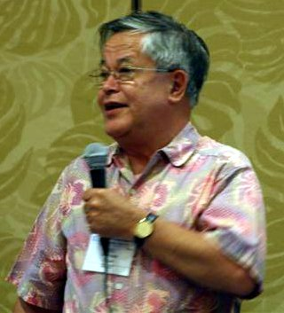
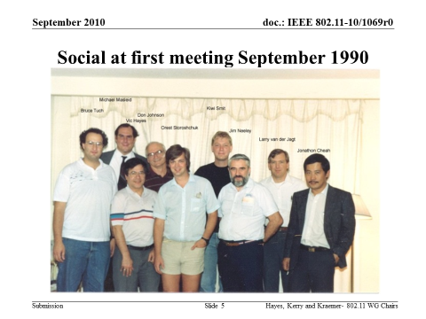
The first meeting of the IEEE 802.11 Working Group was 10th – 14th Sept 1990
1990s
The original standard was published in 1997, revised in 1999 with MIB changes
IEEE Std 802.11a™-1999: High-speed Physical Layer in the 5 GHz Band
IEEE Std 802.11b™-1999: Higher-Speed Physical Layer Extension in the 2.4 GHz Band
IEEE Std 802.11b-1999/Corrigendum 1-2001: Higher-speed Physical Layer (PHY) extension in the 2.4 GHz band
Notes:
The original standard was published in 1997, revised in 1999 with MIB changes, and reaffirmed in 2003.
A revision was published in 2007, which incorporated into the 1999 edition the following amendments:
— IEEE Std 802.11a™-1999: High-speed Physical Layer in the 5 GHz Band (Amendment 1)
— IEEE Std 802.11b™-1999: Higher-Speed Physical Layer Extension in the 2.4 GHz Band
(Amendment 2)
— IEEE Std 802.11b-1999/Corrigendum 1-2001: Higher-speed Physical Layer (PHY) extension in the
2.4 GHz band (Corrigendum 1 to Amendment 2)

Slide 24
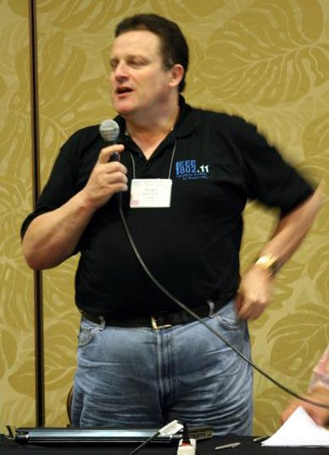
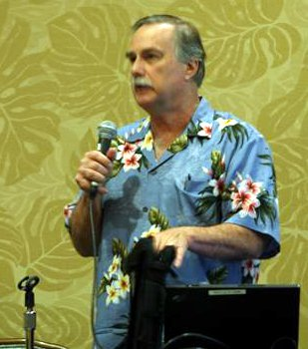
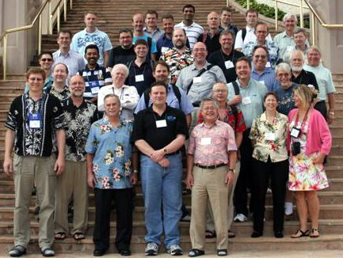
September 2010 - 20th Anniversary: 2nd decade
1990s
IEEE Std 802.11d™-2001: Specification for operation in additional regulatory domains
IEEE Std 802.11g™-2003: Further Higher Data Rate Extension in the 2.4 GHz Band
IEEE Std 802.11h™-2003: Spectrum and Transmit Power Management Extensions in the 5 GHz band in Europe
IEEE Std 802.11i™-2004: Medium Access Control (MAC) Security Enhancements
IEEE Std 802.11j™-2004: 4.9 GHz–5 GHz Operation in Japan
IEEE Std 802.11e™-2005: Medium Access Control (MAC) Quality of Service Enhancements
IEEE Std 802.11™ -2007
IEEE Std 802.11k™-2008: Radio Resource Measurement of Wireless LANs
IEEE Std 802.11r™-2008: Fast Basic Service Set (BSS) Transition
IEEE Std 802.11y™-2008: 3650–3700 MHz Operation in USA
IEEE Std 802.11w™-2009: Protected Management Frames
IEEE Std 802.11n™-2009: Enhancements for Higher Throughput
Notes:
— IEEE Std 802.11d™-2001: Specification for operation in additional regulatory domains
(Amendment 3)
— IEEE Std 802.11g™-2003: Further Higher Data Rate Extension in the 2.4 GHz Band (Amendment
4)
— IEEE Std 802.11h™-2003: Spectrum and Transmit Power Management Extensions in the 5 GHz
band in Europe (Amendment 5)
— IEEE Std 802.11i™-2004: Medium Access Control (MAC) Security Enhancements (Amendment 6)
— IEEE Std 802.11j™-2004: 4.9 GHz–5 GHz Operation in Japan (Amendment 7)
— IEEE Std 802.11e™-2005: Medium Access Control (MAC) Quality of Service Enhancements
(Amendment 8)
A revision was published in 2012, which incorporated into the 2007 revision the following amendments:
— IEEE Std 802.11k™-2008: Radio Resource Measurement of Wireless LANs (Amendment 1)
— IEEE Std 802.11r™-2008: Fast Basic Service Set (BSS) Transition (Amendment 2)
— IEEE Std 802.11y™-2008: 3650–3700 MHz Operation in USA (Amendment 3)
— IEEE Std 802.11w™-2009: Protected Management Frames (Amendment 4)
— IEEE Std 802.11n™-2009: Enhancements for Higher Throughput (Amendment 5)

Slide 25
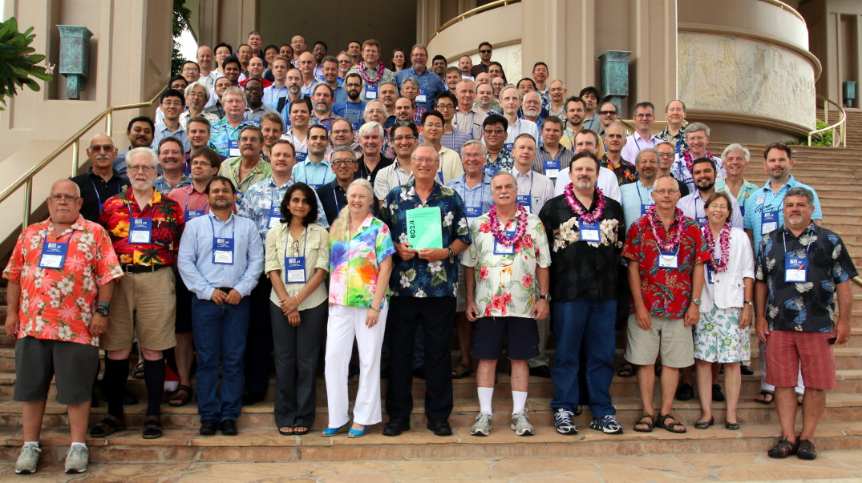
July 2015 - 25th Anniversary: Next 5 years
1990s
IEEE Std 802.11p™-2010: Wireless Access in Vehicular Environments
IEEE Std 802.11z™-2010: Extensions to Direct-Link Setup (DLS)
IEEE Std 802.11v™-2011: Wireless Network Management
IEEE Std 802.11u™-2011: Interworking with External Networks
IEEE Std 802.11s™-2011: Mesh Networking
IEEE Std 802.11™ -2012
IEEE Std 802.11ae™-2012: Prioritization of Management Frames (Amendment 1)
IEEE Std 802.11aa™-2012: MAC Enhancements for Robust Audio Video Streaming
IEEE Std 802.11ad™-2012: Enhancements for Very High Throughput in the 60 GHz Band
IEEE Std 802.11ac™-2013: Enhancements for Very High Throughput for Operation in Bands
below 6 GHz
IEEE Std 802.11af™-2013: Television White Spaces (TVWS) Operation
Notes:
IEEE Std 802.11p™-2010: Wireless Access in Vehicular Environments (Amendment 6)
— IEEE Std 802.11z™-2010: Extensions to Direct-Link Setup (DLS) (Amendment 7)
— IEEE Std 802.11v™-2011: Wireless Network Management (Amendment 8)
— IEEE Std 802.11u™-2011: Interworking with External Networks (Amendment 9)
— IEEE Std 802.11s™-2011: Mesh Networking (Amendment 10)
— IEEE Std 802.11ae™-2012: Prioritization of Management Frames (Amendment 1)
— IEEE Std 802.11aa™-2012: MAC Enhancements for Robust Audio Video Streaming
(Amendment 2)
—IEEE Std 802.11ad™-2012: Enhancements for Very High Throughput in the 60 GHz Band
(Amendment 3)
— IEEE Std 802.11ac™-2013: Enhancements for Very High Throughput for Operation in Bands
below 6 GHz (Amendment 4)
— IEEE Std 802.11af™-2013: Television White Spaces (TVWS) Operation (Amendment 5)

Slide 26
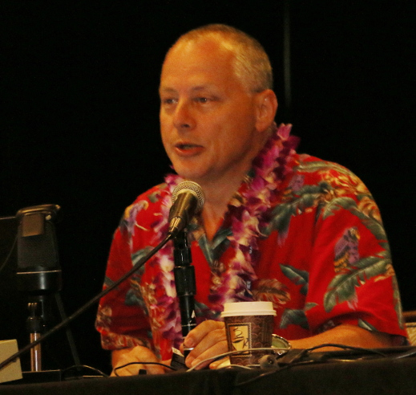
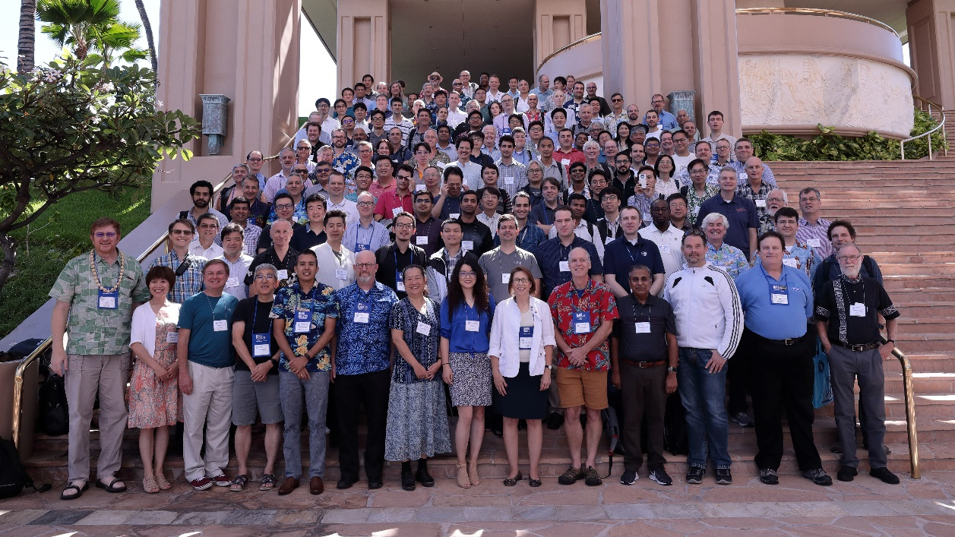

September 2020- 30th Anniversary: Next 5 years
IEEE Std 802.11™ -2016
IEEE Std 802.11ai™-2016 (second printing): Fast Initial Link Setup
IEEE Std 802.11ah™-2016: Sub 1 GHz License Exempt Operation
IEEE Std 802.11aj™-2018: Enhancements for Very High Throughput to Support Chinese Millimeter Wave Frequency Bands (60 GHz and 45 GHz)
IEEE Std 802.11ak™-2018: Enhancements for Transit Links Within Bridged Networks
IEEE Std 802.11aq™-2018: Preassociation Discovery
Group Photo form 2019:
Looking forward to REVmd,
11ax, 11ay, 11az, 11ba, 11bb,
11bc, 11bd,11be, 11bf……

Slide 27
background data

Slide 28
Members by country and region

Slide 31
Attendees by affiliation
(attended at least one meeting July to Sept)

Slide 32
Attendance by subgroup (last 30 days)

