Slide 1
Tentative (Re)Association for Non-AP MLD
Date: 2020-05-19
Authors:
Name | Affiliations | Address | Phone | Email
Guogang Huang | Huawei | Shenzhen, China |  | huangguogang1@huawei.com
Ming Gan |  |  |  | ming.gan@huawei.com
Yunbo Li |  |  |  | liyunbo@huawei.com
Yuchen Guo |  |  |  | guoyuchen@huawei.com
Yifan Zhou |  |  |  | zhouyifan8@huawei.com
Yiqing Li |  |  |  | liyiqing3@huawei.com

Slide 2
Introduction
For a STA with one single radio, the data delivery will be interrupted during a roaming until the re-association with a new AP is completely finished
Contribution [1] first proposed the “Make Before Break” concept to reduce the gap in data delivery during a roaming in 2003
Exploit the power save mechanism to communicate to both old AP and new AP on the different channels
Considering the fact of inter-frequency deployment and the limitation of only one single radio, the data delivery will be still interrupted during the tentative association with the new AP on a different channel
This contribution will address how to implement the “Make Before Break” scheme under the MLD framework

Slide 3
Recap-Association Operation
Necessary Actions before data transfer
802.11 open system authentication
Exchange Association Request/Response frames
802.1X authentication if needed
Derived PMK
4-way handshake if needed
Derived PTK and GTK
(PMK)

Slide 4
Recap-Association Operation
802.11 Spec-2016. At any given instant, a STA is associated with no more than one AP. This allows the DS to determine a unique answer to the question, “Which AP is serving STA X?” Once an association is completed, a STA can make full use of a DS (via the AP) to communicate.
DS-STA-NOTIFY.request primitive
Update STA-AP Mapping info
When to send DS-STA-NOTIFY.request primitive to the DS is not specifically defined in the current Spec.
The reason may be that it doesn’t matter for the single-radio client

Slide 5
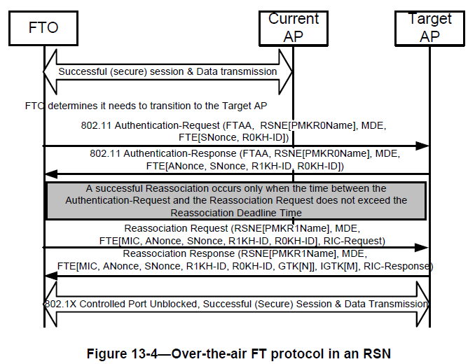
Recap-Fast BSS Transition
AC/AS
The data delivery is interrupted during this period.
Maybe need to go to AC/AS to inquire PMKID info

Slide 6
Recap-Make Before Break [1]
Main Idea
In order to minimize or eliminate any gap in data connectivity while roaming, it is proposed to let a STA make a partial connection with a new AP without dropping the connection with the old AP.
Then the STA can negotiate with the new AP to set up the correct conditions for data connectivity, while still using the old AP for data connectivity.
Once the correct conditions are set up, the new AP will trigger DS-STA-Notify.request to update STA-AP mapping info. The STA can then break the connection with the old AP, and the new AP start using the new AP for data connectivity.

Slide 7
Recap-Make Before Break (Cont.)
Split necessary actions before data transfer into two parts
Part-1 action. All necessary actions except of STA-AP Mapping Notification
e.g. Authentication, Association Request/Response, 802.1 X authentication, 4-way handshake to generate PTK and GTK, even BA agreement setup
Note that existing EAPOL security communications are, strictly speaking, between the STA and the AP; the AP proxies these messages to the DS using its own MAC address, rather than the MAC address of the STA.
In other word, during this period, communication is only allowed between STA and AP, but not from STA to DS directly.
Part-2 action. STA-AP Mapping Notification by using the DS-STA-NOTIFY.request primitive to the DS

Slide 8
Recap-Make Before Break (Cont.)
Procedure of Make Before Break
Step 1. STA sends a Tentative Association Request to the new AP.
Step 2. Once the new AP responds to this request with a Tentative Association Response, the new AP and the STA would then be free to do Part-1 actions in order
Step 3. STA sends a Complete Association Request to the new AP
Step 4. In response, the new AP sends a Complete Association Response to the STA, and the STA-AP Mapping Notification to the DS.
At this point, the association is complete, and the data delivery can go through the new AP.

Slide 9
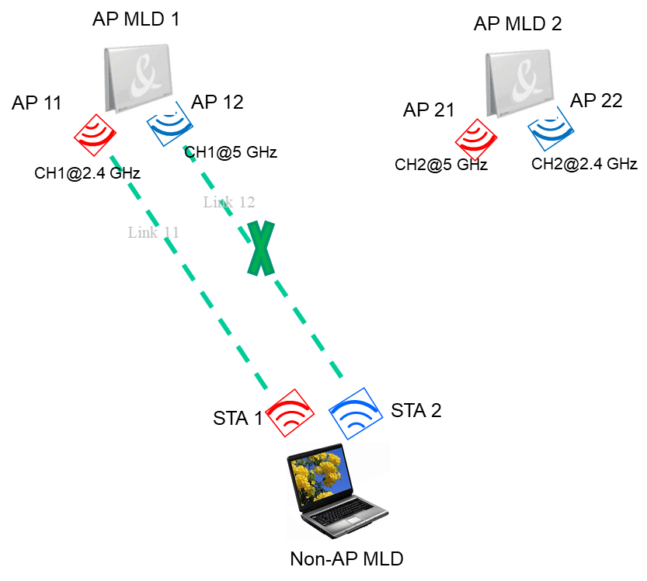
Make Before Break under MLD Framework
Phase 1. Prior roaming
Non-AP MLD inform AP MLD 1 to disable Link 12. Then non-AP MLD will let STA 2 to do the multi-link tentative association with neighboring candidate AP MLD or AP

Slide 10
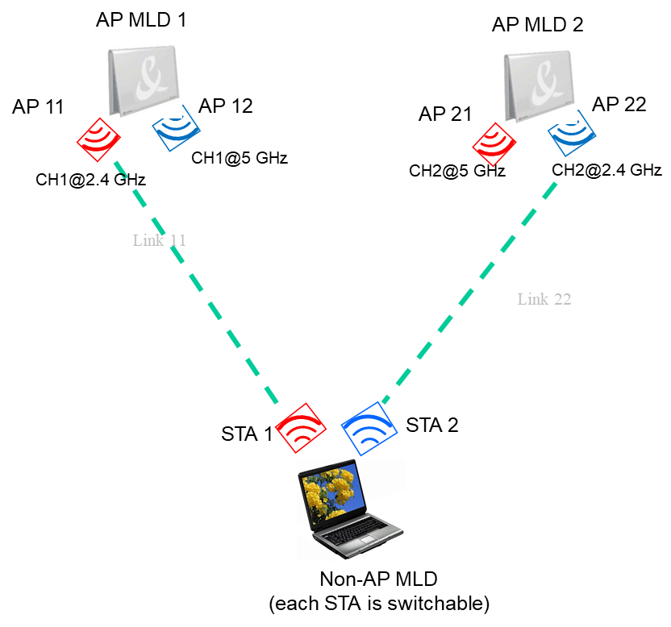
Make Before Break under MLD Framework
Phase 2. During roaming
STA 2 affiliated with non-AP MLD tries to do the tentative multi-link association with AP MLD 2 on CH2@2.4 GHz. In the Multi-link Re-association Request/Response frame, non-AP MLD will inform AP MLD 2 to disable link 22. The the following actions maybe included, e.g.
802.11 Authentication Request/Response frames exchange
(Multi-link) Re-association Request/Response frames exchange
BA Agreement negotiation
Meanwhile, non-AP MLD still can deliver data traffic with AP MLD 1 through Link 11

Slide 11
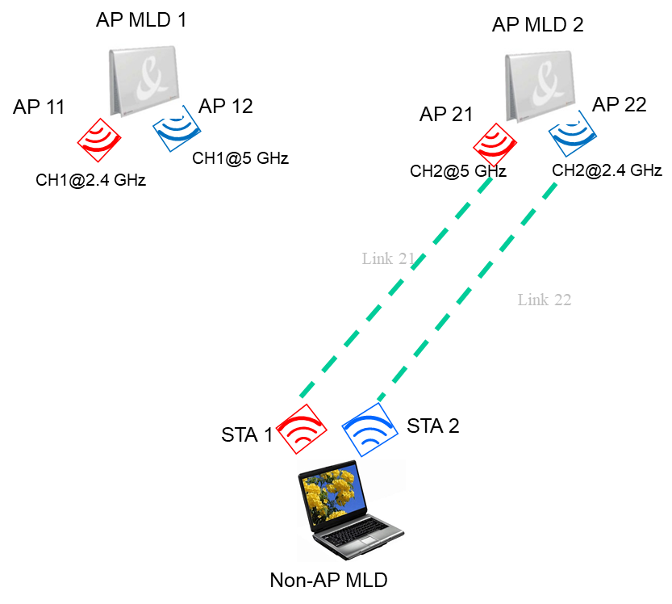
Make Before Break under MLD Framework
Phase 3. Post roaming
Step 1. Non-AP MLD sends a new frame to trigger AP MLD 2 to send the DS-STA-NOTIFY.request primitive to the DS. This will cause that all MSDUs belonged to non-AP MLD will be routed to AP MLD 2.
Step 2. Then non-AP MLD is allowed to deliver data with AP MLD 2 only through link 22. STA 1 affiliated with non-AP MLD can switch to CH2@5 GHz.
Step 3. When entering the coverage of AP 21 affiliated with AP MLD 2, non-AP MLD can inform AP MLD 2 to enable link 21

Slide 12
Make Before Break under MLD Framework
Extension 1
For the roaming scenario, assuming that Non-AP MLD having 3 links, it can disable two links and initiate tentative re-association with two neighboring AP MLDs simultaneously. Finally, the Non-AP MLD would have to complete the association with only one AP MLD by sending STA-AP Mapping Notify frame.
Pros. Increase the success rate of roaming considering the roaming may be rejected by candidate AP MLD for some reason

Slide 13
Make Before Break under MLD Framework
Extension 2
Similarly, for the initial association scenario, assuming that Non-AP MLD having 3 links, it can initiate tentative association with three neighboring AP MLDs simultaneously. Finally, the Non-AP MLD would have to complete the association with only one AP MLD by sending STA-AP Mapping Notify frame
Pros. Increase the success rate of association considering the association may be rejected by AP MLD due to the specific admission control policy
To avoid performing 802.1X authentication with multiple AP MLDs, non-AP MLD maybe send a new defined frame to initiate the 802.1X authentication via only one selected AP MLD

Slide 14
Related Signaling Indication
Signaling of link status
Option 1(Prefer) . Non-AP MLD needs to explicitly indicate the status of each non-transmitted link in the Association Request frame
Disable. For the disable link, maybe further indicate the corresponding Reason Code, e.g. power save, low RSSI, tentative association and so on.
Enable.
Option 2. use the TID-to-link mapping to implicitly indicate the status of each non-transmitted link in the Association Request frame
Capability indication for tentative association
Can be carried in Fast BSS Transition element , Mobility Domain element, RSNE or EHT Capabilities element

Slide 15
Related Signaling Indication (Cont.)
Signaling of tentative association
In the conventional association, the 802.1X authentication, 4-way handshake and sending DS-STA-NOTIFY.request is automatically followed by successful (Re)association Request/Response exchange. In order to allow non-AP MLD simultaneously initiating tentative association with multiple AP MLDs, a new frame needs to be defined to trigger AP MLD sending DS-STA-NOTIFY.request, named as Non-AP MLD Trigger STA-AP Mapping Notify
To differentiate with the conventional association, a signaling indication for tentative association needs to be carried in the Association Request frame
One method is to define a new element, named Tentative Association element, which includes the following info
Non-AP MLD Trigger STA-AP Mapping Notify. Set to 1, indicate the non-AP MLD will proactively send a frame to trigger the STA-AP Mapping Notify procedure
Tentative Association Lifetime. Indicate the tentative association age-out time. Any communication between the non-AP MLD and AP MLD will reset the timer.
Element ID
Length
Tentative Association Control
Tentative Association Lifetime
B0
B1
B2
B3
B7
Non-AP MLD Trigger STA-AP Mapping Notify
Non-AP MLD Trigger 802.1X Authentication Notify (Optional)
Non-AP MLD Trigger 4-way Handshake Notify (Optional)
Reserved

Slide 16
Summary
In this contribution, we describe that how to implement the “Make before Break” scheme [1] under the MLD framework.
This scheme can really realize that the data delivery is not interrupted during the roaming by exploiting the multiple radios of non-AP MLD

Slide 17
Reference
[1] 11-03-0770-06-frfh-make-before-break

Slide 18
Straw Poll 1
Do you support to standardize tentative (re)association scheme for the non-AP MLD?
Y
N
A

Slide 19
Annex 802.1X Authentication
IEEE 802.16 Spec.-2016. A single IEEE 802.1X Port maps to one association, and each association maps to an IEEE 802.1X Port. Each association between a pair of STAs creates a unique pair of IEEE 802.1X Ports, and authentication takes place relative to those ports alone.
An IEEE 802.1X Port consists of an IEEE 802.1X Controlled Port and an IEEE 802.1X Uncontrolled Port.
The IEEE 802.1X Controlled Port is blocked from passing general data traffic between two STAs until an IEEE 802.1X authentication procedure completes successfully over the IEEE 802.1X Uncontrolled Port.
Within IEEE Std 802.11, EAPOL PDUs are carried as MSDUs within one or more Data frames

