Slide 1
Non-AP MLD Initiated Aggregation: Opportunity in TXOP
Date: 2020-07-13
Authors:
Name | Affiliation | Address | Phone | Email
Insun Jang | LG Electronics | 19, Yangjae-daero 11gil, Seocho-gu, Seoul 137-130, Korea |  | insun.jang@lge.com
Jinsoo Choi |  |  |  | js.choi@lge.com
Jeongki Kim |  |  |  | jeongki.kim@lge.com
Taewon Song |  |  |  | taewon.song@lge.com
Namyeong Kim |  |  |  | namyeong.kim@lge.com

Slide 2
Introduction
Many contributions [1]-[8] have addressed how to transmit UL PPDUs on multiple links simultaneously for non-STR non-AP MLD
In this contribution, we first focus on non-STR non-AP MLD’s behaviors on a link during a TXOP on the other link and discuss another method for a constrained non-AP MLD to aggregate links during the TXOP

Slide 3
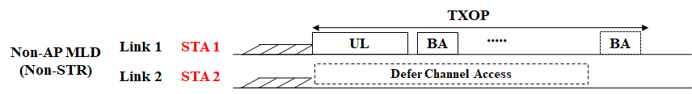
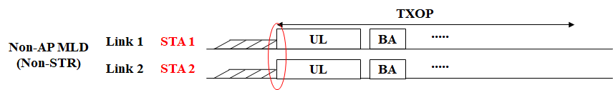
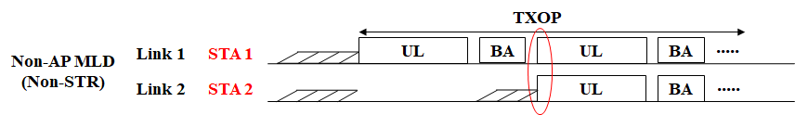
UL Aggregation of Non-STR Non-AP MLD
Basically, UL aggregation means aligning starting times and ending times of PPDUs that are sent simultaneously on multiple links
Several Scenarios
  No Aggregation: It may provide opportunities of power saving [9]
  When gaining a channel access (Not focus)
  After gaining a channel access, during TXOP
Notes:
The initiator of transmission is non-STR non-AP MLD
Not focus on AP-assisted

Slide 4
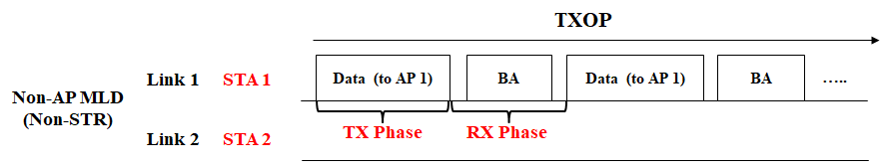
Observation on TXOP with Non-STR
On Link 2 At TX Phase on link 1
  In almost every cases, back-off counter (BC) wouldn’t decrease due to strong in-device (self) interference as Non-STR
    It always may set the channel state to BUSY, which cannot decrease BC
On Link 2 At RX Phase on link 1
  BC can decrease by following existing EDCA rules without the interference
    Timer like NAVSyncDelay could be also considered, will be discussed in the slide 6
  If BC = 0, STA 2 cannot transmit a PPDU during RX phase on link 1
How can we do on Link 2?

Slide 5
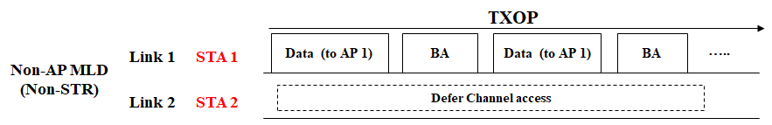
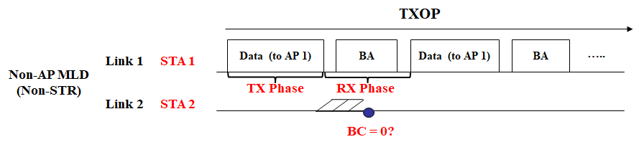
Possible Options During TXOP
Option 1: Defer Channel Access (Not decrease BC) during TXOP
  It is simple and can have an opportunity to save power during the TXOP [9]
  However, it can lose an opportunity to transmit frames
  Note that when gaining a channel access on link 1, the aggregation is not excluded
Option 2: Performs Channel Access during TXOP
  It just follows the existing EDCA rules
  During RX phase, if BC = 0?, STA 2’s behavior?
Notes:
Both options can be possible

Slide 6
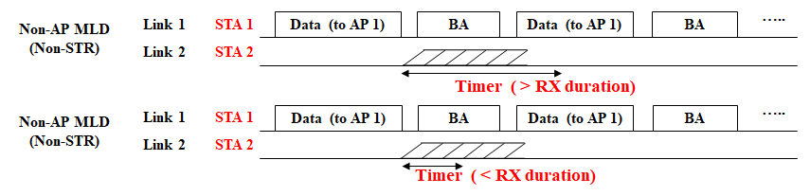
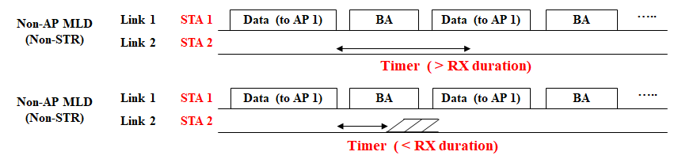
Discussion on NAV Synchronization
(for Option 2)
We have deaf issues on a link 2, which addresses in some contributions [10]-[12] considering Timer and EDCA during timer
We can have opportunities to decrease BC in some cases depending on the value of timer and whether back-off is possible during the timer
If we allow to
decrease BC during Timer
If we disallow to
decrease BC during Timer
Notes:
Both options can be possible

Slide 7
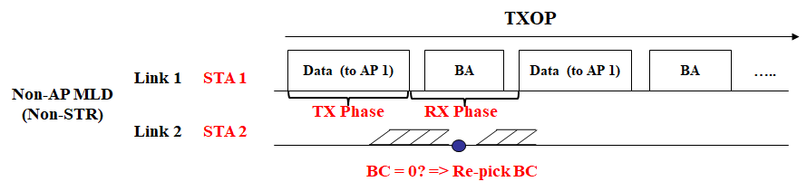
If BC = 0 During RX Phase
Option 2-1: Re-pick BC (Not transmit anything)
  It can avoid non-STR issue easily, but it can lose an opportunity to transmit frames
Option 2-2: Defer (hold BC) until the last transmitting PPDU and transmit a PPDU (including RTS for protection)
  It can have an opportunity to transmit frames
Option 2-3: Defer (hold BC) during a certain time and transmit a PPDU by aligning it with the PPDU transmitted on TXOP link
  It can have an opportunity to transmit frames

Slide 8
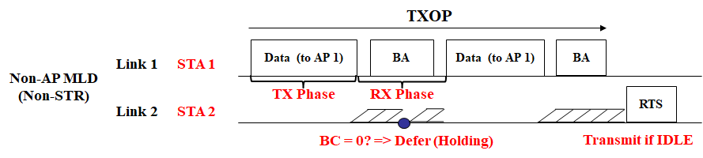
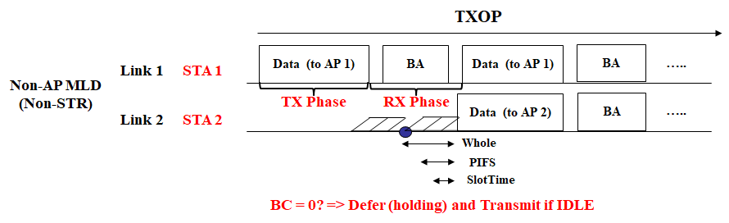

Figure: Option 2-2 and Option 2-3
Option 2-2
  To make generalizations, STA 2 may hold BC$≥$ 0 and then can decrement back-off counter in a timely manner (e.g., after TXOP, during the last BA)
Option 2-3
  This option can also have the above generalizations to make
Notes:
STA needs to have the ability of fast cross-link communication for the information sharing

Slide 9
Comparison
Option | Channel State and Behavior | Pros | Cons or Requirements
2-1 | Doesn’t matter | Simple | No chance to transmit May extend EDCA rules (e.g., Pick BC even if queued)
2-2 | If IDLE, transmit RTS (protection) or Data frame | Chance to transmit | Extends EDCA rules (e.g., Holding BC)
2-3 | If IDLE, transmit Data frame If BUSY, can move to 2-1 or 2-2 | Chance to transmit + Agg. | Extends EDCA rules (e.g., Holding BC) Fast cross-link communications

Slide 10
Summary
We observed TXOP with non-STR
  As a result, we can allow some options including an UL aggregation
Specifically, we can have some methods when gaining a channel access on another link while TXOP on a link in case of non-STR
  Re-pick BC
  Holding BC
    After TXOP on a link, STA on another link can try to transmit frames
    During TXOP on a link, STA on another link can try to can transmit frames simultaneously with the next PPDU on the TXOP link

Slide 11
SP #1
Do you agree that 11be shall define the following operation for a non-STR non-AP MLD
  During a TXOP obtained by a non-AP STA affiliated with the non-AP MLD, another non-AP STA affiliated with the non-AP MLD may hold its current back-off counter even if operating channel is IDLE
Y/N/A

Slide 12
SP #2
Do you agree that 11be shall define the following operation for non-STR
  During a TXOP obtained by a non-AP STA affiliated with the non-AP MLD, when another STA affiliated with the MLD gains a channel access, the another STA may defer and transmit a PPDU simultaneously with the next PPDU of STA if medium is IDLE
    Medium sensing duration is the interval of TBD immediately preceding the start of next PPDU duration
      For example, the interval can be time elapsed from BC = 0 until the start of next PPDU or PIFS
    Starting and Ending times of the PPDUs are aligned with TBD margin
Y/N/A

Slide 13
Appendix: BA Duration in 11be
Duration of RX Phase
  Expected Time: 2 SIFS * + Compressed BA duration
    Assuming Data rate 7.3Mbps (MCS 0, 1x1 SS, 20MHz in 11ax)
Case 1: 256 bitmap => 93.4us
Case 2: 512 bitmap => 128.4us
Case 3: 1024 bitmap => 198.6us
Notes:
24 + 32/64/128

Slide 14
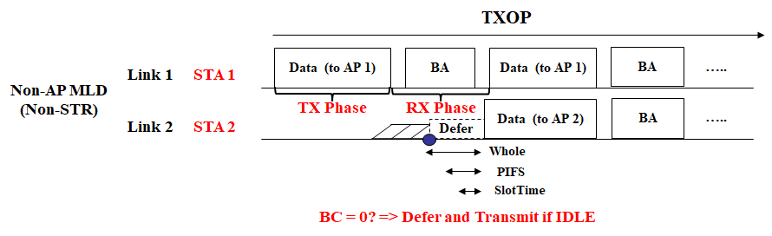
Appendix: Focusing on Option 2-2
A Proposed Rule
  During a TXOP of an STA of a non-STR non-AP MLD, when another STA of the MLD gains a channel access, the another STA may defer and transmit a PPDU simultaneously with the next PPDU of STA if medium is IDLE
    Medium sensing duration is the interval of TBD (e.g., PIFS, aSlotTime) immediately preceding the start of next PPDU duration
    Starting and Ending times of the PPDUs are aligned with TBD margin
The STA needs to know the length and starting and ending times of a PPDU to be transmitted by other STA(s)
Notes:
STA needs to have the ability of fast cross-link communication for the information sharing

Slide 15
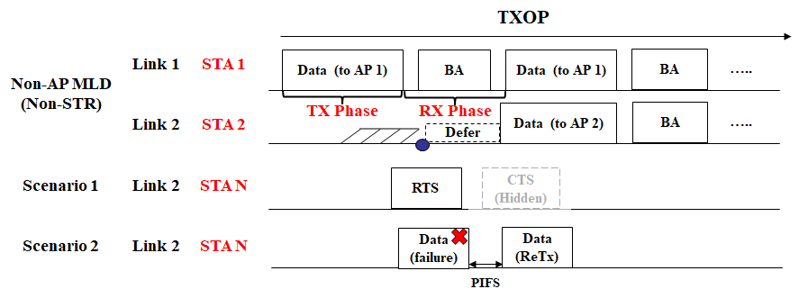
Appendix: Discussion on Sensing Duration
Some scenarios
  During PIFS or less than PIFS (e.g., SIFS, aSlotTime), STA 2 may not be able to detect any frames, e.g., STA 2 will recognize channel is IDLE
We think it would be good to perform CCA during “Whole time” for reliability (at the expense of efficiency)

Slide 16
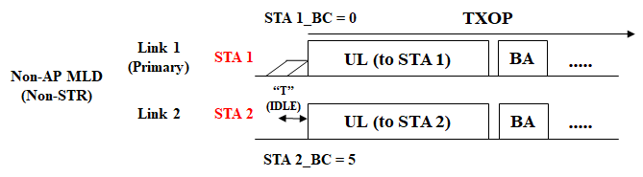
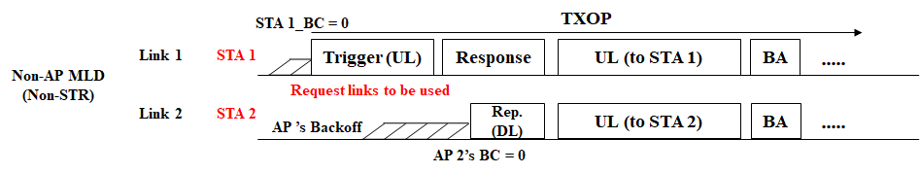
Back-up: UL Aggregation (Non-STR) [2]
Basically, UL aggregation means aligning start/end of UL PPDUs that are sent simultaneously on multiple links
  The initiator of transmission is non-STR non-AP MLD
Non-AP Initiated Aggregation (e.g., Truncation of BC [1]-[5], [8])
AP-assisted Aggregation [2], [6], [7]
  Example: Request and Response for Aggregation [1]

Slide 17
References
[1] 802.11-19/1144r6 Channel Access for Multi-link Operation
[2] 802.11-20/0414r4 Method for Handling Constrained MLD
[3] 802.11-20/0026r7 MLO: Sync PPDUs
[4] 802.11-20/0275r2 MLO: Need for sync PPDUs
[5] 802.11-20/0487r5 Multiple Link Operation Follow Up
[6] 802.11-20/0081r3 MLO-Synch-Transmission
[7] 802.11-20/0291r1 MLO a-synchronize and synchronize operation discussions
[8] 802.11-20/0577r0 RTS and CTS Procedure in Synchronous Multi-link Operation
[9] 802.11-20/0037r1 Power Saving Considering Non-AP without STR Capability
[10] 802.11-20/0444r1 MLA: Non-STR STA EDCA rules after self-interference
[11] 802.11-20/1009r1 Multi-link hidden terminal-followup
[12] 802.11-20/0490r0 Multi-link hidden terminal

