Slide 1
Supporting Latency Sensitive Applications in 11be
Date: 2020-05-28
Authors:
Name | Affiliations | Address | Phone | email
Chunyu Hu | Facebook Inc. | 1 Hacker way Menlo Park, CA |  | chunyuhu@fb.com
Payam Torab |  |  |  | torab@ieee.org
Akira Kishida | NTT |  |  | akira.kishida.fs@hco.ntt.co.jp
Yasuhiko Inoue |  |  |  | yasuhiko.inoue.br@hco.ntt.co.jp
Taewon Song | LG Electronics |  |  | taewon.song@lge.com
Xin Zuo | Tencent | Tencent Building, Kejizhongyi Avenue, Hi-tech Park, Nanshan District, Shenzhen |  | xinzuo@tencent.com
Hao Harry Wang |  |  |  | harryhwang@tencent.com
Glenn Hu |  |  |  | glennhu@tencent.com

Slide 2
Abstract
Background: new emerging technology and social demand
Background: 11be goal and staged release
Review of latency sensitive service enabling feature
Discuss a feasible path inline with 11be timeline
Straw polls

Slide 3
New Emerging Technology
AR/VR/MR has been widely viewed as new emerging enabling technologies in many areas:
  Remote work, healthcare, education, e-commerce, entertainment, tourism …
FCC opens 6GHz band to Wi-Fi and other unlicensed uses on April 23, 2020
  ^{[1]} The Report and Order authorizes indoor low-power operations over the full 1,200 megahertz and standard-power devices in 850 megahertz in the 6 GHz band. …
  ^{[1]} The Further Notice of Proposed Rulemaking seeks comment on a proposal to permit very low power devices to operate across the 6 GHz band to support high data rate applications including high-performance, wearable, augmented-reality and virtual-reality devices.

Slide 4
Social Demand
In the pandemic time, it’s ever paramount important to be virtually present (meetings, parties), to collaborate remotely, to do remote learning, to “see” doctor and be seen remotely …
AR/VR/MR can bring people “together” while maintaining “social distance”
  They are needed in both home and enterprise environments
  Key requirement: multiple applications running simultaneously in one or more BSS’s (virtual reality is no longer a solo gaming experience)
FCC commissioner G. Starks comments [2]:
  The COVID-19 pandemic may be the most challenging event of our generation …
  The 6 GHz spectrum is expected to complement 5G wireless service and unleash a wave of innovation for the Internet of Things. It will allow doctors to conduct complex examinations and procedures remotely, enable the training of students and workers using virtual and augmented reality, and spur the next generation of streaming content and gaming
  Multiple comments mentioned AR/VR as important applications in the current situation [1] …

Slide 5

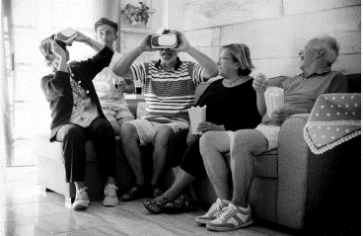
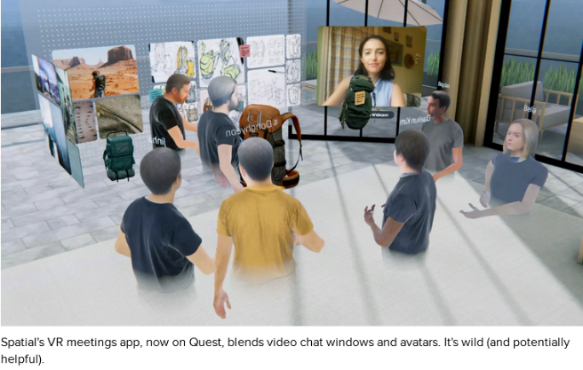

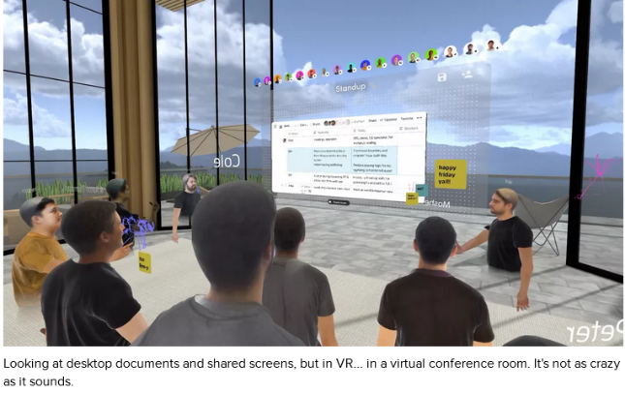
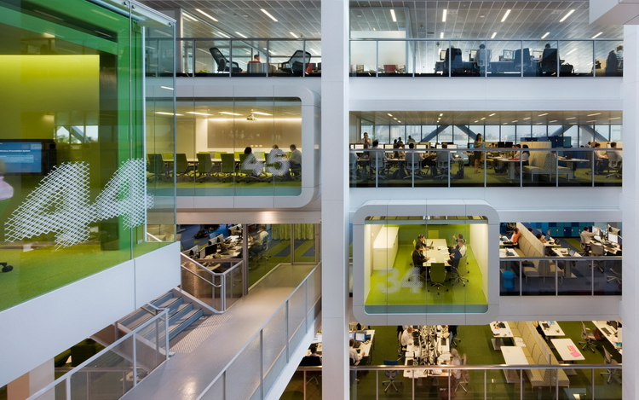

Work from Office or Anywhere
Home
Notes:
Diagram-1: showing a house with a family, each is running an application over Wi-Fi: video conference, virtual workroom, virtual classroom, virtual party, shopping, watching movie …
Diagram-2: a multi-cube/floor office building showing people joining remote whiteboard discussion, virtual desktop, virtual meeting …

Slide 6
TGbe Goal and Staged Release
Latency improvement is one of TGbe goals
  802.11be PAR [18/1231r6]
    5.5 Need for the project
    … New high-throughput, low latency applications will proliferate such as virtual reality or augmented reality, gaming, remote office and cloud computing.
    …
    With the high throughput and stringent real-time delay requirements of these applications, users will expect enhanced throughput, enhanced reliability, reduced latency and jitter, and improved power efficiency in supporting their applications over WLAN.
  802.11be CSD [18/1233r7]
    1.2.1 Broad market potential
    … The throughput requirements of these [video] applications is in constant evolution with the emergence of 4k and 8k video, and new high-throughput applications will proliferate such as Virtual Reality or Augmented Reality, gaming, remote office, cloud computing.
    With the throughput and real-time requirements of these applications, WLAN users demand improved throughput and performance in delivering their applications in many environments.
IEEE 802.11be Staged Release [11-19/2153]:
  R1 and R2: R1 include MLO etc.
  R1 and R2 features need to be stable in agreed target timeline
  Notes: all release target increasing throughput and/or reducing worst case latency and/or improving power efficiency

Slide 7
Supporting Latency Sensitive Applications
Technical gap review
  Peak PHY rate is sufficient, especially with wide bandwidth support and 4K QAM
  Single application in clean channel: requirements ^{[3]} can be met in most cases
  Single application in noisy channel: hard to meet requirements.
  Multiple applications in clean channel: hard to meet due to contention.
  Multiple applications in neighboring BSS’s: cannot meet due to contention and lack of coordination/scheduling.
Requirements in green/orange box can be largely fulfilled or addressed by:
  Increase peak PHY rate in SU/MU:
    Increased bandwidth and efficient spectrum utilization such as bw 320/240 MHz, multi-RU for STAs, preamble puncture;
    Higher modulation: 4K QAM
  Applications reduce bandwidth requirements:
    Uncompressed → compressed
    More efficient encoding, split rendering (server + local computation), …
  Choose a clean channel with sufficient BW
    New 6GHz release for Wi-Fi and other unlicensed use
    Homes in not dense area …
Notes:
Propose goal 1 in red box for R1, and goal 2 in red box for R2

Slide 8
What We Are Still Lacking …
MLO basic operation has been focusing on the throughput and latency from viewpoint of a single stream in presence of OBSS
  Single BA session over multiple links
  Asynchronous/synchronous mode
  MLO single radio operation
Throughput is not the first-order bottleneck with compressed video
Need to improve co-channel operation of multiple latency sensitive application within single or multiple BSS’s
Tethered link scheduling needs to be inherently supported
  Challenge: AP doesn’t know traffic info over tethered link. It’s not realistic to have AP schedule for tethered link

Slide 9
Supporting Latency Sensitive Application
Enabling components to meet the goal in red box
  Allocate sufficient network bandwidth for such applications
  Prioritize over regular traffic; and distribute priority over streams of similar requirement (priority is a relative concept)
  Necessary QoS provisioning, e.g. limiting maximum txop
  Build in support of tethered link in above bullets
  Extend intra-BSS coordination to across BSS’s
Proposals are being made towards the direction
  Proposal of the framework: latency sensitive link in MLO [5]
    Latency sensitive link: a subset of links in MLO allocated for latency sensitive applications
    Prioritized EDCA access to time-slotted channel
    More details TBD (welcome contribute/collaborate)
  Admission control policy [6]
  Triggered P2P [7]
  Other studies – see back up slides

Slide 10
Latency-related Features – Staged Development
Goal: multiple applications running simultaneously in one or more BSS’s
  Single BSS (hard to meet due to contention)
  Multiple BSS (hard to meet due to contention and lack of coordination)
Release 1: Basic framework for BSS/link management | QoS provisioning
  Allocate link for latency sensitive traffic under the MLO framework
  Channel access design for low latency
  Any essential TBD components for the scheme operational
Release 2:
  Complete features for interested RTA categories
  Multi-BSS coordination
Release 1
Release 2
Essential functions for first wave of 11be

Slide 11
More Discussion
Develop core mechanisms for common traffic characteristics
  Develop basic functionality
    Prioritized EDCA access, link allocation, admission control, …
  Tackle critical problems and common scenarios
  Keep solution practical and feasible
Define multi-class services for latency sensitive applications, in recognition of wide range of requirements
  Class-0: complete framework and enabling most critical scenarios (AR/VR)
  Class-1: … e.g. more fine-granularity level of scheduling and requirements, complicated scenarios
  Class-2: … any special design for other RTA category
  This helps staging feature development
High throughput, Low latency

Slide 12
Summary
Discussed significance of latency sensitive applications
Discussed critical roadblocks for enabling such applications
Explored feasibility under 11be staged release plan
Proposed scope of supporting features and a multi-class approach for R1 and beyond

Slide 13
Straw Poll 1
Do you support a staged feature development to support latency sensitive applications as following
  Release 1:
    A basic framework under multi-link operation framework that includes link management and QoS provisioning
    Channel access optimization/design for low latency
  Release 2:
    Extend to support multi-BSS coordination for low latency
    Any additional features (including additional channel access improvements)
  Notes
  Channel access improvement for low latency implies more predictable channel access
  R1 can include any other essential components to make the framework functional.
  Whether to introduce different mechanisms for different classes of low-latency applications is TBD

Slide 14
References
[1] https://www.fcc.gov/document/fcc-opens-6-ghz-band-wi-fi-and-other-unlicensed-uses : report and order
[2] https://docs.fcc.gov/public/attachments/DOC-363945A6.pdf
[3] RTA report draft: DCN 11-18/2009r6
[4] Triggered P2P: DCN 11-19/1604r1
[5] Prioritized EDCA channel access over latency sensitive links in MLO: DCN 11-20/408r4
[6] Low latency service in 802.11be. DCN: 11-20/418r1
[7] Link Latency Statistics of Multi-band Operations in EHT. DCN 11-20/105r4

Slide 15
Backup Slides

Slide 16
Review RTA Applications and Requirements
Use cases |  | Intra-BSS latency (ms) | Jitter variance (ms) | Packet loss | Data rate* (Mbps)
Real-time mobile gaming |  | < 5 | < 2 | < 0.1% | < 1
Cloud gaming |  | < 10 | < 2 | Near-lossless | < 0.1 on Reverse link > 5 on Forward link
Real-time video |  | < 3-10 | < 1-2.5 | Near-lossless | 100-20,000: forward link 10-100 Kbps: reverse link
Robotics and industrial automation | Equipment control | < 1-10 | < 0.2-2 | Near-lossless | < 1
 | Human safety | < 1-10 | < 0.2-2 | Near-lossless | < 1
 | Haptic technology | < 1-5 | < 0.2-2 | Lossless | < 1
 | Drone control | < 100 | < 10 | Lossless | < 1 > 100 with video
AR/VR/MR
From 802.11 RTA TIG report for rough categorization and characterization.
*: actual data rate range vary depending on application.

Slide 17
(Data Rate, Latency)* Requirement Spans a Wide Range
High throughput, Low latency
Latency and data rate requirements vary depending on category
➔ Multi-class service
*: High reliability is a common requirement: deliver packets successfully within certain latency bound
Notes:
High reliability is a common requirement
Deliver packets successfully within certain latency bound

Slide 18
11be latency-related studies (1)
Presented or in the queue (list is not comprehensive)
[19/0402] Multiple primary channels (M-PCH) to achieve < 2 msec for 99.9% of packets
[19/0762] Simple 11ax DL/UL simulations; showing optimizing throughput and latency are not the same
[19/1081] Up to 7x improvement for 95th percentile latency with 2.4 + 5 GHZ MLO for a single STA
[19/1118] RU redundancy and hopping for improved robustness, embedding a micro schedule into TF
[19/1207] Need for TSN support, admission control and scheduling to improve worst case latency in managed networks
[19/1524] More traffic queues through 11aa with different IFS, uplink OFDMA latency issues without scheduling
[19/1613] Multi-link TXOP sharing multi-STA Block Ack
[19/1615] Proposing scheduled access and admission control with MLO
[19/1622] Dedicated low latency link with auto repetition for improve robustness
[19/1851] Additional Access Categories for low latency traffic with dynamic EDCA parameters
[19/1938] Use case review proposing to set target numbers for intra-BSS average and worst-case latency
[19/1942] Need for standardized latency and jitter measurement for real time applications
[20/0003] Proposing 95th or 99th percentile latency as a TGbe latency metric
[20/0005] Set of ideas to handle low latency traffic, including narrowband static allocation and traffic preemption
[20/0093] Multi-link access with shared PHY and simultaneous transmit/receive constraints
[20/0105] BSS level latency metrics for measurement and distribution
[20/0408] Assigning different EDCA parameters to STAs on a scheduled basis
[20/0418] Definition of a latency sensitive traffic service
[20/0481] HARQ benefits for worst case latency
[20/0484] Intra-BSS and inter-BSS latency statistics through measurement

Slide 19
11be latency-related studies (2)
Presented or in the queue (list is not comprehensive)
[19/0402] Enrico Rantala et al., 11-19-0402-01-0eht-reducing-channel-access-delay.pptx
[19/0762] Suhwook Kim et al., 11-19-0762-00-00be-latency-analysis-for-eht.pptx
[19/1081] Abhishek Patil et al., 11-19-1081-01-00be-multi-link-aggregation-gain-analysis-latency.pptx
[19/1118] Thomas Handte et al., 11-19-1118-01-00be-enhancements-for-time-critical-data-transmission.pptx
[19/1207] Akira Kishida et al., 11-19-1207-04-00be-views-on-latency-and-jitter-features-in-tgbe
[19/1524] Suhwook Kim et al., 11-19-1524-00-00be-latency-enhancement-for-eht.pptx
[19/1613] Yongsu Gwak et al., 11-19-1613-01-00be-multi-link-txop-sharing-for-delay-reduction.pptx
[19/1615] Liuming Lu et al., 11-19-1615-01-00be-multi-band-multi-channel-operation-for-low-latency-and-jitter.pptx
[19/1622] Tony Zeng et al., 11-19-1622-00-00be-use-auto-repetition-in-low-latency-queue
[19/1851] Suhwook Kim et al., 11-19-1851-01-00be-latency-enhancement-in-multi-link.pptx
[19/1938] Kazuyuki Sakoda et al., 11-19-1938-02-00be-discussion-on-low-latency-capability-for-802-11be.pptx
[19/1942] Akira Kishida et al., 11-19-1942-07-00be-timing-measurement-for-low-latency-features.pptx
[20/0003] Suhwook Kim et al., 11-20-0003-00-00be-discussion-on-latency-metric.pptx
[20/0005] Shubhodeep Adhikari et al., 11-20-0005-01-00be-proposals-on-latency-reduction.pptx
[20/0093] Adrian Garcia-Rodriguez et al., 11-20-0093-03-00be-multi-link-for-low-latency.pptx
[20/0105] Frank Hsu et al., 11-20-0105-04-00be-link-latency-statistics-of-multi-band-operations-in-eht.pptx
[20/0408] Chunyu Hu et al., 11-20-0408-02-00be-prioritized-edca-channel-access-over-latency-sensitive-links-in-mlo.pptx
[20/0418] Dave Cavalcanti et al., 11-20-0418-01-00be-low-latency-service-in-802-11be.pptx
[20/0481] Shimi Shilo et al., 11-20-0481-00-00be-impact-of-harq-on-latency-system-level-simulation-analysis.pptx
[20/0484] Liuming Lu et al., 11-20-0484-00-00be-latency-measurement-for-low-latency-applications.pptx

