Slide 1
Impacts of MCS set expansion on 11be link adaptation
Date: 2020-01-06
Authors:
Name | Affiliations | Address | Phone | email
Yan Zhang | NXP |  |  | yan.zhang_5@nxp.com
Hongyuan Zhang
Rui Cao

Slide 2
Motivations
HARQ studies show that HARQ IR can achieve higher throughput than ARQ with ideal link adaptation in some SNR regions, by puncturing some parity bits of BCC/LDPC code of a given MCS supported in current WiFi standards.
This is due to the big SNR requirement (e.g., to achieve 10% PER per MCS) gaps among some neighboring MCS values when modulation order is increased on AWGN channel, e.g., MCS1 and MCS2, MCS4 and MCS5, MCS7 and MCS8, MCS9 and MCS10, or code rate is increased considerably (assuming same modulation order) on DNLOS channel, e.g., MCS3 and MCS4.
Puncturing parity bits essentially create new code rates resulting in new MCS values, to fill those big SNR requirement gaps between certain neighboring MCS pairs. However, those puncturing patterns are not optimized, i.e., the performance of the punctured code with effective code rate R will not exceed that of the optimized LDPC code with code rate R in current standards.
New MCS values can be created by utilizing all possible modulation and code rate combinations supported in the current standards.
Notes:
Following are some schemes used in dense Wifi deployments:
Usage of directional antennas.
APs will be using same BW (higher BW available).
On the intersection area, the CCI (if both APs are transmitting) is more.
Usage Band planning
Because of CCI, the band which is used by adjacent AP need to have higher separation.
Planning of band for each AP based on the location is required.
Spatial diversity
Use higher number of antenna to exploit the spatial diversity in the channel.
Requires more hardware and high cost.
Pcell
Use multiple-antenna placed at widely different location and use BF scheme to direct the transmission
Proposed Solution (SDM)
Similar to Pcell but use different APs to attain the effect of multiple antennas.
The co-operation of APs will be done as required.
Can be implemented using software update.

Slide 3
Simulation setup
20MHz, 40MHz, and 80MHz 1x1 AWGN and 1x1 and 2x2 DNLOS channels (per channel normalization)
4x HE-LTF for channel estimation
MCS0-11, plus 6 MCS candidates (shown in slide 4) , LDPC
Nss = 2, TxBF for 2x2 DNLOS channel
No preambles
No impairments
Data length: more than 10 OFDM symbols per MCS, scaled according to data rate per MCS.

Slide 4
New MCS candidates
MCS | code rate | Modulation | Spectral efficiency
1 | 0.5 | QPSK | 1
1-2 | 2/3 | QPSK | 1.33
2 | 3/4 | QPSK | 1.5
2-3 | 5/6 | QPSK | 1.67
3 | 0.5 | 16QAM | 2
3-4 | 2/3 | 16QAM | 2.67
4 | 3/4 | 16QAM | 3
4-5 | 5/6 | 16QAM | 3.33
5 | 2/3 | 64QAM | 4
7 | 5/6 | 64QAM | 5
7-8 | 2/3 | 256QAM | 5.33
8 | 3/4 | 256QAM | 6
9-10 | 2/3 | 1024QAM | 6.67 (same as MCS9)
Potential MCS values are marked in red

Slide 5
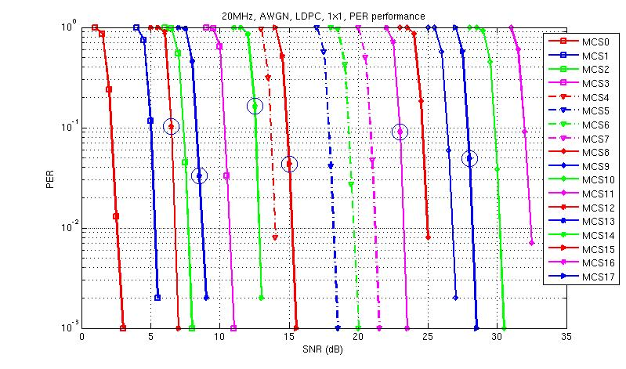
PER performance on 20MHz AWGN channel
The potential MCS values 12-16 fills the SNR requirement gaps between MCS1 and MCS2, MCS2 and MCS3, MCS3 and MCS4, MCS4 and MCS5, MCS 7 and MCS8 as shown in the figure above (curves with blue circle.
Note that MCS17 has the same spectral efficiency as MCS9, but with worse PER performance for AWGN channel due to higher modulation order.

Slide 6
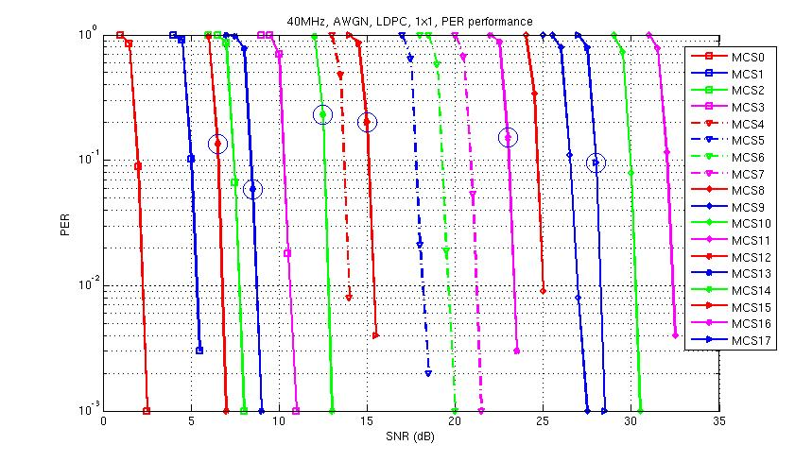
PER performance on 40MHz AWGN channel
Same observation as 20MHz channel.

Slide 7
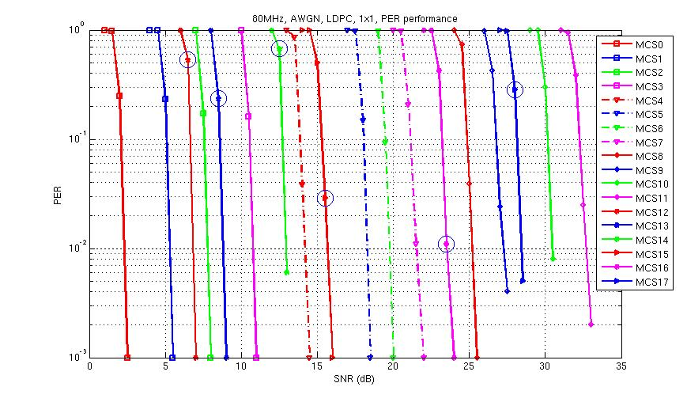
PER performance on 80MHz AWGN channel
Same observation as 20MHz

Slide 8
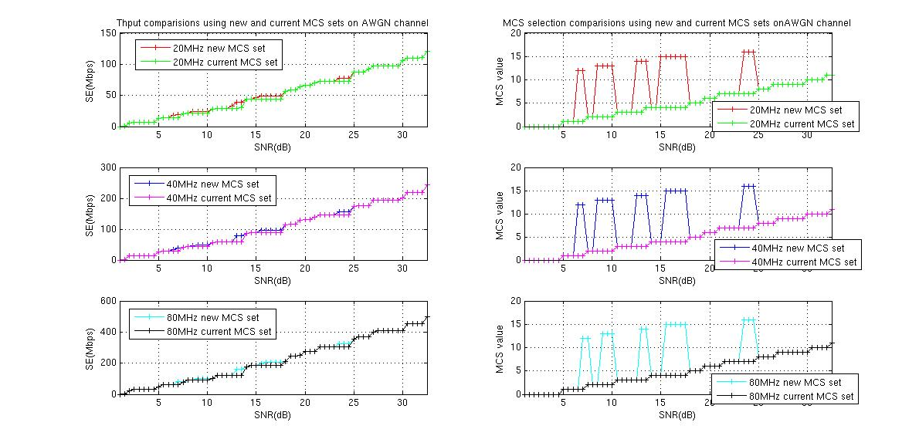
Thput performance of new MCS set on AWGN 1x1 channel
Potential MCS values 12-16 are selected as the optimal MCS to achieve highest throughput at certain SNR regions, especially MCS14 between MCS3 and MCS4, MCS15 between MCS4 and MCS5, MCS16 between MCS7 and MCS8, to avoid Thput plateau in certain SNR ranges.

Slide 9
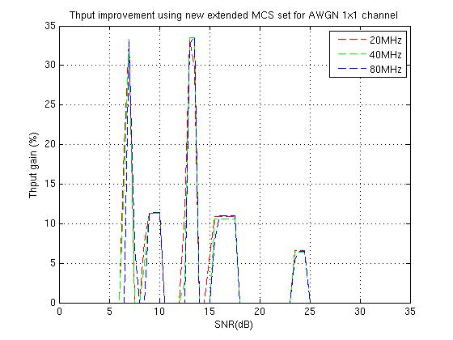
Throughput gain of new MCS set on AWGN channel
The throughput gain using new expanded MCS set can achieve mostly above 10%, and up to 25% in some SNR region.

Slide 10
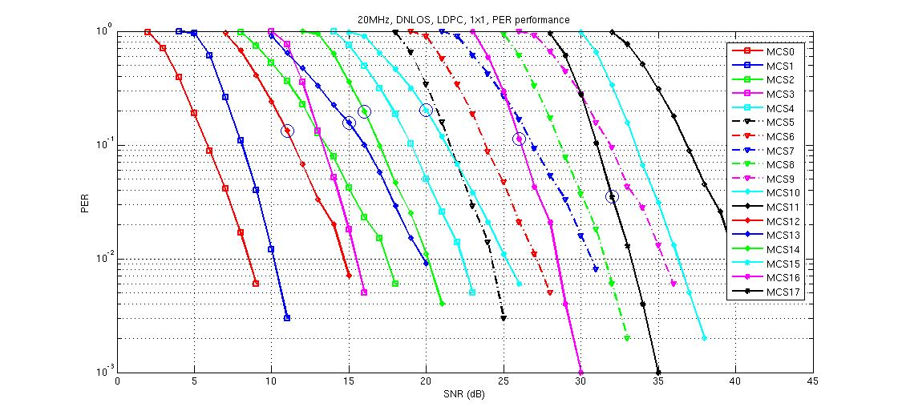
PER performance on 20MHz DNLOS1x1 channel
For DNLOS channel, high code rate is not as resistant to channel fading as low code rate, e.g., MCS 3 with code rate 1/2 has lower Rx sensitivity than MCS 13 (MCS2-3) with code rate 5/6 even though MCS3 has a higher modulation order. The same observation applies to MCS15 (MCS4-5) and MCS5. MCS16 (MCS7-8) outperforms MCS7 due to lower code rate even it has a higher modulation order. MCS17 (MCS9-10) outperforms MCS9 as well due to lower code rate.

Slide 11
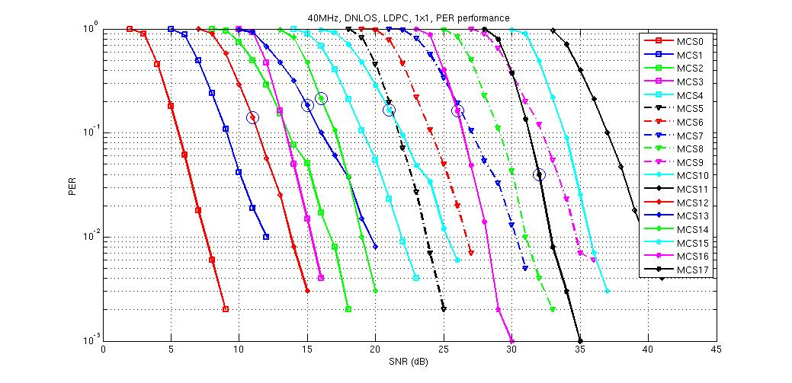
PER performance on 40MHz DNLOS1x1 channel
Same observation as 20MHz channel

Slide 12
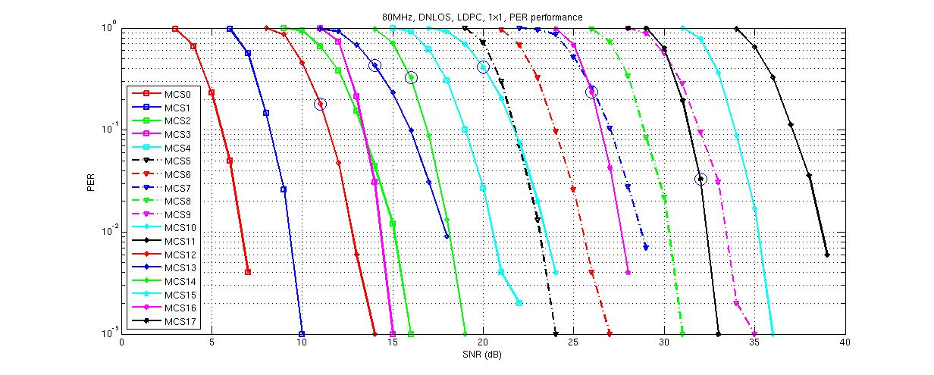
PER performance on 80MHz DNLOS1x1 channel
Same observation as 20MHz channel.

Slide 13
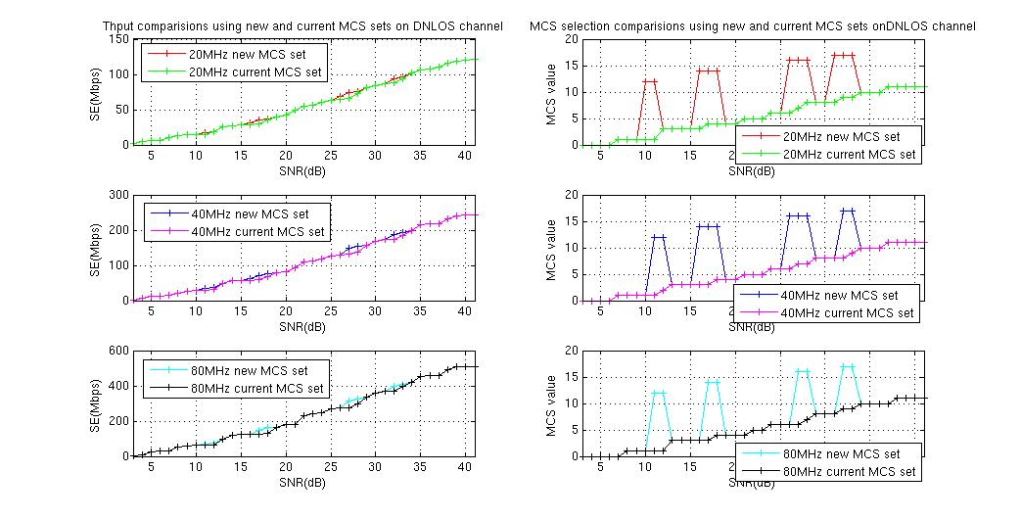
Throughput performance of new MCS set on DNLOS1x1 channel
MCS12 (MCS1-2), MCS14 (MCS3-4), MCS16 (MCS7-8) and MCS17 (MCS9-10) are selected as the optimal MCS to achieve highest throughput at certain SNR regions. Specially MCS14 between MCS3 and MCS4 avoids Thput plateau, and MCS16 between MCS7 and MCS8 replaces MCS6 and MCS7 in certain SNR region. MCS17 replaces MCS8 and MCS9 in certain SNR region.

Slide 14
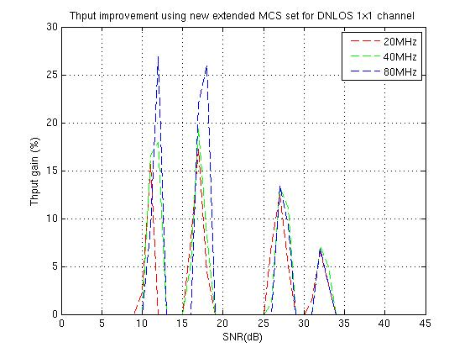
Throughput gain of new MCS set on DNLOS1x1 channel
The throughput gain using new expanded MCS set can achieve above 20% in some SNR region.

Slide 15
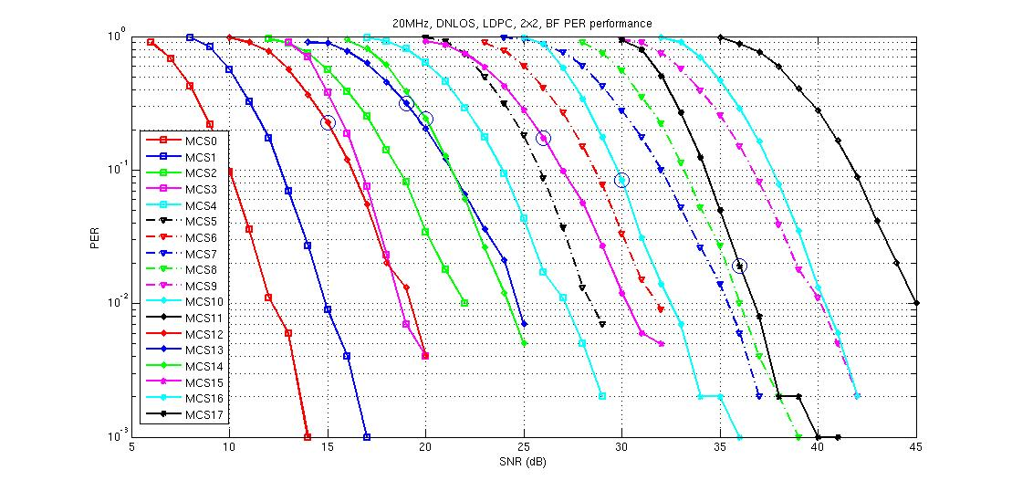
PER performance on 20MHz DNLOS2x2 channel
For DNLOS channel, high code rate is not as resistant to channel fading as low code rate, e.g., MCS 3 with code rate 1/2 has lower Rx sensitivity than MCS 13 with code rate 5/6 even MCS3 has a higher modulation order. The same observation applies to MCS15 and MCS5. MCS16 outperforms MCS7 due to lower code rate even it has a higher modulation order. MCS17 outperforms MCS9 as well due to lower code rate.

Slide 16
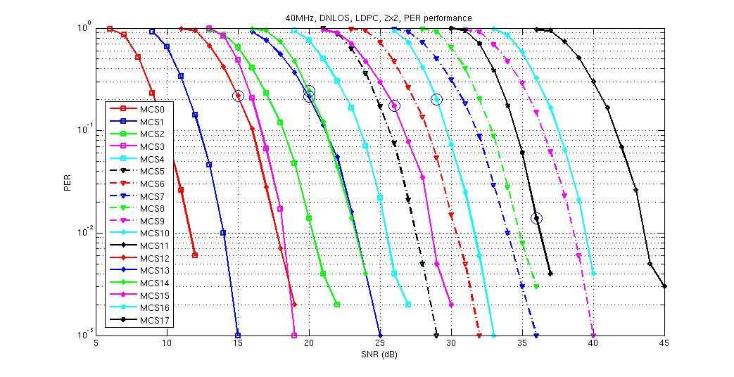
PER performance on 40MHz DNLOS2x2 channel
Same observations as 20MHz channel.

Slide 17
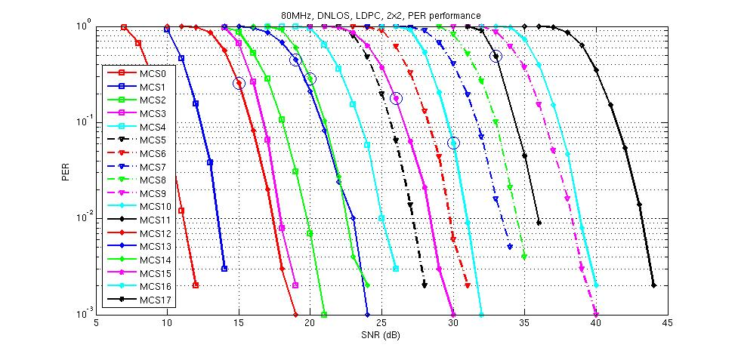
PER performance on 80MHz DNLOS2x2 channel
Same observations as 20MHz channel.

Slide 18
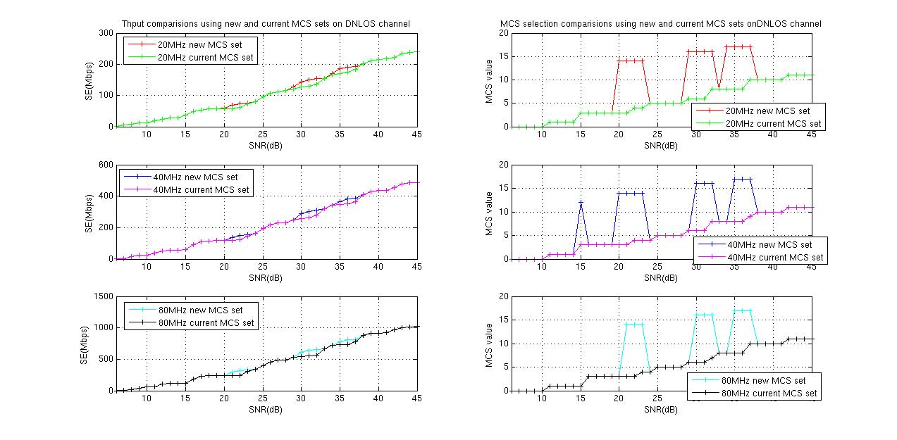
Throughput performance of new MCS set on DNLOS2x2 channel
MCS14, MCS16 and MCS17 are selected as the optimal MCS to achieve highest throughput at certain SNR regions. Specifically, MCS14 between MCS3 and MCS4 avoids Thput plateau in certain SNR range, and MCS16 between MCS7 and MCS8 replaced MCS6 and MCS7 in certain SNR region. MCS17 replaces MCS8 and MCS9 in certain SNR region.

Slide 19
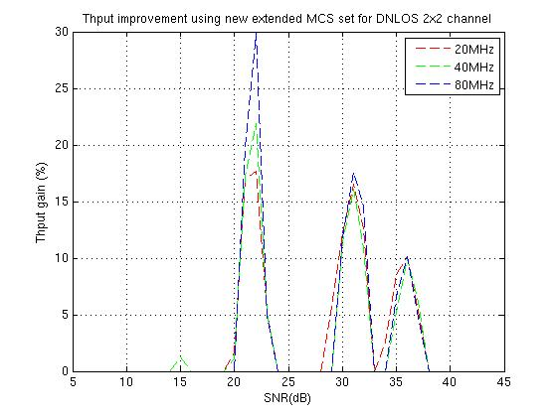
Throughput gain of new MCS set on DNLOS2x2 channel
The throughput gain using new expanded MCS set can achieve above 10% in some SNR regions.

Slide 20
Observations and Conclusions
By adding potential combinations of supported LDPC code rate and modulation orders in current wifi standards, the throughput can be improved in certain SNR regions for both AWGN and DNLOS channels, and the gain is up to 30% in some SNR regions.
Higher modulation order and lower code rate combinations are more favorable than higher code rate and lower modulation order combinations for DNLOS channel, the throughput and PER performance gain are both higher using higher modulation order and lower code rate combinations due to the fact that lower code rate is more resistant to channel fading, as shown by the comparisons between MCS7 and new proposed MCS 16 (MCS7-8), and the comparisons between MCS17 and MCS9 for DNLOS channel.
There is not much additional implementation complexity required to adopt those MCS combinations except adding those values into rate selection lists.
Notes:
Following are some schemes used in dense Wifi deployments:
Usage of directional antennas.
APs will be using same BW (higher BW available).
On the intersection area, the CCI (if both APs are transmitting) is more.
Usage Band planning
Because of CCI, the band which is used by adjacent AP need to have higher separation.
Planning of band for each AP based on the location is required.
Spatial diversity
Use higher number of antenna to exploit the spatial diversity in the channel.
Requires more hardware and high cost.
Pcell
Use multiple-antenna placed at widely different location and use BF scheme to direct the transmission
Proposed Solution (SDM)
Similar to Pcell but use different APs to attain the effect of multiple antennas.
The co-operation of APs will be done as required.
Can be implemented using software update.

