Slide 1
Unified Multi-Link and Multi-AP Reference Model
Date: 2020-01-11
Authors:
Name | Affiliation | Address | Phone | Email
Yonggang Fang | ZTE (TX) |  |  | yfang@ztetx.com
Bo Sun | ZTE |  |  | sun.bo1@zte.com.cn
Zhiqiang Han | ZTE |  |  | han.zhiqiang1@zte.com.cn
Nan Li | ZTE |  |  | li.nan25@zte.com.cn
Notes:
doc.: IEEE 802.11-yy/xxxxr0
Month Year
John Doe, Some Company
Page 1

Slide 2
Abstract
This contribution discusses the issue in the reference model to support both multi-link and multi-AP features in IEEE802.11be, and suggests to consider the unified reference model to support both ML and MAP features.

Slide 3
Background
Multi-Link Logic Entity
In the reference [1], it proposes the ML reference model with MLLE.
In the reference [2], it proposes the definition of MLLE as:
A logical entity that has one or more affiliated STAs. The logical entity has one MAC data service interface and primitives to the LLC and a single address associated with the interface, which can be used to communicate on the DSM.

Slide 4
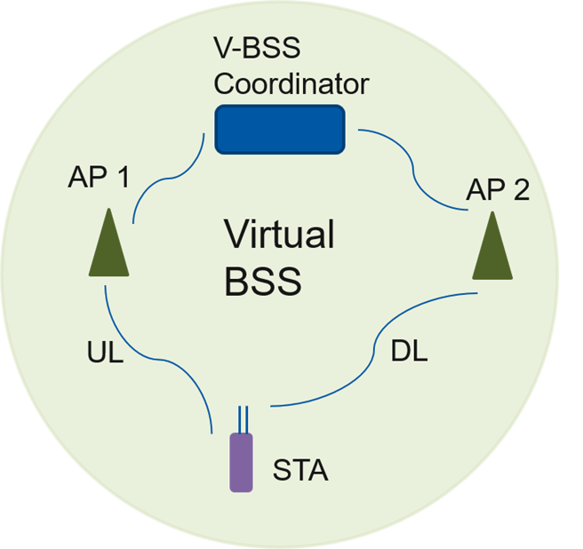
Background
Virtual BSS of Multi AP
In the reference [3], it proposes the multi AP to form a virtual BSS for
Single association and authentication state maintenance within the MAP group
Dynamic AP selection by STA and V-BSS Coordinator
In the reference [4], it proposes two options for forming a MAP group with
pre-configured MAP group for a STA.
Dynamic MAP group formation for a STA
In the reference [4], it discusses the backhaul impact in the MAP joint transmission.
Coordinator AP
Coordinated AP1
X
Coordinated AP2

Slide 5
Concerns on Reference Model
Multi-Link
Multi-Link operation is one of 802.11be features to support aggregation of packets sent on multiple bands/channels concurrently, or distribution of packets to transmit over multiple bands/channels concurrently. This feature requires to update the current reference model.
Multi-AP
Multi-AP operation (e.g. coordinated and/or joint transmission) is another enhancement feature listed in the EHT PAR. This feature needs the coordination and/or data synchronization at least in the MAC layer among multiple AP devices. This feature requires to define a new or update the current reference model as well. However no detail proposal has been made yet.
Issues
When both features are supported,
what the combined reference model should be ?
What is the SAP in the combined reference model to the DS and WM ?
How to support multi AP in ML AP case ?
It would be better to define the unified reference model for both multi-link and multi-AP.

Slide 6
Unified ML and MAP Framework
AP MLD instance
An AP MLD instance is a logical device that has one or more affiliated STAs, where each STA affiliated with the MLD is an AP. The MLD AP instance has one MAC data service interface and primitives to the LLC and a single address associated with the interface, which can be used to communicate on the DSM.
The AP MLD instance forms a MLD Service Set (i.e. MLD-SS) with an identifier of MLD-SSID.
Note: MLLE is the multi-link logical entity (TBD)
AP MLD instance
DS
AP Device
MAC-SAP
ML Logical Entity (MLLE)
MLME
STA (MAC/PHY)
STA (MAC/PHY)
Link1
Link2
MLD AP

Slide 7
Unified ML and MAP Framework
Affiliated AP MLD instance and AP MLD Group
An affiliated AP MLD instance is a logical device of AP with a collaborated link to an AP MLD instance. It has no direct MAC data service interface and primitives to the LLC, and a single address associated with the interface to communicate on the DSM.
The AP MLD instance and affiliated AP MLD instance(s) can form an AP MLD Group.
The AP MLD Group creates a MLD Group Service Set (i.e. MLD-GSS) with an identifier of MLD-GSSID.
AP MLD Group
DS
Affiliated AP MLD Instance
MAC-SAP
Affiliated AP MLD Instance
AP MLD Instance
ML Logical Entity (MLLE)
MLME
STA (MAC/PHY)
STA (MAC/PHY)
STA (MAC/PHY)
STA (MAC/PHY)
Link1
Link2
Link3
Link4
A MLD AP Group

Slide 8
Unified ML and MAP Framework
Multiple MLD AP Groups and MLD GSSs
Each AP MLD instance and its affiliated AP MLD instance(s) forms a MLD-GSS with a unique MLD-GSSID.
Each MLD-GSS may support a network slicing to differentiate services from other MLD-GSS.
DS
MLD AP Group 2
MLD AP Group 1
MAC-SAP
Affiliated MLD AP Instance
MLD AP Instance
MAC-SAP
Affiliated MLD AP Instance
ML Logical Entity (MLLE)
MLME
STA (MAC/PHY)
STA (MAC/PHY)
STA (MAC/PHY)
STA (MAC/PHY)
Link1
Link2
Link3
Link4
Multiple MLD AP Group

Slide 9
Unified ML and MAP Framework
An example of MAC functions in AP MLD instance
 | TX |  | RX
MLLE (MAC-U) | A-MSDU Aggregation |  | A-MSDU De-aggregation
 | PS Defer Queue |  | (null)
 | Sequence Number Assignment |  | (null)
 | MSDU Integrity Protection (optional) |  | MSDU Integrity Protection (optional)
 | Fragmentation |  | Defragmentation
 | Packet Number Assignment |  | Replay Detection (optional)
 | (null) |  | Block Ack Buffering and Reordering
 | MPDU Encryption and Integrity Protection |  | MPDU Decryption and Integrity Check
 | (null) |  | Duplicate Removal
 | (null) |  | BA (delayed)
MAC-L | TX1 | TX2 | RX1 | RX2
 | (null) | (null) | HARQ-ACK/NACK, ACK, BA | HARQ-ACK/NACK, ACK, BA
 | (null) | (null) | Address Filtering | Address Filtering
 | MPDU Header + CRC Creation | MPDU Header + CRC Creation | MPDU Header + CRC Validation | MPDU Header + CRC Validation
 | MPDU Aggregation | MPDU Aggregation | MPDU De-aggregation | MPDU De-aggregation

Slide 10
Unified ML and MAP Framework
Special Functions of AP MLD Group
AP MLD group formation
Select an AP MLD (i.e. the master or coordinator) with affiliated MLD AP(s) to form the AP MLD group for non-AP MLD(s)
Establish the multi links between the AP MLD group and a non-AP MLD based on the service category of the traffic, RSSI measurement, etc. and link delay measurement.
Timing synchronization among the AP MLD and its affiliated AP MLD(s) for the coordinated AP MLD transmissions.
Multi AP MLD transmissions
Acquire CSI information from the AP MLD group
Determine the transmission type of AP MLD group
joint MLD AP DL transmission, i.e. multi AP MLDs transmit the same PPDU at same time.
coordinated ML transmission, i.e. coordinated multi AP MLDs beamforming, OFDMA or SR.
Invoke the multi AP MLD transmission from the AP MLD group to the MLD STA

Slide 11
Summary
In this contribution, we
Discussed the issue in the reference model to support both multi-AP and multi-link features.
Proposed a framework of unified ML and MAP reference model for 802.11be.

Slide 12
Straw Polls
SP1
An AP MLD instance is a logical device that has one or more affiliated STAs, where each STA affiliated with the MLD is an AP. The MLD AP instance has one MAC data service interface and primitives to the LLC and a single address associated with the interface, which can be used to communicate on the DSM.
An AP MLD forms a MLD Service Set, i.e. MLD-SS, with an identifier of MLD-SSID.
Note: the name could be determined and changed later.
SP2
Affiliated AP MLD instance is a logical device of AP with a collaborated link to an AP MLD instance without a direct MAC data service interface and primitives to the LLC, and a single address associated with the interface to communicate on the DSM.
The AP MLD instance and affiliated AP MLD instance(s) form an AP MLD group.
An AP MLD group creates a MLD Group Service Set, i.e. MLD-GSS, with an identifier of MLD-GSSID.
Note: the name could be determined and changed later.

Slide 13
References
11-19-0823-02-00be-multi-link-aggregation
11-19-0773-05-00be-multi-link-operation-framework
11-19-1451-01-00be-virtual-bss-for-multi-ap-coordination-follow-up
11-19-1616-01-00be-multi-ap-group-formation
11-19-1588-00-00be-multi-ap-backhaul-analysis

Slide 14
Thank you!

