Slide 1
Implicit Sounding Scheme
Date: 2020-01
Authors:

Slide 2
Abstract
Implicit sounding has been proposed as a method to reduce overhead.
Besides the overhead benefit, it does not introduce burden on STA side, and could be a forward compatible method.
In this presentation, we elaborate different schemes for implicit sounding, and address several challenges.

Slide 3
Implicit Sounding Schemes
SU based multi-trigger sounding
STA transmits NDP sounding PPDU in response to the soliciting trigger frame containing its AID.
In case of multi-AP, slave APs could be re-synchronized by the NDP-trigger frame and refresh channel information of the specified STA from the following NDP sounding PPDU.
SU based single-trigger consequential sounding
STAs transmit NDP sounding PPDU in response to the soliciting trigger frame containing their AIDs.
  Trigger frame contains information indicating the timing at which the STAs respectively transmit NDP
MU based sounding
The difference to SU based scheme is that multiple STAs response NDP simultaneously, leveraging spatial multiplex.
AP(slave)
AP(master)
Trigger
Trigger
Trigger
Trigger
STA1
NDP
NDP
NDP
STA2
NDP
NDP
NDP
SU: multi-trigger
SU: single-trigger
MU

Slide 4
Challenges of Implicit Sounding
Calibration accuracy to maintain channel reciprocity
  [5] shows relative calibration is possible, adding no complexity to STA and estimating channel status accurately.
UL/DL power difference
Power offset among STAs （MU based scheme）
  Could develop STA selection algorithm to select STAs with similar power for MU-MIMO based scheme
Inter-user interference caused by residual CFO （MU based scheme）
In the following slides, we focus on the 2nd and 4th challenges.

Slide 5
UL/DL power difference
In order to compensate for UL/DL transmission power difference, repetitions of EHT-LTF in NDP frame are required
  ChD: 20MHz
  AP N_{RX}: 4,8
  STA N_{TX} : 1,2
  STA Tx Power: 9 dBm
  Noise Power: -90 dBm
  HE-LTF repeated 1~20 times for implicit sounding
  HE-LTF mode: 4x, GI: 3.2 μsec
Based on various EIRP requirements and Wi-Fi products we define three main cases
  For MU based scheme or STA with >1 Nss, it’s natural to have more than one EHT-LTF, may not need additional EHT-LTF for compensation.
  With repetitions of EHT-LTF, implicit sounding still have benefit in terms of ‘overhead’ .

Slide 6
Overhead Comparison
Overhead comparison consumption
# | Use Case | #users | Nss per user | #AP Tx Ant | MU-MIMO Size | Power Difference
1 | Residential | 4 | 2 | 8 | 2 | 6dB
2 | Residential | 2 | 2 | 8 | 1 | 6dB
3 | Office | 8 | 2 | 16 | 4 | 12dB
4 | Office | 8 | 2 | 16 | 6 | 12dB
5 | Office | 8 | 4 | 16 | 2 | 12dB
6 | Dense Network | 16 | 2 | 16 | 1 | 3dB
7 | Dense Network | 16 | 2 | 16 | 4 | 3dB
8 | AP Coop | 2 | 2 | 8X2 | 2 | 9dB
9 | AP Coop | 4 | 2 | 16X2 | 2 | 9dB
10 | AP Coop | 12 | 1 | 4x4 | 1 | 12dB
11 | AP Coop | 12 | 1 | 4x4 | 12 | 12dB
N_{g}: 4
MCS: 3
BW: 20 MHz
EHT-LTF mode: 2x, GI: 0.8 μsec
Overhead comparison result considering repetitions of EHT-LTF
Feedback Procedure Duration (µsec)
Explicit sounding
Multi-trigger
Single-trigger
Duration

Slide 7
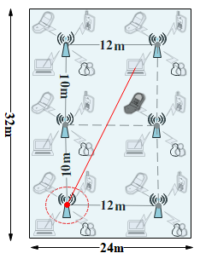

Residual CFO in MU based Sounding
Channel estimation accuracy is extremely important for 16ss and joint transmission.
With number of concurrent user increasing, it requires much smaller CFO to achieve same level EVM as single user. ( Single user --- 350Hz, 8 users --- ~20Hz)
  ChD: 20MHz
  AP N_{RX}: 8
  STA N_{TX} : 1
  STA N_{STA} : 1, 2,4,8
  STA Tx Power: 9 dBm
  Noise Power: -90 dBm
  CFO for Users: $±$0~350Hz
  HE-LTF mode: 4x, GI: 3.2 μsec
4800 STAs in the cell, 40cm apart

Slide 8
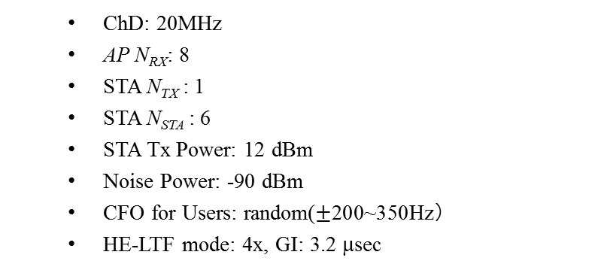
Residual CFO in MU based Sounding
Masked LTF in .11ax cannot maintain small CFO if there is Timing Offset.
Timing Offset may be caused by
Distance between STAs and AP is different
A certain amount of symbol synchronization error (Detection Delay) introduced by implementation algorithm
  ChD: 20MHz
  AP N_{RX}: 8
  STA N_{TX} : 1
  STA N_{STA} : 6
  STA Tx Power: 12 dBm
  Noise Power: -90 dBm
  CFO for Users: random($±$200~350Hz）
  HE-LTF mode: 4x, GI: 3.2 μsec
Conclusion:
If no timing offset residual CFO is 10Hz @90%.
If consider timing offset caused by propagation distance and implementation algorithm, residual CFO is impacted.

Slide 9
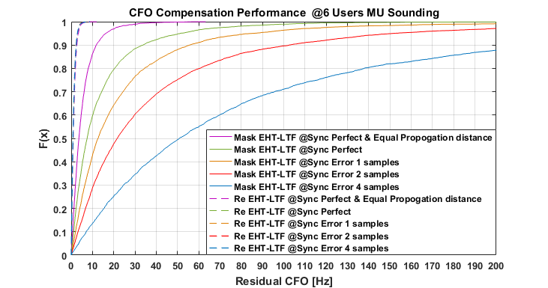
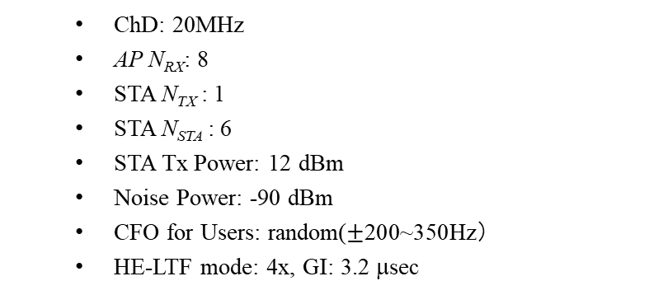

Replicated LTF(s)
Replicate LTF(s) in NDP sounding frame can solve the problem.
By replicating LTF on STA side, residual CFO between STA and AP can be calculated
Group 1
Group 2
2x2 example
EHT-LTF
EHT-LTF
EHT-LTF
EHT-LTF
EHT-LTF
EHT-LTF
$$P_{2×2}$$
EHT-LTF
EHT-LTF
EHT-LTF
EHT-LTF
EHT-LTF
EHT-LTF
  ChD: 20MHz
  AP N_{RX}: 8
  STA N_{TX} : 1
  STA N_{STA} : 6
  STA Tx Power: 12 dBm
  Noise Power: -90 dBm
  CFO for Users: random($±$200~350Hz）
  HE-LTF mode: 4x, GI: 3.2 μsec
Conclusion:
Timing offset has no impact on residual CFO when using replicated LTF(s).
Residual CFO is <5Hz @90%

Slide 10
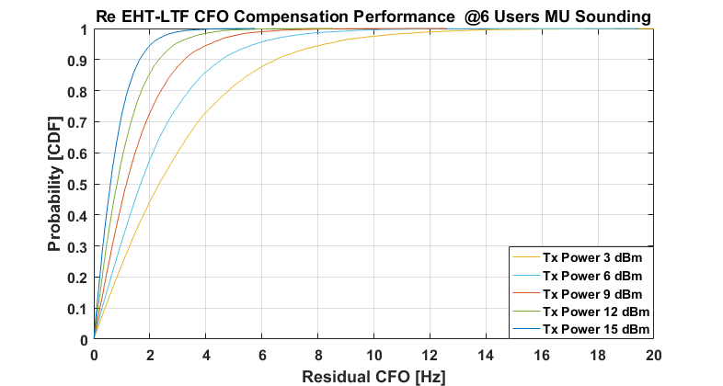
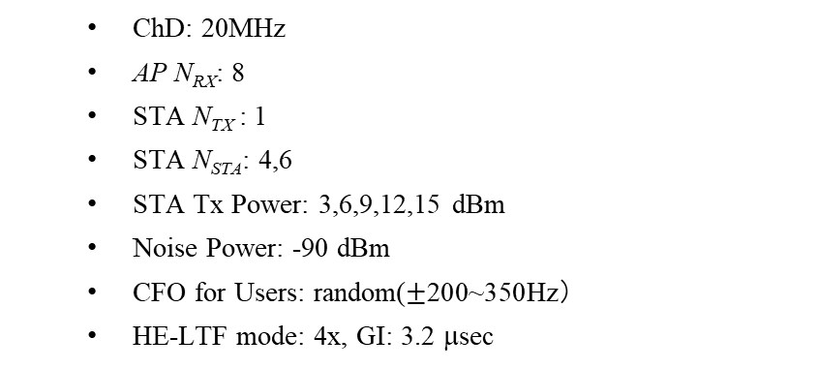
More simulation on Replicated LTF(s)
  ChD: 20MHz
  AP N_{RX}: 8
  STA N_{TX} : 1
  STA N_{STA}: 4,6
  STA Tx Power: 3,6,9,12,15 dBm
  Noise Power: -90 dBm
  CFO for Users: random($±$200~350Hz）
  HE-LTF mode: 4x, GI: 3.2 μsec
Conclusion:
Residual CFO of STA is always within 10Hz, no big difference when number of MU increases.

Slide 11
Summary
We discussed several implicit sounding schemes, including SU-based and MU-based.
Repetitions of EHT-LTF can solve UL/DL power difference issue and residual CFO issue in MU based scheme.
Based on the analysis, we propose implicit sounding as an option in TGbe to help improve sounding efficiency.

Slide 12
SP1
Do you think implicit sounding should be considered as an optional method in TGbe?
Y:
N:
Abstain:

Slide 13
SP2
Do you think MU-MIMO based scheme should be considered in implicit sounding?
Y
N
Abstain

Slide 14
References
[1] 19/1268 Implicit sounding overhead analysis
[2] 19/767 Implicit Channel Sounding in IEEE 802.11 (Feasibility Study)
[3] 18/1191 MU sounding improvements
[4] 19/768 Implicit Channel Sounding in IEEE 802.11
[5] 19/1939 Calibration of Implicit Sounding

Slide 15
Backup

Slide 16




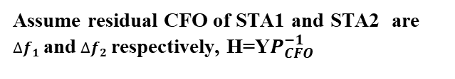

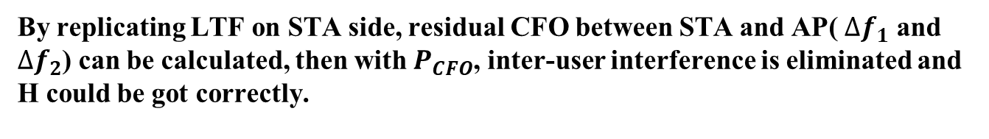



MU-MIMO Based Implicit Sounding Challenge
Replication LTF could also work on the residual CFO problem.
Take 2x2 UL MU-MIMO for example.
If there is no residual CFO, H$={YP}^{−1}$
-1,1
h11
$$y_{1}^{1}= h_{11}+h_{12}$$
$$y_{1}^{2}={−h}_{11}+h_{12}$$
P matrix
$${\left[\begin{matrix}1 & −1 \\ 1 & 1\end{matrix}\right]}^{−1}$$
STA1
h21
$$\left[\begin{matrix}y_{1}^{1} & y_{1}^{2} \\ y_{2}^{1} & y_{2}^{2}\end{matrix}\right]=\left[\begin{matrix}h_{11} & h_{12} \\ h_{21} & h_{22}\end{matrix}\right]\left[\begin{matrix}1 & −1 \\ 1 & 1\end{matrix}\right]$$
$$\left[\begin{matrix}h_{11} & h_{12} \\ h_{21} & h_{22}\end{matrix}\right]$$
h12
h22
AP
Assume residual CFO of STA1 and STA2 are $∆f_{1}$ and $∆f_{2}$ respectively, H=Y$P_{CFO}^{−1}$
1,1
STA2
$$y_{2}^{1}= h_{21}+h_{22}$$
$$y_{2}^{2}={−h}_{21}+h_{22}$$
$P_{CFO}$ matrix
$$\left[\begin{matrix}y_{1}^{1} & y_{1}^{2} \\ y_{2}^{1} & y_{2}^{2}\end{matrix}\right]=\left[\begin{matrix}h_{11} & h_{12} \\ h_{21} & h_{22}\end{matrix}\right]\left[\begin{matrix}1 & −1e^{j2π∆f_{1}T} \\ 1 & 1e^{j2π∆f_{2}T}\end{matrix}\right]$$
$$\left[\begin{matrix}h_{11} & h_{12} \\ h_{21} & h_{22}\end{matrix}\right]$$
By replicating LTF on STA side, residual CFO between STA and AP( $∆f_{1}$ and $∆f_{2}$) can be calculated, then with $P_{CFO}$, inter-user interference is eliminated and H could be got correctly.

Slide 17





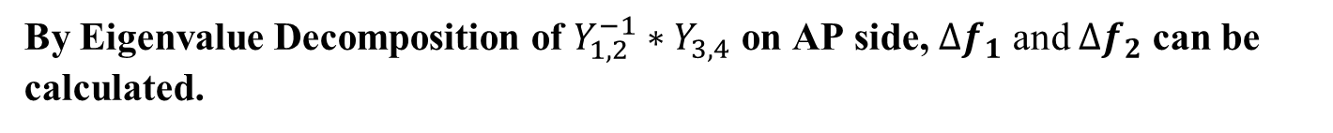
MU-MIMO Based Implicit Sounding Challenge
$$P_{CFO}$$
Original LTF
$Y_{1,2}$=$\left[\begin{matrix}y_{1}^{1} & y_{1}^{2} \\ y_{2}^{1} & y_{2}^{2}\end{matrix}\right]=\left[\begin{matrix}h_{11} & h_{12} \\ h_{21} & h_{22}\end{matrix}\right]\left[\begin{matrix}1 & −1e^{j2π∆f_{1}T} \\ 1 & 1e^{j2π∆f_{2}T}\end{matrix}\right]$
$$P_{CFO, Rep}$$
Replicated LTF
$Y_{3,4}$=$\left[\begin{matrix}y_{1}^{3} & y_{1}^{4} \\ y_{2}^{3} & y_{2}^{4}\end{matrix}\right]=\left[\begin{matrix}h_{11} & h_{12} \\ h_{21} & h_{22}\end{matrix}\right]\left[\begin{matrix}1e^{j2π∆f_{1}2T} & −1e^{j2π∆f_{1}3T} \\ 1e^{j2π∆f_{2}2T} & 1e^{j2π∆f_{2}3T}\end{matrix}\right]$
$$=\left[\begin{matrix}h_{11} & h_{12} \\ h_{21} & h_{22}\end{matrix}\right]\left[\begin{matrix}e^{j2π∆f_{1}2T} & 0 \\ 0 & e^{j2π∆f_{2}2T}\end{matrix}\right]\left[\begin{matrix}1 & −1e^{j2π∆f_{1}T} \\ 1 & 1e^{j2π∆f_{2}T}\end{matrix}\right]$$
By Eigenvalue Decomposition of $Y_{1,2}^{−1}∗Y_{3,4}$ on AP side, $∆f_{1}$ and $∆f_{2}$ can be calculated.
$$Y_{1,2}^{−1}∗Y_{3,4}={\left[\begin{matrix}1 & −1e^{j2π∆f_{1}T} \\ 1 & 1e^{j2π∆f_{2}T}\end{matrix}\right]}^{−1}\left[\begin{matrix}e^{j2π∆f_{1}2T} & 0 \\ 0 & e^{j2π∆f_{2}2T}\end{matrix}\right]\left[\begin{matrix}1 & −1e^{j2π∆f_{1}T} \\ 1 & 1e^{j2π∆f_{2}T}\end{matrix}\right]$$

