Slide 1
Updates from EN 301 893 GoToMeetings since BRAN#103
Date: 2019-11-13
Authors:
Name | Affiliations | Address | Phone | email
David Boldy | Broadcom |  |  | david.boldy@broadcom.com

Slide 2
Update on PD Testing
3 contributions to meeting:
Test Signals for Preamble Detection – BRAN(19)100037
Issues with Preamble Detection – BRAN(19)100038
PD Test Results – BRAN(19)103035r1 (later updated to r2 to include the waveform file of the possible test signal)
Discussions related to what the test signal should be and interpretations of a valid/real life signal related to the IEEE requirements.
Some agreement that current PD in EN 301 893 may need better definition
No agreement on a solution.
R&S agreed that they could do some further testing using the waveform provided by Qualcomm in BRAN(19)103035r2. This would not be a new plugfest due to lab BW constraints and commitments.
Needs further discussion at BRAN#104 in December.

Slide 3
Abstract
Updates from ETSI BRAN GoToMeetings since BRAN#103 (related to PD testing, Spectrum mask and inclusion of 5.8GHz in the EN 301 893 standard).

Slide 4
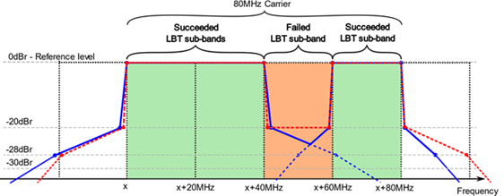
Spectrum Mask Questions
Q1:RAN4 would kindly request ETSI TC BRAN understanding whether preamble punctured mask for a wide band carrier larger than 20MHz having a relaxed mask requirement with a constant reference level of -20dBr in the punctured region(s) is compliant to ETSI mask?
Q2: RAN4 respectfully asks ETSI TC BRAN to confirm this understanding and explain the reasoning of the ETSI transmit spectral mask widening with increased bandwidth configurations, particularly at the -20dBr limit.

Slide 5
Update on Spectrum Mask
There was some agreement to use the Nokia proposal detailed in BRAN(19)101019 but with the lower limit for all cases being increased from -28dBr to -25dBr.
Huawei raised concerns with the measurement RBW with regards to the limits in the proposals (i.e. ETSI is typically 1MHz but IEEE is 100kHz). Huawei will put in a contribution to further highlight their concern.
LOs were also discussed and there was some agreement that we may need to build some sort of exceptions into the ETSI language for this.
Nokia have updated their contribution to BRAN(19)101019r1 to reflect the changes to the minimum -25dBr for in band mask as agreed in the meeting.
Some concerns with regards to the Out of Band (e.g. for a 60MHz BW channels what roll off to apply for the mask) still to be addressed.
GoToMeeting to discuss further on 27th Nov 3pm CET

Slide 6
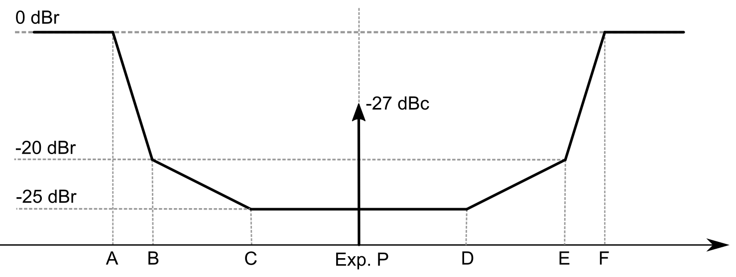
Extracts from BRAN(19)103019r1 for information (1)
Placement of unavailable sub-channels | A [MHz] | B [MHz] | C [MHz] | D [MHz] | E [MHz] | F [MHz]
Within | LE | LE + 1 | LE + 20 | RE - 20 | RE - 1 | RE
Left edge | LE | LE + 1 | LE + 20 | LE + N | - | -
Right edge | - | - | RE – N | RE - 20 | RE - 1 | RE
Note: N is the Nominal Channel Bandwidth (in MHz) of the initial carrier. LE is the frequency of the lower edge of the succeeded LBT sub-band (in MHz). RE is the frequency of the upper edge of the succeeded LBT sub-band (in MHz).

Slide 7
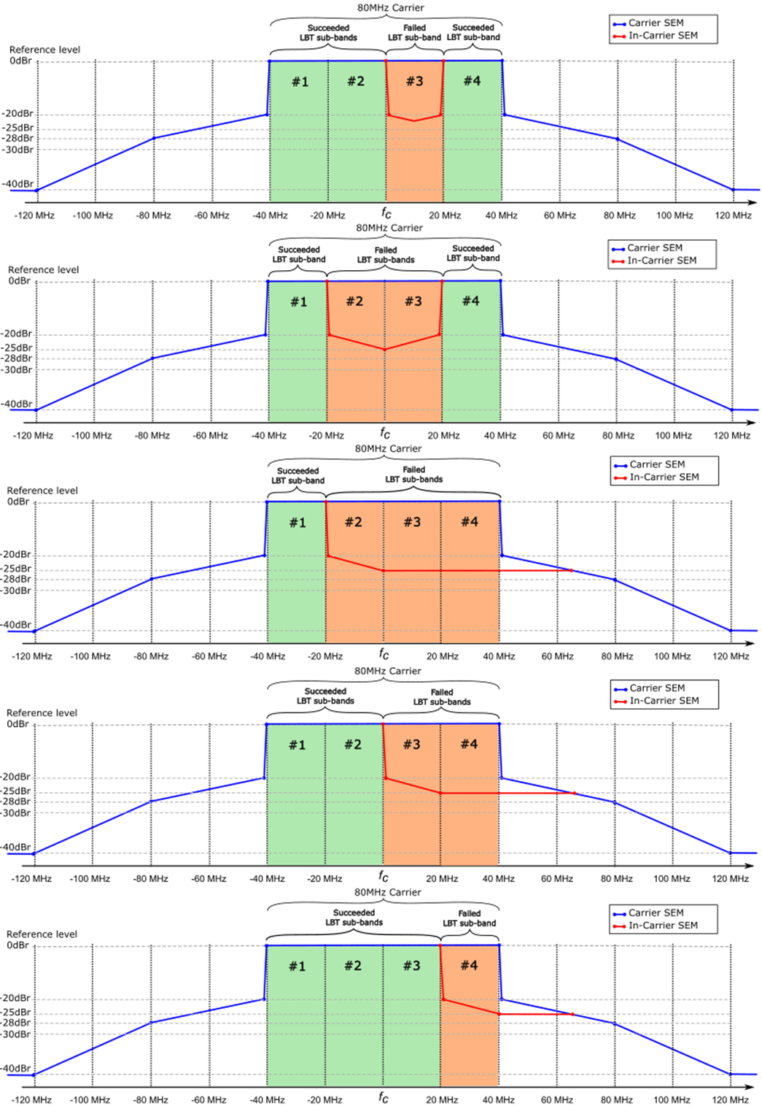
Extracts from BRAN(19)103019r1 for information (2)

Slide 8
Update on Revisions to Include 5.8GHz
Ongoing
Agreed changes and related comments included in the latest draft v.2.1.22 on the ETSI drafting tool.
GoToMeeting to further discuss on 21st Nov 3pm CET

