Slide 1
Discussion on low latency capability for 802.11be
Date: 2019-11-11
Name | Affiliation | Address | Phone | Email
Kazuyuki Sakoda | Sony |  |  | kazuyuki.sakoda(at)sony.com
William Carney | Sony |  |  | William.Carney(at)sony.com
Thomas Handte | Sony |  |  | Thomas.Handte(at)sony.com

Slide 2
Agenda
Recap on real-time application use case
Target metric
Potential technologies that 802.11be should consider
Discussion and straw-poll

Slide 3
Motivation
802.11be is supposed to provide a technology to minimize worst-case latency and jitter [1]
RTA TIG discussed use case, requirements, and potential technologies to mitigate the latency issue. Outcome of the discussion is summarized in [2]
According to [2], there are wide spectrum of latency requirements, depending on applications
At this point in time, it is still not clear what type of delay-constrained application we should aim at, and what type of technical approach we should take with 802.11be
This presentation will walk through the application requirements and potential technical approach, trying to start building a common understanding on our goal

Slide 4
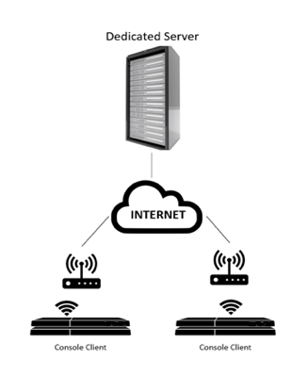
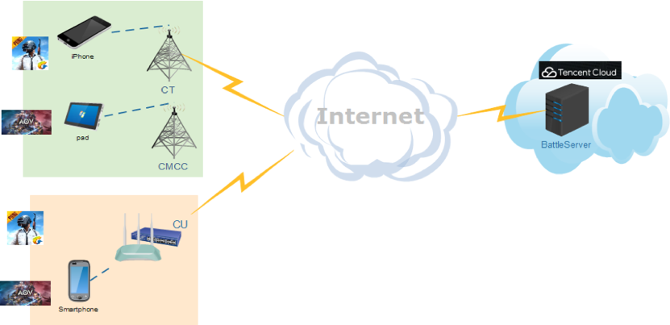
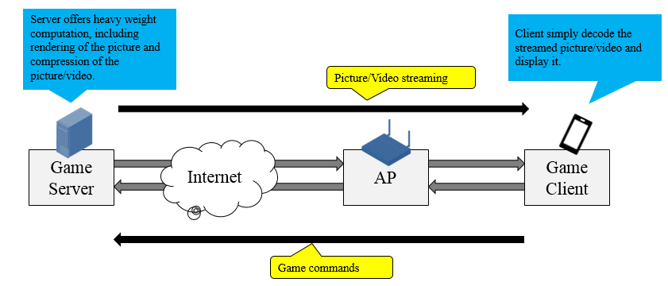
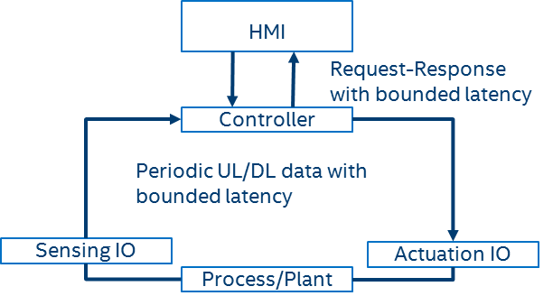
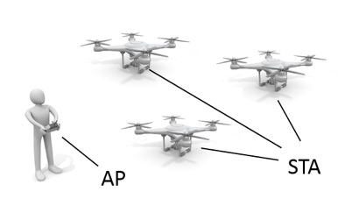
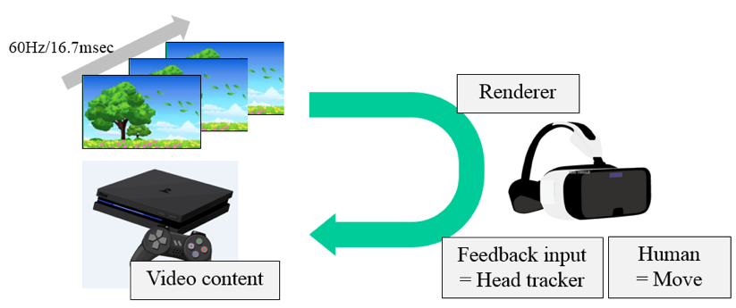
Recap on real-time application use case
[2] identified 6 use cases that will enjoy low latency communication
Real-time Mobile Gaming
Wireless Console Gaming
Cloud Gaming
Realtime Video
(Interactive Video)
Drone Control
Industrial Systems

Slide 5
Latency definition [2]
End-to-End latency
Intra-BSS latency

Slide 6
Latency definition [2]
End-to-End latency:
System level round trip time (RTT) among devices in a feedback loop system involving 802.11 link to transmit data between devices. End-to-End latency includes all factors that contribute to impact latency, including 802.11 link transmission delay, non-802.11 link transmission delay, signal processing delay, delay caused by synchronization, etc. For instance, in-game latency is one form of the End-End latency.
Intra-BSS latency:
Time consumed to transmit an MSDU from a STA to another STA within a BSS. It is equal to elapsed time while an MSDU travels from MAC-SAP of a transmitter STA to MAC-SAP of a receiver STA in a BSS.

Slide 7
Target metric
Use cases |  | Intra BSS latency/ms | Jitter variance/ms | Packet loss | Data rate/ Mbps
Real-time gaming |  | < 5 | < 2 | < 0.1 % | < 1
Cloud gaming |  | < 10 | < 2 | Near-lossless | < 0.1 (Reverse link) > 5 (Forward link)
Real-time video |  | < 3 ~ 10 | < 1~ 2.5 | Near-lossless | 100 ~ 28,000
Robotics and industrial automation | Equipment control | < 1 ~ 10 | < 0.2~2 | Near-lossless | < 1
 | Human safety | < 1~ 10 | < 0.2 ~ 2 | Near-lossless | < 1
 | Haptic technology | <1~5 | <0.2~2 | Lossless | <1
 | Drone control | <100 | <10 | Lossless | <1 >100 with video
Requirements varies depending on the application
  Intra-BSS latency: 1msec : Motion control with safety constraints
  5~ 10msec : Realtime video input/output
  ~ 100msec: Remote control

Slide 8
Potential technology that 802.11be should consider (1)
TSN integration:
  As discussed intensively in [3], [4], [5], etc.
  Although the coverage of 802.11 is MAC/PHY in a BSS, the standard should define a set of interface that allows vendors to design a system meeting End-to-End
  latency requirements
  Making 802.11 MAC/ MLME interface
  compatible with TSN framework
  Time Synchronization,
  Bounded Latency, etc.
TSN Talker
TSN Listener
CUC: Central User Configuration
CNC: Central Network Configuration

Slide 9
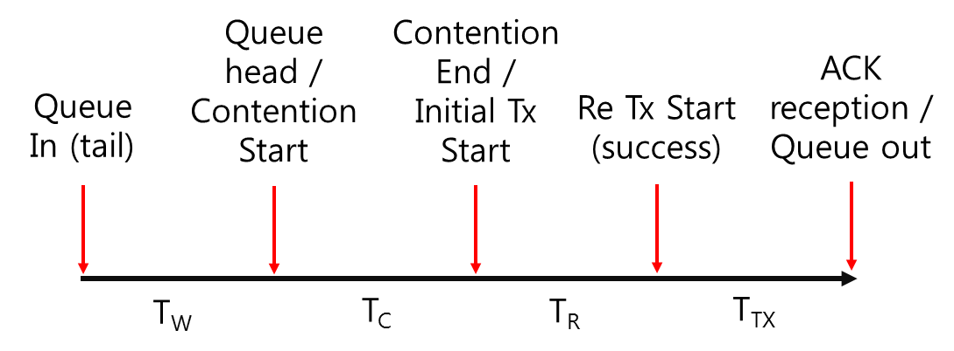
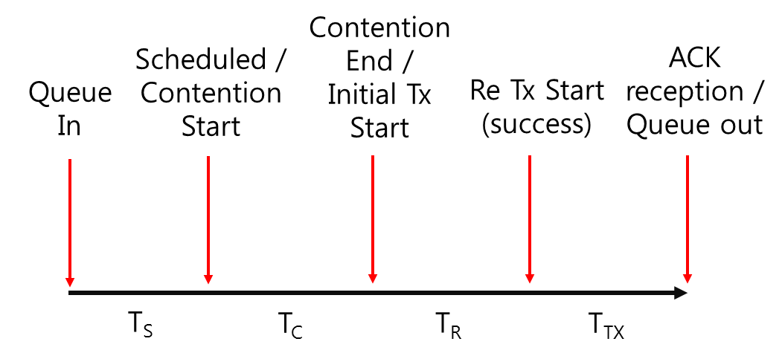
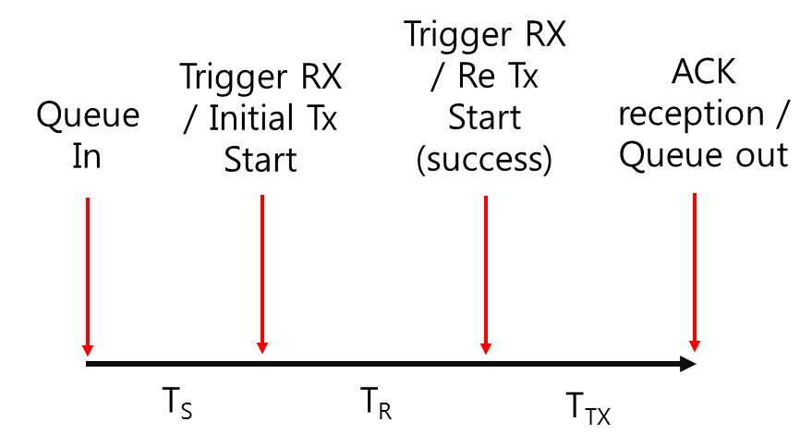
Potential technology that 802.11be should consider (2)
Technologies to minimize Intra-BSS latency
[6] gives very helpful breakdown of the latency components in an BSS
Let us walk through high-level category of the latency components
EDCA
DL OFDMA
UL OFDMA

Slide 10
Potential technology that 802.11be should consider (3)
Queuing and scheduling delay:
  After an RTA datagram passed MAC-SAP of a transmitter, the datagram is queued in a transmitter’s queue
  If there are other traffic queued at the transmitter’s queue, it may take some time until the STA will trigger transmission attempt of the RTA datagram
  → Queueing delay
  If frame transmissions are made based on scheduling, the time until the RTA datagram is scheduled will be added as a part of the latency
  → Scheduling delay
As discussed, there should be ways to minimize queueing delay [7], [8], and scheduling delay [9], [10], [11]
There should be many other approaches that could contribute to minimize these delays, depending on the assumption, target scenario and application

Slide 11
Potential technology that 802.11be should consider (4)
Channel access delay:
  After a STA triggers transmission attempt (start counting backoff), the STA needs to perform CCA to gain access to the channel.
  There are many uncertainty in channel access owing to the nature of unlicensed spectrum
However, there should be ways to minimize channel access delay as proposed in [11], [12], [13], [14]
In addition to Intra-BSS channel access control, we should consider minimizing channel access delay even when OBSS signal is present

Slide 12
Potential technology that 802.11be should consider (5)
Retransmission and ARQ:
  It is possible that a receiver cannot decode a transmitted frame correctly for variety of reasons
  802.11 relies on retransmissions to gain reliability
  However, typical 802.11 retransmission will accumulate additional latency with another channel access delay
It should be reasonable to revisit retransmission and ARQ scheme for low latency traffics [14], [15]

Slide 13
Discussion
What type of application should 802.11be aim at in terms of latency/jitter requirements?
  Slides 4 and 7
Do we think low-latency discussion is making sense for now?
  Slides 8-12

Slide 14
Strawpoll (1)
What should be our intra-BSS latency target for real-time application?
  ~1 msec (Typical application: Motion control with safety constraints)
  5~10 msec (Typical application: Gaming / Real time video)
  ~100msec (Typical application: Remote control)

Slide 15
Strawpoll (2)
Should we consider queuing and scheduling delay mitigation techniques for real-time applications?
  Y
  N
  A

Slide 16
Strawpoll (3)
Should we consider channel access delay mitigation techniques with OBSS scenario specifically for real-time applications?
  Y
  N
  A

Slide 17
Strawpoll (4)
Should we consider retransmission/ARQ enhancement techniques for real-time applications?
  Y
  N
  A

Slide 18
References
[1] 802.11-18/1231r6 “EHC draft proposed PAR,” Laurent Cariou
[2] 802.11-18/2009r6 “IEEE 802.11 Real Time Applications TIG Report,” Kate Meng, et.al.
[3] 802.11-19/1287r1 “TSN support in 802.11 and potential extensions for TGbe”, Dave Cavalcanti, et.al.
[4] 802.11-19/1266r1 “Wireless + TSN = Part of the Picture”, Norman Finn
[5] 802.11-19/1298r1, “IEEE 802.1 TSN – An Introduction”, Janos Farkas
[6] 802.11-19/762r1, “Latency analysis for EHT,” Suhwook Kim, et.al.
[7] 802.11-19/1175r0, “Considerations of New Queue Mechanism for Real-Time Application,” Xin Zuo, et.al.
[8] 802.11-19/1524r0, “Latency enhancement for EHT,” Suhwook Kim, et.al.
[9] 802.11-19/1622r0, “Use Auto Repetition in low latency queue,” Tony Zeng, et.al.

Slide 19
References
[10] 802.11-19/1538r1 “Use of Uplink Persistent Allocation for RTA,” Xin Zuo, et.al.
[11] 802.11-19/1118r1, “Enhancements for Time-Critical Data Transmission,” Thomas Handte, et.al.
[12] 802.11-19/1615r0, “Multi-band/Multi-channel Operation for Low Latency and Jitter,” Liuming Lu, et.al.
[13] 802.11-19/1081r1, “Multi-Link Aggregation: Latency Gains,” Abhishek Patil, et.al.
[14] 802.11-19/1223r0, “Improving WLAN reliability,” Antonio del la Oliva, et.al.
[15] 802.11-19/1884r0, “Discussion on RTA Retransmission,” Liangxiao Xin, et.al.

