Slide 1
Setup for Multi-AP coordination
Date: 2019-11-11
Authors:
Name | Affiliation | Address | Phone | Email
Sungjin Park | LG Electronics | 19, Yangjae-daero 11gil, Seocho-gu, Seoul 137-130, Korea |  | allean.park@lge.com
Ensung Park |  |  |  | esung.park@lge.com
Jeongki Kim |  |  |  | jeongki.kim@lge.com
Jinsoo Choi |  |  |  | js.choi@lge.com

Slide 2
Introduction
The Multi-AP coordination has been discussed as one of the candidate features in 11be.
In order to use Multi-AP transmission schemes, the Multi-AP coordination set should be configured by APs in advance.
In this contribution, we discuss how to setup for the Multi-AP coordination.

Slide 3
Motivation
In order to use Multi-AP transmission schemes (e.g., Coordinated BF, Joint TX, etc.), an AP should acquire channel information with STA associated with neighboring AP as well as STA associated with itself.
In order to perform sounding to acquire channel information, an AP should know the identifiers of STAs which is associated with neighboring AP.
Therefore, it needs to define a method in which an AP establishes a link with neighboring AP and knows information about STA associated with the neighboring AP.

Slide 4
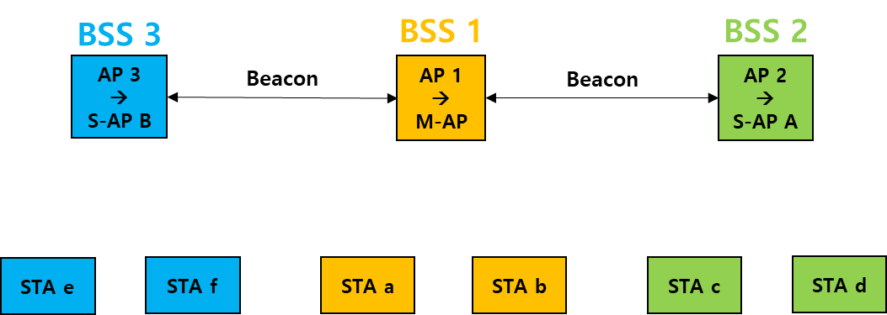
Phase 1: Topology of multiple APs
We consider the following environments.
STA “a” and STA “b” are associated with AP 1 in BSS 1.
STA “c” and STA “d” are associated with AP 2 in BSS 2.
STA “e” and STA “f” are associated with AP 3 in BSS 3.

Slide 5
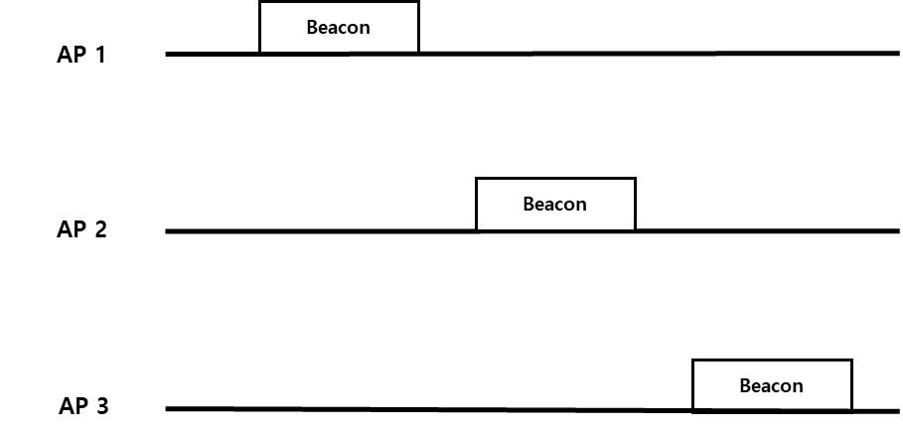
Phase 1(Cont.): Discovery of neighboring APs
APs can discover each other by receiving Beacon frame or management frames sent by neighboring APs.
When the AP sends Beacon frame or management frame, the neighboring AP should be informed that there is a capability to participate Multi-AP coordination.
APs know which of neighboring APs is hearable and has Multi-AP capability.

Slide 6
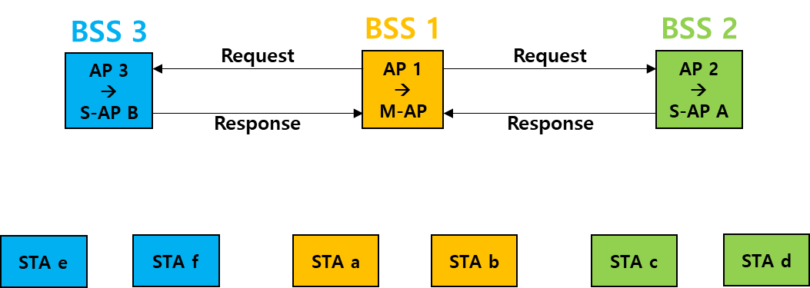
Phase 2: Setup for Multi-AP coordination
The AP which initiates Multi-AP coordination is the Master AP.
Master AP selects neighboring APs as Slave APs in order to participate in the Multi-AP coordination.
In this Phase 2, Mater AP and Slave APs exchange information to configure Multi-AP coordination set.

Slide 7
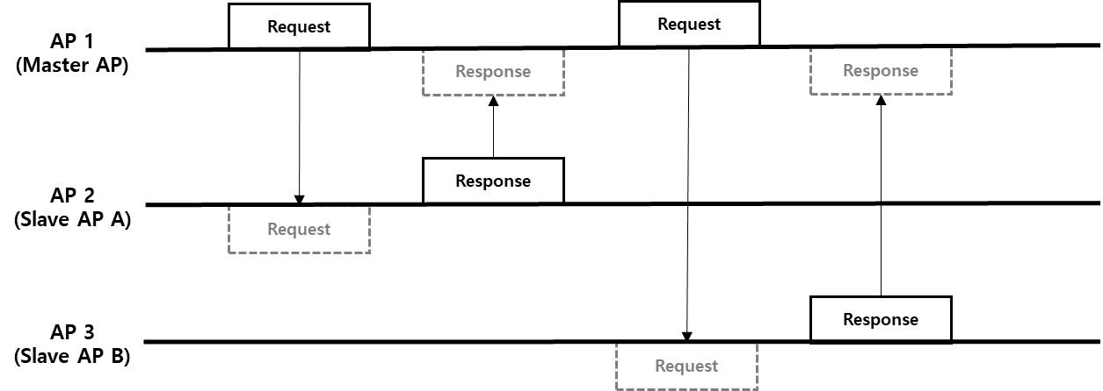
Phase 2 (Cont.): Contents for setup
Master AP sends Request frame to Slave APs.
Assign Slave AP’s identifier in Multi-AP coordination
Assign Multi-AP group ID
Slave AP sends Response frame to Master AP.
List of STAs associated with Slave AP: STA’s identifier and capability to participate in Multi-AP TX/RX scheme
Priority of STAs to participate in Multi-AP TX/RX scheme
The information of priority of STAs can be used when the Master AP has to involve the limited number of STAs due to Master AP’s antenna capability..

Slide 8
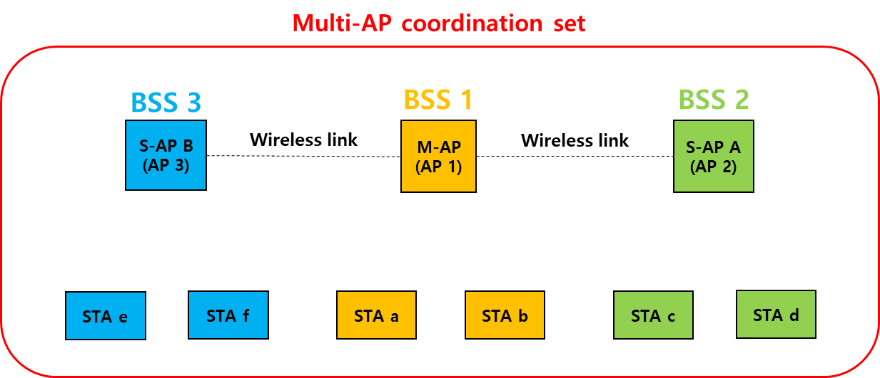
Multi-AP coordination set
After phase 2, Multi-AP coordination set is configured by Master AP and Slave-APs.
Since the Master AP has acquired the STA’s information belonging to the Slave APs, the Master AP can communicate those STAs for the multi-AP scheme.

Slide 9
Usage of setup for Multi-AP coordination
Multi-AP sounding should be performed to send data frames by using Multi-AP transmission scheme (e.g., Coordinated BF, Joint TX, etc.).
In order that sounding is performed between APs (Master AP & Slave APs) and STAs which are associated with different AP, an AP should identifiers of STAs associated with other APs.
From the result of setup for Multi-AP coordination, the Master AP can know identifiers of STAs associated with Slave APs.

Slide 10
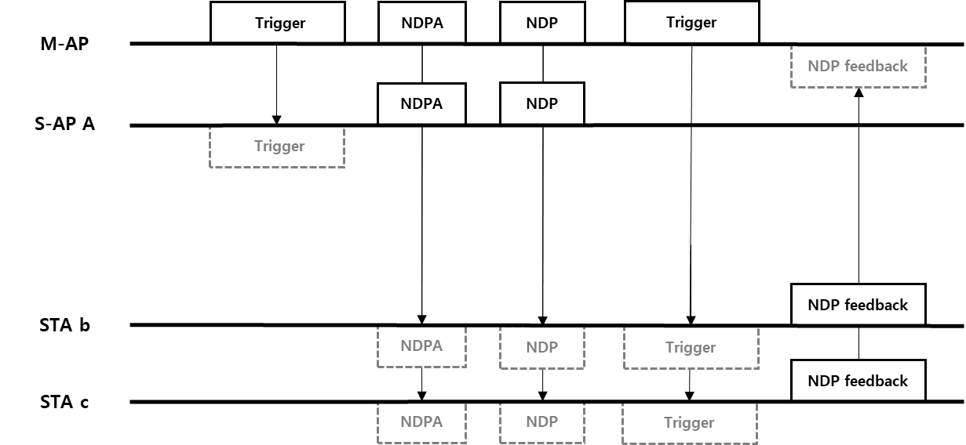
Example of setup usage in Multi-AP sounding
Master AP already knows the identifier of STA “c” which is associated with Slave AP “A” from the result of setup for Multi-AP coordination.
By using Trigger frame, Master AP informs Slave AP “A” of the identifiers of the STA “b” and “c” participating in Multi-AP sounding.
Both Master AP and Slave AP “A” send NDPA and NDP simultaneously to the STA “b” and STA “c”.

Slide 11
Conclusion
In order to use Multi-AP transmission scheme, the Multi-AP coordination set should be configured by Master AP and Slave-APs and the Master AP should know information of STAs associated with the Slave APs.
By using proposed method of Multi-AP coordination setup, an AP can communicate with the STAs associated with neighboring APs.
The Master AP can transmit NDPA + NDP to the STA associated with Slave AP.
The Slave AP can transmit NDPA + NDP to the STA associated with Master AP.

Slide 12
Straw Poll 1
Do you agree to add the following text to the TGbe SFD:
An EHT AP supporting the Multi-AP coordination can send a frame (e.g., Beacon or other management frame) including capabilities of Multi-AP transmission schemes.
- Multi-AP transmission schemes are TBD (e.g., Coordinated OFDMA)

Slide 13
Straw Poll 2
Do you agree to add the following text to the TGbe SFD:
An EHT AP which obtains TXOP and initiates the Multi-AP coordination is the Sharing AP*.
An EHT AP which is coordinated for the Multi-AP transmission by the Sharing AP is the Shared AP*.
*Note: The name can be modified.

Slide 14
Motion 1
Move to add the following text to the TGbe SFD:
An EHT AP supporting the Multi-AP coordination can send a frame (e.g., Beacon or other management frame) including capabilities of Multi-AP transmission schemes*.
*Note: Multi-AP transmission schemes are TBD (e.g., Coordinated OFDMA)

Slide 15
Motion 2
Move to add the following text to the TGbe SFD:
An EHT AP which obtains TXOP and initiates the Multi-AP coordination is the Sharing AP*.
An EHT AP which is coordinated for the Multi-AP transmission by the Sharing AP is the Shared AP*.
*Note: The name can be modified.

