Slide 1
Performance aspects of Multi-link operations with constraints
Date: 2019-11-11
Authors:
Name | Affiliations | Address | Phone | Email
Dmitry Akhmetov | Intel |  |  | Dmitry.akhmetov@intel.com
Laurent Cariou
Dibakar Das
Notes:
September 2012

Slide 2
Recap:
In [1] we proposed classification of multi-link device operations based on channel access capabilities
SPC – single primary channel operation
MPC – multiple primary channel operation
JMPC – join multiple primary channel operation
We discussed performance aspects of a device with multi-link capabilities in comparison to a single link operation with a conclusion that MPC is a preferable mode of operation
~1.27x gain for SPC mode of operation
~2.09x gain for MPC mode of operation
~2.22x gain for JMPC mode of operation
In this presentation we will focus on modes of operation with constraints arising from physical limitations of co-located radios
EHT MLLE 1
STA
STA
Link 1
Link 2
EHT MLLE 2
STA
STA

Slide 3
Complicated life of a device with co-located radios
Multi-link device may need to impose constraints on concurrent TX/RX operations on different bands
For example, interference across links/radios - TX on band 1 can impact radio on band 2 (and vice versa).
Levels of interference/leakage across links vary depending on device capabilities and link/channel location in a frequency domain
Devices radio capabilities / implementation may not allow for concurrent operation
No TX operation is possible on band1 if band 2 is busy with RX operation and vice versa
Introducing 2 new modes of operation with restrictions
isolated (R)estricted MPC
Non-isolated (R)estricted MPC
TXOP
TXOP
MLLE STA
STA1
Tx data
Rx ack
Tx data
Rx ack
Tx data
Rx ack
band 1
3
2
1
0
5
4
3
2
1
0
TXOP
TXOP
STA 2
band 2
Tx data
Rx ack
Rx data
Tx ack
Tx
Rx
Tx data
Rx ack
Tx data
Rx ack
1
0

Slide 4
Restricted mode of operations assumptions
isolated RMPC
Leakage/interference from TX on link1 is not sufficient to cross ED threshold on link2
Leakage still add interference noise
sufficient to harm data frame receptions on a high MCSes but not enough to damage RX of control frames
non-isolated RMPC
Leakage from TX on link1 is sufficient to cross ED threshold on link2
Leaking power rise CCA Busy signal on link 2 stopping it from contention and destroying all ongoing RX events/processes
Channel access rules to accommodate restrictions:
Before initiating TXOP on a link1 MLLE STA need to verify status of a link 2
do not initiate TX operation if other link/radio is in RX state unless STA is not an intended receiver of that transmission
do not initiate TXOP if a response is expected on link 2
do not initiate TXOP if STA on link 2 is going to send a response frame on link 2
if the other link/radio is in TX state, limit own TX duration to match end of the other transmission
If status of link 2 does not allow MLLE STA to initiate TXOP, restart backoff counter on link 1
AP is considered a “better” device and can operate under “isolated RMPC” while STA operates under “non-isolated RMPC” rules
AP initialize TXOP operations in a way to avoid interfering with RX activity of a STA operating under non-isolated RMPC on another link.
AP does not initiate TXOP on link 1 if it detect UL transmission from a STA operating under non-isolated RMPC on another link
Synchronization of TX/TX and RX/Rx operations, i.e. packet level/PHY level synchronization across links is desirable

Slide 5
Simulation setup. DL case
SU HE, 2x2x80, MCS11
BSS TXOP limit 5.4ms
OBSS TXOP limit: uniformly distributed for each TXOP between 1 and 5.4ms
No TXOP bursting
RTS/CTS on
A-MPDU size: 256
EHT AP
EHT STA
AP1
STA1
OBSS AP1
OBSS STA 1
OBSS AP n
OBSS STA n
Link 1
OBSS AP 2
OBSS STA2
OBSS AP 2n
OBSS STA 2n
AP2
STA2
Link 2
BSS load: UDP traffic in DL direction with load of
Case 1: 300Mbps, e.g. 25% of MCS11 rate; Case 2: 600Mbps, e.g. 50% of MCS11 rate; Case 3: 1200Mbps, e.g. 100% of MCS11 rate
For each case vary number of OBSSes from 0 to 10
Each OBSS has bidirectional UDP traffic with total load 120Mbps ( e.g.10% MCS11 rate)
All BSSes are in ED/PD range of each other
Metrics of interest
Throughput
# of synchronous/asynchronous operations ( simultaneous TXOP start)

Slide 6
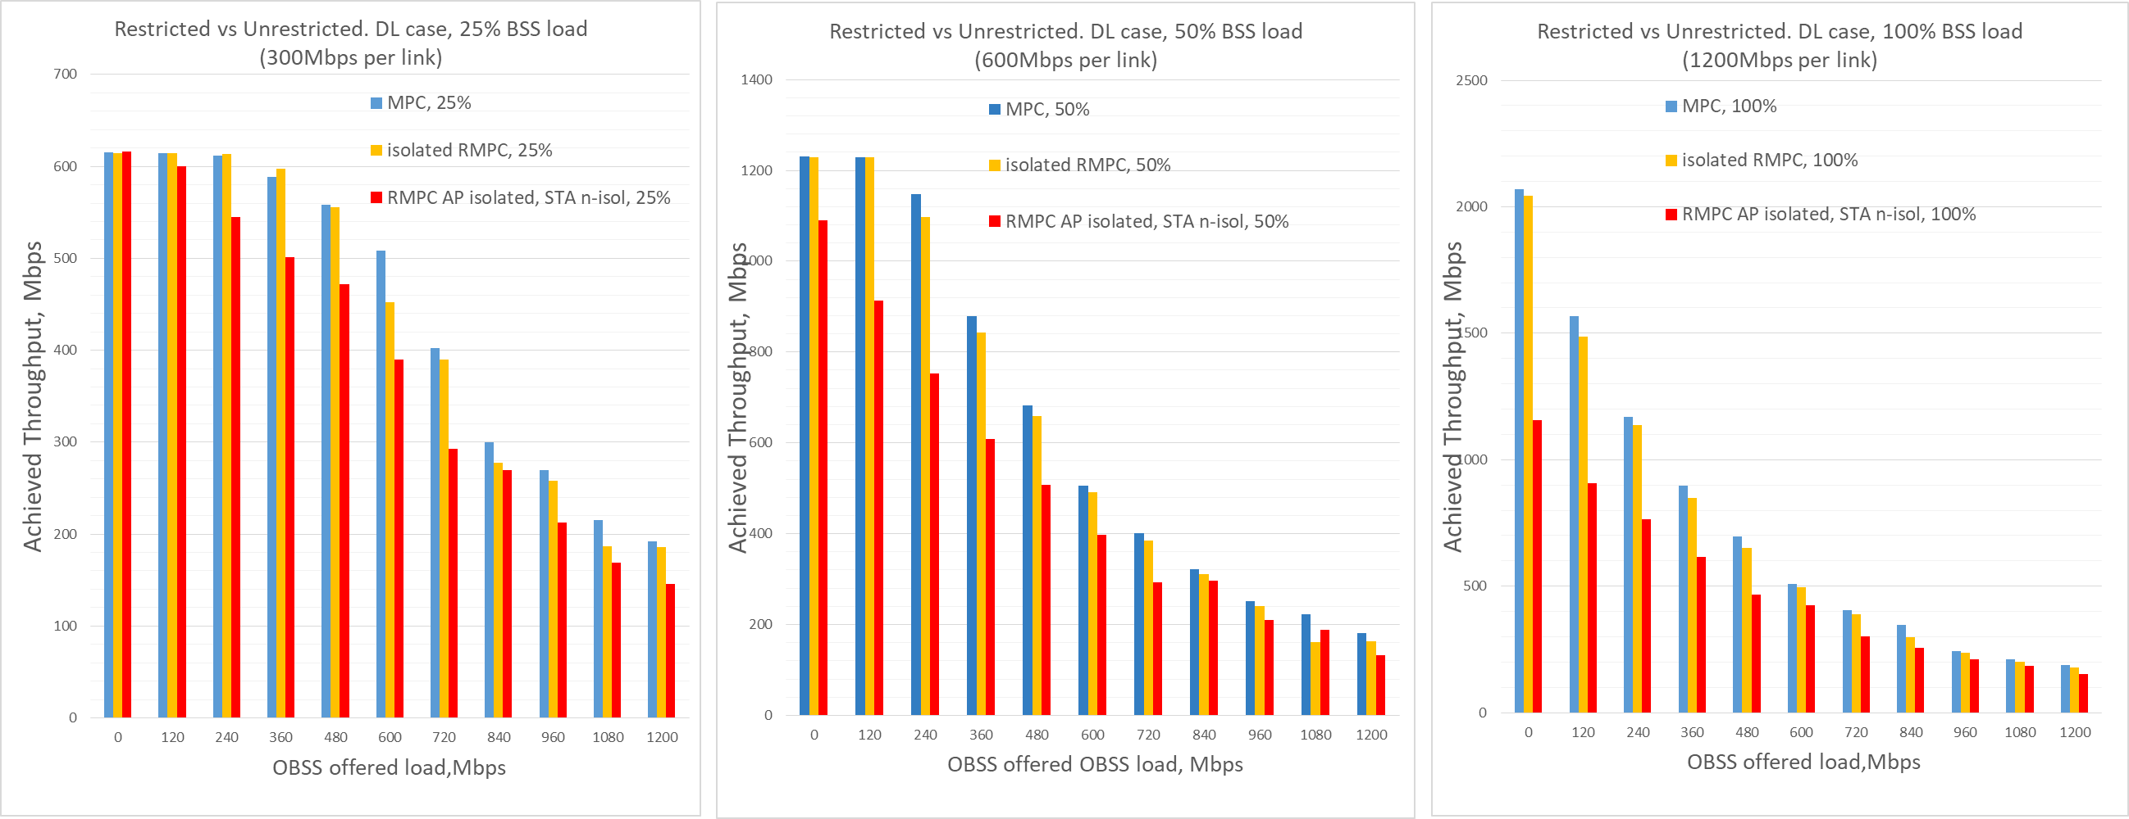
Restricted vs Unrestricted. DL case
Depending on the link load there might be a huge impact on throughput. In certain cases (high link load, lightly loaded BSS/OBSS) dual link performance might be converging to a single link operation performance
A potential for improvement/proprietary implementation exist
OBSS equally affect all modes of operation

Slide 7
Latency, MLLE, benefits
It is expected that throughput of MLA will be reduced at the STA MLLE with Tx/Rx constraints
STA MLLE cannot simultaneously Tx in one link and Rx in another adjacent link due to leakage
Under certain conditions multi-link operation will be converging to a single link operation
We still may expect improved of latency from having more than one active contending channel
Even without/limited multi-link operation a multi-link channel access shall provide some gain in terms latency

Slide 8
Simulation setup. UL case
AP MLLE associated with
MLLE STA on link 1 and 2 doing UL only traffic, AC_VO
1 legacy STA on each link receiving DL traffic, AC_VI
4 OBSS APs with 1 STA with DL traffic, AC_VI
Configuration 1:
UL traffic: 512 bytes packets every 20ms @ MCS4
DL traffic: @ MCS0 with load as % TX rate
1a: all the DL traffic from EHT AP is for legacy STA
1b: all the DL traffic from EHT AP is for EHT STA
Configuration 2:
UL CBR traffic, 1500bytes packets of 12Mbps @ MCS8
DL traffic as above
Configuration 3:
UL bursty traffic, 6Mbps packets of 12Mbps @ MCS8
DL traffic as above
EHT AP
EHT STA
AP
OBSS AP1
OBSS STA 1
OBSS AP4
OBSS STA 4
STA
Legacy
STA
Link 1
AP
OBSS AP1
OBSS STA 1
OBSS AP4
OBSS STA 4
STA
Legacy
STA
Link 2

Slide 9
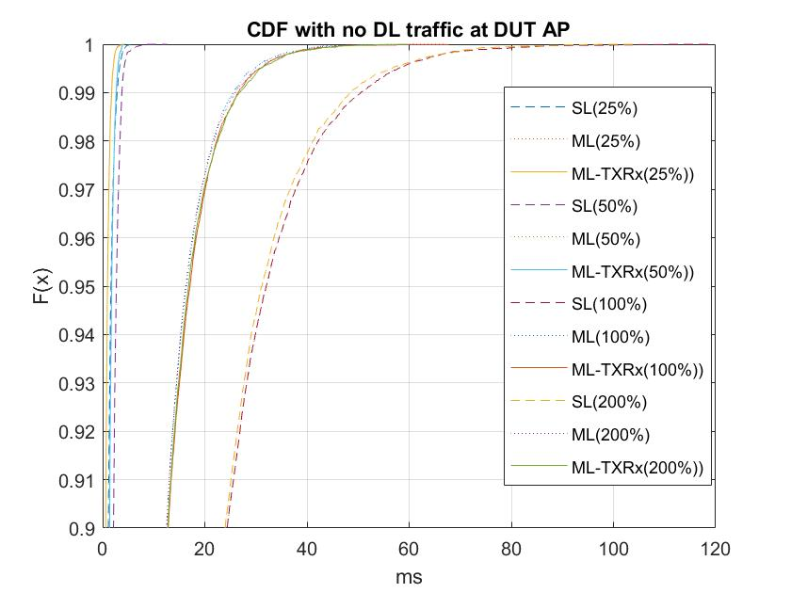
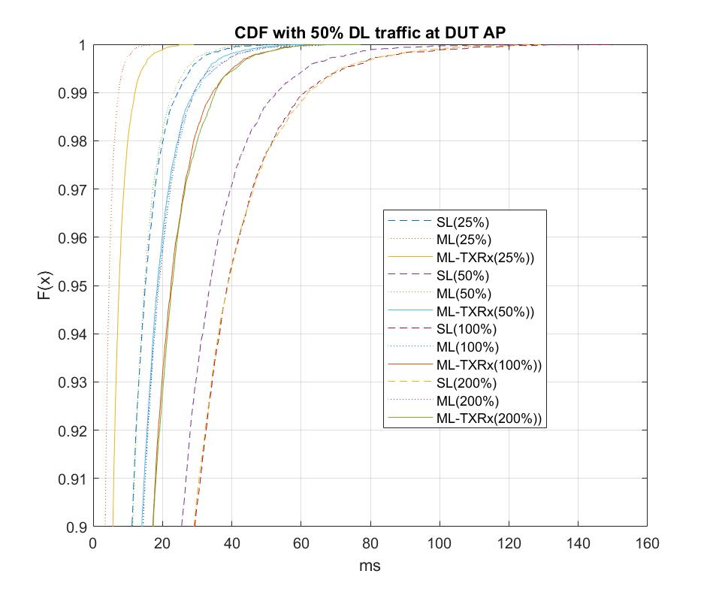
Example: CDF view of Configuration 1, 50% BSS DL load
The spread between curves is explained by the time required for MLLE to identify address of the intended receiver in case of one link if found it RX state

Slide 10
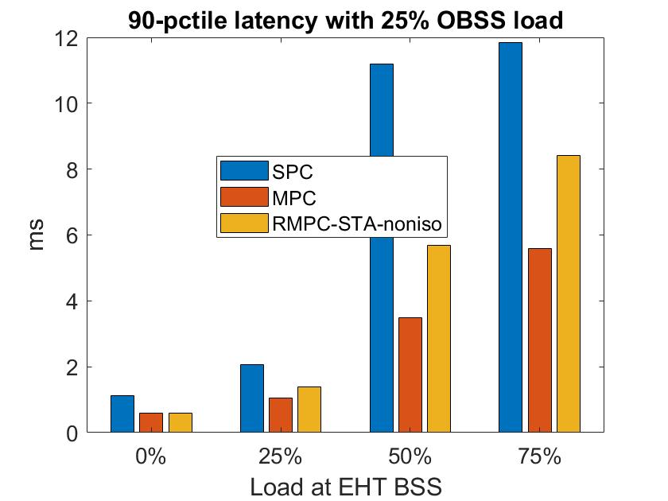
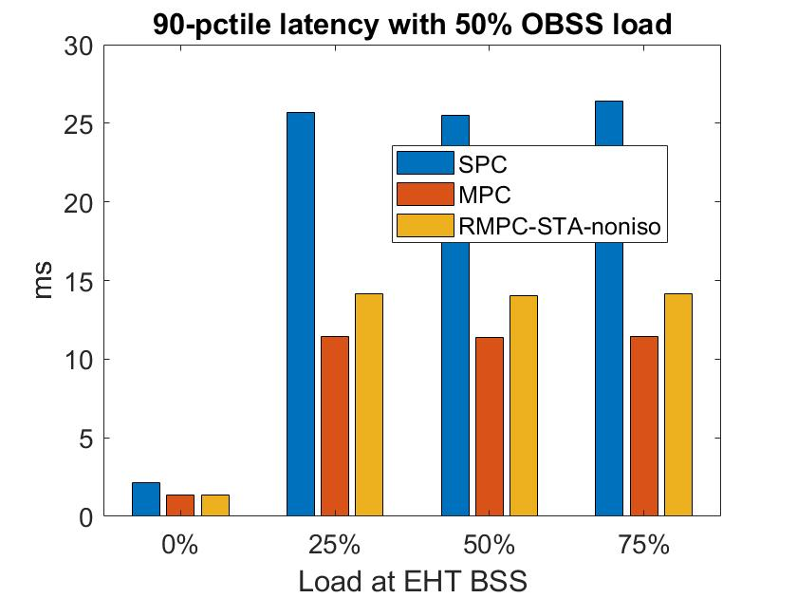
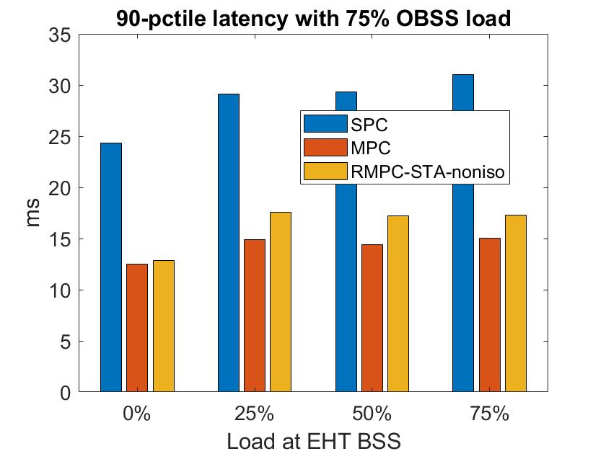
Light CBR UL traffic (Config 1a)
The gap between MPC and RMPC is more pronounced when the OBSS load is smaller relative to the BSS load (due to lower number of events when early detection occurs).

Slide 11
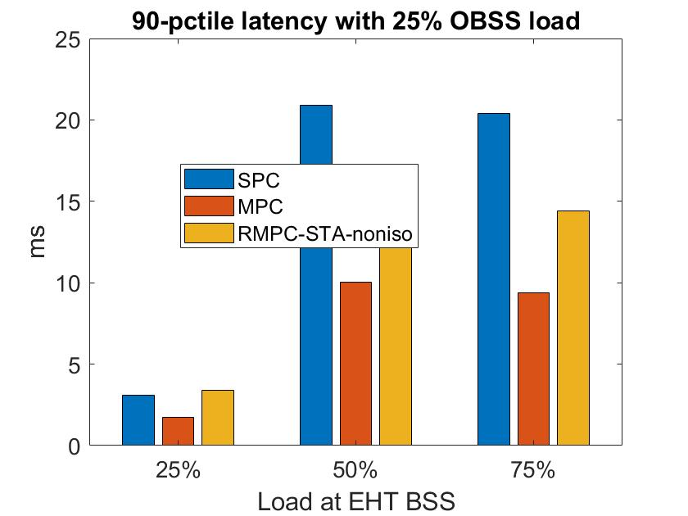
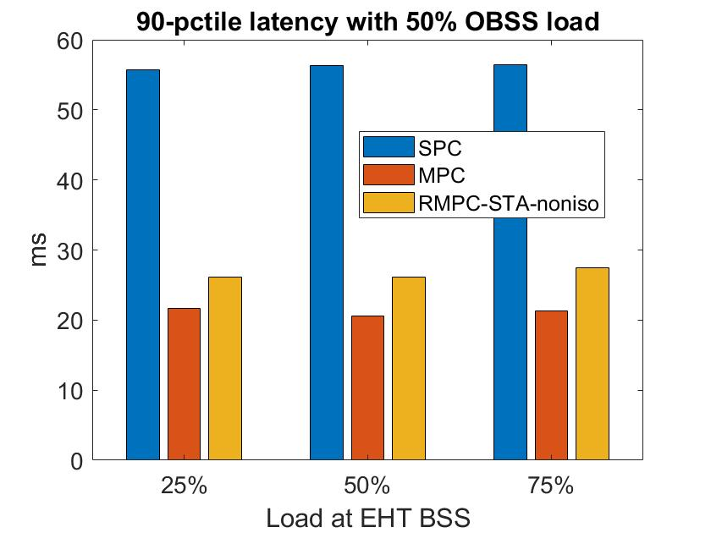
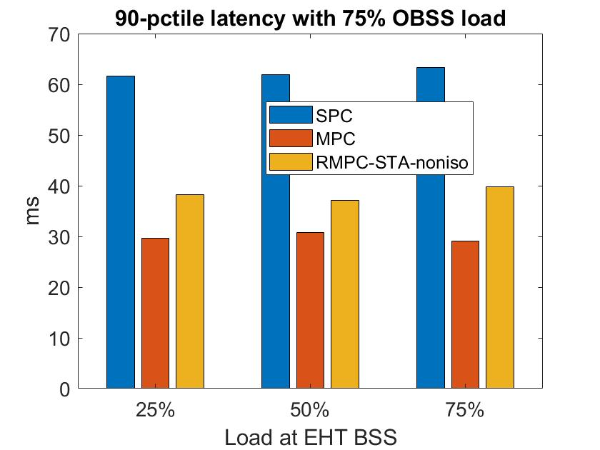
Light CBR UL traffic (Config 1b)
~38% reduction in latency from SPC to RMPC when the network is congested. Gap between MPC and RMPC therein is about 25%.

Slide 12
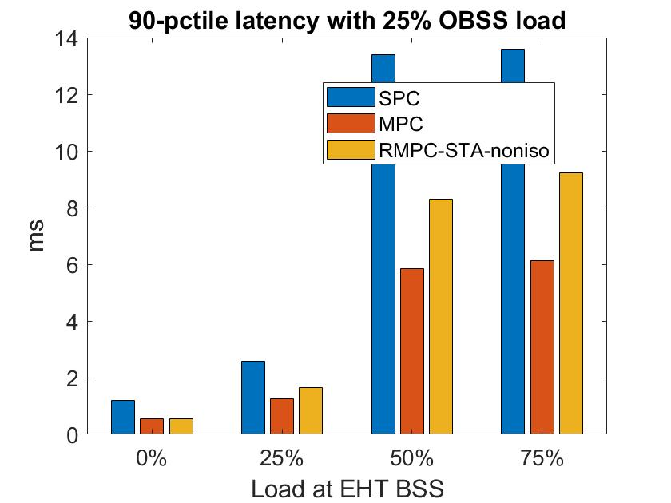
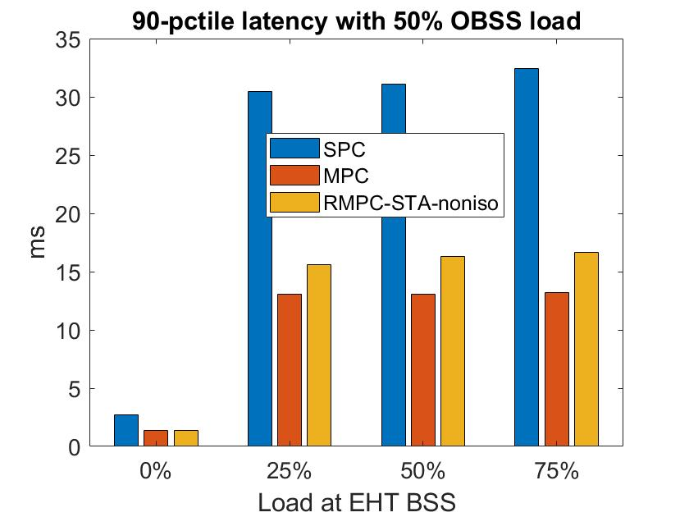
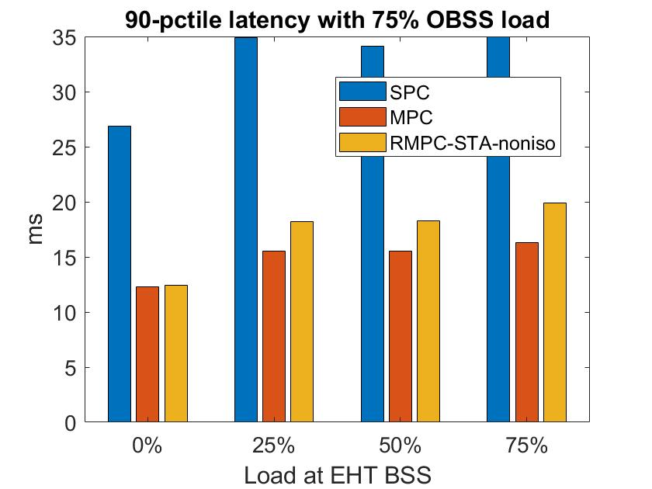
Heavy UL CBR traffic (Config 2)
~44% reduction in latency from SPC to RMPC when the network is congested. Gap between MPC and RMPC therein is ~16%.

Slide 13
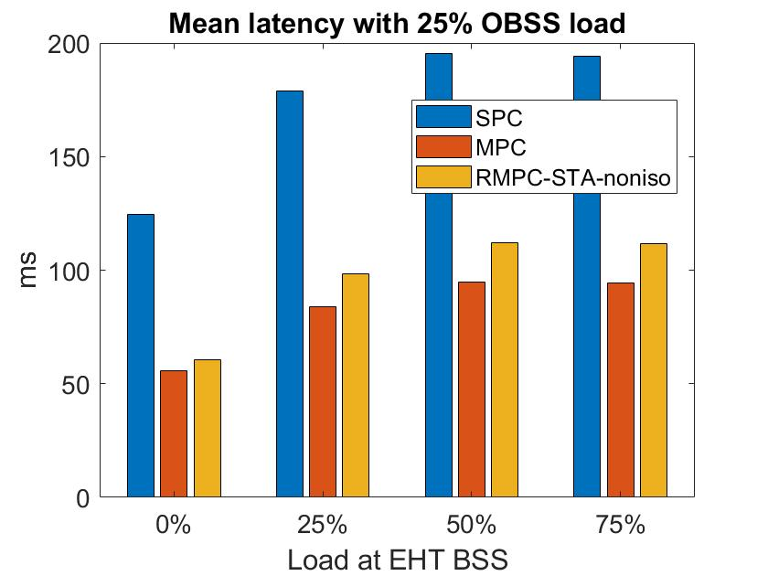
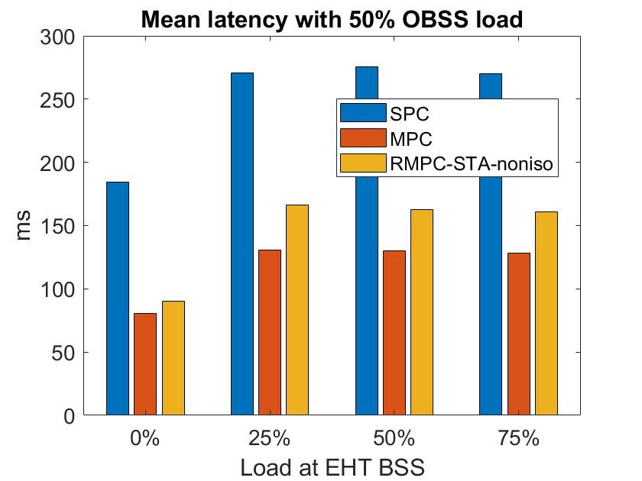
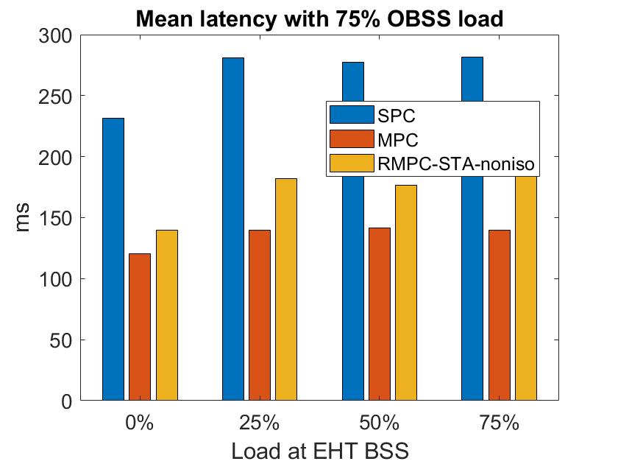
Heavy UL bursty traffic (Config 3)
~30% reduction in latency from SPC to RMPC when the network is congested. Gap between MPC and RMPC therein is ~28%.

Slide 14
Conclusion
For STAs without Tx/Rx constraints, MPC mode of operation performs very well
For STAs that have Tx/Rx constraints, both isolated and non isolated RMPC mode of operations preform much better than fully synchronized access
Average performance gain from multi-link operation over a single link operation
MPC mode of operation: DL case: 2.07x;
isolated RMPC mode of operation: DL case: 1.91x;
non-isolated RMPC: DL case: 1.6x* ;
SPC mode of operation: DL case: 1.27x;
* Note: performance gain varies a lot depending on a BSS load from 1.16 with 25% BSS load to 1.77 with 100% BSS load and OBSS loads of 10% to 40%
Even with Tx/Rx constraints, MLLE still can provide benefits in terms of reduced latency
Both for RTA-like traffic and heavy bursty traffic
30% and more improvement observed for congested networks
MLLE performance is better the sooner it can resolve RX activity on a busy link
Operational modes with constraints, including non-isolated cases, require additional study/simulations
A definition/clarification of channel access mechanism with constraints is desirable
A better definition for constraints is required

Slide 15
Appendix
[1] Performance aspects of Multi-link operations, 11-19-1291/02

Slide 16
Single link vs Multi-link. DL case

Slide 17
Classification: Completely synchronous (S)ingle (P)rimary (C)hannel, SPC
TXOP
TXOP
TXOP
AP1
band 1
3
2
1
0
2
1
0
3
2
1
0
busy
busy
TXOP
busy
AP2
band 2
Perform contention on primary channel
Do energy detect for PIFS on a secondary channel
If IDLE – transmit over two channels
If BUSY – transmit on primary only

Slide 18
Classification: Completely asynchronous, (M)ultiple (P)rimary (C)hannels, MPC
TXOP
busy
TXOP
AP1
band 1
3
2
1
0
9
8
7
6
5
4
3
2
1
0
busy
TXOP
TXOP
TXOP
AP2
band 2
2
1
0
3
2
1
0
4
3
2
1
0
Perform contention independently on both links
Transmit/receive independently on both links

Slide 19
Classification: Semi-asynchronous (J)oin (M)ultiple (P)rimary (C)hannels, JMPC
band 1
TXOP
TXOP
TXOP
TXOP
AP1
3
2
1
0
9
8
7
6
5
4
3
2
1
0
band 2
busy
TXOP
TXOP
busy
AP2
2
1
0
4
3
2
1
0
7
6
Perform contention independently on each link
If one channel/link won contention - verify status of a another channel/link
If another link is in IDLE/Contention state – transmit jointly
Otherwise transmit using on available link only

Slide 20
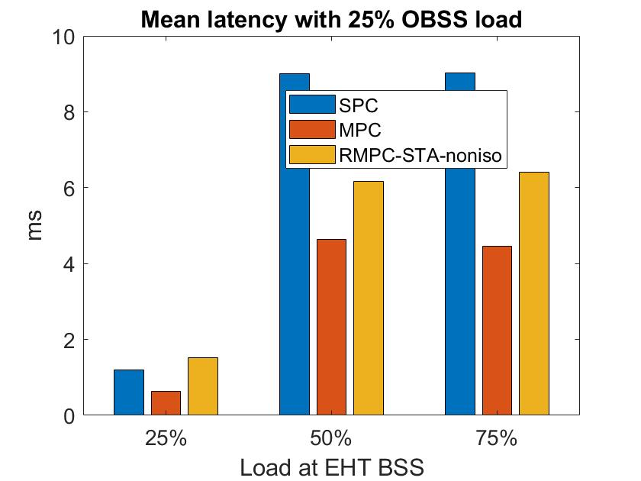
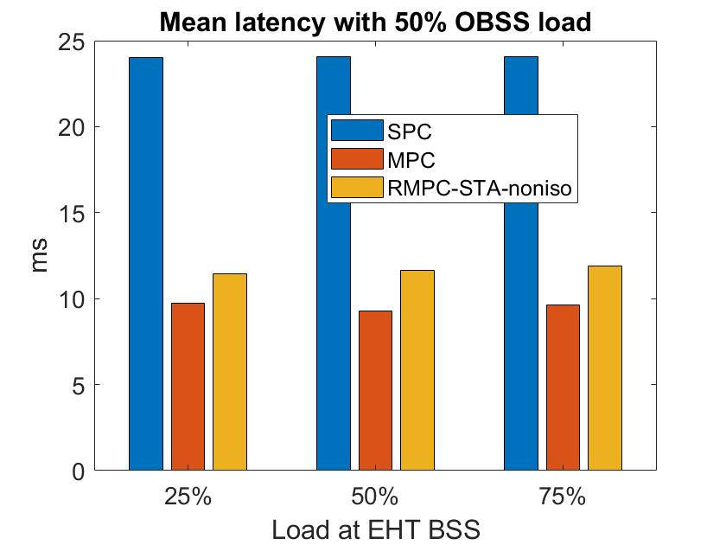
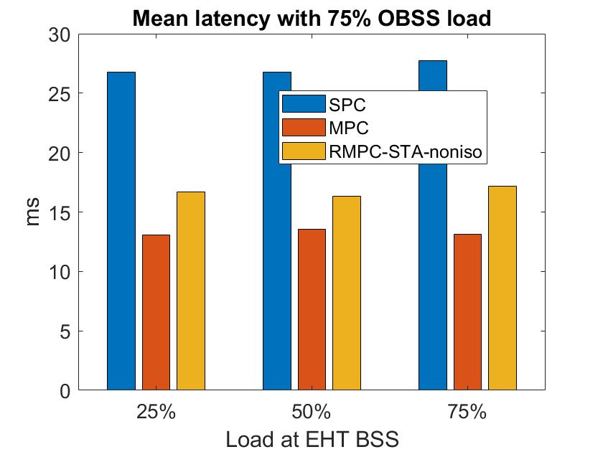
Mean Latency (Config 1b)

Slide 21
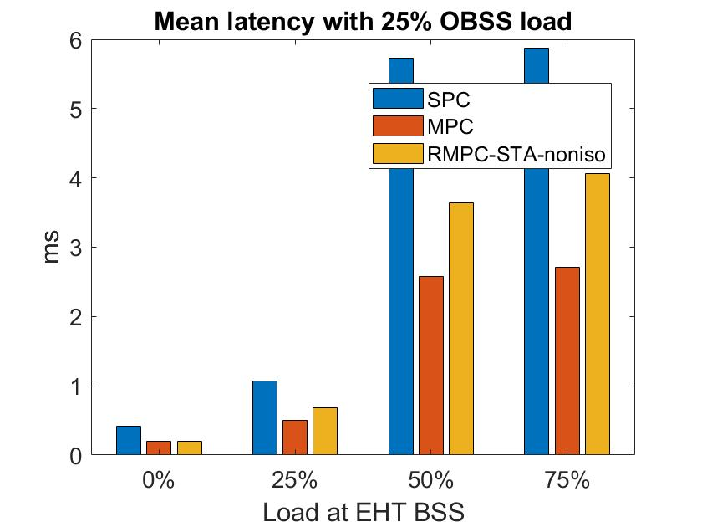
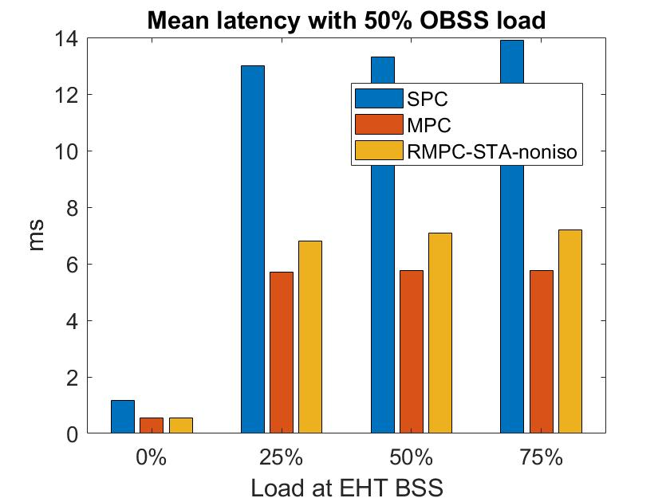
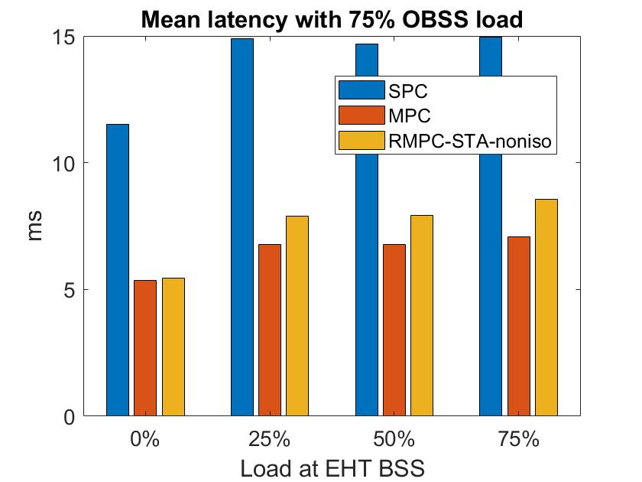
Mean Latency (Config 2)

