Slide 1
Discussion on Multi-link Setup
Date: 2019-09-16
Authors:
Name | Affiliation | Address | Phone | Email
Insun Jang | LG Electronics | 19, Yangjae-daero 11gil, Seocho-gu, Seoul 137-130, Korea |  | insun.jang@lge.com
Jinsoo Choi |  |  |  | js.choi@lge.com
Jeongki Kim |  |  |  | jeongki.kim@lge.com
Suhwook Kim |  |  |  | suhwook.kim@lge.com
Sungjin Park |  |  |  | allean.park@lge.com
Taewon Song |  |  |  | taewon.song@lge.com

Slide 2
Introduction
Multi-link capable devices need to negotiate multi-link capability during a multi-link setup
Multi-link setup would include scanning, authentication, and association
In this contribution, we discuss the multi-link setup for negotiating multi-link capability between multi-link capable devices
We call an AP with multi-link capability a multi-link (ML) AP logical entity* [1]
We call a non-AP with multi-link capability a multi-link (ML) non-AP logical entity* [1]
*Exact names of terms can be changed

Slide 3
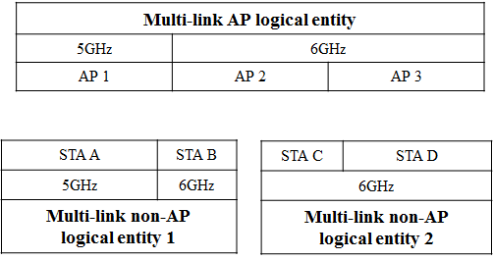
Multi-link Capability and Setup
An ML AP logical entity and ML non-AP logical entities can have different information of ML capabilities
ML capability means capabilities regarding multi-link (e.g., supported band/bandwidth per link, async/sync. operation)
Therefore, we need to discuss how and what ML capabilities information the ML AP logical entity and the ML non-AP logical entities should be negotiated during the ML setup

Slide 4
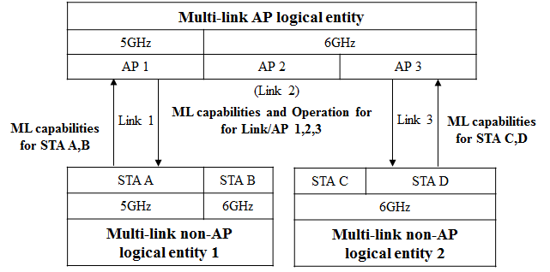
Multi-link Setup Procedure
ML AP logical entity and ML non-AP logical entities would negotiate multi-link capability through one or more links
Basically, the ML AP logical entity doesn’t know scanning channels of all non-APs of ML non-AP logical entities to be associated if the channels aren’t pre-determined in 11be
Therefore, it would be of ML capabilities and operationbetter for the ML AP and non-AP logical entities to include the information for the links supported by all APs and ML capabilities information for all STAs, respectively in each link to enable multi-link setup through one association [2]
ML AP logical entity would announce
its information of ML capabilities and Operation (e.g., BSS channel information)
ML non-AP logical entity would announce
its information of ML capabilities

Slide 5
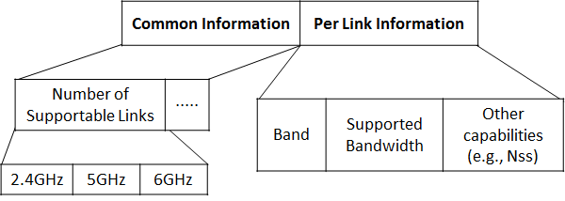
ML Capabilities
ML Capabilities would be included in management frames during/after multi-link setup
For example, Probe Request/Response, Beacon, Association Request/Response, …
Example: Link-specific capabilities in ML Capabilities can have Common and Per link information
Common information can include number of supportable links per band, etc.
Per link information can include band, supported bandwidth, other capabilities, etc.
Other capabilities (e,g., sync. operation) can be included in ML capabilities
Details of Information can be changed and capabilities to be indicated may be different between APs and STAs

Slide 6
Operation Information
Generally, Operation element includes operation information such as BSS channel information
HT Operation element in 2.4GHz
HT/VHT/HE Operation element in 5GHz
HE Operation element in 6GHz
ML AP logical entity would include EHT Operation element in Beacon or (Re)Association response to announce operation information of each link
It would be good not to modify (already existing) HT/VHT/HE operation element for legacy non-APs
We can have two options to indicate them, as follows
Option 1: New composition for all links
Option 2: Modifying and adding existing operation elements for each band

Slide 7
Part of EHT Operation Element
Option 1: New composition
It can be similar to 6GHz operation information in HE operation element
Primary channel, Channel Width, CCFS,…
Additional information can be included (e.g., Link ID, beacon interval, …)
Option 2: Modifying and adding existing operation elements
Using HT OE in 2.4GHz, HT/VHT OE combination in 5GHz, HE OE in 6GHz
Some information for multi-link needs to be added, which may make it complex

Slide 8
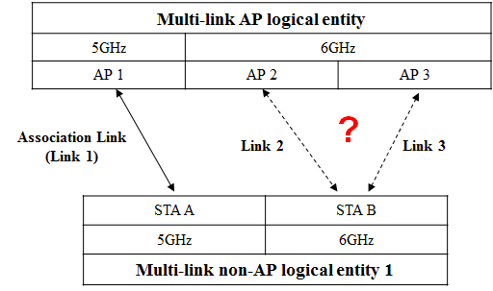
Discussion on Link Selection
Legacy Wi-Fi system uses a single link, i.e., non-APs can use the link based on the single link operation information from AP without any selection
However, 11be supports multi-link, which would require the link selection due to different ML capabilities

Slide 9
Link Selection for Multi-link non-AP logical entity
Based on ML non-AP logical entity’s ML capabilities information, ML AP logical entity can select links which non-APs of ML non-AP logical entity can enable
It would be included in Association Response
ML non-AP logical entity may inform (or request) preferred links of ML AP logical entity in Association Request
After that, ML AP logical entity may just confirm the links requested
How to select links may be out of scope of 11be
For notification, ML AP logical entity may use EHT operation element or new element
Option 1: Transmitted EHT operation element includes operation information of selected link only
Option 2: Transmitted EHT operation element includes additional several information (e.g., link availability, AID)
Option 3: New element can be used

Slide 10
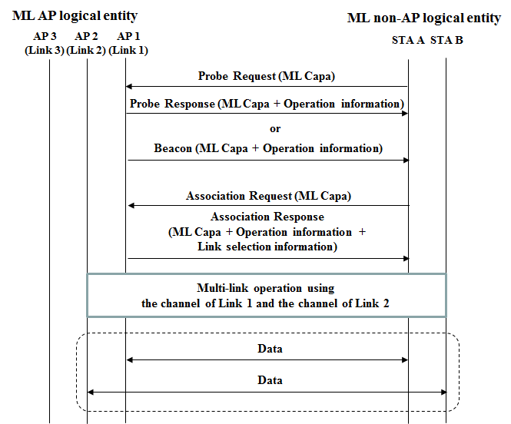
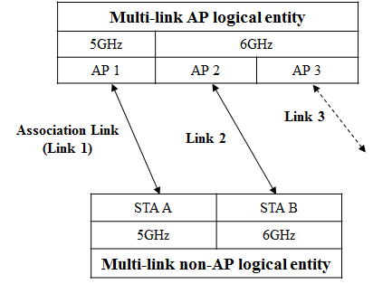
Example of Multi-link Setup Procedure

Slide 11
Summary
We have discussed the multi-link setup for negotiating multi-link capability between Multi-link capable devices
Specifically, how and what ML capabilities information the ML AP logical entity and the ML non-AP logical entities, and link selection for the multi-link operation was discussed

Slide 12
Motion
Move to add the following to the 802.11be SFD:
Support a mechanism for multi-link operation
An AP affiliated with an AP multi-link device can indicate the capabilities and operational parameters for one or more APs of the AP multi-link device
A non-AP STA affiliated with a non-AP multi-link device can indicate the capabilities for one or more non-AP STAs of the non-AP multi-link device
Specific information of capabilities and operational parameters of multi-link device is TBD
Mover: Insun Jang
Second:
Y/N/A:

Slide 13
References
[1] 802.11-19/0773r2 Multi-link Operation Framework
[2] 802.11-19/0821r2 Multiple Band Operation Discussion

