Slide 1
Wi-Fi sensing – Follow up
Date: 2019-09-15
Authors:
Name | Affiliation | Address | Phone | Email
Tony Xiao Han | Huawei Technologies Co., Ltd. | F1, Huawei Base, Shenzhen, China |  | Tony.hanxiao@huawei.com
Rui Du
Baojian Zhou
Xiaohui Peng
Zhichao Rong
Ping Zhang
Jiajin Luo
Chenchen Liu
Meihong Zhang
Dengpeng Shang
Jianhui Li
David Xun Yang
Xin Zuo | Tencent | Tencent Building, Kejizhongyi Avenue, Hi-tech Park, Nanshan District, Shenzhen |  | xinzuo@tencent.com
Kate Meng
Glenn Xin Hu
Xiandong Dong | Xiaomi |  |  | dongxiandong@xiaomi.com

Slide 2
Outline
1. Introduction
2. Some measurement and evaluation results
  2.1 Measurement configurations
  2.2 Evaluation platforms
  2.3 Evaluation procedure
  2.4 Machine learning (Convolutional neural network)
  2.5 Measurement results
  2.6 Classification and evaluation results
3. Potential technology and standard impact
  3.1 Existing training sequence based solution
  3.2 New signal/waveform/sequence design
  3.3 Radar based scheme
  3.4 Security and privacy
  3.5 Angular measurement based solution
4. Summary
5. References

Slide 3
1. Introduction
In the last IEEE 802.11 meeting in Vienna, we proposed the initial contribution about Wi-Fi sensing [1], and another aligned contribution was also presented [2]. These two contributions discussed the following topics:
  Definition, Advantage, Use case, Current status of Wi-Fi sensing, Technical feasibility
  Technology and standardization gaps for Wi-Fi sensing
It seems that our initial contribution has really drawn some attention of the group of IEEE 802.11, so more follow up contributions will be discussed this time in Hanoi.
In this contribution, the following points will be further discussed:
  Some measurement and evaluation results, in order to assess the technical feasibility of Wi-Fi sensing
  Potential technology and standard impact

Slide 4
Outline
1. Introduction
2. Some measurement and evaluation results
  2.1 Measurement configurations
  2.2 Evaluation platforms
  2.3 Evaluation procedure
  2.4 Machine learning (Convolutional neural network)
  2.5 Measurement results
  2.6 Classification and evaluation results
3. Potential technology and standard impact
  3.1 Existing training sequence based solution
  3.2 New signal/waveform/sequence design
  3.3 Radar based scheme
  3.4 Security and privacy
  3.5 Angular measurement based solution
4. Summary
5. References

Slide 5

2.1 Measurement configurations
In order to assess the technical feasibility of Wi-Fi sensing, we have performed some measurement and evaluation
Measurement Configurations:
  Location: F3-5-A19R @ Huawei, Shenzhen Campus
  Measurement area: 3m×4.5m
  Two measurement platforms (platform details could be found in the next slide):
    CSI-based platform: 1 Wi-Fi transmitter (with 1 Tx antenna) placed in position D (as shown in the figure, with height 0.5m), and 3 Wi-Fi receiver (each with 1 Rx antenna) placed in position A, B, C, respectively (as shown in the figure, with height 0.5, 0.5, 2.5m, respectively). The working frequency is 5.35 GHz, and the bandwidth is 20MHz.
    CW Radar-based platform: 3 mono-static CW Radar nodes, each node with 1 Tx antenna and 1 Rx antenna, placed in position A, B, C, respectively (as shown in the figure, with height 0.5, 0.5, 2.5m, respectively). The working frequency of each node is 5.1, 5.3, 5.4GHz, respectively.
  Antenna pattern: Omnidirectional
  Antennas polarization: V-V
  EIRP: 15dBm
C
D
A
B
Measurement Area
z
C
B
y
A
Measurement Area
D
x
Wi-Fi Tx
Notes:
Radar sample rate: 1kHz;
CSI sample rate: 330Hz

Slide 6
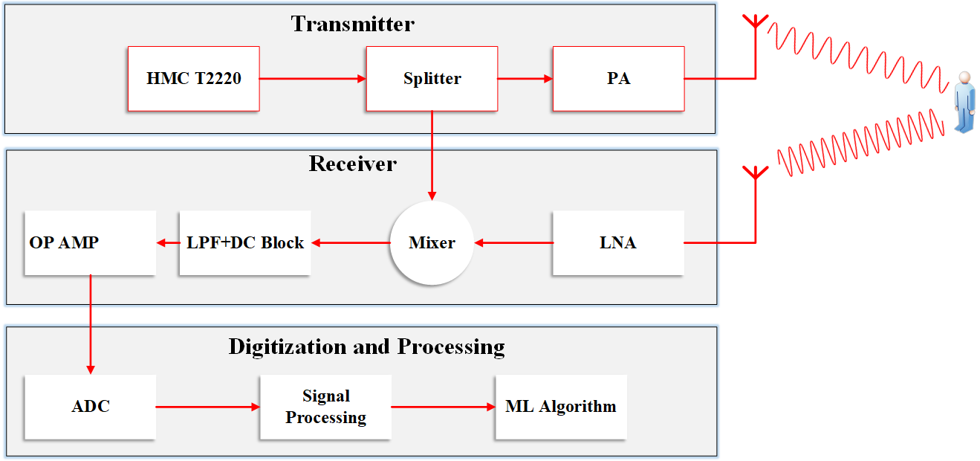
2.2 Evaluation platforms
CSI-based platform
  The CSI-based platform is based on WLAN Toolbox in MATLAB and Zynq SDR.
  IEEE 802.11ax WLAN waveforms are generated by the WLAN Toolbox, and passed to the Zynq SDR (Tx node D) for transmission via hardware support package.
  Three Zynq SDR (Rx node A, B, C) receive the RF signal reflected from the target, and forward it to WLAN Toolbox for CSI analysis.
  Signal processing and ML algorithms are performed afterwards.
  Three Rx nodes receive simultaneously.
CW Radar-based platform
  A CW radar signal is generated by the HMC T2220 Signal Generator, and then passed to the splitter to create two copies, one for transmission and the other one for receiving as the LO input of mixer.
  The receiver receives RF signal reflected from the target, and transforms the RF signals to baseband with a mixer. The baseband signal is passed through LPF, and then sampled by an ADC.
  Signal processing and ML algorithms are performed afterwards.
  Three radar-based nodes operate simultaneously.
Node D
Node A
Node B
Node C

Slide 7
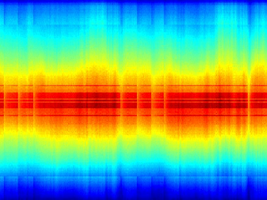
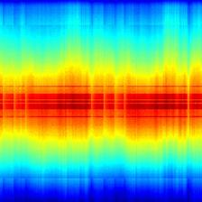


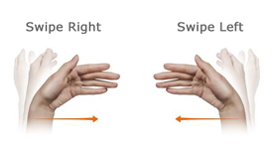
2.3 Evaluation procedure (CSI-based platform)
Radar signals
Normalized
CSI signals
Time-frequency transformation
Procedure to get the normalized CSI
  Choose available data subcarriers.
  Find Max and Min, minus each CSI amplitude by Min, and divide each CSI amplitude by (Max-Min).
  Map each CSI amplitude linearly to color bar.
Crop
(2s sample)
Resize
(224*224)
ML (CNN)
(Details in slide 9)
Action
classification probabilities
Static
1. Static
2. Clap
3. Push
4. Sweep left
5. Sweep right

Slide 8
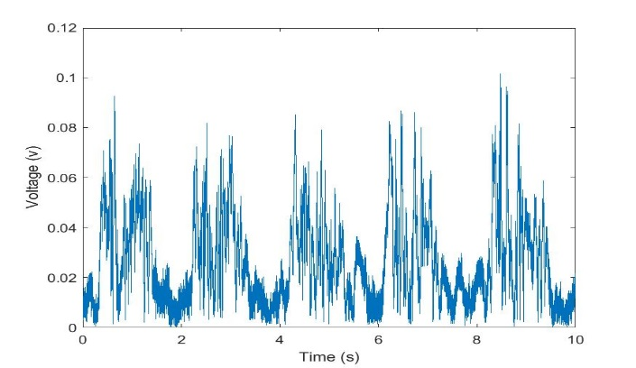
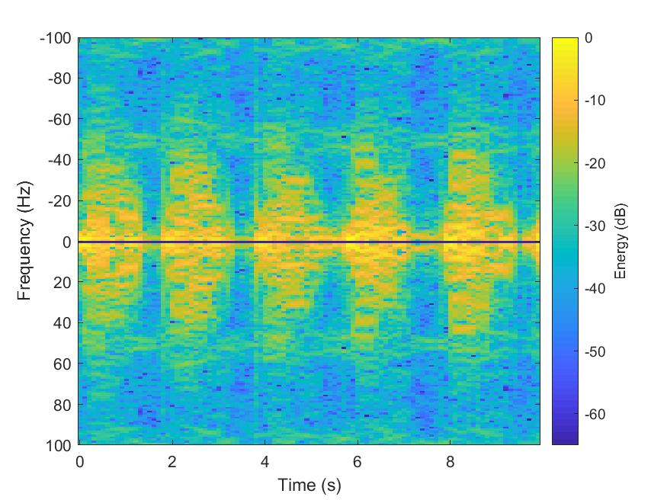
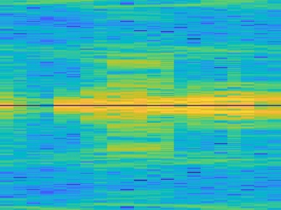
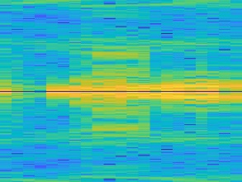
2.3 Evaluation procedure (CW radar-based platform)
Radar signals
Normalized
CSI signals
Time-frequency transformation
Crop
(2s sample)
Resize
(224*224)
ML (CNN)
(Details in slide 9)
Action
classification probabilities
Static
1. Static
2. Clap
3. Push
4. Sweep left
5. Sweep right

Slide 9
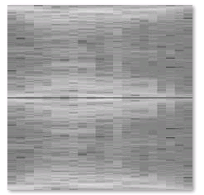
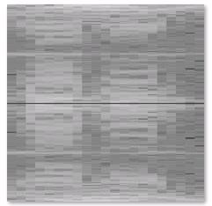

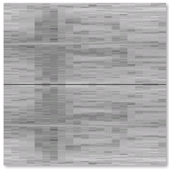
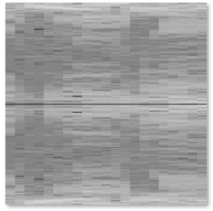
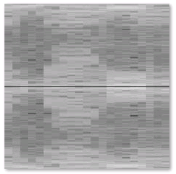
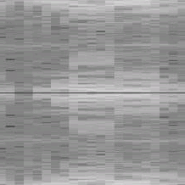
2.4 Machine learning (Convolutional neural network)
Classify different actions by deep convolutional neural network, with the procedure shown below
Load pretrained model
Replace final layers
Early layers
(level features)
Last layers
(specific features)
New layers
…
…
Fewer classes learn faster
Train network
Predict and assess
network accuracy
Classification results
Training images
Training options
Validation images
Static
Clap
…
Push
SweepL
Trained network
SweepR
20k images, 5 classes
Improve network

Slide 10
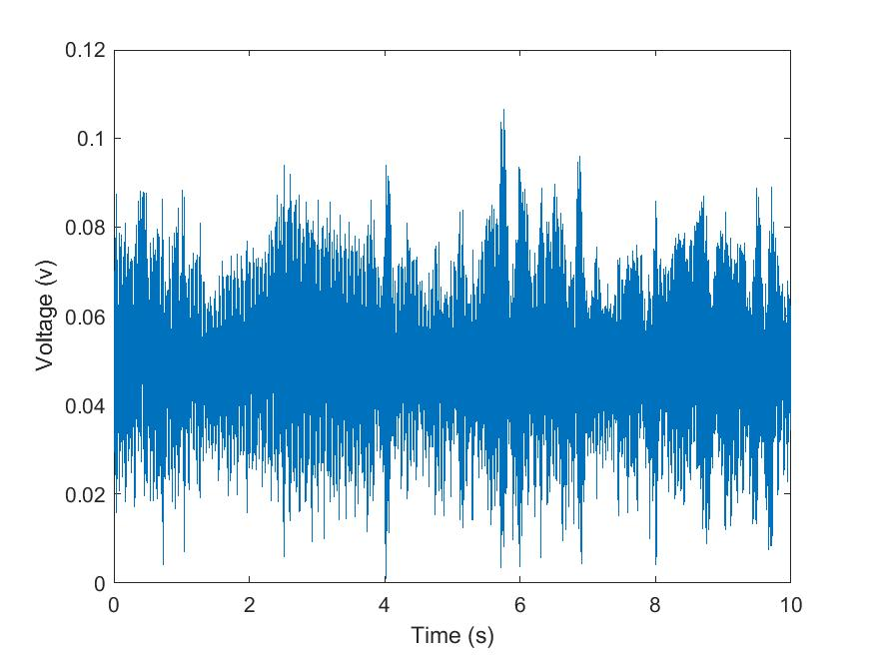
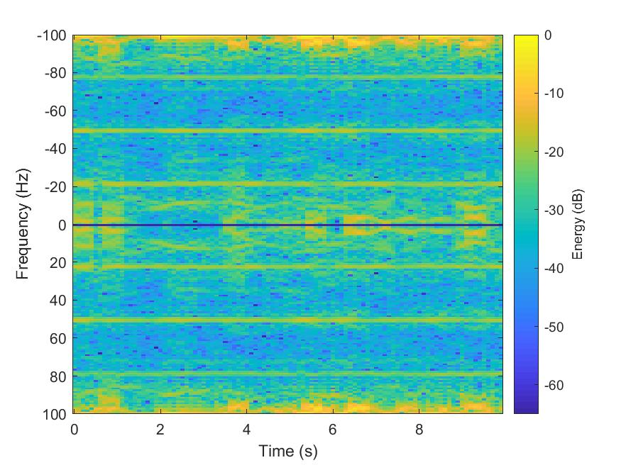
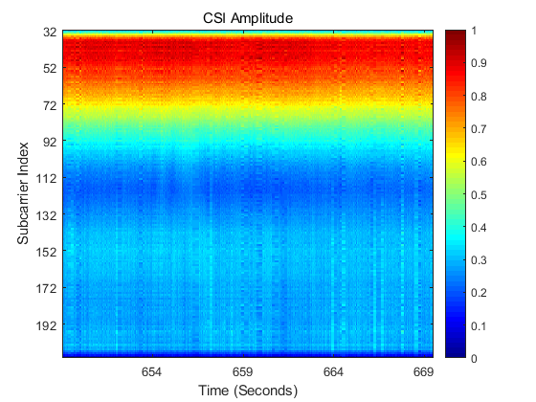
2.5 Measurement results (Static) (1/5)
Static
Static
No special pattern
CW radar-based platform
CSI-based platform

Slide 11


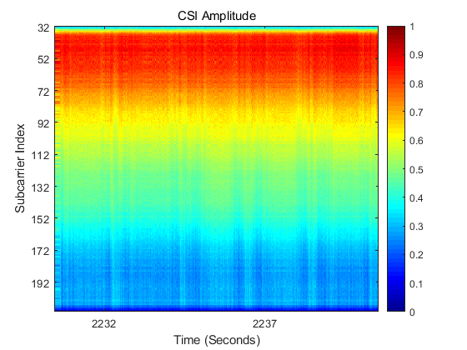
2.5 Measurement results (Clap) (2/5)
2. Clap
CW radar-based platform
CSI-based platform

Slide 12

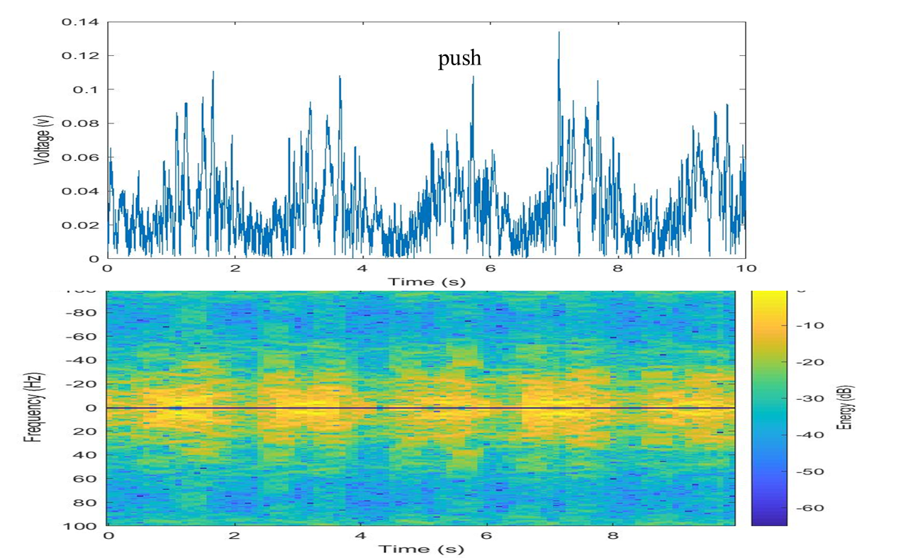

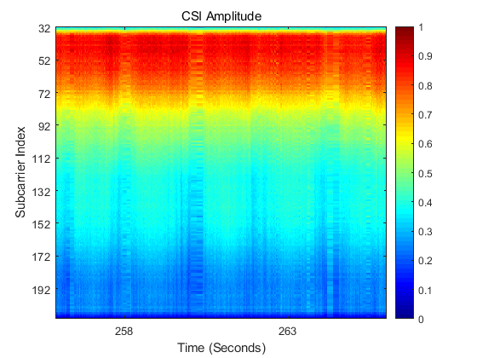
2.5 Measurement results (Push) (3/5)
3. Push
CW radar-based platform
CSI-based platform

Slide 13
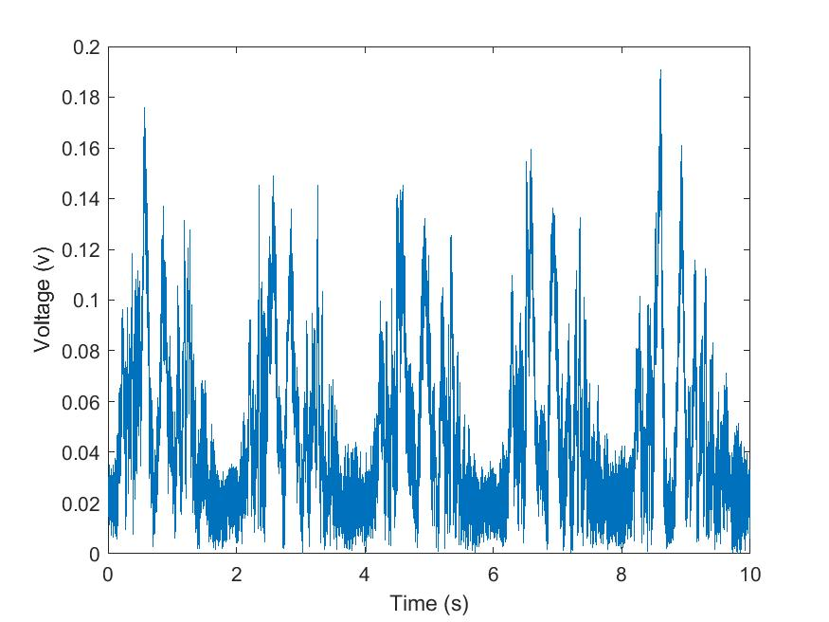
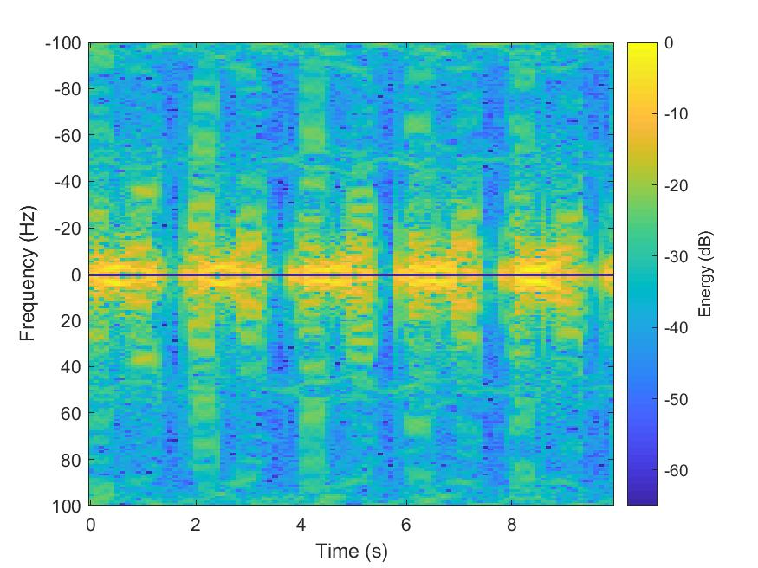
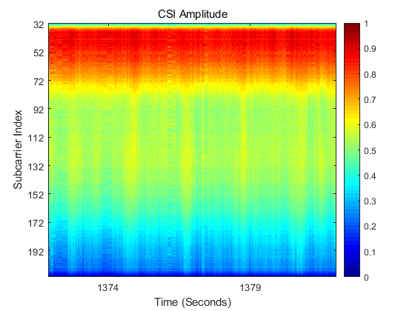
2.5 Measurement results (Sweep left) (4/5)
4. Sweep left
CW radar-based platform
CSI-based platform

Slide 14
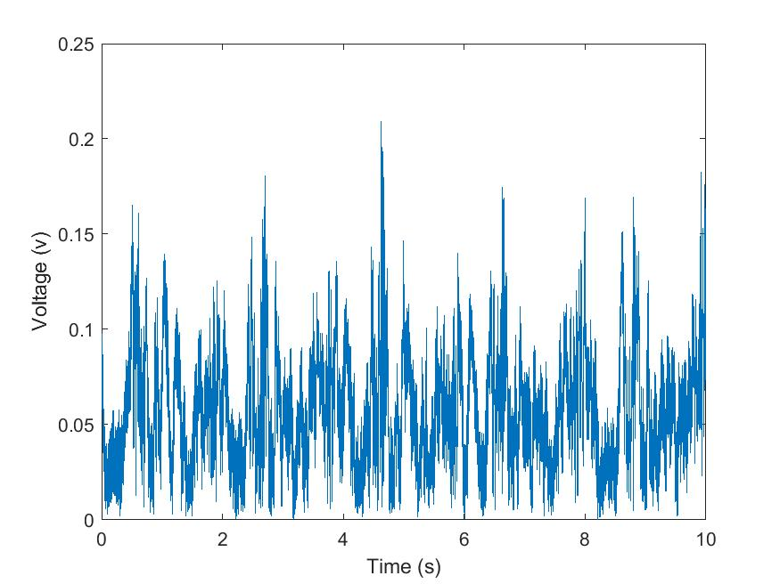
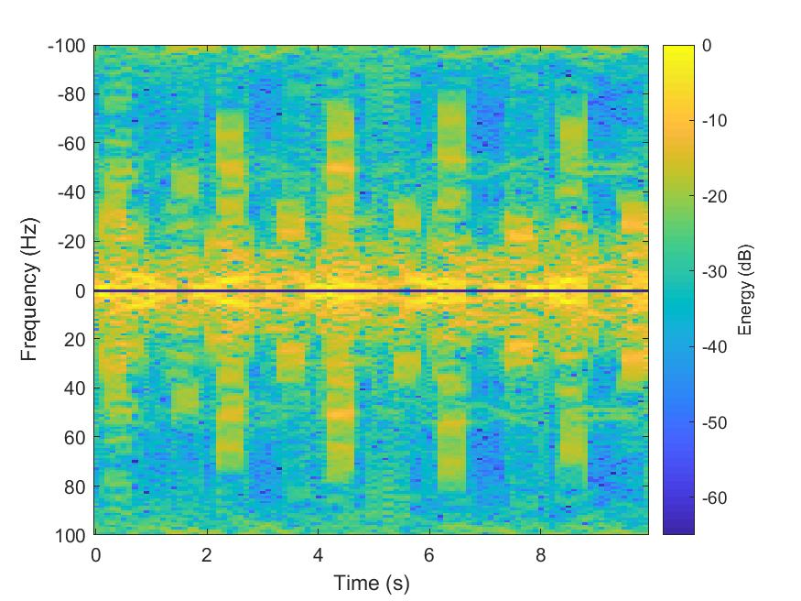
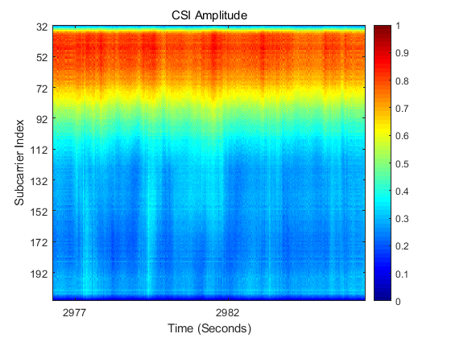
2.5 Measurement results (Sweep right) (5/5)
5. Sweep right
CW radar-based platform
CSI-based platform

Slide 15
2.6 Classification and evaluation results
Cooperation of three nodes
Performance is better
Based on the classification results above (more details could be found in Appendix II, III), some conclusions could be summarized :
  Action/gesture could be classified/recognized by both CSI and CW radar based schemes. Hence, CSI and radar based schemes should be important technical directions for Wi-Fi sensing.
  The performance of cooperation of three nodes is better than the performance of a single node. Hence, the negotiation and cooperation of multiple STAs should be considered.

Slide 16
Outline
1. Introduction
2. Some measurement and evaluation results
  2.1 Measurement configurations
  2.2 Evaluation platforms
  2.3 Evaluation procedure
  2.4 Machine learning (Convolutional neural network)
  2.5 Measurement results
  2.6 Classification and evaluation results
3. Potential technology and standard impact
  3.1 Existing training sequence based solution
  3.2 New signal/waveform/sequence design
  3.3 Radar based scheme
  3.4 Security and privacy
  3.5 Angular measurement based solution
4. Summary
5. References

Slide 17
3. Potential technology and standard impact
Based on, but not limited to, the measurement and evaluation results, some further summary for Wi-Fi sensing are listed below
Technical direction | Potential technologies | Potential standard impact
CSI based
Existing training sequence based solution
e.g., LTF/CEF/Pilot/Midamble
New signal / waveform / sequence design
Mechanism for low-overhead channel response measurement
Radar based
New signal / waveform / sequence design
e.g., CW/FMCW， Time/frequency radar sequence design
Active radar based schemes
e.g., Mono-static/Bi-static/
Multi-static/MIMO Radar
Specific sensing frame definition
Sensing procedures/protocols design
Passive radar based schemes
Multiple STAs negotiation and cooperation
Other
Security and privacy based schemes
Angular measurement based solution

Slide 18
3.1 Existing training sequence based solution
The existing training sequence is predefined and is known both to transmitter and receiver. It could be used for coherent integration sensing, which leads to higher SNR and accuracy.
For the existing training sequence based solution, the following question may need to be further discussed:
  Which sequence (e.g., LTF, CEF, Pilot, Midamble, …) could be used for sensing?
  How these sequences could be used？
  How to feedback the sensing results?
  Other.

Slide 19
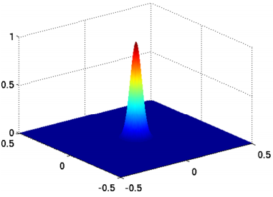
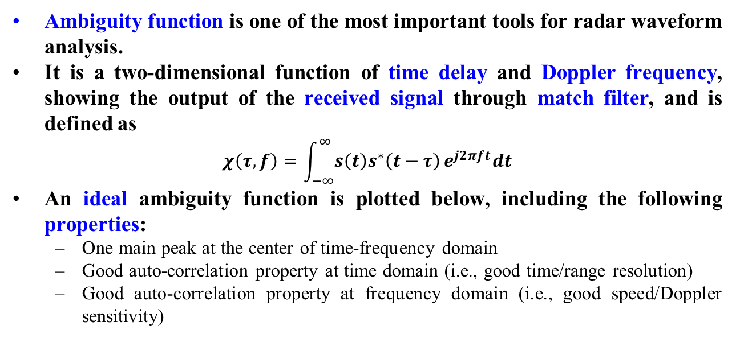
3.2 New signal/waveform/sequence design (1/2)
Ambiguity function is one of the most important tools for radar waveform analysis.
It is a two-dimensional function of time delay and Doppler frequency, showing the output of the received signal through match filter, and is defined as
$$χ\left(τ,f\right)=\int_{−∞}^{∞}{s\left(t\right)s^{∗}\left(t−τ\right)}e^{j2πft}dt$$
An ideal ambiguity function is plotted below, including the following properties:
  One main peak at the center of time-frequency domain
  Good auto-correlation property at time domain (i.e., good time/range resolution)
  Good auto-correlation property at frequency domain (i.e., good speed/Doppler sensitivity)
Time
Doppler

Slide 20
3.2 New signal/waveform/sequence Design (2/2)
However, ambiguity function of time domain sequence in 11ay (Length 512) has the following properties:
  Auto-correlation property at time domain is good (i.e., time/range resolution is good)
  Auto-correlation property at frequency domain is not good (i.e., speed/Doppler sensitivity is not good )
Because, the existing training sequence is designed for communication systems, and the property of sensing (e.g., time/range resolution, speed/Doppler sensitivity) has not been taken into consideration.
Hence, the ambiguity function of the existing training sequence may be not good enough for sensing, and new signal/waveform/sequence may be needed.

Slide 21
3.3 Radar based Scheme
Active radar (including mono-/bi-/multi-static mode)
  Definition: radar systems that detect and track target by processing reflections from cooperative sources, i.e., the signal is transmitted by the radar systems.
  May need the following standard support:
    The negotiation and cooperation of multiple mono-static radars (FDD/TDD/Feedback/…).
    The negotiation and cooperation of bi-/multi-static radars.
    Other.
Passive radar (including bi-/multi-static mode)
  Definition: radar systems that detect and track target by processing reflections from non-cooperative sources in the environment, i.e., the signal is not transmitted by the radar systems.
  May need the following standard support:
    The negotiation and cooperation of multiple passive radars (FDD/TDD/Feedback/…).
    Other

Slide 22
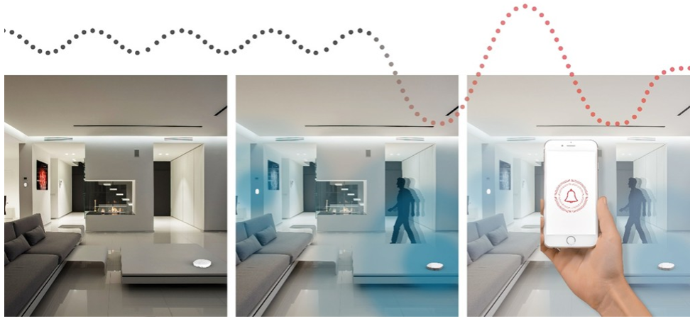
3.4 Security and privacy
Paradox between ‘Normal home sensing’ and ‘illegal monitoring’.
  Normal home sensing is a typical use case for Wi-Fi sensing, and may include through wall sensing.
  Illegal monitor may take advantage of through wall sensing to do illegal monitoring, which may lead to some issues of security and privacy.
The following question may need to be further studied
  When is the security and privacy need to be considered?
  How could the security and privacy to be guaranteed?
Normal home sensing (may include through wall sensing)
Illegal monitoring (may take advantage of through wall sensing)

Slide 23
3.5 Angular measurement based solution
The position of the target could be determined by, but not limited to, the following measurement options:
  Option 1
    The AoD (Angle of departure) of the signal sent from STA 1
    The AoA (Angle of arrival) of the received signal from STA 2
    The position of STA 1 and STA 2
  Option 2
    The time difference of arrival between LOS path and reflecting path
    The position of STA 1 and STA 2
    Either the AoA of the signal sent from STA 1, or AoD of the received signal from STA 2
Doppler frequency shift can provide additional information when tracking moving object.
The following topics may need to be further studied:
  The cooperation of multiple STAs to do sensing based on angular measurement (Procedure/Feedback/…).

Slide 24
4. Summary
  In this presentation, the following topics are discussed
  Some measurement and evaluation results
  Potential technology and standard impact
  To enable richer Wi-Fi applications and the growth of Wi-Fi ecosystem, maybe now is the right time for the group to take the next step for Wi-Fi sensing, and this could be done in a dedicated Topic Interest Group or Study Group.

Slide 25
5. References
    [1] 11-19-1164-00-0wng-wi-fi-sensing.pptx
    [2] 11-19-1293-00-0wng-wi-fi-sensing-usages-requirements-technical-feasibility-and-
    standards-gaps.pptx

Slide 26
Straw poll 1
  What is your preference for the proper venue for future work/presentations for “Wi-Fi sensing” technologies?
  Topic Interest Group (TIG)
  Study Group (SG)
  Continue the presentations in WNG before creating a TIG/SG
  Not interested in further work/presentations in 802.11
  No opinion

Slide 27
Straw poll 2
  Do you support the formation of a new 802.11 TIG (Topic Interest Group) for “Wi-Fi sensing”?
  Yes:
  No:
  Abstain:

Slide 28
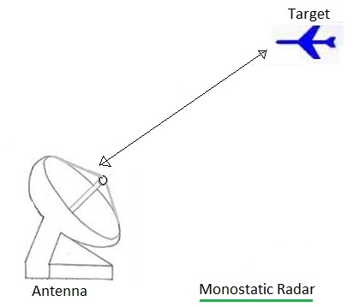
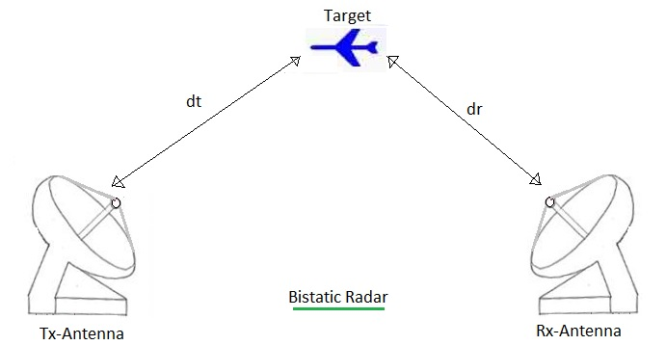
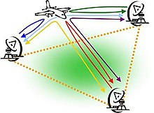
Appendix I: Different types of radar
    Monostatic radar is a type of radar in which the transmitter and receiver are collocated.
    Bistatic radar is the name given to a radar system comprising a transmitter and receiver that are separated by a distance comparable to the expected target distance.
    A system containing multiple spatially diverse Monostatic radar or Bistatic radar components with a shared area of coverage is called Multistatic radar.
Multistatic Radar
http://www.rfwireless-world.com/Terminology/Monostatic-radar-vs-Bistatic-radar.html
https://en.wikipedia.org/wiki/Multistatic_radar

Slide 29
Appendix II: Confusion matrix for CSI based scheme
 | Confusion matrix (CSI node A 2s)
Target Class | clap | 228 | 0 | 3 | 5 | 2 | 95.80%
 | push | 19 | 206 | 1 | 7 | 5 | 86.55%
 | static | 11 | 15 | 202 | 5 | 5 | 84.87%
 | sweepL | 16 | 12 | 2 | 200 | 8 | 84.03%
 | sweepR | 30 | 4 | 0 | 13 | 191 | 80.25%
 |  | 75.00% | 86.92% | 97.12% | 86.96% | 90.52% | 86.30%
 |  | clap | push | static | sweepL | sweepR
 |  | predict class
 | Confusion matrix (CSI node B 2s)
Target Class | clap | 221 | 5 | 0 | 4 | 8 | 92.86%
 | push | 24 | 199 | 4 | 4 | 7 | 83.61%
 | static | 7 | 5 | 214 | 8 | 4 | 89.92%
 | sweepL | 9 | 5 | 2 | 217 | 5 | 91.18%
 | sweepR | 21 | 8 | 0 | 15 | 194 | 81.51%
 |  | 78.37% | 89.64% | 97.27% | 87.50% | 88.99% | 87.82%
 |  | clap | push | static | sweepL | sweepR
 |  | predict class
 | Confusion matrix (CSI node C 2s)
Target Class | clap | 221 | 4 | 2 | 2 | 9 | 92.86%
 | push | 2 | 208 | 0 | 9 | 19 | 87.39%
 | static | 1 | 2 | 229 | 3 | 3 | 96.22%
 | sweepL | 1 | 0 | 3 | 218 | 16 | 91.60%
 | sweepR | 2 | 1 | 1 | 3 | 231 | 97.06%
 |  | 97.36% | 96.74% | 97.45% | 92.77% | 83.09% | 93.03%
 |  | clap | push | static | sweepL | sweepR
 |  | predict class
 | Confusion matrix (CSI all nodes 2s)
Target Class | clap | 237 | 1 | 0 | 0 | 0 | 99.58%
 | push | 5 | 226 | 1 | 5 | 1 | 94.96%
 | static | 1 | 3 | 233 | 1 | 0 | 97.90%
 | sweepL | 2 | 3 | 0 | 233 | 0 | 97.90%
 | sweepR | 4 | 3 | 0 | 0 | 231 | 97.06%
 |  | 95.18% | 95.76% | 99.57% | 97.49% | 99.57% | 97.48%
 |  | clap | push | static | sweepL | sweepR
 |  | predict class

Slide 30
Appendix III: Confusion matrix for CW radar-based scheme
 | Confusion matrix (Radar node A 2s)
Target Class | clap | 247 | 0 | 2 | 9 | 5 | 93.92%
 | push | 7 | 245 | 2 | 16 | 1 | 90.41%
 | static | 2 | 0 | 132 | 1 | 0 | 97.78%
 | sweepL | 22 | 4 | 0 | 223 | 5 | 87.80%
 | sweepR | 4 | 6 | 4 | 4 | 255 | 93.41%
 |  | 87.59% | 96.08% | 94.29% | 88.14% | 95.86% | 92.14%
 |  | clap | push | static | sweepL | sweepR
 |  | predict class
 | Confusion matrix (Radar node B 2s)
Target Class | clap | 234 | 11 | 2 | 13 | 3 | 88.97%
 | push | 11 | 249 | 1 | 8 | 2 | 91.88%
 | static | 3 | 1 | 129 | 2 | 0 | 95.56%
 | sweepL | 36 | 10 | 1 | 190 | 17 | 74.80%
 | sweepR | 7 | 7 | 2 | 7 | 250 | 91.58%
 |  | 80.41% | 89.57% | 95.56% | 86.36% | 91.91% | 87.96%
 |  | clap | push | static | sweepL | sweepR
 |  | predict class
 | Confusion matrix (Radar node C 2s)
Target Class | clap | 236 | 10 | 2 | 9 | 6 | 89.73%
 | push | 1 | 264 | 0 | 5 | 1 | 97.42%
 | static | 0 | 5 | 128 | 2 | 0 | 94.81%
 | sweepL | 5 | 5 | 1 | 241 | 2 | 94.88%
 | sweepR | 3 | 5 | 0 | 11 | 254 | 93.04%
 |  | 96.33% | 91.35% | 97.71% | 89.93% | 96.58% | 93.90%
 |  | clap | push | static | sweepL | sweepR
 |  | predict class
 | Confusion matrix (Radar all nodes 2s)
Target Class | clap | 252 | 0 | 1 | 5 | 5 | 95.82%
 | push | 1 | 263 | 0 | 4 | 3 | 97.05%
 | static | 0 | 1 | 131 | 3 | 0 | 97.04%
 | sweepL | 3 | 1 | 0 | 244 | 6 | 96.06%
 | sweepR | 0 | 0 | 0 | 1 | 272 | 99.63%
 |  | 98.44% | 99.25% | 99.24% | 94.94% | 95.10% | 97.16%
 |  | clap | push | static | sweepL | sweepR
 |  | predict class

