Slide 1
Further Discussion on Feedback Overhead Reduction
Date: 2019-09-09
Authors:

Slide 2
Introduction
In [1], we showed the benefit of supporting 16 streams
In [2], we showed that beamforming gain of overhead reduction scheme matches with subcarrier level compressed beamforming
In this contribution, we provide our thought further

Slide 3
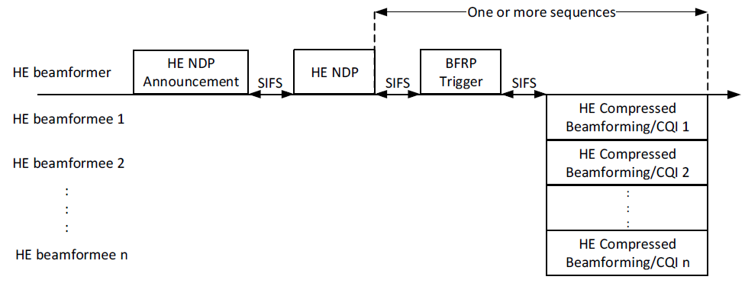
MU Feedback Overhead
We consider following HE MU feedback with 8 STAs
Following is feedback overhead computation
HE NDP Announcement: 21+4*NumUser(8)=53B, MCS0, Non-HT PPDU: 96us
HE NDP: 168us (2x HE-LTF)
BFRP Trigger: 28+6*NumUser(8)=76B, MCS0, Non-HT PPDU: 128us
SIFS: 3*16=48us
440us + TB PPDU (8 users with 106-tone RU) (HE Compressed Beamforming)
See next page for total feedback overhead

Slide 4
Total MU Feedback Overhead
 |  | Total | Nss2, MCS3 | Nss2, MCS4 | Nss2, MCS5 | Nss2, MCS6 | Nss2, MCS7 | Nss2, MCS8 | Nss2, MCS9 | Nss2, MCS10 | Nss2, MCS11
8x2, 80MHz, Ng=4, MU Fine, HE | Baseline | 6752B | 2640us | 1936us | 1584us | 1456us | 1360us | 1232us | 1152us | 1088us | 1024us
16x2, 80MHz, Ng=4, MU Fine, HE | Baseline | 14752B | 5152us | 3600us | 2832us | 2576us | 2368us | 2064us | 1904us | 1760us | 1632us
 | DR, K=8, 5MHz | 9696B | 3568us | 2544us | 2048us | 1872us | 1744us | 1536us | 1440us | 1328us | 1248us
 | DR, K=8, 10MHz | 8224B | 3104us | 2240us | 1808us | 1664us | 1552us | 1376us | 1296us | 1216us | 1136us
 | DR, K=4, 5MHz | 4480B | 1920us | 1456us | 1216us | 1152us | 1088us | 992us | 944us | 896us | 864us
 | DR, K=4, 10MHz | 3616B | 1648us | 1280us | 1088us | 1024us | 976us | 896us | 864us | 816us | 800us
 | 1% Required SNR |  | 4.2dB | 7.3dB | 11.3dB | 12.6dB | 14.0dB | 18.0dB | 19.8dB | 23.6dB | 26.0dB
1% Required SNR computed based on following assumptions: 2Tx STA, 16Rx AP, TGbe channel D [3], packet size 4000B, with all impairments and compensations.
See Appendix for detail dimension reduction (DR) scheme.

Slide 5
MU System Performance
Assume 10dB power difference in downlink and uplink
Best performance chosen from 5ms, 10ms, 20ms and 40ms feedback period for each scheme
In case of 16 antenna MU, feedback periodicity should be 5-10ms
Dimension reduction scheme shows 2-3dB better than conventional compressed beamforming scheme thanks to smaller overhead while maintaining beamforming gain
See appendix for more simulation result

Slide 6
SU Feedback Overhead
We consider following HE SU feedback
Following is feedback overhead computation
HE NDP Announcement: 21+4*NumUser(1)=25B, MCS0, Non-HT PPDU: 60us
HE NDP: 168us (2x HE-LTF)
SIFS: 2*16=32us
260us + HE SU PPDU (HE Compressed Beamforming)
See appendix for total feedback overhead

Slide 7
SU System Performance
Assume 10dB power difference in downlink and uplink
Best performance chosen from 5ms, 10ms, 15ms, 20ms, 40ms and 80ms feedback period for each scheme
In case of 16 antenna SU, feedback periodicity can be as large as 15-20ms
In this case, performance gain due to feedback overhead reduction is minimal
See appendix for more simulation result

Slide 8
Discussions
In case of SU, conventional compressed beamforming overhead is not affecting overall performance much
Feedback periodicity can be longer than MU-MIMO
Overhead itself is smaller than MU-MIMO feedback
In case of MU, we need an overhead reduction scheme
In 16x2 MU-MIMO case, overhead reduction scheme provides 2-3dB gain over conventional compressed beamforming feedback
We propose to have an overhead reduction scheme focusing on MU-MIMO feedback with number of stream (Nc) 1-4

Slide 9
Straw Poll #1
Do you support to have a SU compressed beamforming scheme in 11be?
Number of rows (antennas), Nr = 2 – 16
Number of columns (streams), Nc = 1 – 16
Develop simple extension/modification to 11ax compressed beamforming if necessary

Slide 10
Straw Poll #2
Do you support to have an overhead reduction scheme for explicit feedback in 11be?
Focusing on MU-MIMO feedback with number of columns/streams (Nc) 1-4 and number of rows/antennas (Nr) 9-16.
Other cases, TBD.

Slide 11
Reference
[1] 11-18/1575r0, “Further study on potential features”
[2] 11-19/1018r1, “Feedback Overhead Reduction”
[3] 11-19/0719r1, “TGbe channel model document”

Slide 12
Dimension Reduction Scheme
Wideband/sub band beamforming feedback combined with subcarrier beamforming feedback with reduced dimension
Wideband/sub band beamforming matrix could has dimension N_{TX} × K where N_{TX} is Number of transmit antennas and K is design parameter for dimension reduction. This is to project the space of channel H to its K dimensional principal subspace.
Subcarrier beamforming feedback will have reduced dimension N_{RX} × K
Feedback Wideband beamforming matrix $V_{WB}$ of N_{TX} × K
For each sub carrier/group of subcarriers,
feedback beamforming matrix $V_{sc}$ of N_{RX} × K

Slide 13
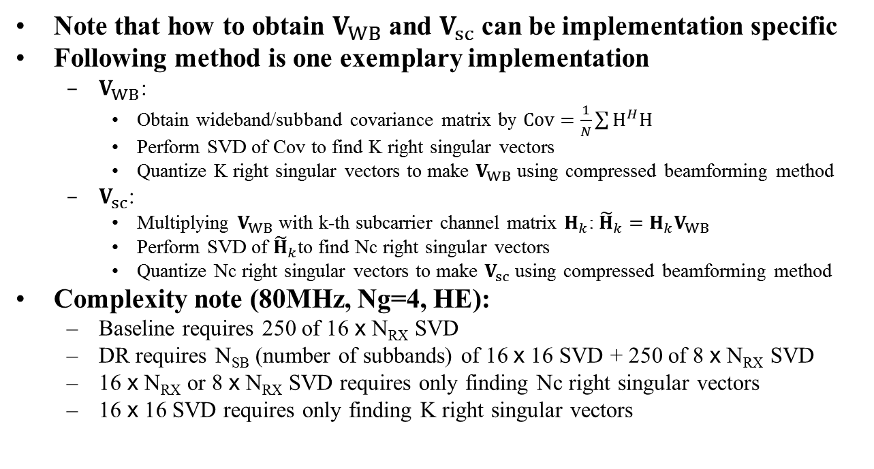
Example Implementation of DR
Note that how to obtain $V_{WB}$ and $V_{sc}$ can be implementation specific
Following method is one exemplary implementation
$V_{WB}$:
Obtain wideband/subband covariance matrix by $Cov=\frac{1}{N}\sum{H^{H}H}$
Perform SVD of Cov to find K right singular vectors
Quantize K right singular vectors to make $V_{WB}$ using compressed beamforming method
$V_{sc}$:
Multiplying $V_{WB}$ with k-th subcarrier channel matrix $H_{k}$: ${\tilde{H}}_{k}=H_{k}V_{WB}$
Perform SVD of ${\tilde{H}}_{k}$to find Nc right singular vectors
Quantize Nc right singular vectors to make $V_{sc}$ using compressed beamforming method
Complexity note (80MHz, Ng=4, HE):
Baseline requires 250 of 16 x N_{RX} SVD
DR requires N_{SB} (number of subbands) of 16 x 16 SVD + 250 of 8 x N_{RX} SVD
16 x N_{RX} or 8 x N_{RX} SVD requires only finding Nc right singular vectors
16 x 16 SVD requires only finding K right singular vectors

Slide 14
Detail MU Simulation Results

Slide 15
Total SU Feedback Overhead
 |  | Total | Nss2, MCS3 | Nss2, MCS4 | Nss2, MCS5 | Nss2, MCS6 | Nss2, MCS7 | Nss2, MCS8 | Nss2, MCS9 | Nss2, MCS10 | Nss2, MCS11
8x2, 80MHz, Ng=4, SU Fine, HE | Baseline | 4064B | 472us | 424us | 408us | 392us | 392us | 376us | 376us | 376us | 360us
16x2, 80MHz, Ng=4, SU Fine, HE | Baseline | 14502B | 808us | 648us | 568us | 552us | 520us | 488us | 472us | 456us | 456us
 | DR, K=8, 5MHz | 5904B | 536us | 472us | 440us | 424us | 408us | 408us | 392us | 392us | 376us
 | DR, K=8, 10MHz | 4984B | 504us | 440us | 424us | 408us | 408us | 392us | 392us | 376us | 376us
 | DR, K=4, 5MHz | 2644B | 424us | 392us | 376us | 376us | 376us | 360us | 360us | 360us | 360us
 | DR, K=4, 10MHz | 2104B | 408us | 376us | 376us | 360us | 360us | 360us | 360us | 360us | 360us
 | 1% Required SNR |  | 4.2dB | 7.3dB | 11.3dB | 12.6dB | 14.0dB | 18.0dB | 19.8dB | 23.6dB | 26.0dB
1% required SNR is from MU feedback result. Difference will be small.

Slide 16
Detail SU Simulation Results

