Slide 1
Coex Simulation and Analysis
Date: 2019-07-16
Authors:
Name | Affiliations | Address | Phone | Email
Chung-Ta Ku | Mediatek | 2840 Junction Ave San Jose, CA 95134 | +1-408-526-1899 | chung-ta.ku@mediatek.com
Paul Cheng | Mediatek |  |  | paul.cheng@mediatek.com
James Wang | Mediatek |  |  | james.wang@mediatek.com
Gabor Bajko | Mediatek
Yongho Seok | Mediatek
James Yee | Mediatek
Thomas Pare | Mediatek

Slide 2
Introduction
This contribution provides the system level simulation to evaluate 802.11 and ETSI LBE channel access engine and parameters which can impact fairness for medium occupancy

Slide 3
ETSI Channel Access Engine: Post-Backoff

Slide 4
Post-Backoff Procedure
ETSI post-backoff procedure allows an alternate faster channel access than IEEE in the case that (data is ready to transmission when) the medium is busy
Starting at q=1. Two devices attempting to transmit will collide
Starting with a New Backoff

Slide 5
Probability Analysis
Two devices competing in post-backoff:
one uses the faster method
one uses IEEE method
when the medium transitions from busy to idle, the probability of winning contention (see scenario from previous figure)
 | Priority Class 4 CW∈ <CWmin, CWmax> | Priority Class 3 CW∈ <CWmin, CWmax> | Priority Class 2 CW∈ <CWmin, CWmax> | Priority Class 1 CW∈ <CWmin, CWmax>
Probability of winning contention – Faster ETSI method | <41.2%,71.4%> | <71.4%,86.7%> | <86.7%,96.8%> | <86.7%,99.8%>
Probability of winning contention –IEEE/ETSI/ method | <41.2%,14.3%> | <14.3%,6.7%> | <6.7%,1.6%> | <6.7%,0.1%>
Collision | <17.6%,14.3%> | <14.3%,6.7%> | <6.7%,1.6%> | <6.7%,0.1%>

Slide 6
Impact of COT (TXOP)

Slide 7
Channel Access Parameters in IEEE and ETSI
For IEEE Access Point/STA and ETSI Supervising device/Supervised device
IEEE Access Category | AIFSN | CWmin | CWmax | TXOP Limit
Voice (VO) | 1/2 | 3/3 | 7/7 | 2.080ms
Video (VI) | 1/2 | 7/7 | 15/15 | 4.096ms
Best effort (BE) | 3/3 | 15/15 | 63/1023 | 2.528ms
Background (BK) | 7/7 | 15/15 | 1023/1023 | 2.528ms
ETSI Priority class | P₀ | CWmin | CWmax | maxCOT
Class 4 | 1/2 | 3/3 | 7/7 | 2ms
Class 3 | 1/2 | 7/7 | 15/15 | 4ms
Class 2 | 3/3 | 15/15 | 63/1023 | 6ms
Class 1 | 7/7 | 15/15 | 1023/1023 | 6ms
Non-AP STA default EDCA parameters are from Table 9-155 of REVmd. ETSI parameters are from Table 7 and 8 of EN301893 v2.1.1

Slide 8
OMNeT++ Baseline Simulation Setup (IEEE vs IEEE)
Simulation Time: 10s
Full-buffer traffic loads
UDP Packet Size = 1472 Bytes
2 IEEE Links
Using 11ac, 20MHz, no SGI, Nss =1
MPDU Size = 1552 Bytes, fixed MCS 8
IEEE AC
Or 1 IEEE Link and 1 ETSI link
IEEE same as above
Using LTE, 20MHz , Nss =1
TBSize = 75376 Bytes, fixed MCS 28
LAA priority class
CCA-CS = -82 dBm
CCA-ED = -62 dBm
TX Power = 20 dBm
(0.5, 9.5)
(0.5 + X, 9.5)
AP or eNB
STA
Distance Y = 9m
AP
STA
(0.5, 0.5)
(0.5 + X, 0.5)
Distance X = 10m, 20m, 30m, …

Slide 9
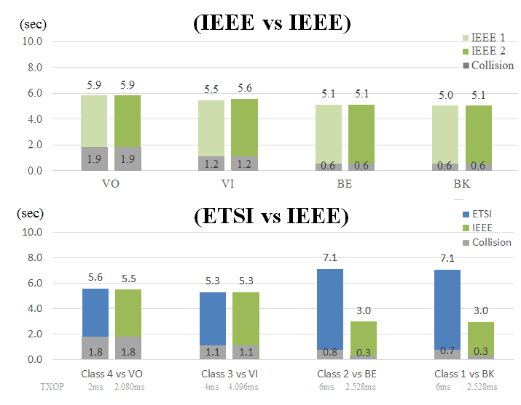
Airtime Utilization
Distance X = 10m
(sec)
Observation
ETSI Class 2 and 1 have airtime advantage mainly contributed by using larger TXOP

Slide 10
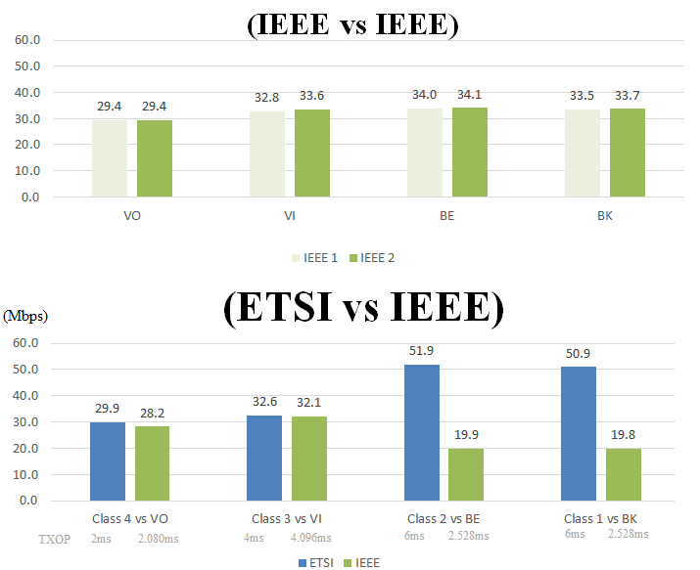
System TP (ETSI vs IEEE)
(Mbps)
Observation
ETSI Class 2 and 1 have higher System Throughput by using larger COT
Note the throughput shown is total data successfully transmitted/simulation time

Slide 11
Simulation Results Different Access Priority Classes

Slide 12
Simulation setup
Discrete Event Simulator (DES) developed to understand the time domain aspects of ETSI adaptivity.
Any combination of LBE (all classes) or FBE devices possible.
Exponential backoff, post backoff, extended COT through contention window doubling or 100us pause all implemented.
Accumulators record full and partial (due to collision) COT airtime dedicated to a device, used to record per device channel utilization and per device type channel utilization, and total collision time.
Reports probability of a device or device type gaining clear channel access.
Poisson traffic model is included
No PD or ED implemented, no assumptions on receiver.
All devices are assumed within range of all other devices with sufficient transmit power to cause significant interference.

Slide 13
Gain Channel Access between Priority Classes
#1 to #4
#1 to #2
#3 to #4
#2 to #3
Larger COT lengths only
partially collide, leaving
partial uncollided portions
for lower priority devices, depicted in darker shades.
CCA is the channel sensing time

Slide 14
Channel Utilization for each Priority Classes
All devices are of only one class, i.e. self-coexistence.
Low Channel Utilization due to collision

Slide 15
Channel Utilization between Priority Classes
Poisson distributed data packet average arrival times are in brackets, e.g. (20ms) implies 50 packets/sec. (0ms) are the full buffer cases from the previous slide. All Poisson traffic models converge on the full buffer case when heavily congested.
#1 to #2
#2 to #3
#3 to #4
Observation:
Relatively small sets of competing priority classes is catastrophic to the lower priority class.
There is no ETSI restrictions on what class to use for which traffic or traffic patterns.

Slide 16
Conclusions
System level simulation regarding 802.11 and ETSI is presented to evaluate fairness for medium occupancy
Multiple factors impacting coexistence fairness were investigated
ETSI Post back-off procedure allows faster channel access than IEEE and has high probability of transmission collision
For future proofing, suggest that ETSI rules should be modified.
Medium utilization is proportional to COT (TXOP limit) for the same priority class.
Proper setting of EDCA Parameters is needed.
Relatively small sets of competing priority classes is catastrophic to the lower priority class.
Coexistence is only possible today due to traffic patterns not fully occupying buffers.
There is no ETSI restrictions on what class to use for which traffic or traffic patterns.

Slide 17
Backup Charts
Chung-Ta Ku, Mediatek

Slide 18
Channel Utilization between Priority Classes
#1 to #2
#3 to #4
#2 to #3
Observation:
Relatively small sets of competing priority classes is catastrophic to the lower priority class.
There is no ETSI restrictions on what class to use for which traffic or traffic patterns.

