Slide 1
LBT should remain the basis of fair & efficient coexistence in 6 GHz unlicensed spectrum
1 July 2019
Authors:
Name | Company | Phone | email
Andrew Myles | Cisco | +61 418 656587 | amyles@cisco.com

Slide 2
IEEE 802.11 WG & 3GPP RAN need to work together on LBT based & new rules for 6 GHz coexistence
Executive summary
  After 20 years, Wi-Fi in unlicensed spectrum is a wildly successful $2T pa socio-economic phenomenon
  New cellular derived technologies threatened the future success of Wi-Fi & 5 GHz unlicensed spectrum
  The threat to Wi-Fi & 5 GHz unlicensed spectrum was mitigated (mostly) by the use of LBT by LAA/NR-U
  There is now a good case for working together on both LBT based & new rules to achieve 6 GHz coexistence
    ... but use the existing proven rules from the 5 GHz band in the 6 GHz band while building consensus on any “new way”

Slide 3
After 20 years, Wi-Fi in unlicensed spectrum is a wildly successful $2T pa socio-economic phenomenon
In the beginning …
In 1997 …
There was nothing …
…or at least there was no widely available or useful WLAN standard for operation in unlicensed spectrum
After seven years the first useful version of IEEE 802.11 was ratified …
…with no rest
in the seventh year ☺
In 1999 …
20 years later …
IEEE 802.11a (5 GHz) and IEEE 802.11b (2.4GHz) were ratified …
… and Wi-Fi was born (with the support of the Wi-Fi Alliance)
Wi-Fi has billions of users globally generating $2T pa economic value …
… representing a global socio-economic phenomenon

Slide 4

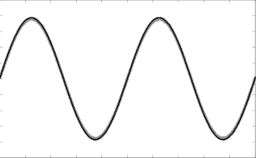



Wi-Fi’s success in unlicensed has been driven by it flexibly & cheaply addressing diverse user needs
IEEE 802.11
& Wi-Fi
+
Unlicensed
spectrum
Means …
Anyone
+
Anytime
+
Anyplace
Can build a WLAN that …
Meets a diversity of user needs
+
Is simple
& cheap
+
Is “good enough”, albeit not perfect

Slide 5
Wi-Fi’s success in unlicensed has been enabled by coordinated standards using LBT based access
Factor 1
Factor 2
Factor 3
Key success factor
Compatibility of between different Wi-Fi versions
Coexistence between Wi-Fi & other technologies
Fair coexistence of independent systems
Enabling method
Coordination by IEEE 802.11 WG & Wi-Fi Alliance
Avoidance of Wi-Fi by other systems, eg Bluetooth
Use of LBT, eg DCF/EDCA rather than PCF/HCCA
Wi-Fi was effectively the only “game in town” making 5 GHz coexistence much easier

Slide 6
New cellular derived technologies threatened the future success of Wi-Fi & 5 GHz unlicensed spectrum
Factor 1
Factor 2
Factor 3
Key success factor
Compatibility of between different Wi-Fi versions
Coexistence between Wi-Fi & other technologies
Fair coexistence of independent systems
Enabling method
Coordination by IEEE 802.11 WG & Wi-Fi Alliance
Other technologies avoid Wi-Fi, eg Bluetooth, Zigbee
Use of LBT, eg DCF/EDCA rather than PCF/HCCA
Issues of new tech.
Needs coordination across IEEE 802.11 WG, 3GPP RAN, LTE-U Forum, …
Cellular derived technologies don’t always avoid
Wi-Fi
Some cellular technologies don’t use LBT, some use LBT variants

Slide 7



The threat to Wi-Fi & 5 GHz unlicensed spectrum was mitigated (a bit) by the use of LBT by LAA/NR-U
3GPP RAN
sims
+
IEEE 802.11
advocacy
+
European
rules
Resulted in …
✓
✗
Common features between Wi-Fi & LAA/NR-U enhancing fair coex
LBT based on 802.11 EDCA
Similar back-offs parameters
Similar TXOP/COT lengths
Note: the similarities were partially driven by decisions in ETSI BRAN and were documented in EN 301 893 v2.1.1
Exceptions for LAA/NR-U potentially putting fair coex at risk
PD/ED in Wi-Fi vs ED-only in LAA/NR-U
(with different thresholds)
Use of “blocking energy” by LAA/NR-U
Use of no/short LBT by LAA/NR-U
Use of paused COT by LAA/NR-U
Immediate ack in Wi-Fi vs delayed ack in LAA/NR-U

Slide 8
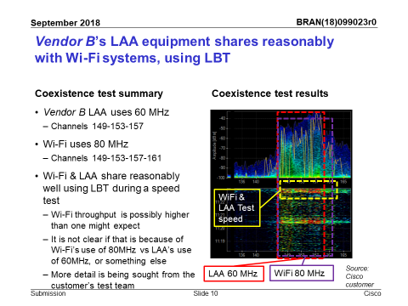
The result is probably mostly fair coexistence (not always but on average) in 5 GHz for Wi-Fi & LAA/NR-U
  Limited testing of real deployments show LAA & Wi-Fi can share
    See BRAN(18)099023
    Testing uses Ericsson LAA & Cisco Wi-Fi
    Caveat: it represents very limited testing!
  It also appears ED & PD thresholds are appropriate based on sim results provided by Ericsson to RAN1, and discussed in BRAN(18)100008

Slide 9
There is now a good case for working together on LBT based & new rules to achieve 6 GHz coexistence
Option | Description | Pro’s/con’s
Don’t define common 6 GHz rules ✗ | Allow 802.11 WG & NR-U to do what they want | Maximises innovation & time to market Risks chaos and failure … which is unacceptable!
Use LBT based 5 GHz rules … but refined ✓ | IEEE 802.11 WG & 3GPP RAN work together to make the LBT based 5 GHz rules work better in 6 GHz band | Leverages what we already know works for coexistence in 5 GHz band, ie LBT Enable innovation in both NR-U and Wi-Fi by allowing for agreed optimisations Provides fair access to 6 GHz while we work together on better ways Constrains any future rules to be backward compatible
Develop new 6 GHz rules ✓ | IEEE 802.11 WG & 3GPP RAN work together on new 6 GHz rules | May be much better than existing rules, particularly with new innovations in 802.11ax/be & NR-U Not obvious (after 40 years of research) what the new sharing rules should be, and so will take time

Slide 10
There are opportunities for IEEE 802.11 WG & 3GPP RAN refine LBT based rules for 6 GHz together
Tasks for IEEE 802.11 WG & 3GPP RAN to work together
  Optimise ED/PD thresholds for LBT operation in 6 GHz
    Contention is likely to be less in 6 GHz due to the use scheduled OFDMA in 802.11ax and it is possible different thresholds are more appropriate
  Define use of common preamble for inter technology communications
    This should at least be an option in NR-U … just in case
  Limit reservation signals for efficiency & to avoid LBT related issues
    It is hoped/believed NR-U will have less need for reservation signals anyway
  Reduce use of no/short LBT
    Noting that NR-U is likely to make more use of no/short LBT than LAA
  Agree of definition of “success” for LBT operation
    This topic is discussed in today’s “reserve” presentation
  Agree on how to update CW with delayed feedback
    This topic is currently being discussed in ETSI BRAN

