Slide 1
WG11 Opening Report Snapshot slides 2019-07
Date: 2019-07-14
Authors:

Slide 2
Abstract
This presentation contains the IEEE 802.11 WG snapshot slides for the July 2019 session:
Editors Meeting
ANA
AANI SC
ARC SC (Architecture)
Coex SC
PAR Review SC
WNG SC (Wireless Next Generation)
JTC1
TGmd
TGax (High Efficiency WLAN)
TGay (Next Generation 60 GHz)
TGaz (Next Generation Positioning)
TGba (Wake-Up Radio)
TGbb (Light Communications)
TGbc (Broadcast Services)
TGbd (Next Gen V2X)
TGbe (Extremely High Throughput)
RCM TIG (Random and Changing MAC addresses)

Slide 3
Agenda for 2019-07-16 editors meeting
Roll Call / Contacts / Reflector
Go round table and get brief status report
Draft Numbering
802.11 Mandatory Draft Review before SB
WG Style Guide for 802.11 09/1034r12
REVmd MDR report 19/260
TGay MDR report 19/681
TGax MDR report 19/1015
Review WG Style Guide

Slide 4
ANA Status – July 2019
The latest database is 11-11/0270r48 (July 2019)
Changes since last meeting:
Allocations for TGba, TGax, TGmd
Pending changes:
Allocation for TGmd (Mirrored SCS)

Slide 5
802.11 AANI SC – July 2019
Goals:
Review: the AANI SC Background and Status
Update: ITU-R WP5D IMT-2020 Status
Update: 802.11ax performance relative to ITU IMT-2020 requirements
Define: a press release on 802.11ax IMT-2020 performance
Update: 3GPP WLAN integration into 5G system (rel. 15, 16, 17)
Proposal on Interworking of 802.11 and 3GPP 5G Core for low latency
Draft an LS: to 3GPP SA on WLAN integration into the 5G system rel. 17
Agenda: See 11-19/1022r1 for additional background and details
AANI SC is scheduled to meet for 2 sessions: Mon: PM2, Thu: AM1
Note: Nendica: “IEEE 802 network enhancements for the next decade” Industry Connections Activity is scheduled for Tuesday Eve (19:30-21:30).

Slide 6
802.11 ARC – July 2019
Meeting slots: Tuesday PM2, Wednesday AM1, Wednesday PM2
Agenda items:
Update on external coordination/monitoring:
IEEE 1588, 802.1AS (802.1ASrev) and use of 802.11 FTM
IETF/802 coordination
Consider IETF DetNet/time-sensitive networking input (potential relationship to RTA TIG?)
IETF SAVI draft: https://datatracker.ietf.org/doc/draft-bi-savi-wlan
“What is an ESS?”: 11-18/1051r5
“What is a STA?” (per REVmd discussion: 11-19/0106r0)
MLME-RESET, versus MLME-JOIN and MLME-START (and MLME-SCAN?)
AP/DS/Portal architecture and 802 concepts
New topics (not started yet):
TGbe (EHT) multi-band operation architecture (11-08/0949r4)
TGbc (Broadcast) unassociated broadcast, broadcast reception

Slide 7
The IEEE 802.11 Coexistence SC will formally meet only once in Vienna in July 2019
The Coex SC is working based on agreed goals
Discuss the use of PD, ED or other 802.11 coexistence mechanisms with the goal of promoting “fair” use of unlicensed spectrum
Promote an environment that allow IEEE 802.11ax “fair access” to global unlicensed spectrum
The Coex SC is formally meeting only once this week
Coex Workshop on Wed PM1/PM2/EVE
Coex SC meeting on Thu PM1

Slide 8
IEEE 802.11 Coexistence SC will focus on workshop, relationship & technical issues
Agenda items (11-19-1145) to be addressed include:
Post mortem of Coexistence Workshop
Relationships
Review recent ETSI BRAN activities
Review recent 3GPP RAN/RAN1 activities
…
Technical issues
CW adjustment related issues
…
Motions (Thu PM1 only, if required)
Possible LS & Workshop motions

Slide 9
PAR Standing Committee – July 2019 Chair: Jon Rosdahl
PARs and ICAIDs
802.1ABdh -Amendment - Support for Multiframe Protocol Data Units, PAR and CSD
802.1Qdj - Amendment - Configuration Enhancements, PAR and CSD
802.3cv - Amendment - Maintenance #15: Power over Ethernet, PAR
802.15.9ma- Standard, Transport of Key Management Protocol (KMP) Datagram, PAR and CSD
PAR Extensions
802.1Qcj - Amendment - Automatic Attachment to Provider Backbone Bridging (PBB) services, PAR extension
802.11ay - Amendment - Enhanced Throughput for Operation in License-Exempt Bands Above 45 GHz, PAR Extension
802.11az - Amendment - Next Generation Positioning (NGP), PAR Extension
Notes:
May 2008
Page 9

Slide 10
802.11 WNG – July 2019
Tuesday 16 July AM1 (08:00-10:00)
Announcements
Presentations
11-19/1164r0 “Wi-Fi sensing” - Tony Xiao Han (Huawei)
“Wi-Fi Sensing: Usages, Requirements, Technical Feasibility, and Standards Gaps” – Carlos Cordiero (Intel)
Plans for September 2019
Chair will make a call for presentations in advance
Adjourn
Current agenda is document 11-19/0991

Slide 11
IEEE 802 JTC1 SC will meet in Vienna in July 2019
Agenda items (11-19-0955) addressed this week (Tue PM1) will include “the usual”:
Review extended goals
Review status of SC6 interactions
Review liaisons of drafts to SC6
Review notifications of projects to SC6
Review status of 60 day/FDIS ballots
Review SC6 activities
None

Slide 12
IEEE 802 has 90 standards in or through the PSDO pipeline
WG | Completed | In-process
802.1 | 28 | 11
802.3 | 15 | 6
802.11 | 8 | 13
802.15 | 2 | 1
802.16 | 0 | 0
802.21 | 3 | 0
802.22 | 3 | 0
All | 59 | 31
FDIS ballots
802.11ah waiting for publication
802.11ak/aq waiting for FDIS ballot start
60-day ballots
802.11aj needs a response

Slide 13
TGmd – July 2019
Overall Status: LB236 on P802.11REVmd D2.0 passed with 92% approval, 723 comments
D2.0 incorporates all approved amendments
About half of the comments resolved/pending resolution
Since May 2019 meeting
Teleconferences held to continue comment resolution
July 2019 meeting goals (6 timeslots):
Complete LB236 comment resolution: approximately 225 comments remain
WGLB recirculation on D3.0
Plans for July- September 2019: Recirculation LB and comment resolution
Agenda: 11-19-0960
Notes:
doc.: IEEE 802.11-10/0503r4
May 2010
Michael Montemurro, Research in Motion
Page 13

Slide 14
IEEE 802.11ax – July 2019
The TG held an ad hoc meeting during the period July 10-12 in the Rennes, France.
Almost 150 CIDs are ready for motion as a result of the ad-hoc last week
The remaining number of editorial comments is about 420 CIDs
Approve the new revision of the TG Coexistence Assurance document.
https://mentor.ieee.org/802.11/dcn/16/11-16-1348-06-00ax-coexistence-assurance.docx
Complete the resolution of all comments submitted on LB 238 (draft D4.0) and start a new 15-day WG LB
Agenda for this meeting is available in document 11-19/0983r0.
https://mentor.ieee.org/802.11/dcn/19/11-19-0983-00-00ax-tgax-july-2019-meeting-agenda.pptx
Agenda for the ad hoc meeting is available in document 11-19/1063r0
https://mentor.ieee.org/802.11/dcn/19/11-19-1063-00-00ax-tgax-july-2019-ad-hoc-meeting-agenda.pptx

Slide 15
Task Group AY – July 2019
Since the May interim
Draft 4.0 is published
IEEE SA ballot pool is formed with 137 members being enrolled.
Second recirculation working group letter ballot on D4.0 (LB242) is passed with an approval rate of 96.97%, 21 technical comments and 42 editorial comments.
A teleconference call on comment assignment is held on July 10
Goals this week
Consider draft readiness for the third recirculation working group letter ballot on Tuesday AM2
Review all comments, especially the 21 technical comments
Agree on a way forward option for the start date of the first SA technical letter ballot (e.g., reject all No-vote comments with sufficient justification and issue a recirculation letter ballot with unchanged draft; or resolve all comments and prepare D5.0 for the third recirculation working group letter ballot)
Comment resolution
Resolve comments related to the PAR extension (if any)
Agenda for this meeting is available in document 11-19/0974

Slide 16
Task Group AZ – July 2019 Next Generation Positioning
Current status:
In comment resolution coming from successful Initial WG Ballot.
TG had a 3 day ad-hoc hosted by Qualcomm and had 4 telecons since the March meeting.
Roughly 60 technical comment resolutions were generated and reviewed – expected to be considered for adoption this week.
Published two new drafts:
D1.1 incorporating CR adopted during the March meeting and editorial comment resolution.
D1.2 incorporating comment resolutions approved during the May meeting.
Upcoming milestones/approved plan:
Continue with comment resolution.
Projected to go to a recirculation ballot coming from Sep. meeting.

Slide 17
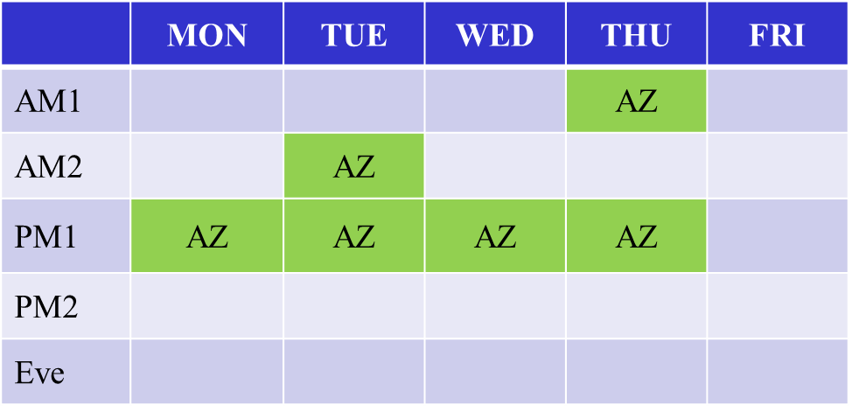
Task Group AZ – July 2019 Next Generation Positioning
Agenda:
refer to submission 11-19/946.

Slide 18
TGba (Wake-up Radio) – July 2019
From the last F2F meeting
TGba completed the comment resolution on D2.0 in the May meeting
Started 15-day recirculation WGLB (LB241) in June
- Passed: 84% approve
- Total 418 comments received (265 technical)
Held three teleconference calls
- Comment assignments
- Reviewed comment resolutions for 51 technical CIDs (~20% complete)
Plan for this meeting
Continue comment resolution on TGba D3.0 (LB241)
Review TG timeline
Agenda can be found in doc: IEEE 802.11-19/988

Slide 19
802.11 TGbb – July 2019
TGbb will discuss :
Approve minutes from the teleconferences
Evaluation Framework document
PHY proposals
MAC discussion
Conference call schedule
Five (5) meeting slots for the July 2019 session
Mon – AM1, PM2; Tue – PM2; Wed – AM1; Thur – PM1;
Proposed Agenda in doc. 11-19/0989r1

Slide 20
IEEE 802.11 TGbc – July 2019 Broadcast Services Chair: Marc Emmelmann
Progress since May 2019:
1 telephone conference
Functional Requirements Document Proposed Update
Performance evaluation of signing schemes
July Goals:
Approve additional technical requirements
Consolidate the system architecture / control plane discussions
Discuss early drafts of amendment text
3 Meeting slots: Tue PM1, Wed AM1; Thu AM2
Agenda: 11-19/0943; Meeting / Chairs slides: 11-19/0944

Slide 21
Snapshot of IEEE 802.11 TGbd – July 2019
Since the May 2019 meeting
1 teleconferences were held
2 hour joint discussion with IEEE 1609 experts on the interface between NGV and upper layer protocol
teleconference minutes
Goal of 2019 July meeting
5 sessions scheduled for TGbd during Jul meeting including one adhoc session
Appoint adhoc co-chairs
Approve updated FRD and SFD
Complete presentations in the list
Run motions for updating FRD and SFD.
Agenda for TGbd May meeting is available as in the latest revision of 11-19/0985

Slide 22
IEEE 802.11be – July 2019
From the May F2F meeting
Approved TGbe Selection Procedure and TG Timeline
Elected/Appointed TG officer
Discussed 16 technical submissions
Goals for the July F2F meeting
Discuss remaining TG documents
Joint session with IEEE802.1 TSN
Presentation of technical submissions
Agenda is available in 11-19/0986

Slide 23
IEEE 802.11 RCM TIG – July 2019
Continue exploration of topics:
Do Not Fear Random MAC Addresses! (presentation)
Prof. Mathieu Cunche from INRIA (Paris) will present privacy-preserving network analytics.
Chair to (personally) present TIG work at Privacy Enhancing Technologies Symposium (PETS) 2019. See https://petsymposium.org/2019/program.php#hotpets_program
Agenda/chair deck for this meeting is available in doc. 11-19/0982r1.
Notes:
doc.: IEEE 802.11-12/xxxxr0
November 2010
Bruce Kraemer (Marvell)
Page 23

