Slide 1
Considerations on Ranging in NGV
Date: 2019-07-15
Authors:

Slide 2
Abstract
Considerations on Ranging in NGV given PAR and use case baseline:
Analysis method: Lower Bounds
Observation model: AWGN and line of sight (LOS) free space path loss
5.9 GHz band:
Waveform analysis
Time-of-arrival (TOA) vs. round-trip-delay (RTD) ranging
Bandwidth and different numerologies
60 GHz band:
Comparison between RTD ranging and Radar
Dynamic Train-to-Train Propagation Measurements and ranging results

Slide 3
Introduction
PAR [1]:
“this amendment defines procedures for at least one form of positioning in conjunction with V2X communications”
Use Case (UC) baseline document [2]:
UC5 Vehicular Positioning & Location
UC8 Train-to-Train
UC9 Vehicle-to-Train

Slide 4
Lower Bounds Evaluation Methodolgy: Benefits
[3], [4], [5]:
Knowledge and understanding about an estimation problem
Effect of nonlinearities
Identification of limiting factors
Estimator efficiency
Evaluation of suboptimal estimators
System parameter optimization
Allocation of signal power
Waveform design
Placement of road side units

Slide 5
Lower Bounds Evaluation Methodolgy: Non-random Parameter Estimation
Classical definition
Cramér-Rao Lower Bound (CRLB) for unbiased estimators
Biased CRLB usually dependent on unknown estimator bias
Over optimistic for many scenarios
estimator
parameter vector
observation vector
parameter vector given
MSE Matrix
Fisher Information Matrix
log-likelihood of observation vector

Slide 6
Lower Bounds Evaluation Methodolgy: Random Parameter Estimation
Bayesian definition
Ziv-Zakai Lower Bound (ZZLB) [5]
Properties of the Bayesian bounds (ZZLB, …)
Valid for biased estimators
Possible to incorporate prior knowledge of the estimated parameters
Applicable also to problems that are singular without prior knowledge
random parameter vector

Slide 7
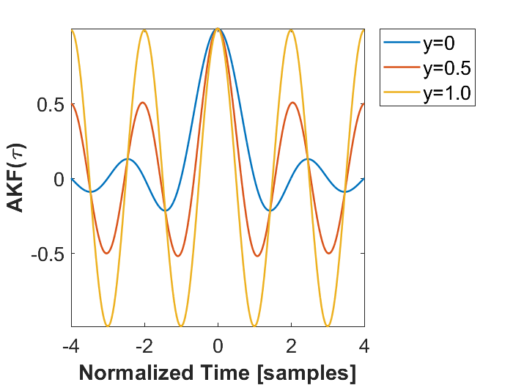
Time-of-Arrival (TOA) Ranging Measurement and Signal Model [6]
Observation model: AWGN
Signal model (Dirac-Rectangular)
$${\left|S(f)\right|}^{2}=\left\{\begin{matrix}\frac{1−γ}{B}+\frac{γ}{2}\left[δ\left(f+\frac{B}{2}\right)+δ\left(f−\frac{B}{2}\right)\right], & \left|f\right|≤\frac{B}{2} \\ 0, & otherwise \end{matrix}\right.$$

Slide 8
Time-of-Arrival (TOA) Ranging Lower Bounds [6]
Cramér-Rao Lower Bound (CRLB) vs . Ziv-Zakai Lower Bound (ZZLB):
Same for high SNR
Rapid increase of ZZLB for medium SNR: Signal ambiguities in observation interval
Convergence of ZZB to mean of observation interval for low SNR
Note, rectangular waveform (γ=0)

Slide 9
Time-of-Arrival (TOA) Ranging Lower Bounds [6]
Waveform parameter γ:
γ=0, rectangular highest CRLB, ZZLB converges at lowest SNR
γ=0.5, 3 dB gain at high SNR, but 2 dB earlier divergence
γ=0.99, only 0.2 dB additional gain at high SNR, but divergence 20 dB before γ=0

Slide 10
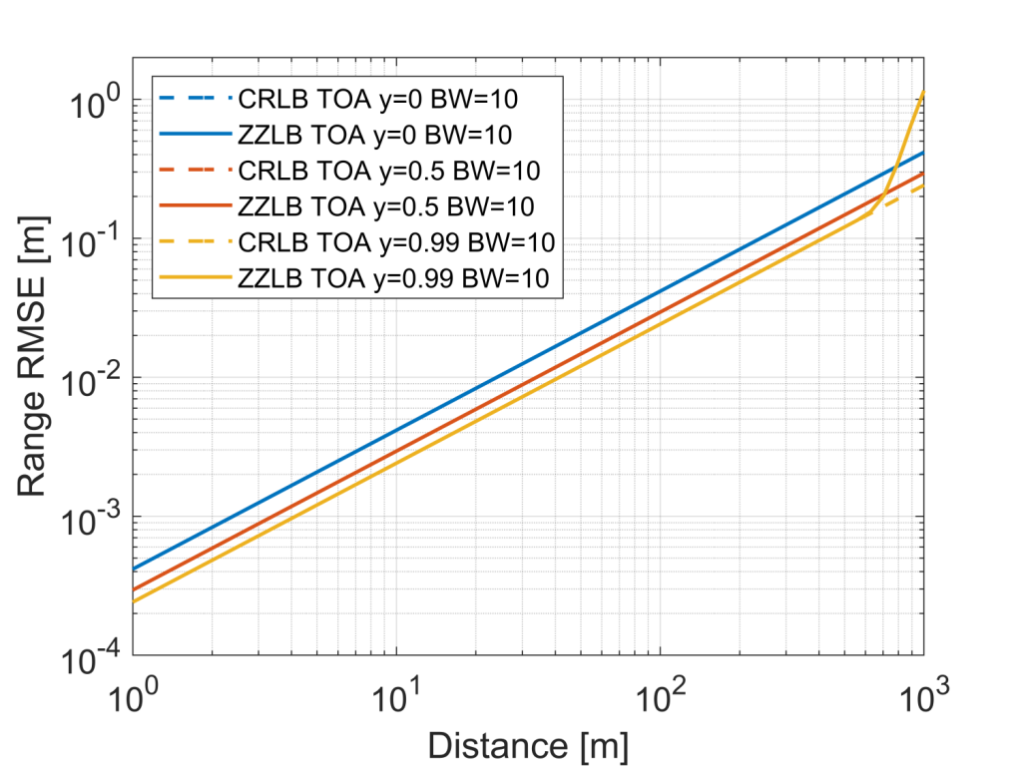
Time-of-Arrival (TOA) Ranging Pathloss Model
Line-of-sight (LOS) free space
$$SNR\left(d\right)={\left(\frac{λ}{4πd}\right)}^{2}\frac{P_{TX}G_{TX}G_{RX}}{{N_{F}k}_{B}T_{N}B_{W}}$$
$f_{c}=5.9 GHz$, $B_{W}=10 MHz$,
$P_{TX}G_{TX}=33 dBm$,
$G_{RX}=5dBi$, $N_{F}=5dB$,
$T_{N}=300K$,
$k_{B}$ Boltzmann constant

Slide 11
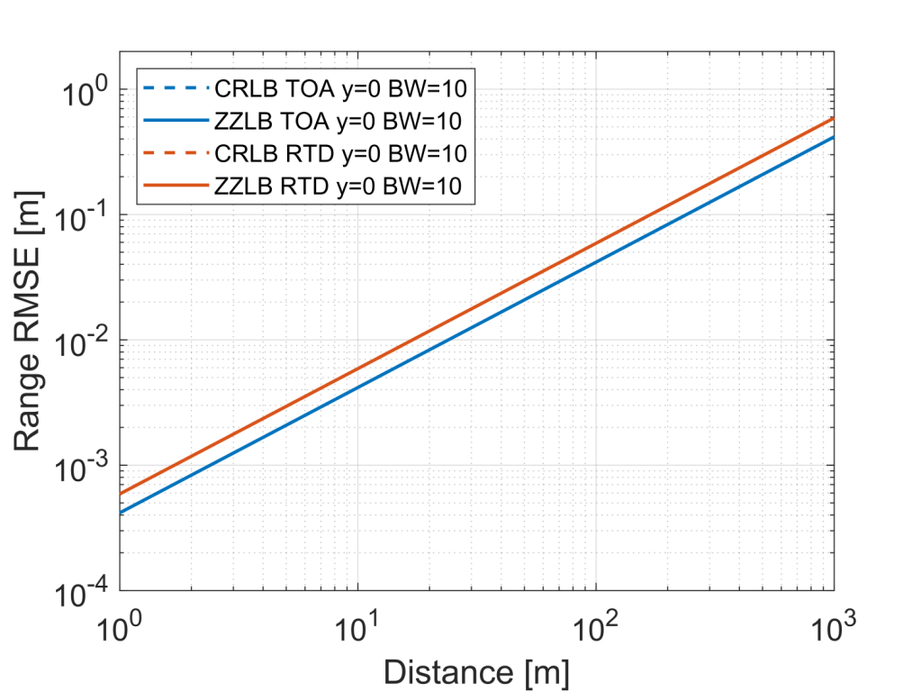
Time-of-Arrival (TOA) vs. Round-Trip-Delay (RTD) Ranging
TOA: Synchronized transmitter and receiver
RTD: No synchronization required, stable oscillators and clocks for duration of message exchange
RTD model: Two independent TOA measurements
Note, rectangular waveform (γ=0) for remaining slides

Slide 12
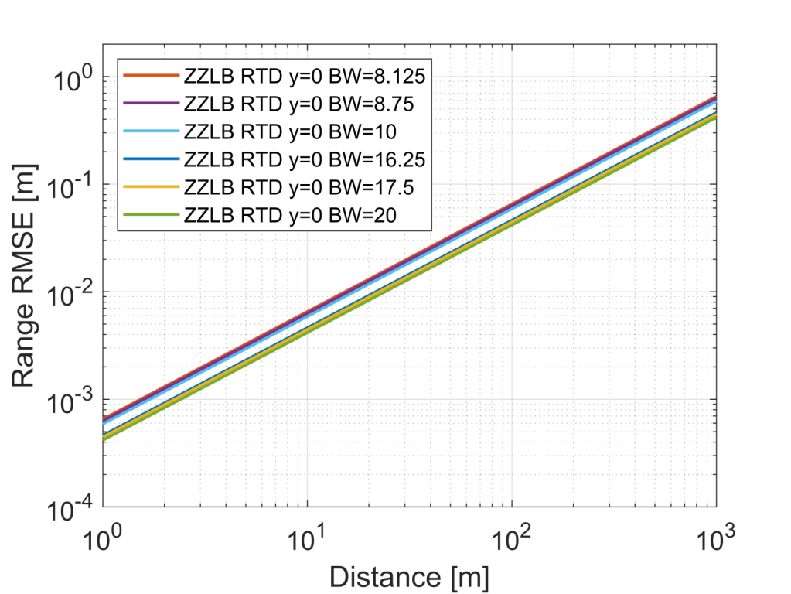
Round-Trip-Delay (RTD) Ranging Bandwidth
8.125 MHz = 52 subcarriers
8.75 MHz = 56 subcarriers
10 MHz = 64 subcarriers
16.25 MHz = 52 subcarriers
17.5 MHz = 56 subcarriers
20 MHz = 64 subcarriers

Slide 13
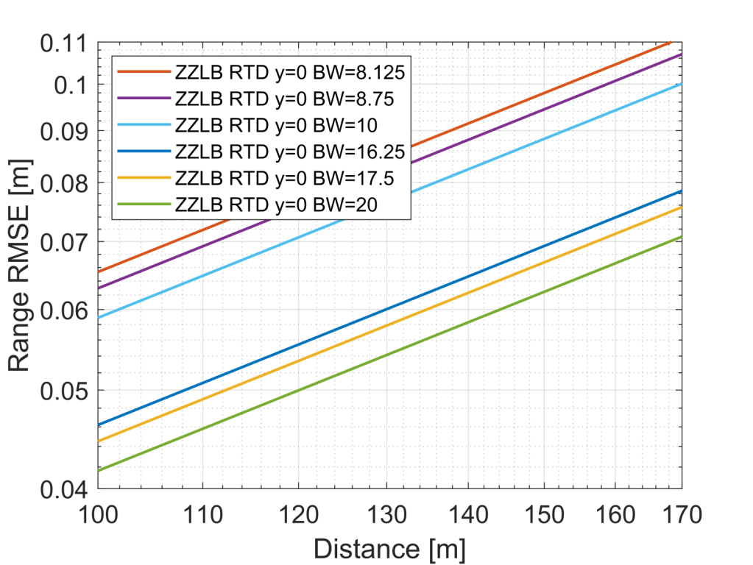
Round-Trip-Delay (RTD) Ranging Bandwidth
4% accuracy gain for 52 ➔ 56 subcarriers 10 MHz
7% accuracy gain for 56➔64 subcarriers 10 MHz
30% accuracy gain 10 MHz ➔ 20 MHz
4% accuracy gain for 52 ➔ 56 subcarriers 20 MHz
7% accuracy gain 56➔64 subcarriers 20 MHz
1)
2)
4)
5)
3)

Slide 14
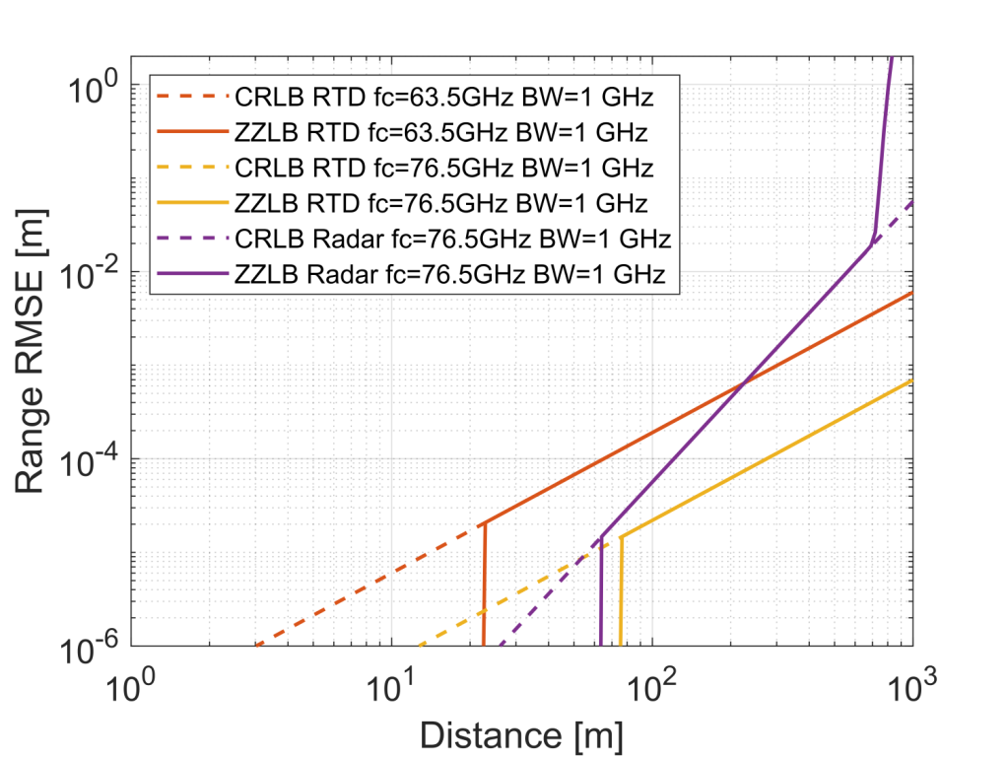
Millimeter Wave Round-Trip-Delay (RTD) Ranging and Radar
Communication, RTD ranging
$$SNR\left(d\right)={\left(\frac{λ}{4πd}\right)}^{2}\frac{P_{TX}G_{TX}G_{RX}N_{Avg}}{{{L_{d_{0}}\left(d/d_{0}\right)N}_{F}k}_{B}T_{N}B_{W}}$$
$f_{c} =63.5, 76.5 GHz$, $P_{TX}G_{TX}=40 dBm,$
$L_{d_{0}}=17.5, 0.2 dB$, $B_{W}=1 GHz$, $N_{Avg}$=1000,
$d_{0}=2 km$, $G_{RX}=23dBi$, $N_{F}=5dB$, $T_{N}=300K$,
Radar [7]
$$SNR\left(d\right)={\left(\frac{λ}{L_{d_{0}}d^{3}/d_{0}}\right)}^{2}\frac{P_{TX}G_{TX}{σ_{c}G}_{RX}N_{Avg}}{{\left(4π\right)}^{3}{N_{F}k}_{B}T_{N}B_{W}}$$
$f_{c}=76.5 GHz$, $L_{d_{0}}=0.2 dB,$ $σ_{c}=100 m^{2}$, $P_{TX}G_{TX}= 50 dBm$, $k_{B}$ Boltzmann constant

Slide 15
Dynamic Train-to-Train Propagation Measurements in the Millimeter Wave Band [8]

Slide 16
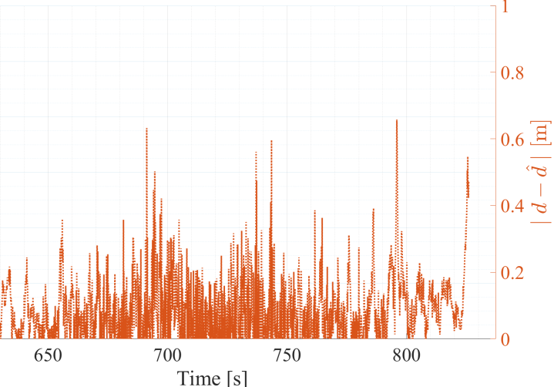
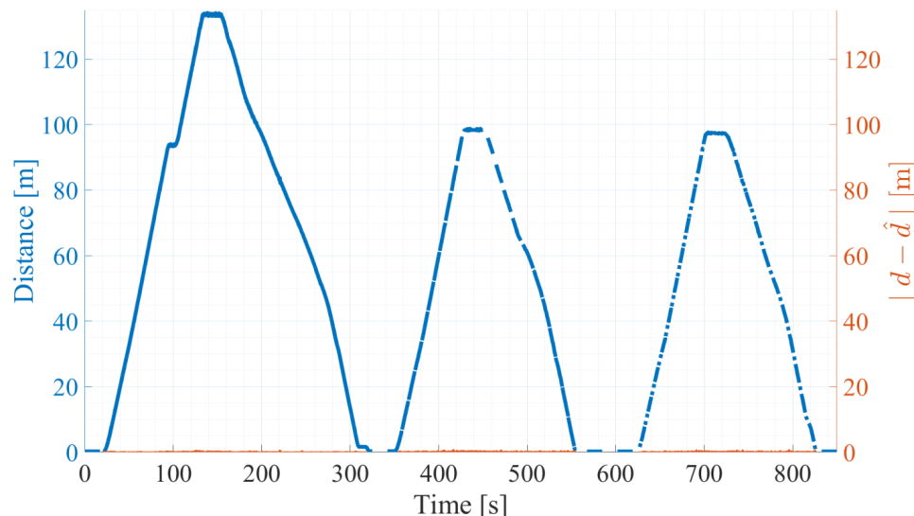
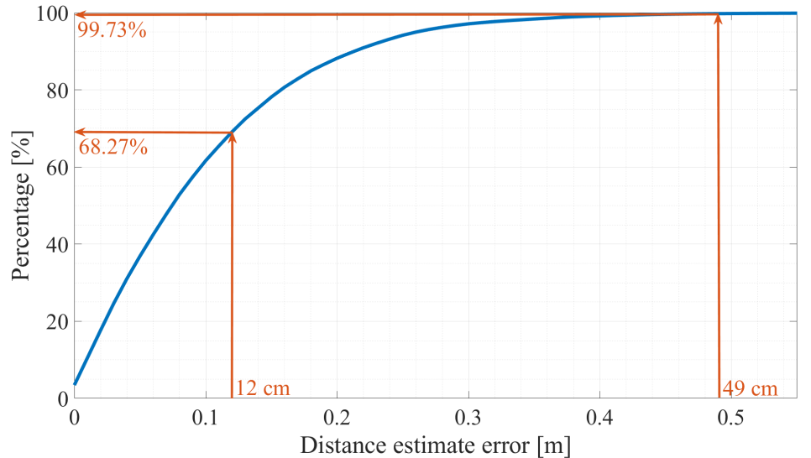
Dynamic Train-to-Train Propagation Measurements in the Millimeter Wave Band [8]
$f_{c} =60 GHz$, $B_{W}=120 MHz$
Snapshot based distance estimator
Accuracy: 12 cm (1σ), 49 cm (3σ)

Slide 17
Conclusions
Bounds
Cramér-Rao Lower Bound (CRLB) vs . Ziv-Zakai Lower Bound (ZZLB):
CRLB simple, analytic solution vs. ZZLB more complex, numerical solution
CRLB and ZZLB same for high SNR
CRLB optimistic for low to medium SNR vs. ZZLB tighter at medium to low SNR (accounts for ambiguities)
Observation model: Simple model ➔ analytic solution for bounds, but overly optimistic
Waveform: Put energy towards band edge, e.g. 50% ➔ 3 dB gain
Free Space LoS Pathloss Model @ 5.9 GHz ➔ submeter accuracy
RTD 3dB performance loss compared to TOA, no synchronization required
Bandwidth comparison: marginal gain for different numerologies, significant gain for 20 MHz vs. 10 MHz
Millimeter Wave 63.5 GHz RTD ranging outperforms Radar 76.5 GHz @ distances > 230 m
Millimeter Wave moving train measurements: 120 MHz BW ➔ 12 cm ranging error @ 1 sigma

Slide 18
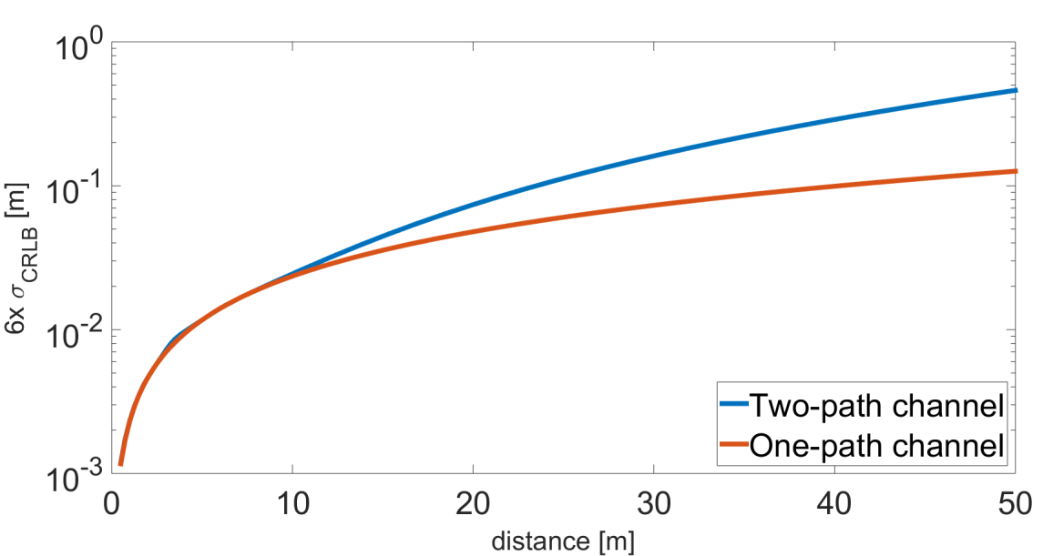
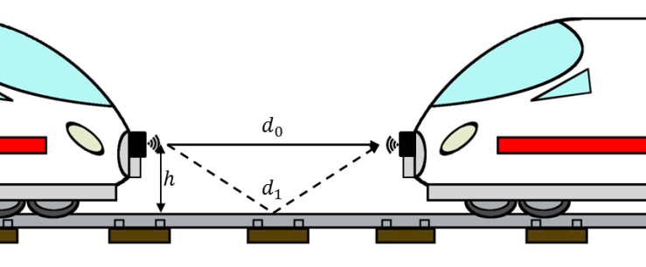
Outlook
More realistic observation models
Multipath, e.g. ground reflection
Clock and oscillator errors
moving train

Slide 19
References
[1] TGbd, “Project Authorization Request (PAR)”, IEEE 802.11-18/0861r9
[2] NGV SG, “Use Case Baseline Document Approved By SG”, IEEE 802.11-18/1323r2
[3] S. M. Kay, Fundamentals of statistical signal processing. New Jersey: Prentice Hall PTR, 1993.
[4] H. L. Van Trees, Detection, estimation, and modulation theory. John Wiley & Sons, 2004.
[5] H. L. Van Trees, Bayesian bounds for parameter estimation and nonlinear filtering/tracking. John Wiley & Sons, 2007.
[6] Dammann, Armin and Jost, Thomas and Raulefs, Ronald and Walter, Michael and Zhang, Siwei (2016) Optimizing Waveforms for Positioning in 5G. In: IEEE Workshop on Signal Processing Advances in Wireless Communications, SPAWC. IEEE International workshop on Signal Processing advances in Wireless Communications, 3.-6. Jul. 2016, Edinburgh, UK. DOI: 10.1109/SPAWC.2016.7536783
[7] Schmidhammer, Martin and Gentner, Christian and Siebler, Benjamin (2019) Localization of Discrete Mobile Scatterers in Vehicular Environments Using Delay Estimates. 2019 International Conference on Location and GNSS (ICL-GNSS), 4.-6. Juni 2019, Nuremberg, Germany.
[8] Soliman, Mohammad and Unterhuber, Paul and Sand, Stephan and Staudinger, Emanuel and Shamshoom, Jeries and Schindler, Christian and Dekorsy, Armin (2019) Dynamic Train-to-Train Propagation Measurements in the Millimeter Wave Band - Campaign and First Results. EuCAP 2019, 31 March - 5 April 2019, Krakow, Poland.

Slide 20
Straw Poll #1
Do you agree to add that 802.11bd in the 5.9 GHz band supports round-trip-delay (RTD) ranging for 10 MHz and 20 MHz bandwidth PPDUs?
Yes/No/Abstain: 17/0/2

Slide 21
Straw Poll #2
Do you agree to add that 802.11bd in the 60 GHz band supports round-trip-time (RTT) ranging for TBD Hz bandwidth PPDUs?
Yes/No/Abstain:

