Slide 1
Measurements for Distributed-MU-MIMO
Date: 2019-05-10
Authors:

Slide 2
Abstract
In this contribution, measured MIMO channels are used to assess the potential performance of some distributed MU-MIMO techniques

Slide 3
Compared TX schemes (Downlink only)
Joint processing transmissions (JPT) This is technique 2 in [1]
Coordinated beamforming (CBF) This is technique 1a in [1]
OBSS - uncoordinated (Baseline) (only one AP transmits at any given time due to LBT, time sharing)
AP1
AP2
STA1
STA2
STA3
STA4
AP1
AP2
STA1
0
STA2
0
0
STA3
STA4
0
AP1
AP2
STA1
STA2
STA3
STA4

Slide 4
Setup
Indoor scenario: office building in Stockholm, Sweden
4 fixed APs, each with 2 TX antennas
STAs with 1 antenna (1 SS/STA)
Coherent MIMO channel measurements
Carrier frequency: 2.7 GHz
Channel bandwidth: 20 MHz
MCS 0-9 with LDPC
Throughput computed using the methodology and mappings from 802.11ax [2]
Zero forcing MU-MIMO precoding
Ideal channel estimates used in precoder computations

Slide 5
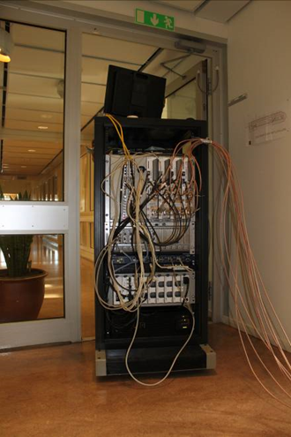
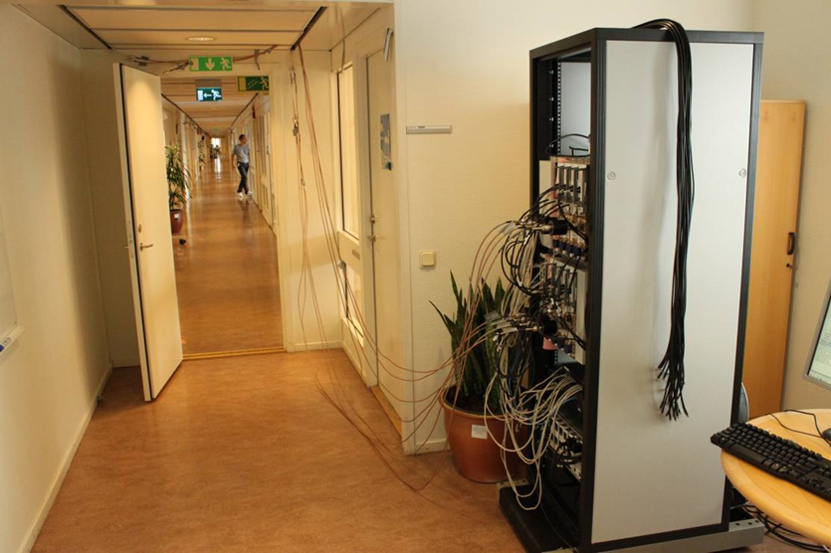
Setup
APs
STAs

Slide 6
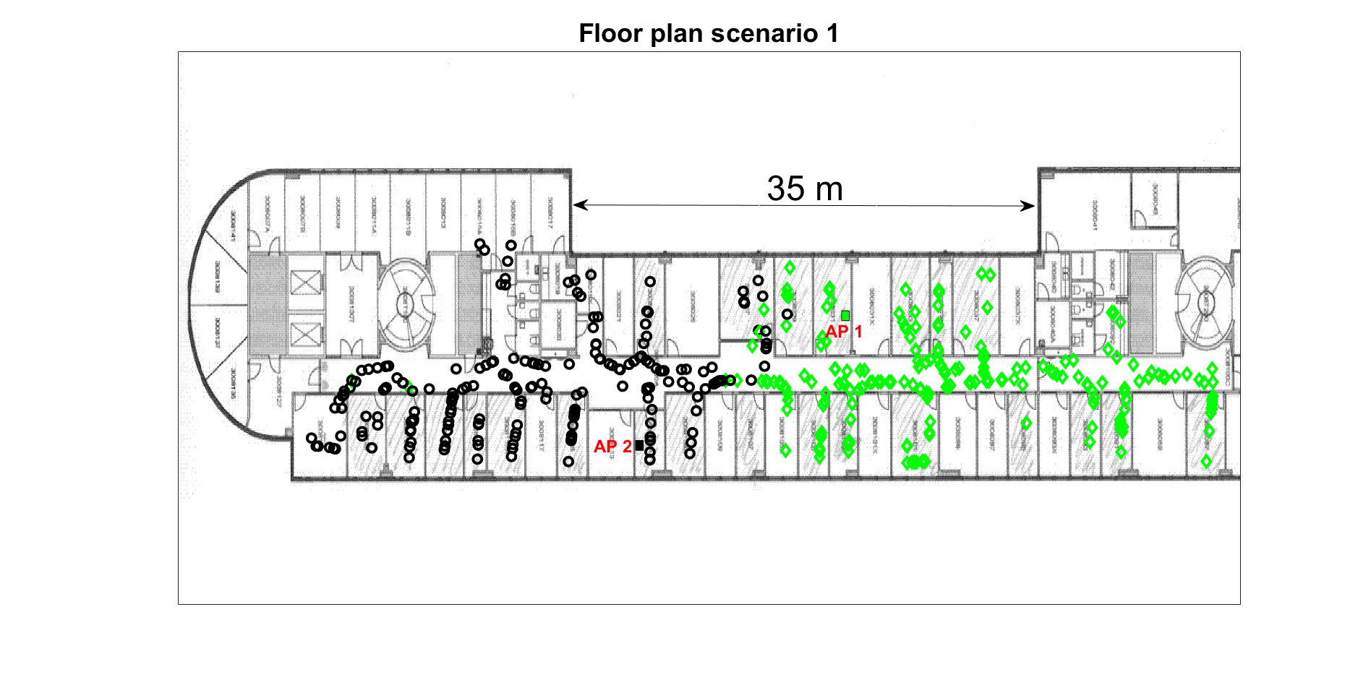
Scenario 1
Superdense STA deployment
2 APs, 2 TX each
STAs have 1 RX
Baseline: OBSS
Green STAs associated to AP 1
Black STAs associated to AP 2
Illustration of STA deployment,
not all STAs shown

Slide 7
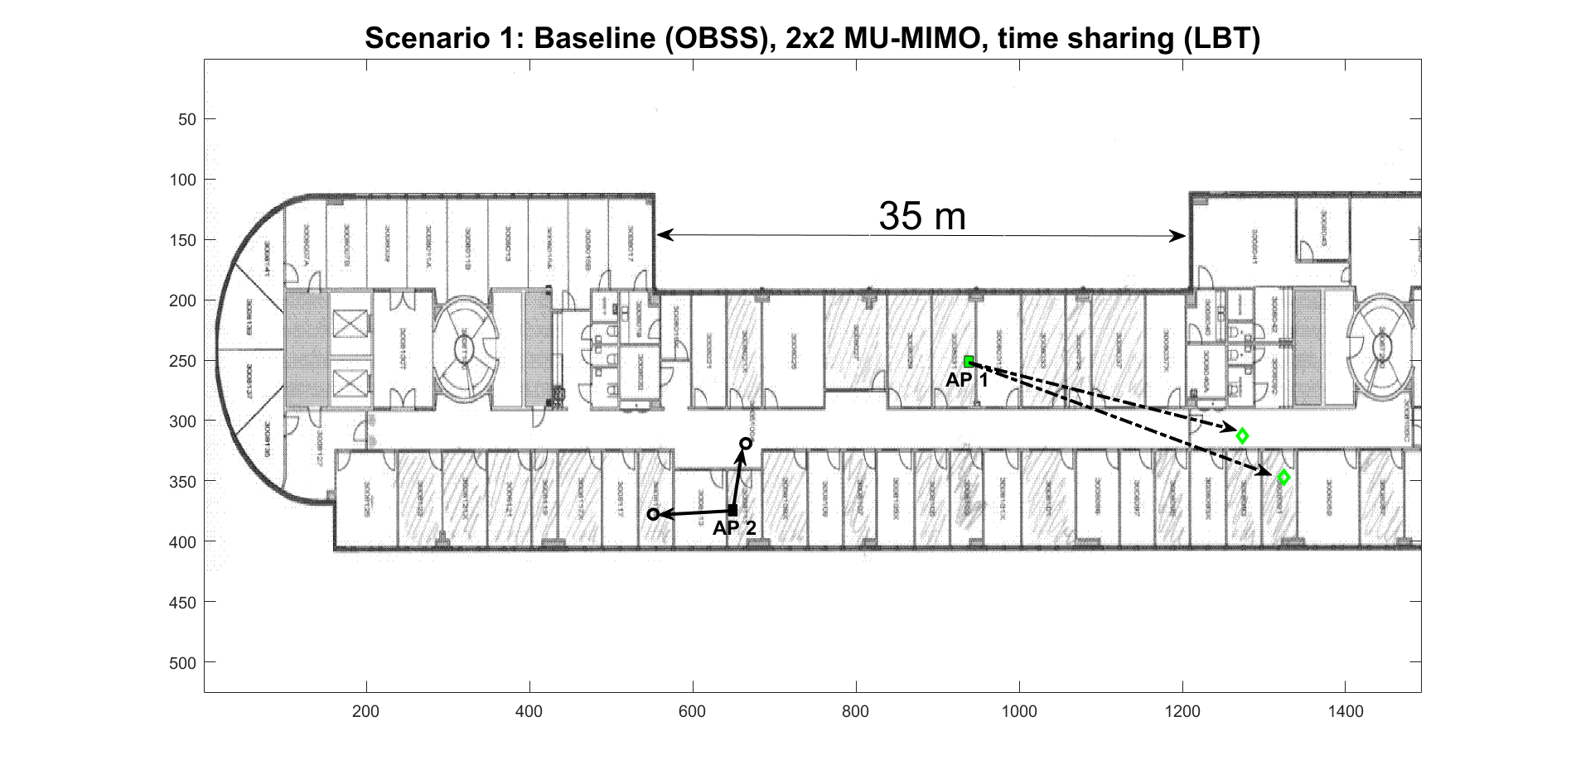
Scenario 1
Baseline: OBSS, 2x2 MU-MIMO, time sharing
One realization: 2 green STAs and 2 black STAs chosen at random
Each AP uses 20 MHz, 50% of the time

Slide 8
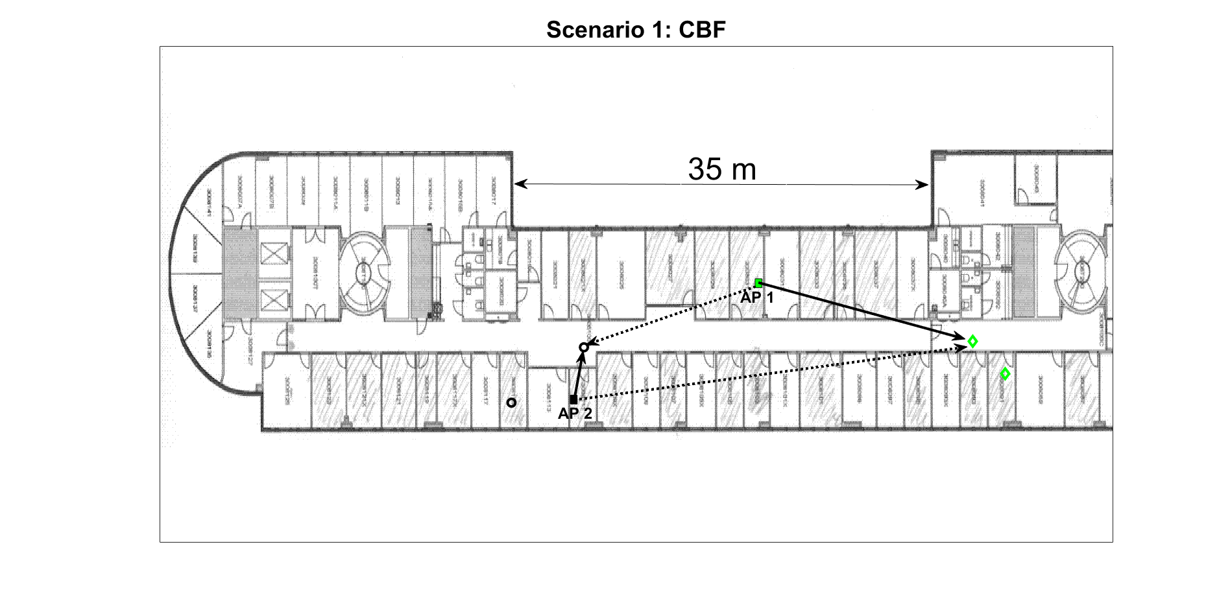
Scenario 1
CBF
One realization: same STAs as in baseline
Each AP uses 20 MHz, 100% of the time, same Tx power as baseline → increased SNR/SS w.r.t. baseline

Slide 9
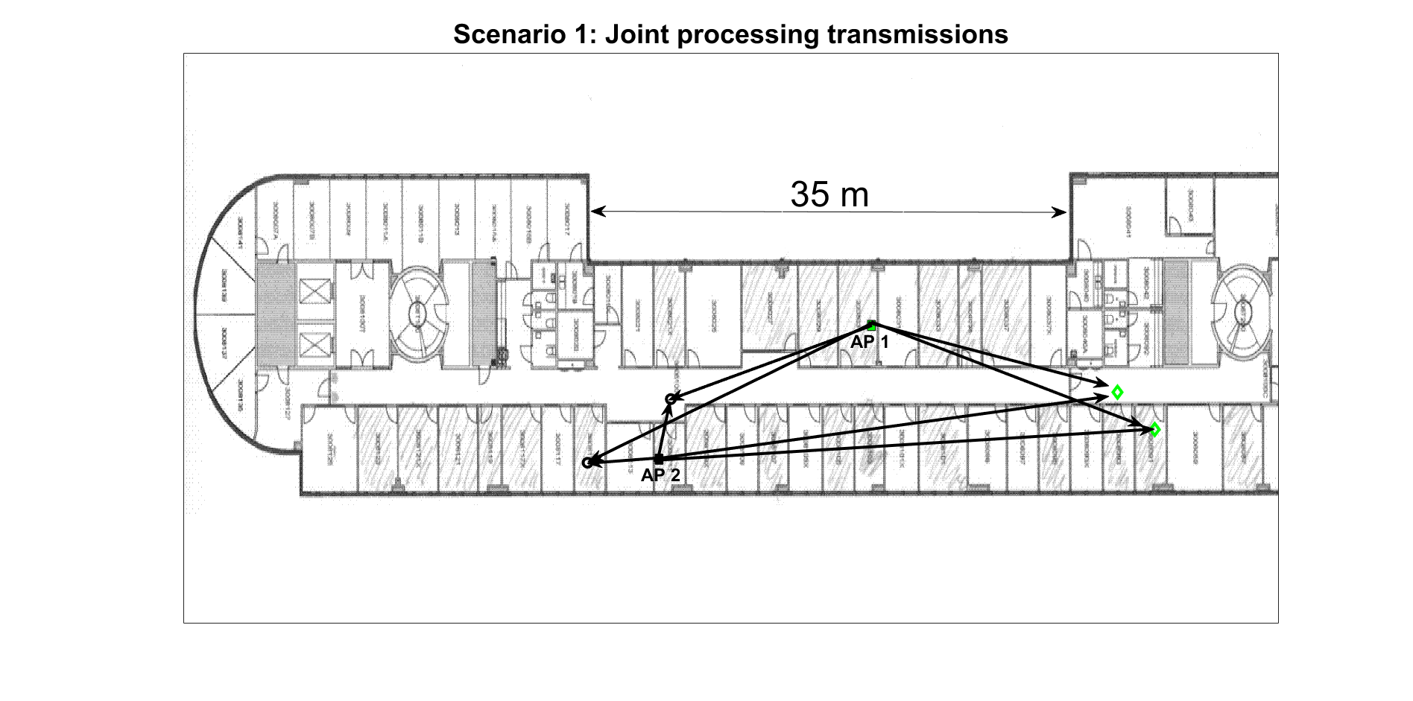
Scenario 1
JPT 4x4 MU-MIMO
One realization: same STAs as in baseline
Each AP uses 20 MHz, 100% of the time, same Tx power as baseline

Slide 10
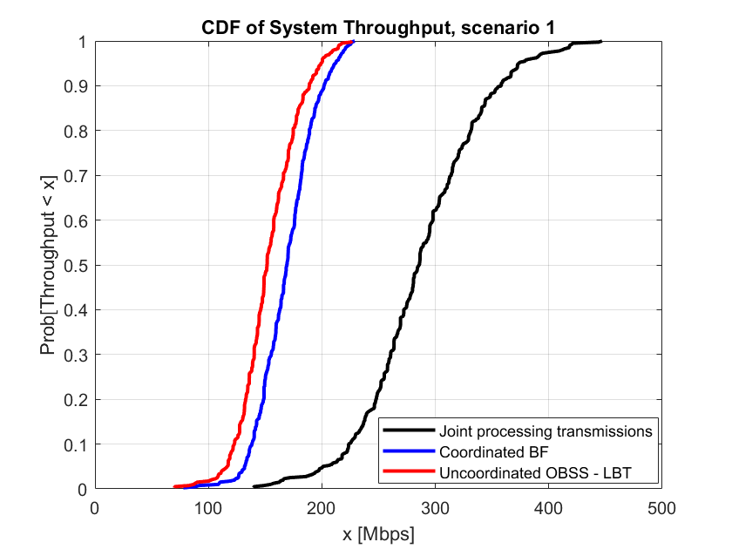
System throughput scenario 1
Empirical CDF computed over 400 realizations

Slide 11
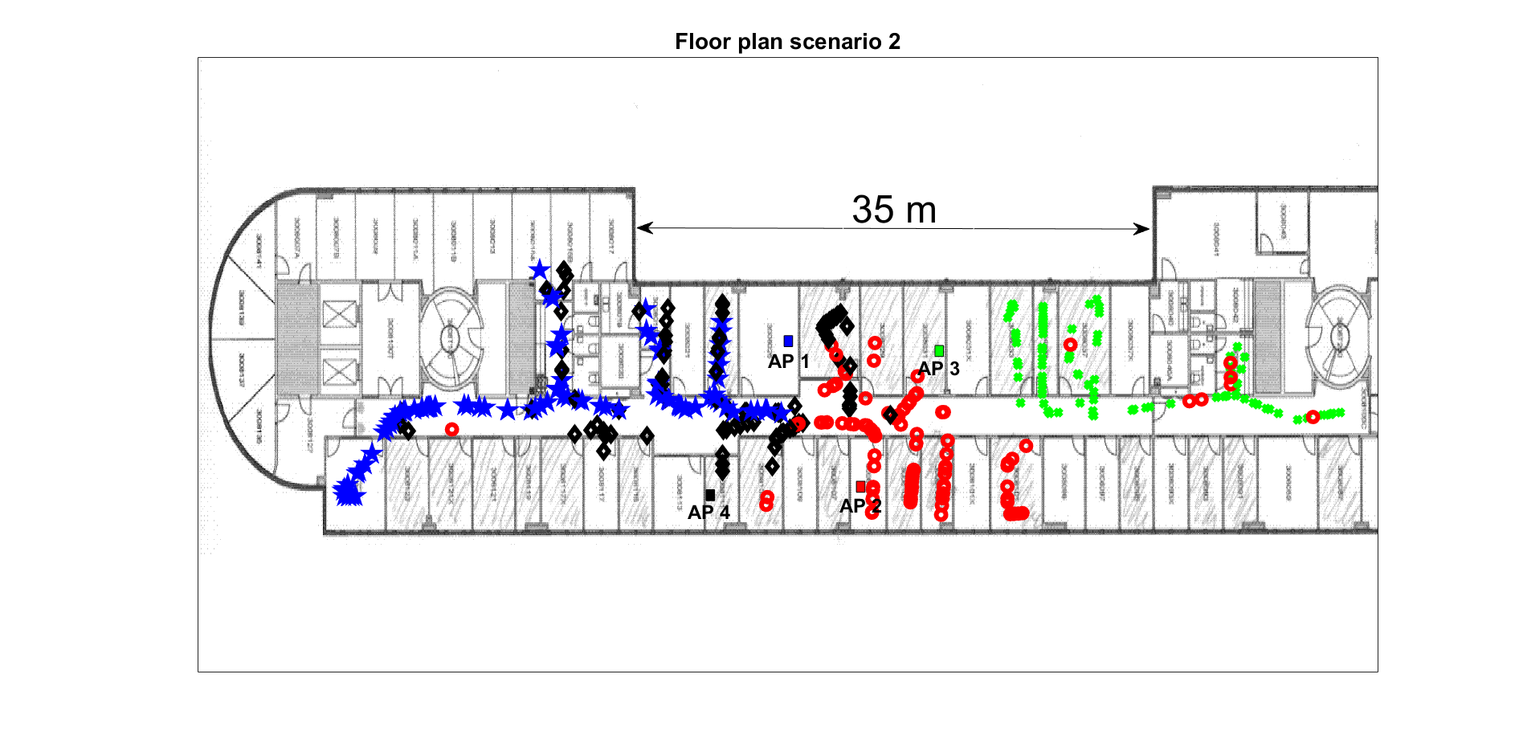
Scenario 2
Superdense deployment
4 APs, 2 TX each
STAs have 1 RX
Baseline: OBSS
Blue STAs associated to AP 1
Red STAs associated to AP 2
Green STAs associated to AP 3
Black STAs associated to AP 4
Illustration of STA deployment,
not all STAs shown

Slide 12
Scenario 2
Baseline: OBSS, 2x2 MU-MIMO, time sharing
One realization: 2 STAs associated to each AP are chosen randomly (8 STAs in total: 2 red, 2 blue, 2 green, 2 black)
Each AP uses 20 MHz, 25% of the time
Joint processing transmissions: 8x8 MU-MIMO
One realization: the same 8 STAs as in baseline
Each AP uses 20 MHz, 100% of the time

Slide 13
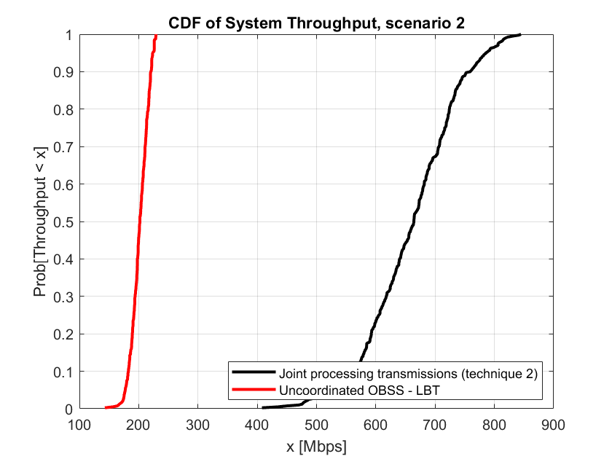
System throughput scenario 2
Empirical CDF computed over 400 realizations

Slide 14
Remarks
The baseline scenario did not exploit the spatial re-use features in 802.11ax
Alternative baseline: BSSs use non-overlapping RF channels. Gains similar to those shown in slides 10, 13 are expected, provided JPT employs a bandwidth equal to the aggregate of the BW of all BSSs
Example of alternative scenario 1:
AP1 → Ch A (20 MHz), AP2 → Ch B (20 MHz)
JPT → Ch A + Ch B (40 MHz)
Baseline: Each AP uses 50% of 40 MHz, 100% of the time JPT: Each AP uses 100% of 40 MHz, 100% of the time

Slide 15
Observations
In the scenarios considered, joint processing transmissions significantly outperform both the baseline and coordinated beamforming
Scenario 1:
JPT median system throughput ~1.9X baseline & CBF
Scenario 2:
JPT median system throughput ~3.2X baseline
In the scenario considered, CBF barely ouperformed the baseline
Scenario 1: CBF median throughput ~1.1X baseline

Slide 16
References
[1] S. Vermani et al., Terminology for AP Coordination https://mentor.ieee.org/802.11/dcn/18/11-18-1926-02-0eht-terminology-for-ap-coordination.pptx
[2] R. Porat et al, Evaluation methodology https://mentor.ieee.org/802.11/dcn/14/11-14-0571-12-00ax-evaluation-methodology.docx

