Slide 1
PHY Numerology Discussions
Date: 2019-05-13
Authors:

Slide 2
Introduction
In [1, 2, 3], different 11bd OFDM numerologies are investigated.
Tone spacing of 39kHz, e.g. 11ac 80MHz downclock by 8, does not provide good tolerance of channel doppler.
In this contribution, more simulation results are provided for 11bd 10MHz OFDM numerology
11ac 20MHz downclock by 2, and
11ac 40MHz downclock by 4.
We will also discuss the 11bd 20MHz PPDU OFDM numerology.

Slide 3
Simulation Settings
10MHz DSRC channel @5.9GHz
Channel model: C2C channel with pure Doppler
CFO: uniform [-10 10]ppm on both Tx and Rx side.
1x1, 1ss, 300 bytes. Ideal timing.
LDPC with Midamble
11n LDPC codes
Midamble: one VHT-LTF, Period – 2,4,6,8,10
OFDM numerology:
11ac 20MHz DC2 v.s. 11ac 40MHz DC4
Goodput is the maximum achievable effective data rate.
Goodput (SNR) = max_{MCS,M}{Rate(MCS) * (1-PER(MCS, SNR))* M/(M+1)}
M is the midamble period

Slide 4
Rural LOS
Low doppler channel: 40MHz DC4 is slightly better due to more number of pilots.

Slide 5
Urban Approaching LOS
Low doppler channel: 40MHz DC4 is slightly better due to more number of pilots.

Slide 6
Urban Crossing NLOS
20MHz DC2 is preferred at high SNR, as 40MHz DC4 needs denser Midamble
40MHz DC4 is slightly better at low-medium SNR

Slide 7
Highway LOS
20MHz DC2 is preferred at high SNR, as 40MHz DC4 needs denser Midamble
40MHz DC4 is slightly better at low-medium SNR

Slide 8
Highway NLOS
20MHz DC2 is preferred at medium-high SNR, as 40MHz DC4 needs denser Midamble.
40MHz DC4 is slightly better at low SNR

Slide 9
10MHz Numerology Discussion
11ac 20MHz DC2 is shown to be a better options compared with 11ac 40MHz DC4
Similar goodput for low Doppler channels, and low SNR range.
Better goodput for higher Doppler channels @medium-high SNR.
Tone map: 11ac 20MHz v.s. 11a/g 20MHz
11ac 20MHz OFDM tone plan uses four extra tone [-28 -27 27 28] on the edge compared to 11a/g.
With state-of-art technology in WiFi, to meet the spectrum mask with four extra tones is not very difficult.
11ac 20MHz tone plan can achieve ~8% better OFDM efficiency.
No need to redefine LDPC tone mapper.

Slide 10
20MHz Spectrum Mask
STA Transmit Power class | Permitted power spectrum density, dBr
 | 10MHz BW |  |  | 20MHz BW
 | +/-0.5 MHz from edge | +/5 MHz from edge | +10MHz from edge | +0.5 MHz from edge (*) | +5 MHz from edge (*) | +10MHz from edge
Class A | -20 | -28 | -40 | -15 | -23.5 | -28
Class B | -20 | -28 | -40 | -18 | -23.5 | -28
Class C | -32 | -40 | -50 | -29 | -35.5 | -40
Class D | -45 | -55 | -65 | -40 | -49.4 | -55
Note: * interpolated value from linear region
Existing 11p 20MHz spectrum mask is relatively relaxed than 10MHz spectrum mask, with more spectrum leakage power.
Tighten the 20MHz spectrum mask for 11bd can allow better adjacent channel operation.
Define new 20MHz spectrum mask to maintain similar power leakage as 10MHz mask.

Slide 11
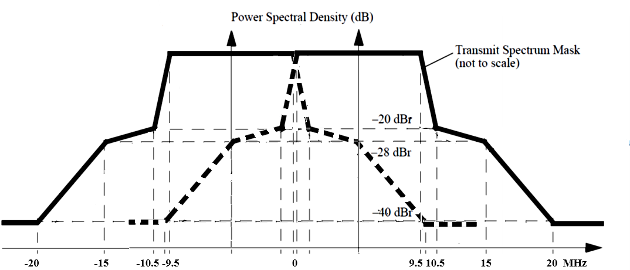
20MHz OFDM Numerology
Option 1: Define tone plan over entire 20MHz bandwidth,
For example, 11ac 40MHz with DC2.
Option 2: 11bd 10MHz + 11bd 10MHz

Slide 12
20MHz OFDM Numerology (cont.)
Option 1 requires much sharper Tx filter to achieve the 20MHz mask, with the gain of
~4% better OFDM efficiency compared to Design 2.
Option 2 “10MHz + 10MHz” enables implementation flexibility to meet the tightened 20MHz mask.
Design A: Reuse 10MHz signal generation path, and combine two 10MHz signals either in digital domain or analogue domain.
Spectrum mask can be readily met by reusing 10MHz signal generation.
Design B: Directly generate the signal using 20MHz IFFT, same as option 1.

Slide 13
Summary
In this contribution, we investigate the OFDM numerology choices for 10MHz and 20MHz 11bd PPDU.
11ac 20MHz DC2 is the best candidate for 10MHz 11bd PPDU.
In order to enable 20MHz 11bd operation, tightened spectrum mask may be needed.
20MHz 11bd PPDU can use 10MHz + 10MHz OFDM numerology.

Slide 14
Reference
[1] Rui Cao and etc., “Potential PHY Designs for NGV”, IEEE 802.11-19/0016.
[2] Dongguk Lim and etc., “PHY Design for 11bd”, IEEE 802.11-19/0332.
[3] Li Nan, and etc., “Simulation of Potential PHY Technology for NGV”, IEEE 11-19/0393.

Slide 15
Straw Poll 1
Do you agree to add the following text into Section 3 of SFD?
10MHz 11bd Data symbol shall use 11ac 20MHz OFDM numerology.
Y:
N:
A:

Slide 16
Straw Poll 2
Do you agree to add the following text into Section 3 of SFD?
20MHz 11bd Data symbol shall use 11bd 10MHz + 11bd 10MHz OFDM.
Y:
N:
A:

