Slide 1
TGbc additional use case scenario
Date: 2019-01-10
Authors:

Slide 2
Abstract
This presentation provides TGbc additional use case scenario to incorporate TGbc use case slide.

Slide 3
Scenario # VR eSports Video Distribution
Topology/Architecture
Stakes holders
  Game makers/providers/players
  Game set makers
Server
Service scene
  At the location of VR eSports games, such as arena, eBCS distributes the video that is the view of the player to the audiences.
AP
Player
Audiences
Required function
No authentication / association of STAs with AP
Required authentication of sender
Required authenticity of AP
Video distribution latency should be less than 20ms.
Distribute video to large number of audiences
Benefit of using TGbc
eBCS can distribute the video to thousands of audiences with less bandwidth consumption than unicast.

Slide 4

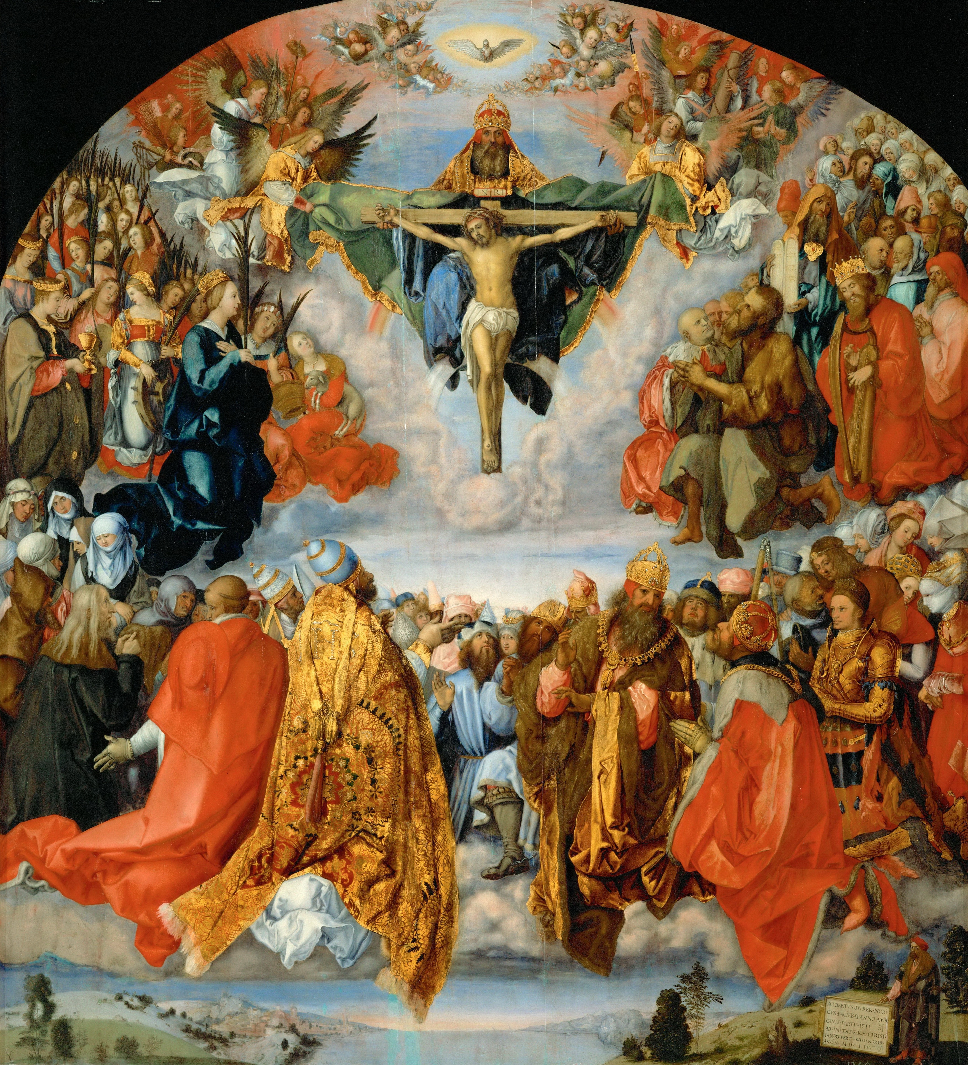




Scenario # Multi-Channel Data Distribution
Topology/Architecture
Stakes holders
  Museum/Concert Hall/Convention Hall/Sightseeing Venue/etc.
Server
Ch#1: Japanese
Ch#2: English
Ch#3: Chinese
Ch#4: Korean
…
AP
Service scene
  An AP broadcasts the same information in different languages each in a dedicated channel.
  A user can choose one of the channels
Audiences
Audiences
Required function
No authentication / association of STAs with AP
Required authentication of sender
Required authenticity of AP
Distribution of different data
People can choose their preferred channel.
Benefit of using TGbc
eBCS can be used for multi-lingual services to distribute the same information to people from multiple countries.

Slide 5

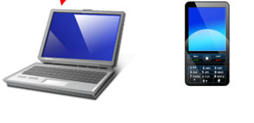
Scenario # Lecture room slide distribution
Topology/Architecture
Stakes holders
School / University /Conference room etc.
Teacher/ Professor / Speaker
Screen
Projector
with AP
Service scene
Simultaneous distribution of slides on the screen to audience PC, Tablet, etc.
The audience no need to download visual aids and change pages
Synchronized slide distribution to all of students.
Professor / Teacher/ Speaker
Student etc.
Required function
No authentication / association of STAs with AP
Required authentication of sender
Required authenticity of AP
low latency
Capacity 1000STAs
Restrict un desired changes of contents by receiver side
Benefit of using TGbc
Easy to distribution of slides to audiences simultaneously.

Slide 6






Scenario # Reginal based broadcast TV service
Topology/Architecture
Stakes holders
Local TV services company
Residential people and home
Evacuation
Information
Local
TV services
Disaster
shelter
Disaster
side
Service scene
  Local news , TV contents can be distributed to consumer BYOD devices (not TV receiver) by small local TV company.
  In case of disaster, evacuation information will be distributed without any complex customer operation.
Wi-Fi
Home
Reginal
services
Inhouse
services
Audiences
Required function
No authentication / association of STAs with AP
Required authentication of sender
Required authenticity of AP
Middle range (up to 1km) services
Benefit of using TGbc
Low CAPEX for TV company
Anytime, Anywhere receivable services for residential people
Easy installation to disaster shelter etc,.

Slide 7
Motion
Motion to approve TGbc use case scenario described in 11-19/0472r1.
And instruct editor to incorporates slide#3 to #6 of 11-19/0472r1 to the TGbc 11-19/0268 use-case-document.
Yes
No
Abstain

