Slide 1
Time-Sensitive Applications Support in EHT
Date: 2019-03-10
Authors:

Slide 2
Abstract
The RTA TIG has documented use cases and requirements for time-sensitive applications
  The main gap for 802.11 is the lack of predicable performance in terms of worst case (bounded) latency, jitter and reliability, particularly in managed environments
The EHT PAR requires improvements in latency, jitter and reliability
  Average latency in 802.11 is already low, the gap is in providing mechanisms to control worst case latency and jitter
In this presentation, we review the time-sensitive application requirements and discuss potential operating assumptions that can guide the development of EHT to meet such requirements

Slide 3
Outline
RTA and Time-sensitive requirements
TSN and new extensions to wireless
Scenarios and assumptions for time-sensitive applications
Enhancements for managed operation
Conclusions

Slide 4
Time-Sensitive Applications
(RTA Use Cases)
Real-time mobile gaming
Console gaming
Industrial automation
Real-time video
AR/VR
Drone control
RTA TIG report doc.#: 11-18-2009

Slide 5
RTA Requirements for the Wi-Fi Network
Use cases |  | Latency/ms | Jitter/ms | Packet loss | Data rate/ Mbps
Real-time gaming |  | < 10 | < 5 | < 0.1 % | < 1
Real-time video |  | < 3 ~ 10 | < 2 ~ 5 | Near-loss less | 100 ~ 20,000
Robotics and industrial automation | Equipment control | < 1 ~ 10 | < 0.2~2 | Near-loss less | < 1
 | Human safety | < 1~ 10 | < 0.2 ~ 2 | Near-loss less | < 1
 | Haptic technology | <1~5 | <0.2~2 | Loss Less | <1
 | Drone control | <100 | <10 | Loss Less | <1 >100 with video
Predictable worst case latency, jitter and reliability are required improvement areas
*RTA TIG report doc.#: 11-18-2009r4

Slide 6
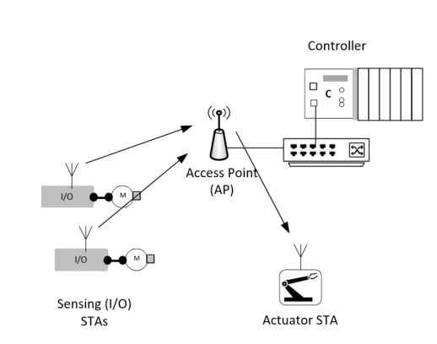
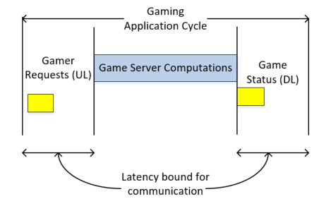
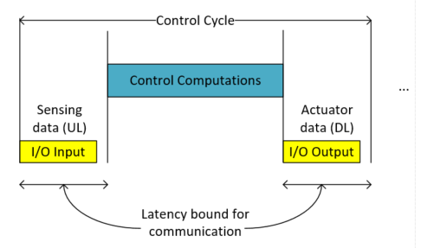
Why do we need to control latency/jitter?
Real-time mobile gaming
Industrial control system
Time synchronized operation
Latency/jitter cause lagging/bad user experience
Latency/jitter may cause instability of the system
Operation (mainly) in consumer scenarios (e.g. home)
Operation in managed/private networks (enterprise, factories, …)

Slide 7
What is TSN (Time Sensitive Networking)?
Networks (typically LANs) that provide the following features for time-critical data streams:
  Time synchronization between network nodes and hosts
  Timeliness (bounded latency)
  High reliability (very low packet loss ratios)
  Convergence of time-critical and other traffic types (e.g. best-effort) on the same network
What applications can benefit from TSN?
  Industrial control, robotics
  Automotive instrumentation, control and automation
  Professional AV, speaker arrays, AR/VR, gaming
The IETF DetNet group is extending TSN capabilities to routed networks

Slide 8
From Wired (Ethernet) to Wireless TSN
The IEEE 802.1 TSN Task Group develops standards to enable TSN features (time synchronization, bounded latency, redundancy, preemption, …) over IEEE 802 networks.
  So far, most TSN capabilities and standards have been restricted to Ethernet
  The 802.3 MAC/PHY provides support through stable/predictable links (the network can be provisioned to provide timeliness with high reliability) and other capabilities (e.g. time sync, preemption)
CUC: Central User Configuration
CNC: Central Network Configuration
Many applications would benefit from TSN capabilities over wireless
  Wireless control/automation
  Mobile robots, drones
  AR/VR, mobile gaming

Slide 9
IEEE 802.1 Time-Sensitive Networking (TSN)
Standard Ethernet with Synchronization, small and/or fixed latency, and extremely low packet loss
TSN Components
Common Standards
Time synchronization:
Time Synchronization (802.1AS)
Ultra reliability:
Frame Replication and Elimination (P802.1CB)
Path Control and Reservation (802.1Qca)
Per-Stream Filtering and Policing (802.1Qci)
Reliability for time sync (P802.1AS-Rev)
Synchronization
√ 802.1AS over 802.11
Timing Measurement (TM)
Fine Timing Measurement (FTM)
Reliability
Reliability
Latency
Bounded low latency:
Time-Aware traffic shaping (802.1Qbv)
Preemption (802.1Qbu/802.3br)
Cyclic Scheduling (802.1Qch)
Asynchronous Scheduling (802.1Qcr)
Resource Mgmt
Dedicated resources & API
Stream Reservation Protocol (802.1Qat)
TSN configuration (P802.1Qcc)
YANG (P802.1Qcp)
Link-local Registration Protocol (P802.1CS)
Zero congestion loss
Timeliness Performance Vectors yet to be enabled over Wireless
√ 802.11aa (SRP over 802.11 for AV)
√ 802.11ak (802.11 links in an 802.1Q network)
Credit: János Farkas, Ericsson
TSNA Conference 2017, http://www.tsnaconference.com/

Slide 10
802.1 TSN and Wireless Support Required
Application
Transport
Direct L2 access
IP Encapsulation
IP
IEEE 802.1 Network
TSN Capabilities: time sync, time-aware, reservations, and many others …
L2 TSN protocols for reservation, scheduling, … need MAC/PHY support
Link Layer
MAC/PHY
IEEE 802.3
Ethernet
IEEE 802.11
Wi-Fi
3GPP
5G URLLC
Media Specific Support required for TSN Capabilities
802.11 support for TSN:
3GPP 5G NR support for TSN:
  Time synchronization: 802.1AS over 802.11 (TM and FTM)
  Timeliness (bounded latency, reliability): N/A (opportunity with EHT)
  5G_URLLC, Vertical_LAN, NR_unlic WIs (Rel-16)
  TSN support (time synchronization, bounded latency) is part of Vertical_LAN WI.

Slide 11
TSN over 5G URLLC
Goal is to enable a 5G TSN Network to behave as a Virtual Bridge
Mainly driven by market opportunity and industry transformations
  Industry 4.0, smart manufacturing, Industrial IOT
Assumption: solution to be deployed as a Private (managed) Network
  single operator, planned deployment, ability to coordinate access
  Leverage unlicensed (<7GHz) spectrum (5G NR-U)
Key 5G NR feature
  Low latency guarantees through scheduled access and scalable 5G NR frame structure/numerology
  Targeting latencies down to 1 ms with 99.9999 reliability for the air interface [Factory Automation/URLCC - 3GPP TR 38.824]

Slide 12
Why support is required from the 802.11 MAC/PHY?
The 802.1 TSN protocols need support to operate on top of 802.11
A simple example can illustrate the problem
It is hard to meet the bounded latency due to contention/congestion in the 802.11 network
This is the main problem identified by the RTA TIG.

Slide 13
Considerations for meeting time-sensitive performance targets in 802.11
Interference and congestion are the main challenges leading to variable latency in 802.11
  caused by OBSS operation, by other (unmanaged) STAs or other devices/networks sharing the spectrum
Managing the use of the spectrum is required to meet predictable low latency/jitter and high reliability requirements
The most stringent time-sensitive requirements can be met in the scenarios where the network (APs and STAs) is managed
  This is practical in several scenarios (e.g. private enterprises, factories)
  In such scenarios, scheduled access has several benefits as described in a previous presentation [Pascal Thubert, Cisco, 802.11-18/1918r0]: optimize bandwidth usage, reduce frame loss, reduce power consumption

Slide 14
Operating Scenarios
Normal operation: this is the typical Wi-Fi operation where interference and contention are expected (e.g. from unmanaged OBSSs, legacy devices, …) and no coordination exists between BSSs to avoid interference/contention
  Example scenarios: public hot spots, apartment buildings, homes, …
  Enhancements in throughput, latency and jitter can enable time-sensitive applications in these scenarios but performance will be limited by interference
Managed operation: A scenario where all BSSs and STAs are managed and interference can be controlled to support time-sensitive requirements. There is no interference due to unmanaged BSSs/STAs.
  Example scenarios: factory networks, enterprise networks, …
  These are mostly indoor areas, where physical access is typically enforced and network access is fully controlled (no BSS or STA can be enabled without the network manager’s knowledge).
  Predictable low latency, jitter and higher reliability can be obtained more easily under the assumption that there is no unmanaged interference

Slide 15
Example scenarios
Normal operation scenario (Home scenarios with OBSSs)
Managed scenario
(Private factory network)
Throughput, latency/jitter enhancements subject to unmanaged OBSS interference
Predictable throughput, latency/jitter and reliability performance

Slide 16
Managed Operation Design Goals
Predictable channel access with minimal overhead for time-sensitive traffic streams
Support periodic and asynchronous traffic
Compliance with channel access regulations for unlicensed bands
Support time-sensitive services in managed scenarios, but enable coexistence with unmanaged 802.11 networks for scenarios/applications that less-demanding time-sensitive requirements

Slide 17
Conclusions
EHT has the opportunity to provide more predictable low latency/jitter and improve reliability for RTA and time-sensitive applications
RTA and TSN enhancements should consider multiple scenarios
  Normal (unmanaged) operation: support RTA applications in OBSS scenarios
    Throughput increase, congestion control, dual-links, …
  Managed operation: enable RTA/time-sensitive services where interference/OBSSs can be managed/avoided
    Efficient scheduled channel access
    It may also be used in unmanaged (or semi-managed) scenarios (e.g. multiple managed APs in a home), depending on the level of OBSS interference
EHT MAC/PHY can also consider support for other TSN capabilities (redundancy, preemption, … )

Slide 18
References
Doc#: 802.11-18/1419r4
Doc#: 802.11-18/1160r0
Doc#: 802.11-18/1918r0

