Slide 1
Fading Channel Models for 5.9 GHz NGV simulations
Date: 2019-03-08
Authors:

Slide 2
Abstract
This submission provides technical details on channel models for ITS-band at 5.9 GHz, for IEEE 802.11p and IEEE 802.11bd performance testing.
This submission reviews the extensive and more than sufficient modelling work that has taken place in the past for V2X application in the 5.9 GHZ ITS band, originally for IEEE 802.11p standardization.
The models presented in this submission are TDL (tap-delay-lines) models, and shall be used for device testing and PHY link-level simulations. This submission presents the « classical » models and the « enhanced » ones as well.

Slide 3
Introduction (1)
High-speed and rich multi-path fading are two key element of V2X communications in the 5.9 GHz ITS band, which is a challenging band (wavelength = 5cm)
Multitude of driving conditions can occur for V2X communications, with LOS often obstructed by trucks, other vehicles, buildings, or road curvature
Doppler effect is key element, where the fading channel state evolves rapidly.
[1]. P. Alexander, D. Haley and A. Grant, “Outdoor Mobile Broadband Access with 802.11”, IEEE Comm Mag, Nov. 2007

Slide 4
Introduction (2)
Studies have been carried out [1-2-3-5] to properly model such fading channels, and usually describe three main situations, with : Urban, Rural, Highway
These scenarios are usually available in LOS and NLOS version [6-7].
ETSI ITS-G5 ETSI TS 103 257-1 (draft) specifies TDL channel models for V2X testing [7].

Slide 5
Introduction (3)
Reference articles and submissions on this topic:
[1] P. Alexander, D. Haley and A. Grant, “Outdoor Mobile Broadband Access with 802.11”, IEEE Comm Mag, Nov. 2007
[2] Ian Tan, Wanbin Tang, Ken Laberteaux, Ahmad Bahai , “Measurement and Analysis of Wireless Channel Impairments in DSRC Vehicular Communications,” Electrical Engineering and Computer Sciences University of California at Berkeley, April 2008
[3]. A. Molisch, F. Tufvesson, J. Karedal, C. F. Mecklenbrauker “A Survey of Vehicle-to-Vehicle Propagation Models”, IEEE Wireless Comm Mag, Dec 2009
[4] Paul Alexander, David Haley, Alex Grant , “Cooperative Intelligent Transport Systems: 5.9-GHz Field Trials,” Proceedings of The IEEE Volume:99 , Issue 7, July 2011
[5] Laura Bernado, Thomas Zemen, Fredrik Tufvesson, Andreas F. Molisch, Christoph F. Mecklenbrauker , “Delay and Doppler Spreads of Non-Stationary Vehicular Channels for Safety Relevant Scenarios,” May 2013
[6] Malik Khan (Cohda Wireless), “IEEE 802.11 Regulatory SC DSRC Coexistence Tiger Team, V2V Radio Channel Models”, IEEE 802.11-14/0259r0
[7] ETSI ITS-G5 ETSI TS 103 257-1 v0.0.6 (2018-10) (draft)

Slide 6
« Classical » TDL models
Rural LOS
Urban Approaching LOS
Urban Crossing NLOS
Highway LOS
Highway NLOS

Slide 7
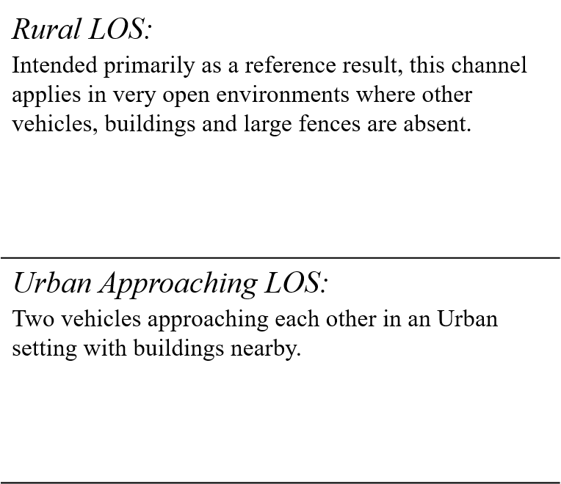
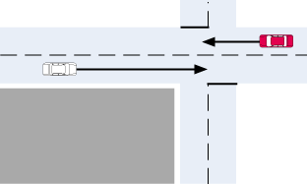
Scenario Descriptions (1)

Slide 8
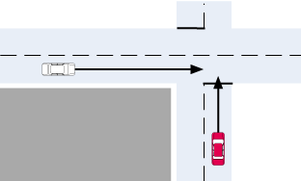
Scenario Descriptions (2)

Slide 9
« Classical » TDL models: parameters
 |  | Power [dB] | Delay [ns] | Doppler [Hz] | Profile
Urban approaching LOS | Tap 1 | 0 | 0 | 0 | Static
 | Tap 2 | -8 | 117 | 236 | HalfBT
 | Tap 3 | -10 | 183 | -157 | HalfBT
 | Tap 4 | -15 | 333 | 492 | HalfBT
Urban crossing NLOS | Tap 1 | 0 | 0 | 0 | Static
 | Tap 2 | -3 | 267 | 295 | HalfBT
 | Tap 3 | -4 | 400 | -98 | HalfBT
 | Tap 4 | -10 | 533 | 591 | HalfBT
Rural LOS | Tap 1 | 0 | 0 | 0 | Static
 | Tap 2 | -14 | 83 | 492 | HalfBT
 | Tap 3 | -17 | 183 | -295 | HalfBT
Highway LOS | Tap 1 | 0 | 0 | 0 | Static
 | Tap 2 | -10 | 100 | 689 | HalfBT
 | Tap 3 | -15 | 167 | -492 | HalfBT
 | Tap 4 | -20 | 500 | 886 | HalfBT
Highway NLOS | Tap 1 | 0 | 0 | 0 | Static
 | Tap 2 | -2 | 200 | 689 | HalfBT
 | Tap 3 | -5 | 433 | -492 | HalfBT
 | Tap 4 | -7 | 700 | 886 | HalfBT
119km/hr max differential
126km/hr max differential
144km/hr max differential
252 km/hr max differential
252 km/hr max differential

Slide 10
Doppler Spectra
The Delay and Mean Power of the taps is a strong function of the environment whereas the Doppler frequencies can scale with speed stipulated as part of the scenario.
We want asymmetric spectra, and thus the Doppler spectra is specified as half-bath tub. Other options are a uniform offset Classic Bathtub.
The key attributes of these Doppler spectra are that they induce a significant bias to the instantaneous Doppler consistent with the constant macro dynamics of the scenario.
For example two cars approaching a blind intersection will tend to compress frequency on the direct path but may stretch frequency on a reflected path of a following truck.
Power
Classic Bath Tub
Pure Doppler
Asymmetric Uniform
Doppler freq
-fd
0
fd

Slide 11
« Enhanced » TDL models
Enhanced V2V channel profile is still a tapped delay line model, same as the originally Car2Car channel profile.
However, more taps with longer delay spread and higher Doppler are added to reflect more challenging fading channel environments.
The resulting channel characteristics (e.g., delay spread, Doppler) were intended to match real-world channel characteristics reported in empirical measurement campaigns conducted in US and Europe [1][3].
These enhanced models can be used in addition to the “classical” models, for more stringent channels.
Enhanced Rural LOS
Enhanced Urban Approaching LOS
Enhanced Urban Crossing NLOS
Enhanced Highway LOS
Enhanced Highway NLOS

Slide 12
« Enhanced» TDL models: parameters
 |  | Power [dB] | Delay [ns] | Doppler [Hz] | Profile
Enhanced Urban approaching LOS | Tap 1 | 0 | 0 | 0 | Static
 | Tap 2 | -11 | 222 | 224 | HalfBT
 | Tap 3 | -13 | 334 | 1173 | HalfBT
 | Tap 4 | -15 | 533 | 588 | HalfBT
Enhanced Urban crossing NLOS | Tap 1 | 0 | 0 | 0 | Static
 | Tap 2 | -3 | 220 | -142 | HalfBT
 | Tap 3 | -4 | 266 | -542 | HalfBT
 | Tap 4 | -7 | 475 | -155 | HalfBT
 | Tap 5 | -15 | 630 | 320 | HalfBT
Enhanced Rural LOS | Tap 1 | 0 | 0 | 0 | Static
 | Tap 2 | -12 | 84 | 94 | HalfBT
 | Tap 3 | -15 | 183 | -1176 | HalfBT
Enhanced Highway LOS | Tap 1 | 0 | 0 | 0 | Static
 | Tap 2 | -11 | 167 | 1941 | HalfBT
 | Tap 3 | -13 | 433 | -1176 | HalfBT
 | Tap 4 | -17 | 600 | -391 | HalfBT
Enhanced Highway NLOS | Tap 1 | 0 | 0 | 0 | Static
 | Tap 2 | -2 | 100 | 50 | HalfBT
 | Tap 3 | -5 | 500 | 1157 | HalfBT
 | Tap 4 | -7 | 867 | -2352 | HalfBT
 | Tap 5 | -15 | 1152 | 1573 | HalfBT
215 km/hr max differential
158 km/hr max differential
232 km/hr max differential
571 km/hr max differential
718 km/hr max differential

Slide 13
Benefits
Extensive and more than sufficient modelling work already carried out for V2X application in the 5.9 GHZ ITS band, originally for IEEE 802.11p standardization.
We propose to re-use the five “classical” TDL models, and introduced their enhanced version for system testing and PHY link-level simulations.
« Classic » TDL models | « Enhanced » TDL models
Urban approaching LOS | Enhanced Urban approaching LOS
Urban crossing NLOS | Enhanced Urban crossing NLOS
Rural LOS | Enhanced Rural LOS
Highway LOS | Enhanced Highway LOS
Highway NLOS | Enhanced Highway NLOS

