Slide 1
Simulation of Multi-channel Interference
Date: 2019-03-14
Authors:
Onn Haran, Autotalks

Slide 2
Abstract
March 2019
Multi-channel interference mitigation scheme was presented in the last meeting (IEEE802.11-19-48/r0)
In a nutshell, defer transmission when transmission in adjacent channels is detected
Network simulation results of concurrent multi-channel operation, with and without mitigation scheme, are presented
The expansion of V2X service depends on using multiple channels without degrading communication range
Onn Haran, Autotalks

Slide 3
Network Simulation Environment
March 2019
All vehicles include two MACs tuned to two different channels
Vehicles are statically placed 25 meters apart on two-lanes road
Concurrent operation of all MACs is simulated
PHY is modeled. A packet is received when power exceeds sensitivity
-95dBm sensitivity
+23dBm transmission power
Applying two-ray model with adding 2dB attenuation for each blocking vehicle
Enhanced adjacent channel rejection (25dB for QPSK ½)
Onn Haran, Autotalks

Slide 4
Simulated Traffic
March 2019
Packets are transmitted periodically
Random delay between transmissions: 95-105mS
Packet length is distributed uniformly
Safety channel packet length: 200-400 bytes
Second channel packet length: 400-800 bytes
Simulation was also performed while doubling those lengths
Channel load
Each vehicle observes ~34 other vehicles
Safety channel: ~20% load
Second channel: ~40% load
No DCC
Onn Haran, Autotalks

Slide 5
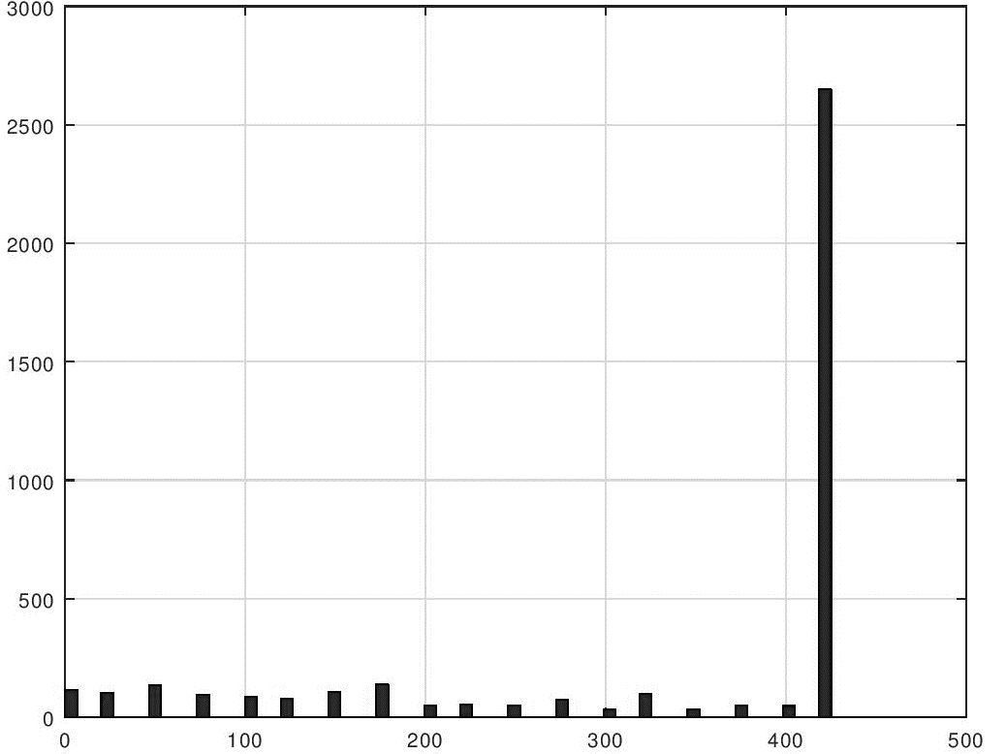
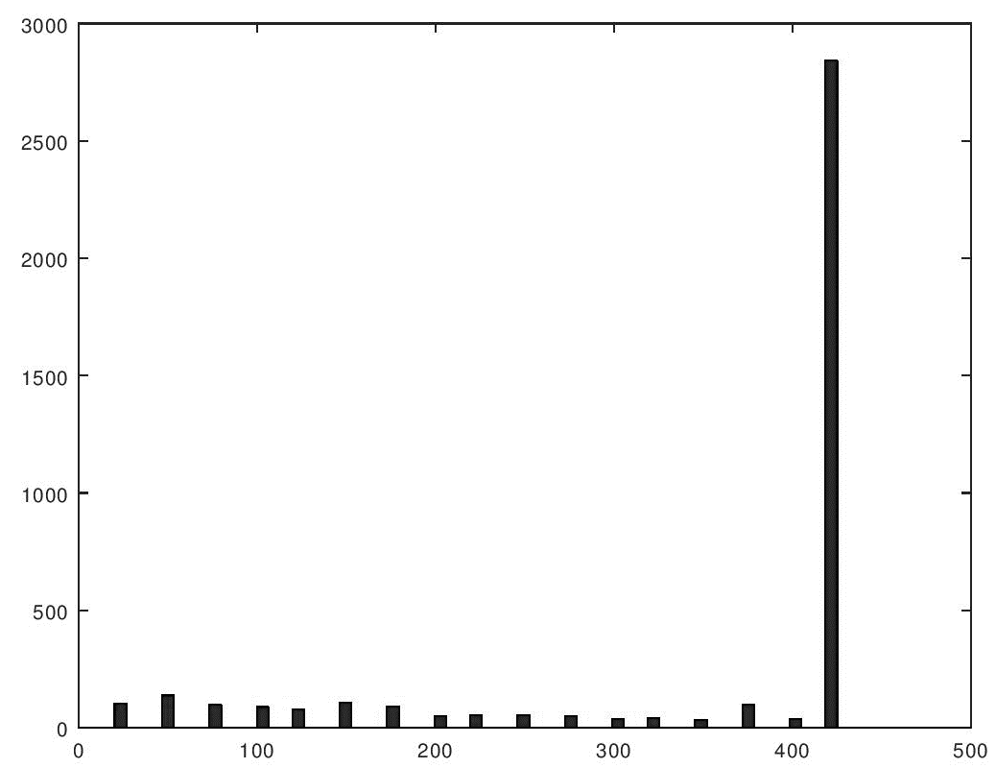
Network Simulation Results Histogram of communication range
March 2019
Adjacent channel
Co-adjacent channel
Occurrences
Occurrences
Communication range drops due to multi-channel interference
Communication range [m]
Communication range [m]
Onn Haran, Autotalks

Slide 6
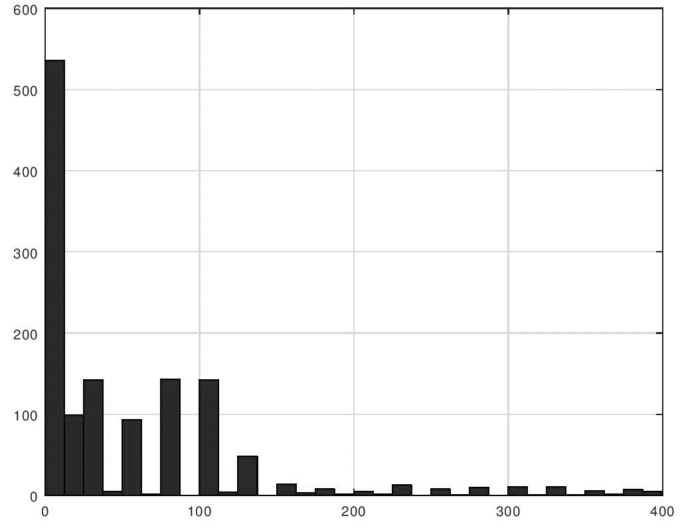
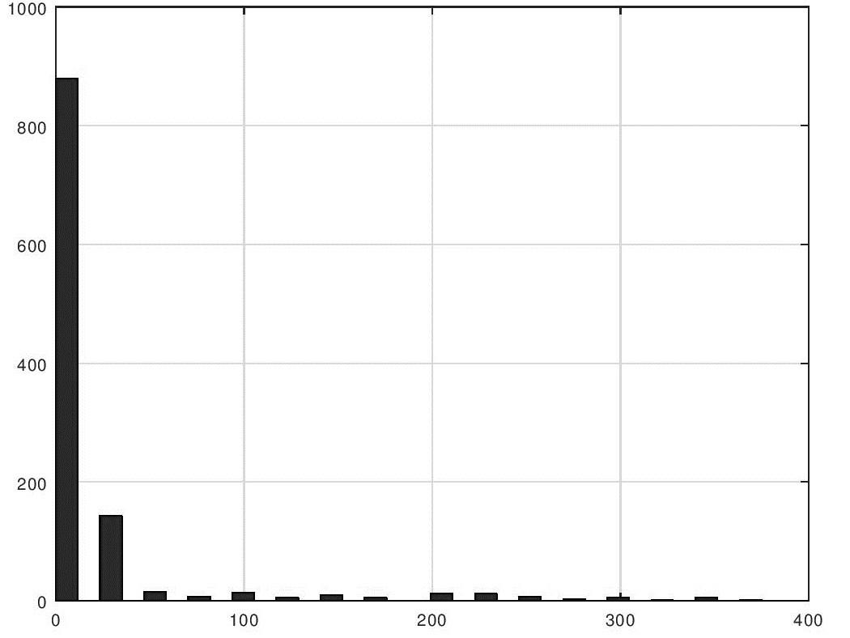
Network Simulation Results Histogram of diameter of no communication zone
March 2019
Adjacent channel
Co-adjacent channel
Interference spans far beyond second channel transmitter
Interference mostly blinds one channel when vehicle transmits second channel
For example: if interfering vehicle is 150m away, then no communication only between 150-175m
Occurrences
Occurrences
Communication range [m]
Communication range [m]
Onn Haran, Autotalks

Slide 7
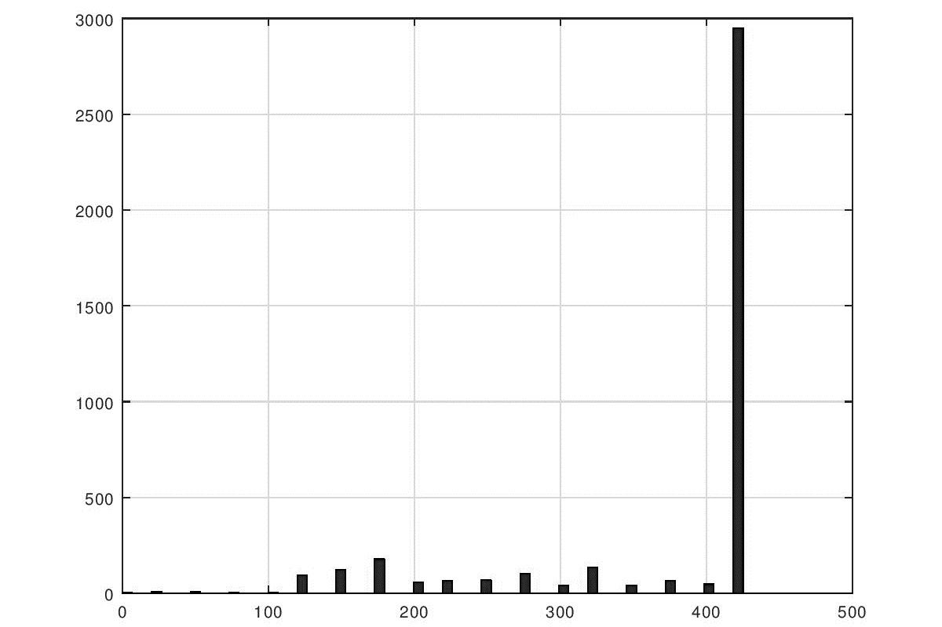
Results when Transmission is Deferred to Avoid Interferences Histogram of communication range
March 2019
Adjacent channel
Occurrences
Interference-free operation
Communication range [m]
Onn Haran, Autotalks

Slide 8
Probability of Shortened Communication Range 20% / 40% Channel load
March 2019
Adjacent channel detection threshold | Occurrence of range <100m | Occurrence of range <200m | Occurrence of range <300m
Baseline: no mitigation | 11.2% | 21.4% | 27.1%
-62dBm detection | 5.7% | 16.9% | 23.1%
-67dBm detection | 3.2% | 15.1% | 22.1%
-72dBm detection | 0.5% | 10.6% | 17.9%
-77dBm detection | 0.4% | 5.6% | 13.7%
-82dBm detection | 0.4% | 0.6% | 9.5%
Onn Haran, Autotalks

Slide 9
Probability of Shortened Communication Range Double packet length (double channel load)
March 2019
Adjacent channel detection threshold | Occurrence of range <100m | Occurrence of range <200m | Occurrence of range <300m | Latency >10mS | Max latency
Baseline: no mitigation | 21.2% | 40% | 50.4% | 0.2% | 16.5mS
-62dBm detection | 13.3% | 34.2% | 45.2% | 0.3% | 20mS
-67dBm detection | 7.2% | 30.5% | 42.7% | 0.2% | 13.6mS
-72dBm detection | 2.1% | 22.2% | 36.9% | 0.3% | 18mS
-77dBm detection | 2.6% | 13.5% | 30% | 0.3% | 17mS
-82dBm detection | 2.5% | 3.4% | 22.9% | 0.4% | 17.6mS
Onn Haran, Autotalks

Slide 10
Observations
March 2019
Adjacent channel cannot be used without a mitigation scheme
Mitigation scheme, based on deferring transmission upon energy existence in adjacent channel, effectively protects close vehicles without impacting latency
Each MAC detects adjacent channel activity
Mitigation scheme applies to vehicles with single MAC or dual MAC
Co-adjacent interference mostly impacts same vehicle
A vehicle with two MACs can condition a transmission in one channel by inactivity of other channel
Onn Haran, Autotalks

Slide 11
Adjacent Channel Activity Detection
March 2019
It is very challenging to estimate the energy of the adjacent channel from just analyzing the main channel
Most implementations would determine either “some energy exists in the adjacent channel” or “no energy exists in the adjacent channel”
Better adjacent channel detection sensitivity increases the interference-free communication range
Adjacent channel detection threshold should be further studied
-72dBm is back-of-the-envelope value, roughly assuring 200m interference free communication range in LOS
Onn Haran, Autotalks

