Slide 1
802.11 New Participant Introduction
Date: 2019-07-15
Authors:
Slide 1
Notes:
doc.: IEEE 802.11-06/0528r0
May 2006
Bruce Kraemer, Marvell
Page 1

Slide 2
July 2019
Welcome to IEEE 802.11 Newcomer Orientation
IEEE 802 Plenary Session
Last updated, July 15th, 2019
Slide 2
Adrian Stephens, Intel : Stephen McCann, Blackberry
Notes:
2
2

Slide 3
Where can I access important information?
The 802.11 website is your starting point for looking for information, as this links to all other relevant sources.
Bookmark this now: http://www.ieee802.org/11/
The other major information source is submissions on the 802.11 document server.
Bookmark this now: https://mentor.ieee.org/802.11/documents
Download this submission from the document server now as you may need it to follow the presentation.

Slide 4
Who we are

Slide 5

IEEE Standards Association (IEEE-SA)
Vision: To be a world-class standards-development organization
Mission: To provide a high-quality, market-relevant standardization environment, respected worldwide
20,000 STANDARDS DEVELOPERS
160⁺ COUNTRIES INVOLVED
1200⁺
ACTIVE STANDARDS
600⁺ STANDARDS UNDER DEVELOPMENT
IEEE Standards span a broad spectrum of technologies, such as:
Aerospace Electronics
Broadband Over Power Lines
Broadcast Technology
Clean Technology
Cognitive Radio
Design Automation
Electromagnetic Compatibility
Green Technology
Ethernet/WLAN
Medical Device Communications
Nanotechnology
Organic Components
Portable Battery Technology
Power Electronics
Power & Energy
Radiation/Nuclear
Reliability
Transportation Technology

Slide 6
IEEE 802 within IEEE and IEEE-SA Structure
IEEE MEMBERS
Board of Directors (BOD)
Exec Director & Staff
Technical
Activities:
many technical societies
Publication
Activities
Standards Association
(IEEE-SA)
Member & Geographic
Activities
Educational
Activities
IEEE 802 LMSC is a standards sponsor of the IEEE-SA and standards committee of the IEEE Computer Society.
IEEE Computer Society
IEEE-SA Board of Governors
(BOG)
Corporate Advisory Group (CAG)
Registration Authority Committee (RAC)
Standards Activities
IEEE 802 LMSC
Standards Board
(SASB)
Administrative Committee
(AdCom)
Audit Committee
(AudCom)
Industry Connections Committee
(IC Com)
New Standards Committee
(NesCom)
Patent Committee
(PatCom)
Procedures Committee
(ProCom)
Standards Review Committee
(RevCom)

Slide 7
Lower-Layer Focus
Reference
Model for
End Stations
  IEEE 802 standards emphasize the functionality of the lowest two layers of the OSI reference model, and the higher layers as they relate to network management
    physical layer (PHY, Layer 1)
    data link layer (DLL, Layer 2)
  IEEE 802 divides DLL into:
    Medium Access Control (MAC)
      Multiple specifications
    Common logical link control (LLC)
  See details in IEEE Std 802
    “IEEE Standard for Local and Metropolitan Area Networks: Overview and Architecture”
Application
Presentation
Session
Transport
Network
LLC
IEEE
802
Data Link
MAC
Physical
Medium
•Copper
•Fiber
•Air
•Others?
Notes:
7
7

Slide 8
Computer Society Sponsors
July 2019
Cloud Computing Standards Committee: Steve Diamond (s.diamond@computer.org)
Design Automation Standards Committee: Stan Krolikoski (stanleyk@cadence.com)
Cybersecurity and Privacy Committee: Eric Hibbard (eric.hibbard@ieee.org)
Learning Technology Standards Committee: Avron Barr (avron@aldo.com)
LAN/MAN (IEEE 802) Standards Committee: Paul Nikolich (p.nikolich@ieee.org)
Microprocessor Standards Committee: Baker Kearfott (rbk@louisiana.edu)
Portable Applications Standards Committee: Joseph Gwinn (gwinn@raytheon.com)
Software & Systems Engineering Standards Committee: Paul Croll (pcroll@computer.org)
Simulation Interoperability Standards Organization Standards Committee: Katherine Morse (Katherine.Morse@jhuapl.edu)
Test Technology Standards Committee: Adam Cron (adam.cron@synopsys.com)
Slide 8
Adrian Stephens, Intel : Stephen McCann, Blackberry

Slide 9
July 2019
Some terms
PAR – project authorization request – the document that authorizes work on a project.
WG - Working group – responsible for developing standards in an area
TAG – Technical Advisory Group – experts on a topic area that crosses working groups – may develop a recommended practice.
Task group or Task force – a part of a working group which focuses on a particular project.
Slide 9
Adrian Stephens, Intel : Stephen McCann, Blackberry
Notes:
9
9

Slide 10
July 2019
All those dots….decoder ring
802.1 Bridging and Architecture – generally the top of the link layer
802.3 Ethernet
802.11 Wireless LAN (WLAN)
802.15 Wireless Personal Area Network (WPAN)
802.16 Broadband Wireless Access (BWA)
802.18 Radio Regulatory TAG
802.19 Coexistence
802.21 Media Independent Handover Services (MIS)
802.22 Wireless Regional Area Networks (WRAN)
802.24 Vertical Applications TAG
Slide 10
Adrian Stephens, Intel : Stephen McCann, Blackberry
Notes:
10
10

Slide 11
July 2019
EXECUTIVE COMMITTEE (EC)
CHAIR
Paul Nikolich
Working Group/TAG Chairs
802.1
BRIDGING/ARCH
Glenn Parsons
802.3
Ethernet
David Law
802.11
WLAN
Dorothy Stanley
Hibernating
WG Chairs
(non voting)
Appointed Officers
802.15
WPAN
Bob Heile
802.21
Media indep. Handover Servs
Subir Das
802.18 TAG
Radio Regulatory
Ray Holcomb
802.17
Resilent Packet
Ring
John Lemon
1st Vice Chair
Roger Marks
2nd Vice Chair
James P.K. Gilb
802.19
Coexistence
Steve Shellhammer
802.22
WRAN
Apurva Mody
802.24
Vertical Applications
Tim Godfrey
Executive Secretary
Jon Rosdahl
802.16
BWA
Roger Marks
Recording Secretary
John D’Ambrosia
IEEE 802 Organization
Treasurer
Clint Chaplin
Member Emeritus
(non-voting)
Geoff Thompson
DISBANDED
802.2 LLC 802.4 Token Bus ECSG TV Whitespace
802.5 Token Ring 802.6 DQDB ECSG Emergency Services
802.7 Broadband TAG 802.8 Fiber Optic TAG 802.23 Emergency Services 802.9 ISLAN
802.10 Security 802.12 Demand Priority 802.14 CATV
802.20 Mobile Broadband Wireless Access
Slide 11
Adrian Stephens, Intel : Stephen McCann, Blackberry
Notes:
11
11

Slide 12
IEEE 802.11 Revisions
July 2019
802.11
-2016
802.11
-2012
802.11
-2007
802.11
-2003
11aa
Video Transport
11k
RRM
11s
Mesh
11e
QoS
MAC
11u
WIEN
11v
Network
Management
11h
DFS & TPC
IEEE
Std
802.11
-1997
11ae
QoS Mgt Frames
11z
TDLS
11i
Security
11d
Intl roaming
11w
Management
Frame
Security
11r
Fast Roam
11f
Inter AP
11af
TV Whitespace
11n
High
Throughput
(>100 Mbps)
11j
JP bands
11a
54 Mbps
5GHz
PHY & MAC
11ac -VHT
>1 Gbps @ 5GHz
11p
WAVE
11y
Contention
Based
Protocol
11g
54 Mbps
2.4GHz
11b
11 Mbps
2.4GHz
11ad - VHT
>1 Gbps @ 60GHz
Notes:
doc.: IEEE 802.11-11/0483r0
May 2011
Bruce Kraemer (Marvell)
Page 12

Slide 13
IEEE 802.11 Standards Pipeline
July 2019
MAC
802.11aq
PAD
802.11
-2016
802.11
REVmd
802.11az
NGP
802.11ak
GLK
802.11bc
BCS
Random and
Changing MAC
Addresses
(RCM) TIG
802.11ba
WUR
802.11ai
FILS
WNG
802.11be
EHT
802.11ax
HEW
802.11ah
< 1Ghz
802.11bd
NGV
802.11ay
NG60
802.11bb
LC
802.11aj
CMMW
MAC & PHY
Discussion Topics
TIG/Study
groups
TG without
Approved draft
WG
Letter Ballot
Published
Amendment
Published
Standard
13
Notes:
doc.: IEEE 802.11-11/0483r0
May 2011
Bruce Kraemer (Marvell)
Page 13

Slide 14
Life Cycle
July 2019
Slide 14

Slide 15
IEEE Standards Development:
Process Flow
July 2019
Decide / Choose Technology
Write / update a Draft
Letter Ballot Draft
Idea!
Resolve Comments
Done?
~ 4 years
Project Approval Process
Develop Draft Standard
(in Working Group)
Sponsor Ballot
IEEE-SA Standards Board Approval Process
Publish Standard
Revise or Withdraw Standards
Maximum of 10 years
Slide 15
Adrian Stephens, Intel : Stephen McCann, Blackberry
Notes:
This chart illustrates the whole standards process in simplified form.
Idea: The idea for a standard is usually developed by a group of people, and the responsibility for the idea is assumed by the sponsor. The sponsor is usually a society or an existing standards committee.
Project Approval Process: This idea is then transferred onto a form called the Project Authorization Request (PAR) and submitted to the New Standards Committee (NesCom) for approval.
Develop draft standard: The draft is then developed and revised by the working group.
Ballot draft: When the draft work is finalized, the sponsor forms the balloting group and ballots the standard.
Standards Board Approval: After your ballot has achieved consensus, the draft then goes to the Review Committee (RevCom) and the Standards Board for approval. The amount of time from PAR to Board approval is 4 years (an extension can be made if absolutely necessary).
Publish Standard: The draft is then edited and formatted by an IEEE Project Editor and published.
The standard is valid for 10 years before it must be revised or withdrawn.

Slide 16
IEEE-SA Individual and Corporate Standards Development
July 2019
Open, consensus-based process
Open – anybody can participate (payment of meeting fees may be needed)
Individual standards development
  Each individual has one vote
Corporate standards development
  One company/one vote
Results frequently adopted by national, regional, and international standards bodies
Slide 16
Adrian Stephens, Intel : Stephen McCann, Blackberry

Slide 17

IEEE Standards Development: Project Authorization
July 2019
A project may be started by any individual or company
Each project must be supported by a technical group in the IEEE
  Referred to as a “Sponsor”
  Official developer of standard
Projects approved through document called Project Authorization Request (PAR)
  Summarizes details of project
Slide 17
Adrian Stephens, Intel : Stephen McCann, Blackberry
Notes:
Approval of a PAR means that the work is authorized by the IEEE-SA Standards Board
The PAR is the means by which IEEE can extend the umbrella of indemnification (or protection) to its standards developers

Slide 18

IEEE Standards Development: Develop Draft Standard
July 2019
A standard is written by a working group
  The working group consists of participants interested in creating the standard
The working group chooses a way to create the first draft document
  The group writes initial draft, or
  The draft developed from existing documents and specifications
Draft document are refined in the working group through multiple iterations and review
Slide 18
Adrian Stephens, Intel : Stephen McCann, Blackberry
Notes:
Some tips for starting the development of your draft include the following:
• Develop an outline that will be used as key clauses.
• Divide up each topic or clause among working group members, preferably according to their experience.
• It is to your advantage to assign a working group member as a technical editor. During the development process, the technical editor will ensure consistency and can gather and incorporate all contributions and comments.
• The working group meetings should only be used for reviewing important points in the draft and resolving areas of disagreement.
• Working with an IEEE Project Editor will expedite the project since the editor can flag items that could otherwise be slowed down by the IEEE-SA Standards Board during the approval process.
• Use the IEEE Standards Style Manual as the reference for document structure.

Slide 19
IEEE Standards Development: Consensus process
July 2019
Consensus is determined through a ballot
Interested individuals or organizations are invited to ballot on draft standards
A ballot group receives document, reviews it, and votes/comments on it
  Vote yes (approve), no (disapprove), abstain
  Can offer comments on document as well
Ultimate approval of standard is granted by the IEEE-SA Standards Board
Slide 19
Adrian Stephens, Intel : Stephen McCann, Blackberry
Notes:
• The sponsor forms the balloting group. In some cases, this may involve using the membership of an active committee or committees; in other cases, this may involve inviting a wide variety of interested parties to participate.
• The sponsor also approves the balance of the group. No one interest group can be more than 33%.
• Once the balloting group is formed, the composition of that balloting group cannot change until the close of the ballot.
• The IEEE-SA now allows three types of ballot groups: one made up of individuals, one made up of Entities (persons who are representing an Entity), and one made up of both of these types of ballots. See the IEEE-SA Standards Board Operations Manual for details of these balloting processes.

Slide 20
IEEE Standards Development: Publication & Maintenance
July 2019
Standard published after approval
Standard is valid for 10 years after approval
  After 10 years, must be revised or withdrawn
Slide 20
Adrian Stephens, Intel : Stephen McCann, Blackberry
Notes:
Once your standard has been approved, it will receive a thorough, detailed edit from an IEEE Standards editor. The editor does not make any technical changes, thereby ensuring the technical integrity of the document.
It is also the role to the editor to format the text in accordance with IEEE Standards Style. A draft copy is then provided to the committee for final review. Appropriate editorial corrections are then made and the standard is published.
Complimentary copies are then issued to the working group and awards are given to the Chair of the working group in recognition of the work done.

Slide 21
Policy
July 2019

Slide 22
Guiding Principles of the Standards Process
July 2019
Due Process
Develop, publish and follow procedures
Openness
All materially interested parties have access to the process and information
Consensus
Goal is agreement among the majority. For technical matters this means 75%
Balance
Representation from members of all materially interested parties
Notes:
22
• Due process means developing procedures, making them publicly available, and following them. This also means that you need to know the procedures of the IEEE-SA Standards Board, your society, and your technical committee.
• Openness ensures that everyone has access to the process. This is accomplished by making sure that all interested and affected parties can participate in your working group and that all actions are publicly available.
• Consensus means the majority agrees on an issue. While mostly employed during the balloting process, consensus can also be used to help resolve contentious working group issues as well.
• Balance is used during the balloting stage of a draft standard. It is achieved by composing a balloting group that includes a balance between the basic categories of producers, users, and general interest.
• Appeals can be made at any time in the process—even after approval of the standard. In the IEEE, appeals can be technical (which is heard at the Sponsor) or procedural (which is heard at the Standards Board).

Slide 23
Policies and Procedures - Intro
July 2019
The operation of the 802.11 working group (WG11) is governed by a number of documents (next slide).
Matters of procedure in 802.11 (where not described by one of the higher documents in the hierarchy) are decided by the WG11 chair. These WG11 procedures are described in the WG11 operations manual.
If you are new to standards development or new to WG11, do not despair! Day to day rules can be learned by observing and participating in the WG. If you are unsure about the operation of some procedure in WG11, speak to one of the WG officers or the officers of its subgroups.

Slide 24
IEEE-SA policy documents
July 2019
IEEE Code of Ethics
  http://www.ieee.org/about/corporate/governance/p7-8.html
IEEE Standards Association (IEEE-SA) Affiliation FAQ
  http://standards.ieee.org/faqs/affiliation.html
Antitrust and Competition Policy
  http://standards.ieee.org/resources/antitrust-guidelines.pdf
Letter of Assurance Form
  http://standards.ieee.org/develop/policies/bylaws/sect6-7.html#loa
  https://development.standards.ieee.org/myproject/Public//mytools/mob/loa.pdf
IEEE-SA Patent Committee FAQ & Patent slides
  http://standards.ieee.org/board/pat/faq.pdf and http://standards.ieee.org/board/pat/pat-slideset.ppt
Notes:
Agenda item 2.1.2.1

Slide 25
Current IEEE-SA Rule documents
July 2019
The current version of the IEEE-SA Standards Board Bylaws is available at:
  http://standards.ieee.org/develop/policies/bylaws/index.html (HTML version)
  http://standards.ieee.org/develop/policies/bylaws/sb_bylaws.pdf (PDF version)
The current version of the IEEE-SA Standards Board Operations Manual is available at:
  http://standards.ieee.org/develop/policies/opman/index.html (HTML version)
  http://standards.ieee.org/develop/policies/opman/sb_om.pdf (PDF version)

Slide 26
IEEE-SA Patent Policy
July 2019
The following 4 slides are available at https://development.standards.ieee.org/myproject/Public/mytools/mob/slideset.ppt

Slide 27
Participants have a duty to inform the IEEE
July 2019
  Participants shall inform the IEEE (or cause the IEEE to be informed) of the identity of each holder of any potential Essential Patent Claims of which they are personally aware if the claims are owned or controlled by the participant or the entity the participant is from, employed by, or otherwise represents
  Participants should inform the IEEE (or cause the IEEE to be informed) of the identity of any other holders of potential Essential Patent Claims
  Early identification of holders of potential Essential Patent Claims is encouraged

Slide 28
Ways to inform IEEE
July 2019
Cause an LOA to be submitted to the IEEE-SA (patcom@ieee.org); or
Provide the chair of this group with the identity of the holder(s) of any and all such claims as soon as possible; or
Speak up now and respond to this Call for Potentially Essential Patents
If anyone in this meeting is personally aware of the holder of any patent claims that are potentially essential to implementation of the proposed standard(s) under consideration by this group and that are not already the subject of an Accepted Letter of Assurance, please respond at this time by providing relevant information to the WG Chair

Slide 29
Other guidelines for IEEE WG meetings
July 2019
All IEEE-SA standards meetings shall be conducted in compliance with all applicable laws, including antitrust and competition laws.
  Don’t discuss the interpretation, validity, or essentiality of patents/patent claims.
  Don’t discuss specific license rates, terms, or conditions.
    Relative costs of different technical approaches that include relative costs of patent licensing terms may be discussed in standards development meetings.
      Technical considerations remain the primary focus
  Don’t discuss or engage in the fixing of product prices, allocation of customers, or division of sales markets.
  Don’t discuss the status or substance of ongoing or threatened litigation.
  Don’t be silent if inappropriate topics are discussed … do formally object.
---------------------------------------------------------------
For more details, see IEEE-SA Standards Board Operations Manual, clause 5.3.10 and
Antitrust and Competition Policy: What You Need to Know at http://standards.ieee.org/develop/policies/antitrust.pdf

Slide 30
Patent-related information
July 2019
  The patent policy and the procedures used to execute that policy are documented in the:
    IEEE-SA Standards Board Bylaws (http://standards.ieee.org/develop/policies/bylaws/sect6-7.html#6 )
    IEEE-SA Standards Board Operations Manual (http://standards.ieee.org/develop/policies/opman/sect6.html#6.3 )
  Material about the patent policy is available at
  http://standards.ieee.org/about/sasb/patcom/materials.html
  If you have questions, contact the IEEE-SA Standards Board Patent Committee Administrator at patcom@ieee.org

Slide 31
Participation
July 2019
Notes:
doc.: IEEE 802.11-06/0528r0
May 2006
Bruce Kraemer, Marvell
Page 31

Slide 32
July 2019
Participation in IEEE 802 Meetings
Participation in any IEEE 802 meeting (Sponsor, Sponsor subgroup, Working Group, Working Group subgroup, etc.) is on an individual basis
Participants in the IEEE standards development individual process shall act based on their qualifications and experience. (https://standards.ieee.org/develop/policies/bylaws/sb_bylaws.pdf section 5.2.1)
IEEE 802 Working Group membership is by individual; “Working Group members shall participate in the consensus process in a manner consistent with their professional expert opinion as individuals, and not as organizational representatives”. (subclause 4.2.1 “Establishment”, of the IEEE 802 LMSC Working Group Policies and Procedures)
Participants have an obligation to act and vote as an individual and not under the direction of any other individual or group. A Participant’s obligation to act and vote as an individual applies in all cases, regardless of any external commitments, agreements, contracts, or orders.
Participants shall not direct the actions or votes of any other member of an IEEE 802 Working Group or retaliate against any other member for their actions or votes within IEEE 802 Working Group meetings, see https://standards.ieee.org/develop/policies/bylaws/sb_bylaws.pdf section 5.2.1.3 and the IEEE 802 LMSC Working Group Policies and Procedures, subclause 3.4.1 “Chair”, list item x.
By participating in IEEE 802 meetings, you accept these requirements. If you do not agree to these policies then you shall not participate.
(Latest revision of IEEE 802 LMSC Working Group Policies and Procedures: http://www.ieee802.org/devdocs.shtml )
Slide 32
Notes:
32
doc.: ec-16-0149-00-00EC
November 2016
Dorothy Stanley, HP Enterprise
Page 32

Slide 33
Attendance
July 2019
Notes:
doc.: IEEE 802.11-06/0528r0
May 2006
Bruce Kraemer, Marvell
Page 33

Slide 34
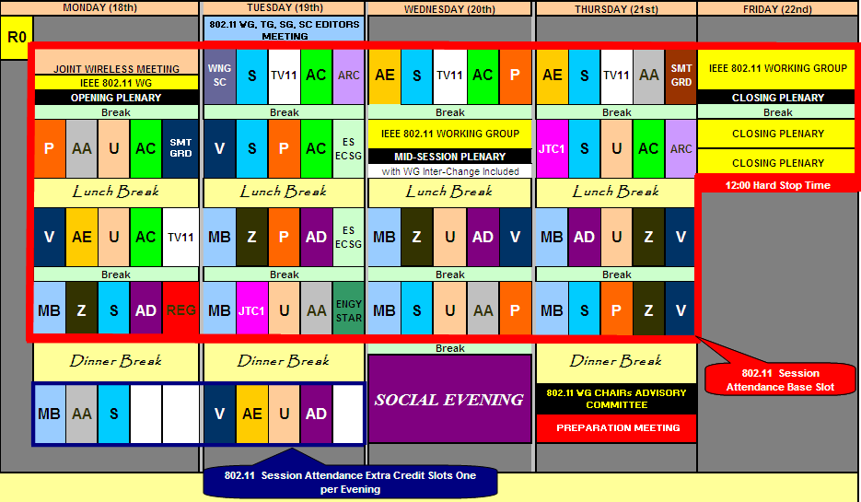
Example Session graphic (interim) Jan 2010
July 2019
18 Normal slots, 2 Extra slots
75% attendance requires 14 slots attended
Closing plenary requires only 1 registration for 2 slot credit
Register once
Notes:
doc.: IEEE 802.11-06/0528r0
May 2006
Bruce Kraemer, Marvell
Page 34

Slide 35
Example Session graphic (plenary) Mar 2010
July 2019
17 Normal slots, 2 Extra slots
75% attendance requires 13 slots attended
Closing plenary requires only 1 registration for 2 slot credit
Register once
Notes:
doc.: IEEE 802.11-06/0528r0
May 2006
Bruce Kraemer, Marvell
Page 35

Slide 36
Recording Attendance
July 2019
It is a requirement that attendees register, in order that a correct record of attendees and their disclosed affiliations can be recorded in the minutes.
You must record 75% attendance of eligible 802.11 slots in a session for that session to count towards gaining or maintaining 802.11 voting membership
You need a single IEEE-SA web account
  The IEEE-SA web account requires a working email address
  do not remove your email address from the account
Use the email address associated with that web account when registering attendance
  If you change email addresses, update the web account, don’t create a new web account, or your membership status may not be calculated properly
Notes:
doc.: IEEE 802.11-06/0528r0
May 2006
Bruce Kraemer, Marvell
Page 36

Slide 37
Attendance Procedures
July 2019
Prior to or during the session:
  (one time) Get a free Web Account if you don’t already have one. Keep your contact data in this area up to date.
  (one time) Register your Interest Areas in myProject if you haven’t done so already (it’s up to you to keep this updated as needed)
During the session:
  (once per session) Register on IMAT
  (once per slot) Record attendance at a specific meeting. You will be asked for your affiliation the first time you attend a new task group.
See following slides for detailed procedure
Notes:
doc.: IEEE 802.11-06/0528r0
May 2006
Bruce Kraemer, Marvell
Page 37

Slide 38
Changing Affiliation
July 2019
The IMAT attendance system keeps a record of stated affiliation per group (task group / working group).
The 802.11 membership records are updated using this information after every session.
If you change affiliation, you need to go to “MyProject” under “Manage Activities” and check/update all 802.11 groups that you have attended in the past or declared an interest in so that they have the correct affiliation.
Notifying the 802.11 officers of a change is not sufficient, as any local changes to the 802.11 membership records will get overwritten with data from MyProject after every session.
Notes:
doc.: IEEE 802.11-06/0528r0
May 2006
Bruce Kraemer, Marvell
Page 38

Slide 39
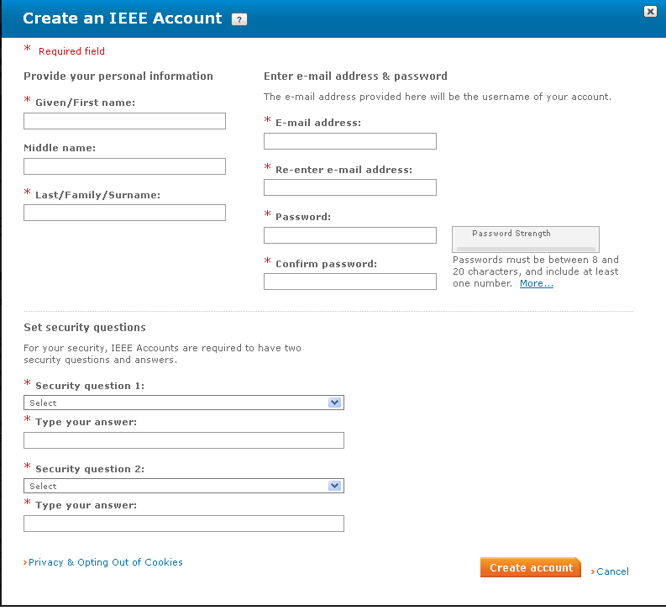
Step 1: Get a free IEEE Account
July 2019
If you already have
an IEEE Account you can skip to the
next step
Otherwise log onto
http://development.standards.ieee.org and click on the link to Create an IEEE Account
Note that you must have an IEEE Web Account in order to get credit for any meetings you attend.
Notes:
doc.: IEEE 802.11-06/0528r0
May 2006
Bruce Kraemer, Marvell
Page 39

Slide 40
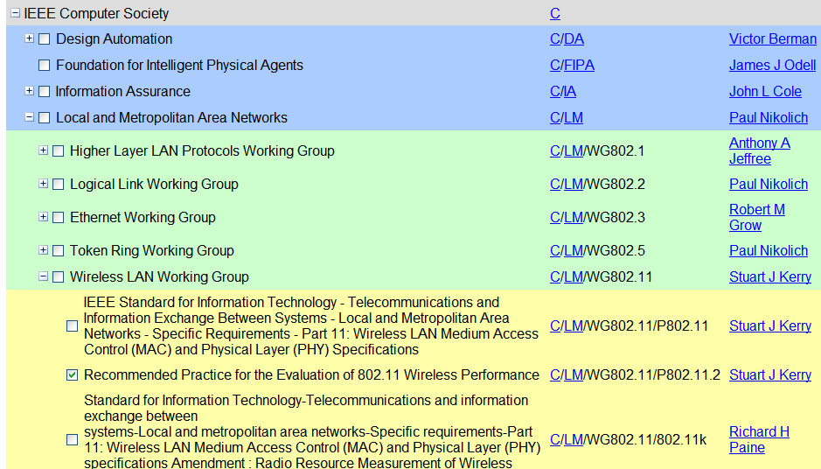
Step 2: Set your myProject Interest Areas
July 2019
Go to http://development.standards.ieee.org and enter your Username (Web Account ID) and password to get into myProject
If you have already selected your Interest Areas in myProject, you may skip this step; otherwise….
Select Manage Activity Profile and drill down to select the WG and/or Project(s) in which you have an interest
For each of these you will have to specify your affiliation
Notes:
doc.: IEEE 802.11-06/0528r0
May 2006
Bruce Kraemer, Marvell
Page 40

Slide 41
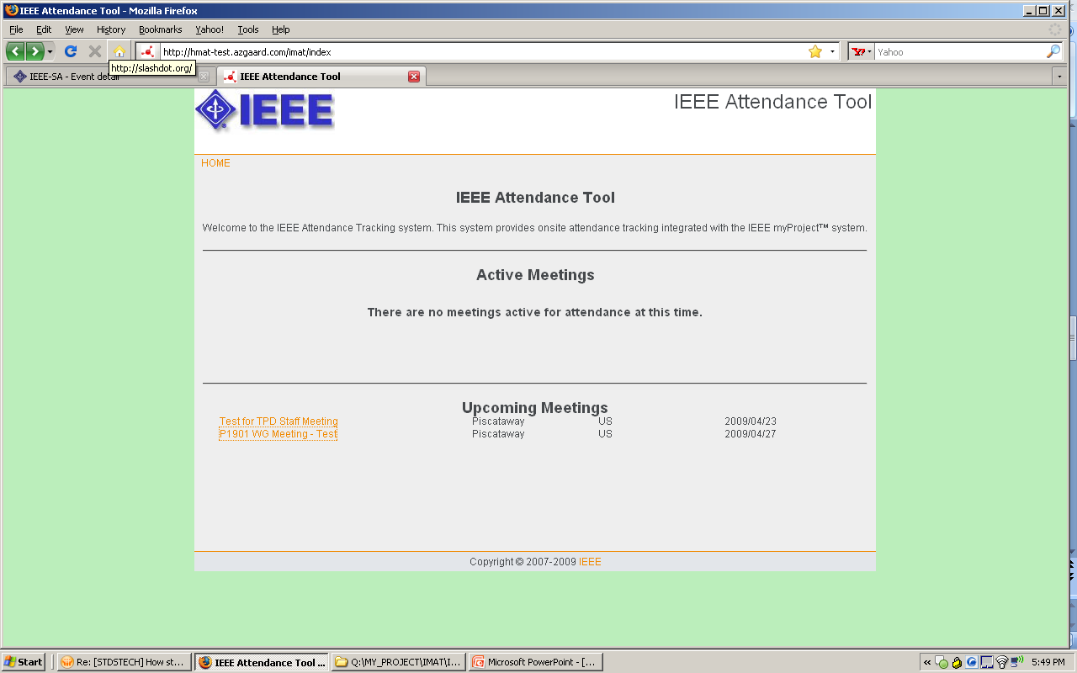
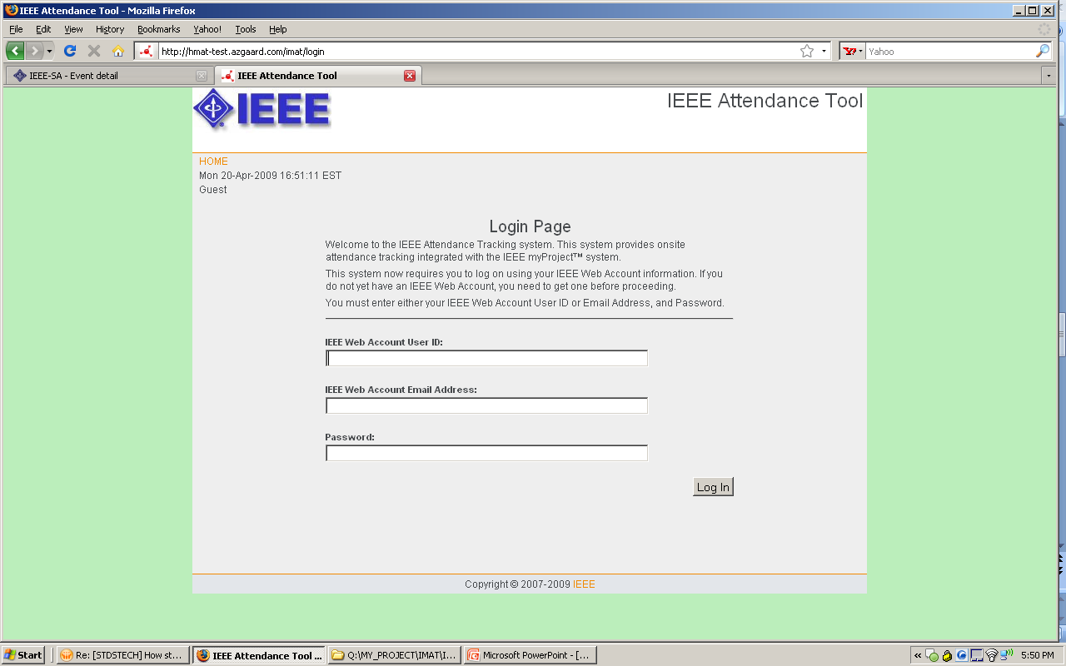
Step 3: Log onto IMAT
July 2019
Make sure you have an IEEE Web Account as described in Step 1
Make sure you’ve designated your myProject Interest Areas as described in Step 2
Log into IMAT using your IEEE Web Account username and password.
The URL for the local server is:
  https://imat.ieee.org
Notes:
doc.: IEEE 802.11-06/0528r0
May 2006
Bruce Kraemer, Marvell
Page 41

Slide 42
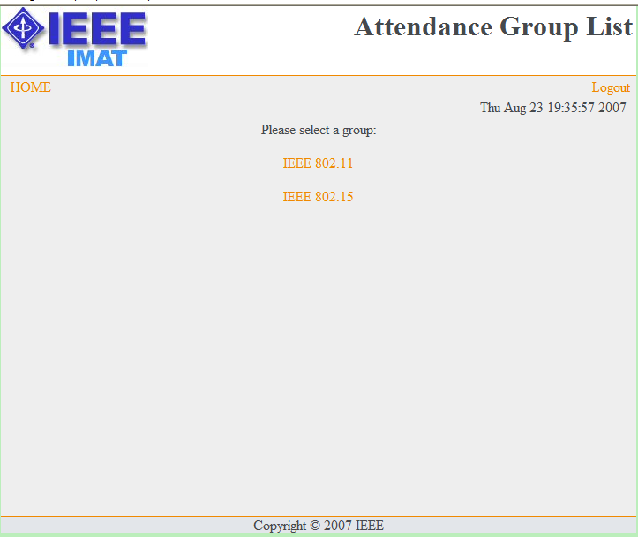
Step 4a: Register Your Attendance
July 2019
Select the WG or option from the home page.
Notes:
doc.: IEEE 802.11-06/0528r0
May 2006
Bruce Kraemer, Marvell
Page 42

Slide 43
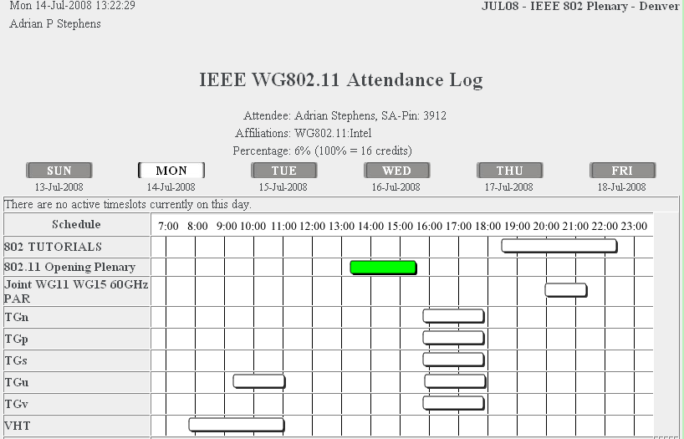
Step 4b: Select the Meeting
July 2019
Select the Day and Meeting you are attending and update the screen
  Note that you will only be able to click a single button in the active timeslot column for the current day
  Once updated, the column will turn green and your selection will be locked in.
  Selections may not be changed once the timeslot closes
Repeat Step 4 for each distinct breakout you attend
Notes:
doc.: IEEE 802.11-06/0528r0
May 2006
Bruce Kraemer, Marvell
Page 43

Slide 44
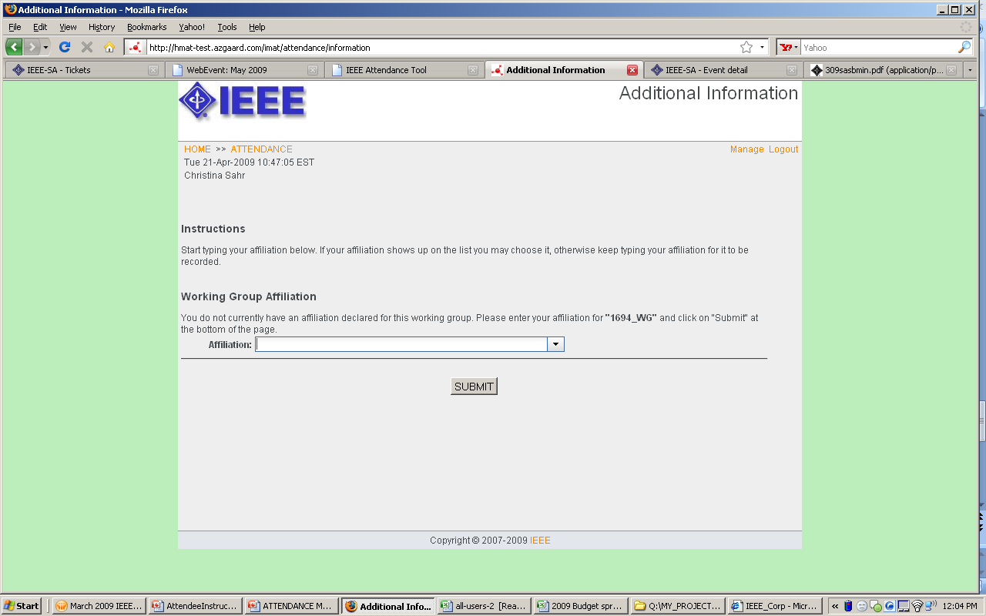
Step 4b: Supply your Affiliation
July 2019
You must provide an affiliation in order to receive credit for your attendance and to record your presence for the minutes
You will be asked your affiliation once for the WG and once again for each unique TG or SG you attend. Start typing your affiliation/company name and either choose from the dropdown list or continue typing to add.
Notes:
doc.: IEEE 802.11-06/0528r0
May 2006
Bruce Kraemer, Marvell
Page 44

Slide 45
Membership
July 2019
Notes:
doc.: IEEE 802.11-06/0528r0
May 2006
Bruce Kraemer, Marvell
Page 45

Slide 46
Member Status Graphic
July 2019
Notes:
doc.: IEEE 802.11-06/0528r0
May 2006
Bruce Kraemer, Marvell
Page 46

Slide 47
What are my rights/obligations?
July 2019
As a new participant, aspirant, potential-voter or voter
  Must record attendance and affiliation during meeting
  Can vote in Study Groups and in straw polls (i.e., informal votes) in other groups
As an aspirant, potential-voter or voter
  Can access any 802.11 WG reflector on request
  Can have access to the 802.11 member’s private area, containing drafts and balloting materials
As a voter
  Can vote in any 802.11 group, including formal motions and straw polls
  Must vote in mandatory 802.11 WG ballots

Slide 48
Website membership list
July 2019
Go to http://www.ieee802.org/11/members.htm
or by “Members List” link on http://www.ieee802.org/11
Family Name | Given Name | MI | Affiliation | Status
McCann | Stephen |  | BlackBerry | Voter
Notes:
doc.: IEEE 802.11-06/0528r0
May 2006
Bruce Kraemer, Marvell
Page 48

Slide 49
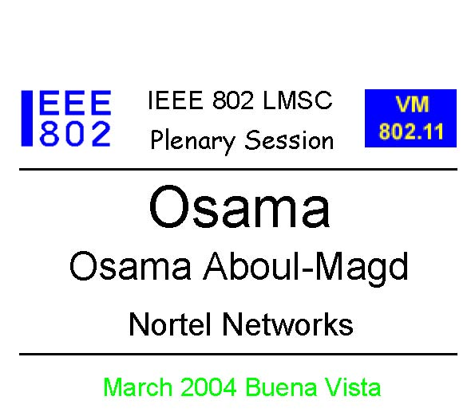
Badges
July 2019
Your badge indicates:
  That you have registered and paid for the session
  Your voting status
You must wear your badge at all times while in the meeting area
Your badge is personal to you – do not lend it to anybody else
Voting members must show their voting token to the counters during a formal vote so that their voting status can be confirmed.
James
James Bond
Fleming Enterprises
VM11
Notes:
doc.: IEEE 802.11-06/0528r0
May 2006
Bruce Kraemer, Marvell
Page 49

Slide 50
Documentation
July 2019
Notes:
doc.: IEEE 802.11-06/0528r0
May 2006
Bruce Kraemer, Marvell
Page 50

Slide 51
Documentation Generally
July 2019
Downloading Documents during a session
  All documents are updated on the local server from mentor
  When retrieving document please follow the instructions in the previous pages and obtain all documentation from the local server. This will keep traffic at a lower level on the external links.
New document numbers are obtained from the mentor web site
  Need to register on mentor to request a login
  New requests handled after the session and 75% attendance in that session is required to gain write access. If you need write access during your first session, ask a colleague to upload on your behalf.
  Login and request a document number from:
https://mentor.ieee.org/802.11/documents
Uploading Documents
  Login and upload to the mentor web site https://mentor.ieee.org/802.11/documents
Notes:
doc.: IEEE 802.11-06/0528r0
May 2006
Bruce Kraemer, Marvell
Page 51

Slide 52
Email Reflectors
July 2019
Notes:
doc.: IEEE 802.11-06/0528r0
May 2006
Bruce Kraemer, Marvell
Page 52

Slide 53
Email Reflectors
July 2019
There is an email reflector for the working group and each task group.
Write access to the reflectors allowed for those who are members with status: aspirant, nearly-voter, potential-voter, voter.
To make a request, visit the reflector request page:
http://www.ieee802.org/11/Reflector.html
  Gathers information and sends an email to Vice Chair
If you change your email address – please let the vice-chairs know. They will perform a global change to the list servers.
Public read access to all reflectors is available via the 802.11 home page http://www.ieee802.org/11 on the “WG Email” menu.

Slide 54
Onsite File Server (Intranet)
July 2019
Notes:
doc.: IEEE 802.11-06/0528r0
May 2006
Bruce Kraemer, Marvell
Page 54

Slide 55
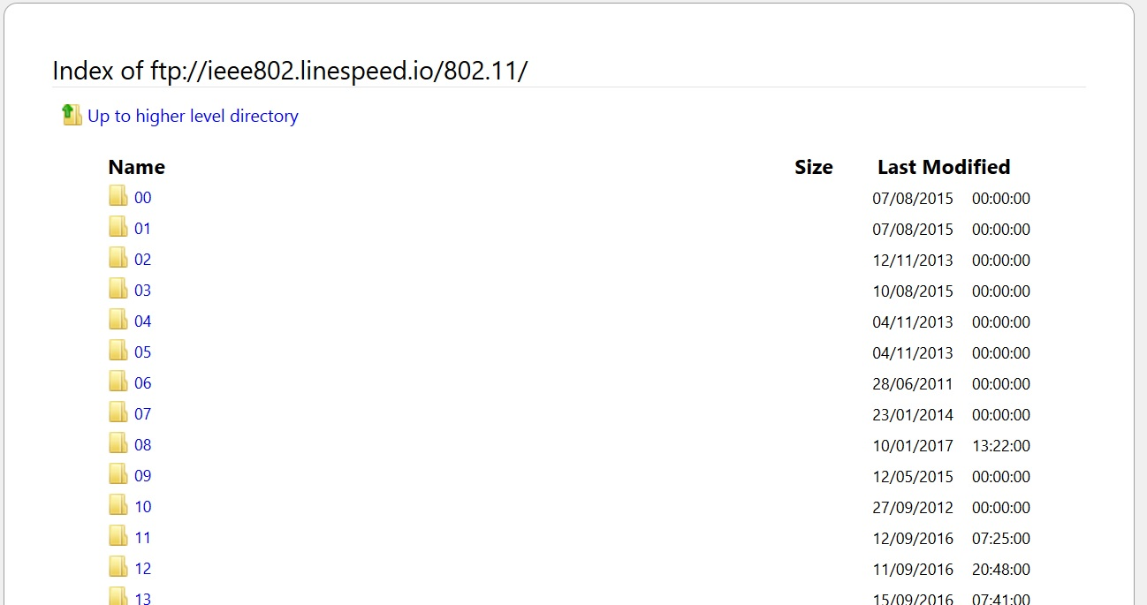
Local File Document Server information
July 2019
Local FTP server: ftp://ieee802.linespeed.io/802.11 (anonymous)
External Document Server https://mentor.ieee.org/802.11/documents
Notes:
doc.: IEEE 802.11-06/0528r0
May 2006
Bruce Kraemer, Marvell
Page 55

Slide 56
Questions ?
July 2019
Notes:
doc.: IEEE 802.11-06/0528r0
May 2006
Bruce Kraemer, Marvell
Page 56

