Slide 1
Use Cases for NGV using High Data Rate
Date: 2018-11-12
Authors:

Slide 2
Abstract
This submission proposes use cases for NGV SG, which are utilizing NGV’s high data rate. Includes:
IP Traffic Offloading
Shared Bird’s-Eye View

Slide 3
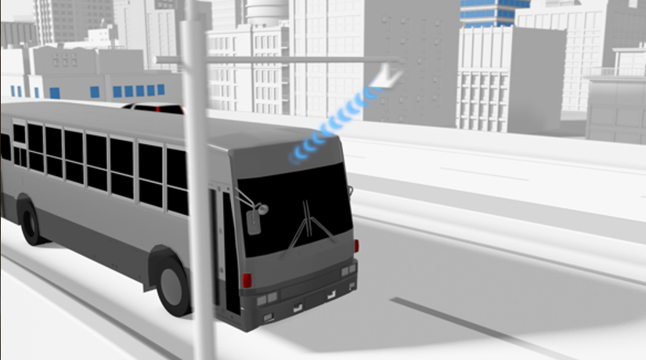
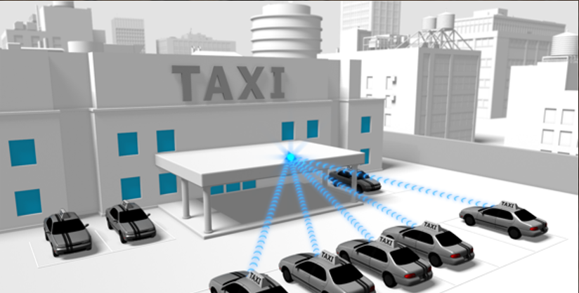
IP Traffic Offloading
Downloading 3D maps
Uploading sensor data
DSRC/WAVE supports IPv6 over 11p
Cloud-based applications are expected
Offload IP traffic from 11p to NGV
distribute location dependent data
map, advertisement
download/upload delay tolerant data
logs, sensor data for non/semi-real time usage, entertainment

Slide 4
IP Traffic Offloading
Overview: Offload IP traffic from 11p to NGV
distribute location dependent data
download/upload delay tolerant data
Deployment timeline:
>2019 (5.9 GHz band)
>2022 (60 GHz band)
Requirements:
Packet NGV should carry higher number (>50%) of transmitted bytes than IEEE802.11p packet under same conditions (packet duration, PER, range, wireless channel)
Nice to have:
Optional mmWave capability based on 11ad PHY to have >1Gbps
Limitations:

Slide 5
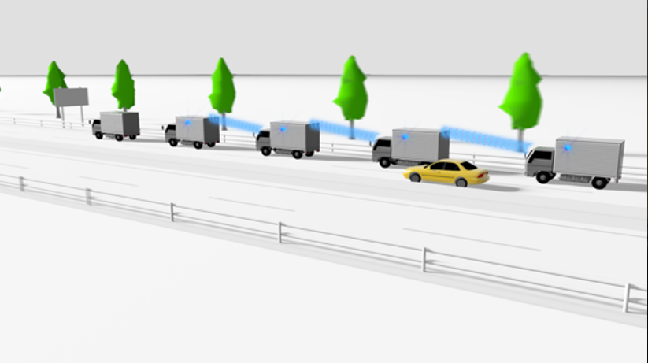
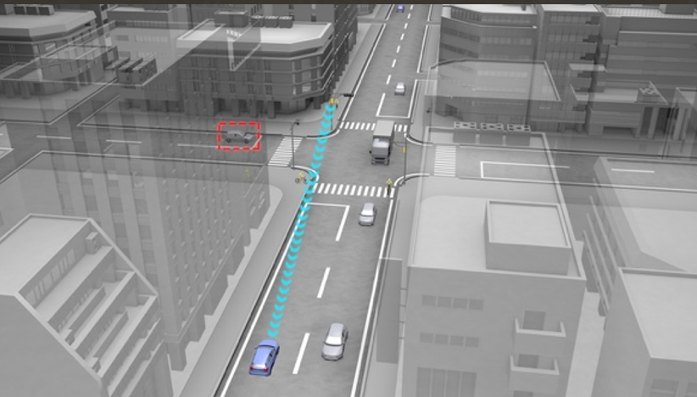
Shared Bird’s-Eye View
Bird’s-Eye View for Platoon (V2V)
Bird’s-Eye View for Intersection (V2I/V2X)
Vehicles and infrastructures share their own views to each other to construct bird’s eye views
For safety: blind spot monitoring
For drivers/passengers: navigation, augmented reality

Slide 6
Shared Bird’s-Eye View
Overview: Vehicles and infrastructures share their own views to each other to construct bird’s eye views
the views are used for safety and driver/passengers usage
example scenario: (1)around intersection; (2)around platoon
Deployment timeline: >2025 (expected)
Requirements:
Packet NGV should carry higher number (>50%) of transmitted bytes than IEEE802.11p packet under same conditions (packet duration, PER, range, wireless channel)
Nice to have:
Optional mmWave capability based on 11ad PHY to have >1Gbps for tens of vehicles near the intersection / lower latency for platooning
Limitations:
Packet prioritization algorithm at higher layer to share radio resources with higher priority applications (e.g. BSM)

Slide 7
References
[1] 11-18/0861r08 802.11 NGV Proposed PAR
[2] 11-18/1323r01 NGV SG Use Cases

Slide 8
Straw Poll
Do you agree to adopt each of the use cases on slide 4 and 6 as one of NGV use cases?
Y/N/A

