Slide 1
Bringing Determinism for IoT Wireless
- sharing 802.15.4 experience -
Date: 2018-11-04
Authors:

Slide 2
Introduction
RTA investigates latency and stability issues for real time applications (such as robotics and industrial automation)
The same problems were observed in other radio technologies (e.g. 802.15.4) and solutions were designed that could be of interest for 802.11
In this submission, we share the reasoning applied to enable determinism over Wireless in the case of 802.15.4 and Industrial IoT.

Slide 3
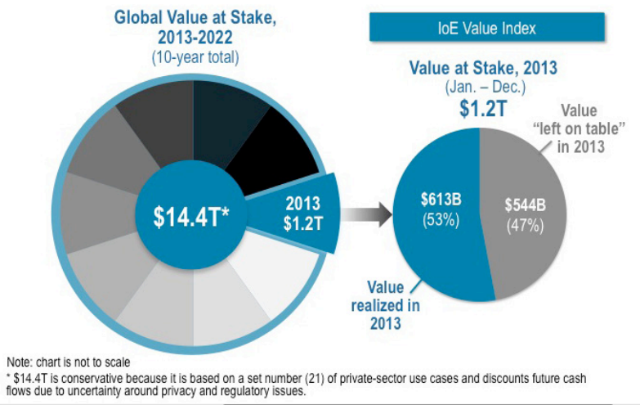

The Industrial Internet of Things
Converge Control Networks to IP
  Make IP operations more efficient
  Emulating existing Industrial protocols
Beyond Control and Automation
  Optimize processes (by 1%?)
  Leveraging IT, Live big data and Analytics
Pascal Thubert, Cisco

Slide 4
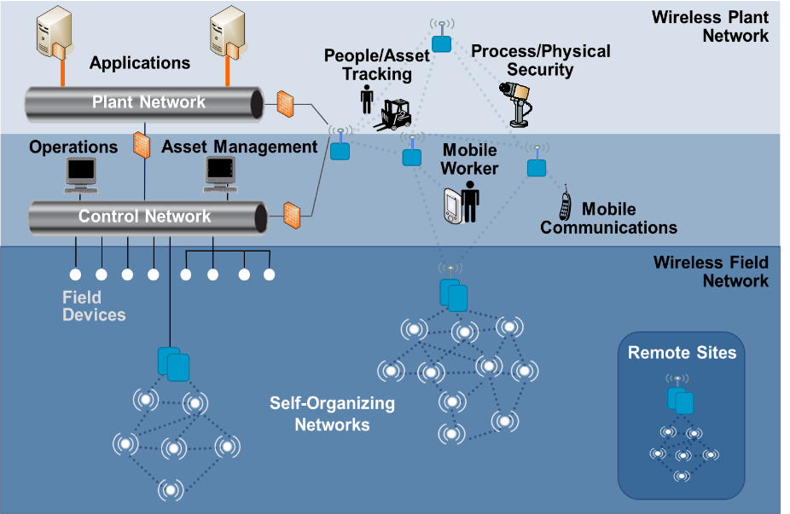
Networking in Operational Technology
Control loops and Movement detection
    Deterministic: highly reliable, fixed latency, global optimization through central computation.
    with static multipath, packet replication and elimination at the edges (PRP, HSR) => TSN, DetNet, Wi-Fi?
Large Scale Monitoring
    Stochastic: self-healing - thus distributed routing
    Background resource optimization => 6TiSCH
Management
    a separate topology that does not break.
alerts
    bursty, unexpected, on-demand slot allocation, prioritization
    Dynamic resource optimization
Pascal Thubert, Cisco

Slide 5
The Industrial Internet challenge
Field is after next % point of operational optimization:
Requires collecting and processing of live “big data”, huge amounts of missing measurements by widely distributed sensing and analytics capabilities.
Often sharing the same medium as critical (deterministic) flows used for Industrial control loops and motion control
Achievable by combination of the best of IT and OT technologies together, forming the IT/OT convergence, aka Industrial Internet.
The next problem is to extend Deterministic OT traffic to share bandwidth with non-deterministic IT traffic, reaching higher scales at lower costs.
Pascal Thubert, Cisco

Slide 6
Deterministic networking
Pascal Thubert, Cisco

Slide 7

What is
Deterministic?
(per Wikipedia definition)
I know what, I control when, I can reproduce it every time, guaranteed
In mathematics and physics, a deterministic system is a system in which no randomness is involved in the development of future states of the system. A deterministic model will thus always produce the same output from a given starting condition or initial state.
[In philosophy] A deterministic system is a conceptual model of the philosophical doctrine of determinism applied to a system for understanding everything that has and will occur in the system, based on the physical outcomes of causality. In a deterministic system, every action, or cause, produces a reaction, or effect, and every reaction, in turn, becomes the cause of subsequent reactions. The totality of these cascading events can theoretically show exactly how the system will exist at any moment in time.
Pascal Thubert, Cisco
Notes:
Deterministic Networking refers to the allocation of pre-determined physical resources in the network (queues, buffers, transmission medium) for well-characterized flows that are known a-priori, in order to avoid the statistical effects that lead to a poor bandwidth utilization, uncontrolled jitter, and congestion loss. Bandwidth that is not actually used by deterministic flows is available for use by other traffic. In more details, a path is nailed down with a particular set of resources at particular times, and the forwarding behavior ensures that the right packets are forwarded at the right time to make use of these resources.
This requires capabilities for:
Hop-by-hop synchronization, which enables to restore an apparent end-to-end clock signal that can be associated with the timely distribution of data streams, which in turn can be decoded to reproduce precisely phased analog signals;
Time-based resource reservation, coupled with enforcement methods, which eliminates collision loss and provides the capability to transport unicast or multicast data streams of predefined characteristics such as data rate and bounded latency.
Work has started at the DetNet WG to enable the establishment and maintenance of deterministic paths over Layer 2 Bridged and Layer 3 routed segments, by defining a common representation (data models) of the physical resources and network topology, and standardizing the protocol flows and interface mappings that are used to set up the flows.
Work will also be needed for management, with in particular network control frames that are carried along a deterministic path to assess its health and performance - aka Operations, Administration, and Maintenance (OAM) frames, but also in-band means to trace a packet from the last replication point from which it may have strayed into the network.

Slide 8
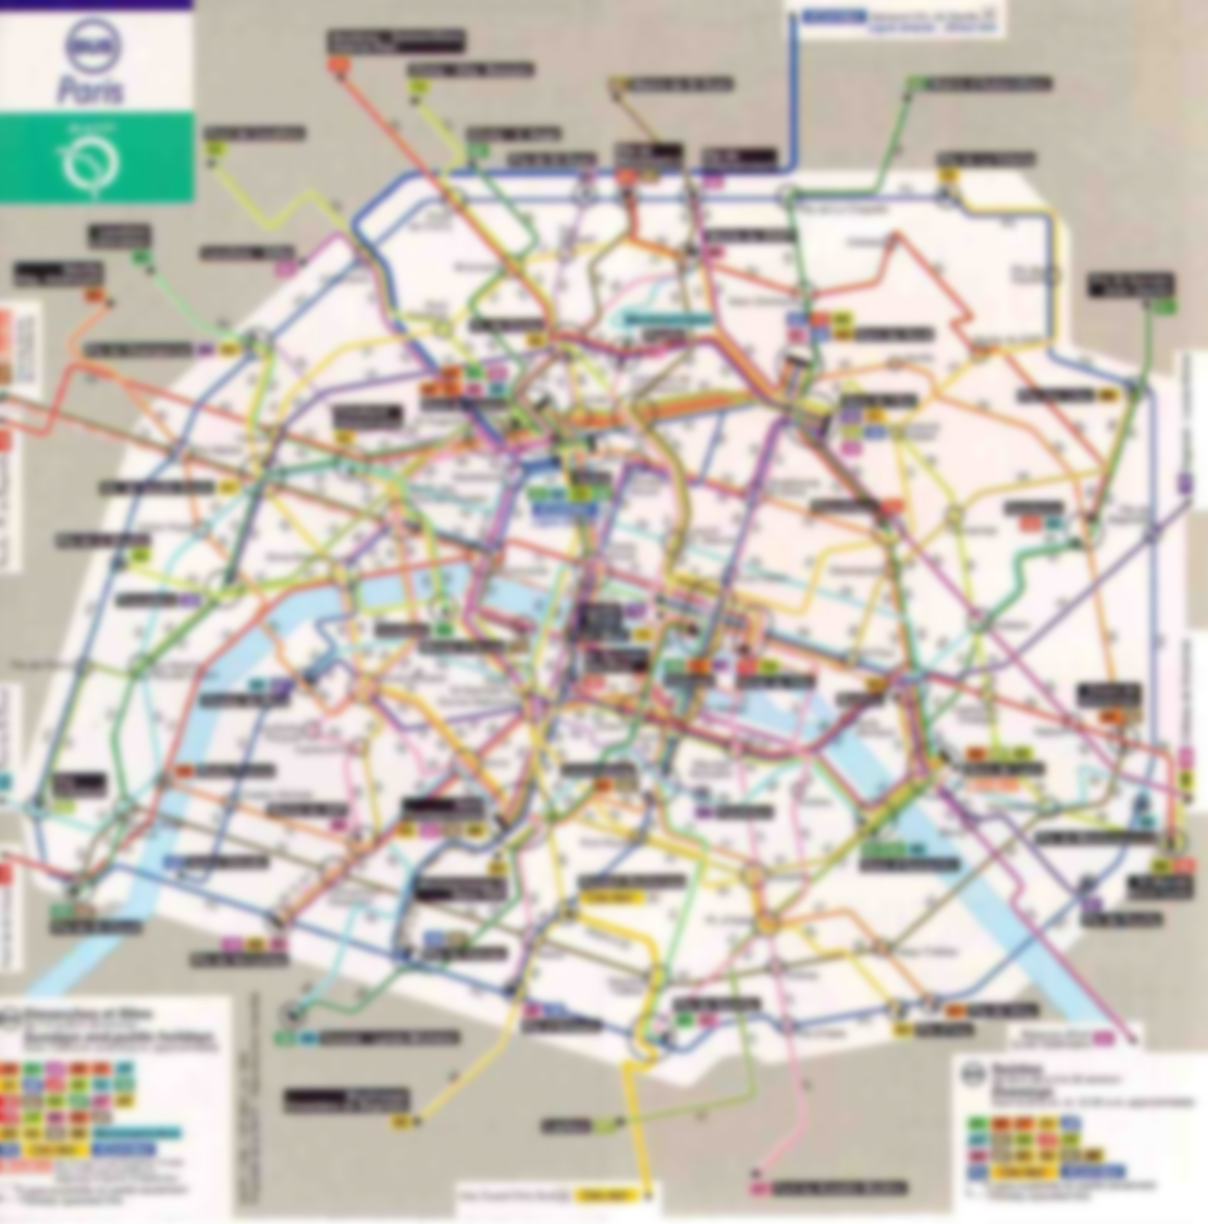

The bus analogy (to deterministic circuit switching)
A bus every T. minutes => guaranteed latency max_wait + travel
Reserved bus lanes => no interaction with other traffic
Switching buses => Lower complexity but increased latency
Towards a perfect emulation of a serial cable over a switched network
8
Pascal Thubert, Cisco
Notes:
The goal of the reserved bus lanes in a city is to avoid that the bus is delayed by traffic jams and guarantee a good and repeatable experience for the passengers.
Say a bus takes 30 minutes to travel from a given bus stop down the street from a user’s home, all the way to his office. If there is a bus every 10 minutes, then the transit time for a particular user of the public service will always be somewhere between 30 and 40 minutes, depending on how lucky he is on a particular day, and this, regardless of the traffic in the car lanes.
This user will certainly not use every bus that passes by, but he knows that there will be one soon enough, and that, 40 minutes later at worst, he will be at his desk.
As it goes, a single bus line may not take our user from his departure point to his final destination, and he may have to hop in another bus midway; the additional transport time for him yields huge benefits in reduction of operational complexity and thus an increased profitability for the bus company.
A bus line is analog to the reserved circuits that can be scheduled in a packet-switched Deterministic Network; regardless of the load, they guarantee a periodic transmission opportunity with a bounded latency for asynchronous commands and alerts.
In that context, the ultimate realization of a Deterministic Network appears to be a perfect emulation of the good old serial cable over a packet-switched network, transporting the exact same application, at a much lower cost than a full mesh of wires.

Slide 9
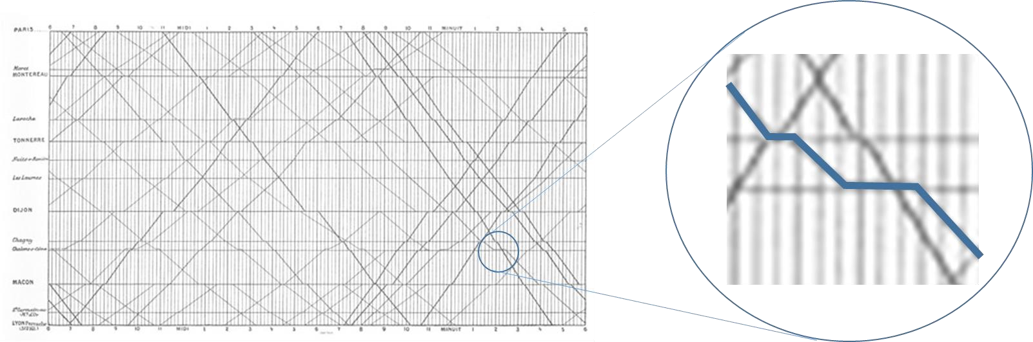
The Train Analogy (to control loop traffic)
Periodic trains along a same path and same schedule (time table)
Collision avoidance on the rails guaranteed by schedule
End-to-End latency enforced by timed pause at station
Typical deterministic flows incur a higher latency than “hot potato”
Pascal Thubert, Cisco
Notes:
The flat portions of the schedule that are enlarged on the right of Figure 2 (colored in blue) illustrate that, in order to avoid collisions, a train may be temporarily stopped on a garage way, until the pre-determined time when it can safely leave the station. The overall travel experience may not be as fast as a hot potato [53] model whereby the train is expelled as soon as the way is open, but scheduling avoids queues and results in a much more predictable experience for the passengers.
Likewise, a deterministic flow may experience short buffering in intermediate hops to guarantee that there are never two deterministic packets scheduled for transmission at overlapping times, in other words that the link is always available at the scheduled time of transmission; because of the extra fixed latency that is added at each hop, most deterministic flows will incur a higher latency than with best effort hot potato forwarding

Slide 10
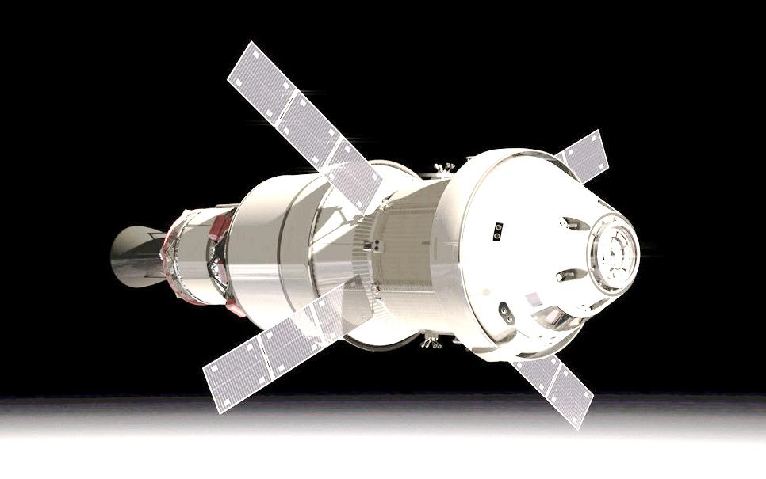


Deterministic Networking Key Requirements
Scheduling and Perfect timing for an optimum use of the medium.
Low loss / Hard bound latency. A new level of QoS guarantees for IT.
Sharing physical resources with classical best effort networking.
High ratio of critical flows for traffic known a priori.
Pascal Thubert, Cisco
Notes:
Transporting OT traffic requires a network that is reliable and jitter-free, and can be trusted to transport periodic and asynchronous commands with a bounded latency. An ever increasing bandwidth is not always a valid response in the face of high loads of time sensitive flows found in OT applications. This strategy was not accepted by the industrial community, which developed its own adaptions of Ethernet and IP to meet its specific needs. As opposed to QoS-based networks, a Deterministic Network must always retain its properties, even under high loads of critical flows.
To achieve this, it is necessary to schedule the timely operation of the network with the granularity of numerous tiny physical resources. While scheduling enables to provide the required guarantees, it may also yield an additional latency for the transported flows. A precise synchronization of the network must be obtained, so the required resources can be reserved for the individual packets within that particular flow at their precise time of arrival. Over the distance, tiny flows must be aggregated into larger ones that can be processed as a single entity.
With Deterministic Networks, the worst-case data loss and latency can be guaranteed in a consistent fashion when multiple services are deployed on a common converged network infrastructure. A deterministic flow is completely isolated in its own time-shared set of physical resources and cannot be influenced by any other traffic in any observable fashion; from the perspective of the application, a deterministic end-to-end connection appears as a dedicated point-to-point wire.
As Deterministic Networking capabilities are deployed, wired and wireless links that are today limited to provide Internet connectivity can be used to replace any of the cables that we see in day-to-day applications, RCA connectors on the stereo gear, RS232 serial cables, fancy bus connectors in cars, 2 and 4-wires cables in industrial control networks, all of them. A shared sense of time enables to transport -in fact to recreate- a clock signal that is used to synchronize both ends of an emulated serial cable. And the perfect isolation between flows that is obtained to guarantee the required latency is also an improvement on the security side, and a factor of trust in the convergence for OT people.
Awareness of Deterministic Networking is now spreading , and the new technology is generally perceived as an evolution of quality of service to bring a new level of guarantees for network-based services. True as it is, what Deterministic also and mostly brings to Networking is more revolutionary; it is the capability, for the first time, to carry any signal that was ever transported across a point-to-point wire, for any form of application that men ever devised, over multi-hop packet networks.
www.embedded.com/electronics-blogs/cole-bin/4406659/Deterministic-networking–from-niches-tothe-mainstream-

Slide 11
Making radio medium More Predictable
Pascal Thubert, Cisco

Slide 12
Benefits of scheduling in wired networks
  Eliminate congestion loss
  Controlled amount of traffic
  Available Resources (bandwidth and buffers) guaranteed
  Guarantee latency
  Deterministic Progress along Scheduled path
  Nor ARQ: Forward Error correction, Network coding
  (Nearly) Eliminate equipment failure losses
  Frame/Packet Replication and Elimination
Pascal Thubert, Cisco
Notes:
A perfectly Deterministic Network would ensure that every packet would reach its destination, and would always do so in due time. In an imperfect world, Deterministic Networking must nearly eliminate packet loss, with the associated goal to guarantee a worst case latency for a packet, and all this whatever the overall network conditions are, effectively emulating the case of a point to point serial cable.
The main cause of data loss in a wired switch fabric is a statistical effect called congestion loss, whereby, at a particular moment, multiple flows entering a switch converge to a same outgoing port, in volumes that exceed the capacity of that port to output the traffic. It results that some of the traffic must be dropped, and one of the desired effects of Quality of Service (QoS) is to intelligently select the frames to be discarded.
Making networks more deterministic eliminates this statistical effect by maintaining at all time the amount of critical packets within the physical capabilities of the hardware. This can be achieved by the use of time-shared resources (bandwidth and buffers) per circuit, and/or by shaping and/or scheduling the packets at every hop.
Equipment failure, such as a switch rebooting, a broken interface adapter, or an unplugged physical wire, is a secondary source of data loss. When a breakage occurs, multiple packets are lost in a row before the flows are rerouted or the system may recover. This is not acceptable for critical applications such as related to safety. A typical process control loop will tolerate an occasional packet loss, but a loss of several packets in a row will cause an emergency stop (typically after 4 packets lost, within a period of 1 second).
Making networks more deterministic improves the resiliency against breakages and statistical transmission loss such as due to cosmic particles, typically by adding redundancy in the network path.
Finally, since the operation of a Deterministic Network rely on precisely applying a tight schedule, and the worst case time of delivery must be guaranteed, there must be a shared sense of time throughout the network that can be exposed to and leveraged by other applications.

Slide 13

Benefits of scheduling in ‘wireless’
  Reduces frame loss
  Time and Frequency Diversity
  Reduces co-channel interference
  Enables non-interfering relay (mesh)
Optimizes bandwidth usage
  No blanks due to IFS and CSMA-CA exponential backoff
  While Increasing the ratio of guaranteed critical traffic
  Saves energy
  Synchronizes sender and listener
  Thus optimizes sleeping periods
  By avoiding idle listening and long preambles
Pascal Thubert, Cisco
Notes:
A perfectly Deterministic Network would ensure that every packet would reach its destination, and would always do so in due time. In an imperfect world, Deterministic Networking must nearly eliminate packet loss, with the associated goal to guarantee a worst case latency for a packet, and all this whatever the overall network conditions are, effectively emulating the case of a point to point serial cable.
The main cause of data loss in a wired switch fabric is a statistical effect called congestion loss, whereby, at a particular moment, multiple flows entering a switch converge to a same outgoing port, in volumes that exceed the capacity of that port to output the traffic. It results that some of the traffic must be dropped, and one of the desired effects of Quality of Service (QoS) is to intelligently select the frames to be discarded.
Making networks more deterministic eliminates this statistical effect by maintaining at all time the amount of critical packets within the physical capabilities of the hardware. This can be achieved by the use of time-shared resources (bandwidth and buffers) per circuit, and/or by shaping and/or scheduling the packets at every hop.
Equipment failure, such as a switch rebooting, a broken interface adapter, or an unplugged physical wire, is a secondary source of data loss. When a breakage occurs, multiple packets are lost in a row before the flows are rerouted or the system may recover. This is not acceptable for critical applications such as related to safety. A typical process control loop will tolerate an occasional packet loss, but a loss of several packets in a row will cause an emergency stop (typically after 4 packets lost, within a period of 1 second).
Making networks more deterministic improves the resiliency against breakages and statistical transmission loss such as due to cosmic particles, typically by adding redundancy in the network path.
Finally, since the operation of a Deterministic Network rely on precisely applying a tight schedule, and the worst case time of delivery must be guaranteed, there must be a shared sense of time throughout the network that can be exposed to and leveraged by other applications.

Slide 14
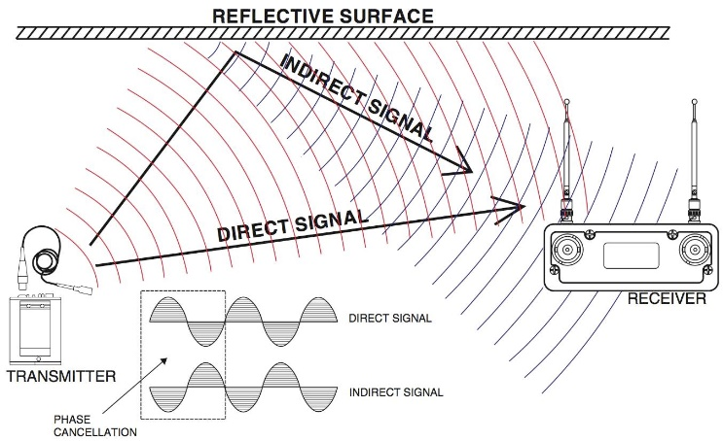
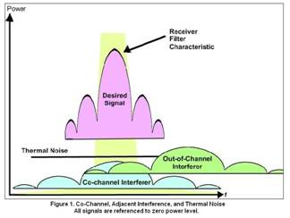
Making Wireless Medium more Predictable and Available
Controlling time of emission
    Can achieve ~10μs sync on 802.15.4
    Can guarantee time of delivery
Protection the medium
    ISM band crowded, no fully controlled
    all sorts of interferences, including self
    Can not guarantee delivery ratio
Improving the Delivery ratio
    Different interferers => different mitigations
    Diversity is the key
Pascal Thubert, Cisco
Notes:
On transmission reliability: The radio medium, in particular in the industrial, scientific, and medical (ISM) bands that are shared not only between data networks but also with all sorts of interferers such as microwave ovens and radars, is orders of magnitude less reliable than classical wired networks such as Ethernet over copper or fiber; providing deterministic services over wireless appears extremely challenging.
Co-channel interferences are not the only possible causes for a frame loss; for instance, physical obstacles may happen to move in the way of the transmission and block the communication. Multi-Path Fading, which is due to multiple reflections that may reinforce or cancel one another out a few centimeters away, is a major cause of transmission errors; it does not affect all channels in a same fashion, and which channels are impacted is highly sensitive to the relative position of the sender and the receiver, and to their environment.
In short, the quality of a given channel is affected by multiple parameters that may vary brutally, and IEEE 802.15.4 transmissions over a fixed channel cannot be expected to remain stable over a long period of time. It results that basic IEEE802.15.4 implementations which operate on a fixed channel will often suffer from intermittent delivery issues, and can only apply to low-end applications for which a consistent reliability is not a concern.
Channel Agility was added to improve the availability of the radio links by permanently sensing the channel, looking for an increase in Bit Error Rate (BER), and switching channel when loss becomes too high. This technique represents a clear improvement from the art of fixed channel, but it only fixes an error condition reactively, and a period of lossy transmissions is experienced before a new channel is selected. This is well suited for applications such as AMI/AMR metering, which do not require a wire equivalent reliability, but, at the same time, this does not provide the deterministic guarantees that industrial applications require.
A predictive technique that would enable to switch to a better channel before the problem even occurs would be ideal but early attempts [22] did not make it to mainstream. Effectively, one can leverage transmission statistics, observe activity on other channels and remember channels with a bad transmission record, so as to black list them. This may be efficient to protect against a stable Wi-Fi co-channel interferer, but there is no way to know if this is effectively the case, and if the problem will last and for how long. The physical phenomenons that are the most common cause of channel degradation, moving an object or starting a process, cannot be fully predicted by the radio device in most practical situations, and making Channel Agility proactive has appeared so far to be a red herring, yielding more complexity than actual benefits.
Time-Slotted Channel Hopping (TSCH) [62] is the best of breed with its simple perpacket channel rotation called channel hopping. TSCH brings Time (by repeating failed transmissions) and Frequency (by switching channel) diversities.
But unless we have infinite time to attempt an infinite number of retries, there is always a limit to the reliability of a system. In short, deterministic delivery within a constrained time cannot be guaranteed over a wireless medium. A realistic goal is to optimize the delivery ratio, and this is best achieved by combining all possible forms of diversity.
On deterministic channel access: The other major difficulty with wireless links is that the medium is shared, meaning that not only this node, but other nodes, may be transmitting at the time intended for a deterministic packet, which would have to wait a variable time till the end of that current transmission. Then, with CSMA/CA [8] mechanisms, it would have to introduce a random delay to obtain access to the channel, and then, in case of a collision, wait for an additional exponential backoff time.
In wireless, a technique like the IEEE802.1Qbu - Frame Preemption - is not really workable, because apart from new specific attempts for full duplex-radios, there is no way to interrupt a remote talker that is blinded by its own signal.
Depending on the specific radio technology, packets may be blocked at the MAC or PHY layer and then sent together in a single transmission opportunity; data rates may vary dramatically with the distance and the environment; it results that the exact duration of the current transmission can be very hard to predict, and that a guard time that would guarantee that the medium is empty at scheduled time (see section 6.2 - Can we make Ethernet deterministic? on page 31) on a wireless medium would necessarily be very long and highly wasteful in terms of bandwidth to cope with highly variable transmission duration.
The only way to approach determinism in wireless transmissions –most people will prefer to use terms such as “highly predictable” instead of deterministic- is to schedule all the transmissions, and that is what TSCH and industrial WSNs do.

Slide 15

6TiSCH: IPv6 over TimeSlotted Channel Hopping
A
Stochastic Traffic only
=> IPv6 best effort with dynamic allocation
Mesh capabilities with RPL (RFC 6550)
Currently based on IEEE 802.15.4 2.4GHz
=> glad to recharter for other PHYs
C
B
E
D
G
F
16 channel offsets
I
H
J
e.g. 31 time slots (310ms)
Pascal Thubert, Cisco
Notes:
A schedule such as illustrated with colored codes in this slide controls at which time and on which channel a frame is forwarded between which pair of nodes.
Scheduling implies that all nodes control the precise time of emission, which in turn requires a shared and precise sense of time. It is, for instance, possible to achieve in the order of tens of microseconds clock synchronization over an IEEE802.15.4 link.
With fully scheduled operations, it is now possible to guarantee the time of delivery for those packets that make it to destination, in a deterministic fashion.
Additional Benefits from scheduling in wireless: In addition to the benefits listed in section 6.1 Expected benefits in wired networks on page 31, scheduling provides specific value to the wireless medium. On the one hand, scheduling reduces transmission losses and with TSCH and its industrial derivatives, a wire-equivalent loss ratio of 10⁻⁵ can be obtained: to achieve this, routes are computed so as to enable at least two forwarding solutions for every node, which ensures spatial diversity, whereas retries over the TSCH MAC provide both time and frequency diversity and effectively combats co-channel interference as well as multipath fading.
On the other hand, scheduling optimizes the bandwidth usage: compared to CSMA/CA operations, there is no blank related to IFS and exponential back-off in scheduled operations, though some minimal Clear Channel Assessment may be needed to comply with the local regulations such as ETSI 300-328. And because TSCH time slots provide a full time sharing operation, there is no limit to the ratio of guaranteed critical traffic.
Finally, scheduling plays a critical role to save energy; in IoT, energy is the foremost concern, and synchronizing sender and listener enables to maintain them in deep sleep at all times when there is no scheduled transmission; this optimizes sleeping periods by avoiding idle listening and long preambles; TSCH enables battery operated nodes that actually forward packets in a mesh topology for multiple years [62].

Slide 16
PAW: Predictable and Available Wireless
A
Adding Deterministic Traffic to 6TiSCH
Centralized, SDN model
RPL additions (Route Projection draft)
“DetNet for wireless”
Replication, elimination, reordering, OAM
Adapted to Wireless (diversity, bcast)
C
B
PAW
E
D
G
F
16 channel offsets
I
H
J
e.g. 31 time slots (310ms)
Pascal Thubert, Cisco
Notes:
A schedule such as illustrated with colored codes in this slide controls at which time and on which channel a frame is forwarded between which pair of nodes.
Scheduling implies that all nodes control the precise time of emission, which in turn requires a shared and precise sense of time. It is, for instance, possible to achieve in the order of tens of microseconds clock synchronization over an IEEE802.15.4 link.
With fully scheduled operations, it is now possible to guarantee the time of delivery for those packets that make it to destination, in a deterministic fashion.
Additional Benefits from scheduling in wireless: In addition to the benefits listed in section 6.1 Expected benefits in wired networks on page 31, scheduling provides specific value to the wireless medium. On the one hand, scheduling reduces transmission losses and with TSCH and its industrial derivatives, a wire-equivalent loss ratio of 10⁻⁵ can be obtained: to achieve this, routes are computed so as to enable at least two forwarding solutions for every node, which ensures spatial diversity, whereas retries over the TSCH MAC provide both time and frequency diversity and effectively combats co-channel interference as well as multipath fading.
On the other hand, scheduling optimizes the bandwidth usage: compared to CSMA/CA operations, there is no blank related to IFS and exponential back-off in scheduled operations, though some minimal Clear Channel Assessment may be needed to comply with the local regulations such as ETSI 300-328. And because TSCH time slots provide a full time sharing operation, there is no limit to the ratio of guaranteed critical traffic.
Finally, scheduling plays a critical role to save energy; in IoT, energy is the foremost concern, and synchronizing sender and listener enables to maintain them in deep sleep at all times when there is no scheduled transmission; this optimizes sleeping periods by avoiding idle listening and long preambles; TSCH enables battery operated nodes that actually forward packets in a mesh topology for multiple years [62].

Slide 17
TimeSlotted Channel Hopping for 802.11ax
An ideal slot structure allows the transport of an IPv6 packet (1280 bytes).
Supposing 9 clients, each with a single RU, a basic trigger from the AP and a simple exchange structure (no mid-amble, with Binary Convolution Coding, no beamforming, etc.), a single 7.5 ms TXOP allows this dual direction exchange at MCS3, half the time if downlink has no data.
9 RUs in 20 MHz spectral domain
time
26-subcarrier RU
(78.125*26 = 2.03125 MHz, minus pilots -> 1.875 MHz)
Pascal Thubert, Cisco
Notes:
A schedule such as illustrated with colored codes in this slide controls at which time and on which channel a frame is forwarded between which pair of nodes.
Scheduling implies that all nodes control the precise time of emission, which in turn requires a shared and precise sense of time. It is, for instance, possible to achieve in the order of tens of microseconds clock synchronization over an IEEE802.15.4 link.
With fully scheduled operations, it is now possible to guarantee the time of delivery for those packets that make it to destination, in a deterministic fashion.
Additional Benefits from scheduling in wireless: In addition to the benefits listed in section 6.1 Expected benefits in wired networks on page 31, scheduling provides specific value to the wireless medium. On the one hand, scheduling reduces transmission losses and with TSCH and its industrial derivatives, a wire-equivalent loss ratio of 10⁻⁵ can be obtained: to achieve this, routes are computed so as to enable at least two forwarding solutions for every node, which ensures spatial diversity, whereas retries over the TSCH MAC provide both time and frequency diversity and effectively combats co-channel interference as well as multipath fading.
On the other hand, scheduling optimizes the bandwidth usage: compared to CSMA/CA operations, there is no blank related to IFS and exponential back-off in scheduled operations, though some minimal Clear Channel Assessment may be needed to comply with the local regulations such as ETSI 300-328. And because TSCH time slots provide a full time sharing operation, there is no limit to the ratio of guaranteed critical traffic.
Finally, scheduling plays a critical role to save energy; in IoT, energy is the foremost concern, and synchronizing sender and listener enables to maintain them in deep sleep at all times when there is no scheduled transmission; this optimizes sleeping periods by avoiding idle listening and long preambles; TSCH enables battery operated nodes that actually forward packets in a mesh topology for multiple years [62].

Slide 18
802.11ax OFDMA Exchange Example
Previous slide was computed as follows:
- No Block ACK agreement on single TID used, Open Auth, no PE;
- DL OFDMA with 9 Users to send 1280B IPv6 MSDU + Basic Trigger (for ACK+UL Data+BSR) [including BSR in case they occasionally need extra UL BW]
HE MU PPDU, 20MHz, 4x HE LTF + 3.2us GI, 9 x RU26 using M3, No Mid-Ambles, BCC, No Beamforming
Service(2) + DLM(4) + QosData(26) + SNAP(8) + MSDU(1280) + CRC(4) + Pad(2) + DLM(4) + Trigger(34) + Pad(2) + Tail(6b), assuming Open Auth
228 Data Symbols, or 231 with CCMP-AES-128
HE-SIGB is = 258 bits, or 3 symbols at M3
-> PPDU is 3712us, or 3760us encrypted
- UL OFDMA with 9Users to send ACK + 1280B IPv6 MSDU
HE TB PPDU, 20MHz, 4x HE LTF + 3.2us GI, 9 x RU26 using M3, No Mid-Ambles, BCC, No Beamforming
Service(2) + DLM(4) + ACK(14) + Pad(2) + DLM(4) + QosData(26) + HTC(4) + SNAP(8) + MSDU(1280) + CRC(4) + Pad(2) + Tail(6b), assuming Open Auth
226 Data Symbols, or 228 with CCMP-AES-128
-> PPDU is 3672us, or 3704us encrypted
- DL MBA
NON-HT at 24Mbps
MPDU is 22+9*2 = 40B = 4 Data symbols = 36us
-> TxOP is DL(3712) + SIFS(16) + UL(3672) + SIFS(16) + MBA(36) = 7452us, or 7532 Encrypted
Or adding AIFS=2 and CWmin=15, we can add 16+9*(2+15/2) = 101.5us
Pascal Thubert, Cisco
Notes:
A schedule such as illustrated with colored codes in this slide controls at which time and on which channel a frame is forwarded between which pair of nodes.
Scheduling implies that all nodes control the precise time of emission, which in turn requires a shared and precise sense of time. It is, for instance, possible to achieve in the order of tens of microseconds clock synchronization over an IEEE802.15.4 link.
With fully scheduled operations, it is now possible to guarantee the time of delivery for those packets that make it to destination, in a deterministic fashion.
Additional Benefits from scheduling in wireless: In addition to the benefits listed in section 6.1 Expected benefits in wired networks on page 31, scheduling provides specific value to the wireless medium. On the one hand, scheduling reduces transmission losses and with TSCH and its industrial derivatives, a wire-equivalent loss ratio of 10⁻⁵ can be obtained: to achieve this, routes are computed so as to enable at least two forwarding solutions for every node, which ensures spatial diversity, whereas retries over the TSCH MAC provide both time and frequency diversity and effectively combats co-channel interference as well as multipath fading.
On the other hand, scheduling optimizes the bandwidth usage: compared to CSMA/CA operations, there is no blank related to IFS and exponential back-off in scheduled operations, though some minimal Clear Channel Assessment may be needed to comply with the local regulations such as ETSI 300-328. And because TSCH time slots provide a full time sharing operation, there is no limit to the ratio of guaranteed critical traffic.
Finally, scheduling plays a critical role to save energy; in IoT, energy is the foremost concern, and synchronizing sender and listener enables to maintain them in deep sleep at all times when there is no scheduled transmission; this optimizes sleeping periods by avoiding idle listening and long preambles; TSCH enables battery operated nodes that actually forward packets in a mesh topology for multiple years [62].

Slide 19
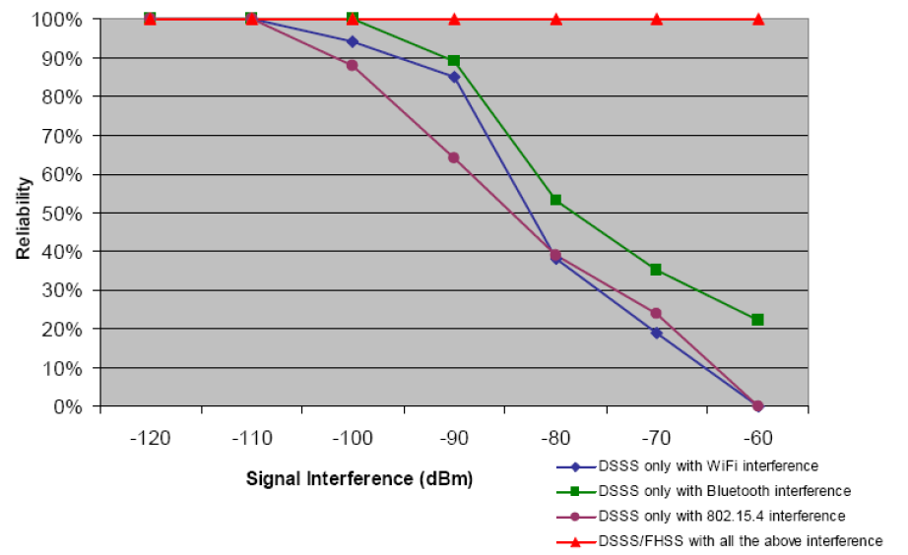
Frequency hopping vs. DSSS in 802.15.4 Networks
With TSCH, ARQ (retries) are scheduled at different times over different channels to maximize diversity.
Source: DUST Networks / Linear Technology
Pascal Thubert, Cisco

Slide 20
Deterministic wireless key Conclusions
Wireless can be made Deterministic through TDM and Scheduling
Provides similar benefits as wired
  High delivery ratio through path redundancy and collision elimination
  High ratio of critical flows
  Bounded maximum latency (and jitter)
Centrally scheduled operations bring additional benefits in wireless
  Medium usage optimization (no IFS, backoff, etc…)
  Energy savings (wake up on scheduled transmission)
But how that is effectively achieved is different in wireless
  All transmission opportunities MUST be scheduled (not just deterministic ones)
  Reserved scheduled transmission opportunities for critical traffic
  Shared scheduled transmission opportunities & dynamic allocation for best effort
Pascal Thubert, Cisco
Notes:
In a nutshell: While scheduling transmissions can guarantee the time of delivery, it is impossible, in the ISM band, to keep all possible interferers at bay. Co-channel interference, as well as the self-inflicted Multi-Path fading, which is due to echoes of the transmission, are unavoidable. So there is no way to guarantee the delivery of all frames.
It takes different mitigation techniques to avoid the different issues that affect wireless transmissions. To combat them all, all possible forms of diversity should be leveraged, in the spatial domain by routing over multipath, in the temporal domain by retrying transmissions or sending copies over parallel paths at distinct times, and in the frequency domain with frequency hopping (within frames) or channel hopping (between frames).
Several times along the way to the destination, the work presented in this manuscript replicates and then eliminates the copies of a packet that are forwarded along parallel disjoint paths, hopping between frequencies with each transmission so that a copy along one path does not interfere with a copy along the other

Slide 21


Sharing the medium with stochastic IP
Type of traffic Type of MAC | Deterministic (e.g. Control Loops) | Stochastic (e.g. classical IP)
Deterministic (e.g. TSCH) | Good fit Adapted to centralized routing and fully scheduled operation All industrial protocols are here | Difficult but achievable: requires dynamic allocation of transmission resources (6TiSCH, ~Wi-SUN)
Stochastic (e.g. CSMA/CA) | Problems with channel access (guard time) Lead to gross over-provisioning CSMA cannot provide hard guarantees | Good fit Adapted for IP traffic, distributed routing and statistical multiplexing with RED
Pascal Thubert, Cisco

Slide 22

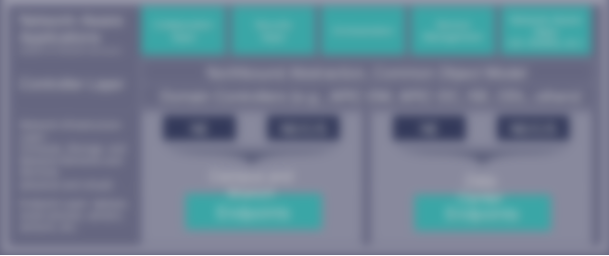
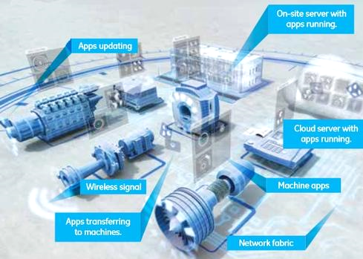
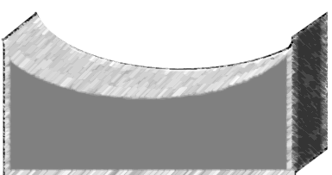
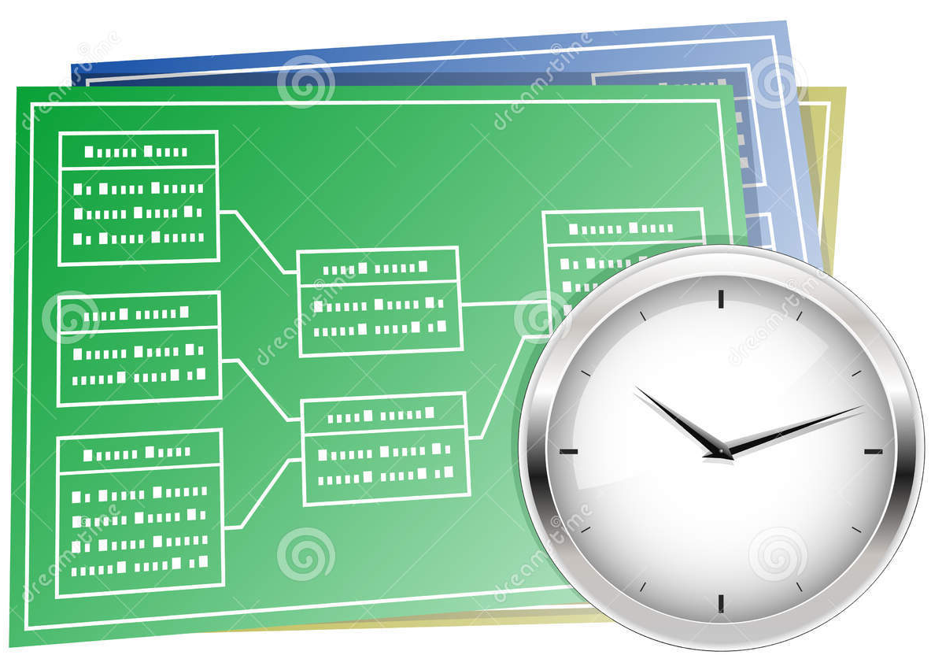

Trends
Industrial Internet
SmartGrid Automation
Fog / Edge Computing
SDN
(Controller)
Clock Synchronization
Deterministic
Networking
Pascal Thubert, Cisco

