Slide 1
Railway Use Cases for NGV
Date: 2018-11-12
Authors:

Slide 2
Abstract
Railway use cases also relevant to NGV besides road vehicle use cases:
Use Case 1: Onboard Train
Wireless train control and monitoring system (TCMS), operator oriented services, customer services (passenger information services, connection to mobile hot spot for public internet)
Use Case 2: Train-to-Train
Autonomous train protection & operation (ATP/ATO): collision avoidance, remote control, automatic coupling and train integrity; virtual coupling (platooning)
Use Case 3: Train-to-Trackside
Signaling, operator oriented services, customer services (passenger information, …)
Use Case 4: Vehicle-to-Train
Shared space in level crossings & shared spectrum

Slide 3
Why Railways?
Definition of vehicle [1]:
A vehicle is a machine that transports people or cargo. Vehicles include
wagons, bicycles, motor vehicles (motorcycles, cars, trucks, buses),
railed vehicles (trains, trams),
watercraft (ships, boats),
amphibious vehicles (screw-propelled vehicle, hovercraft),
aircraft (airplanes, helicopters) and spacecraft.

Slide 4
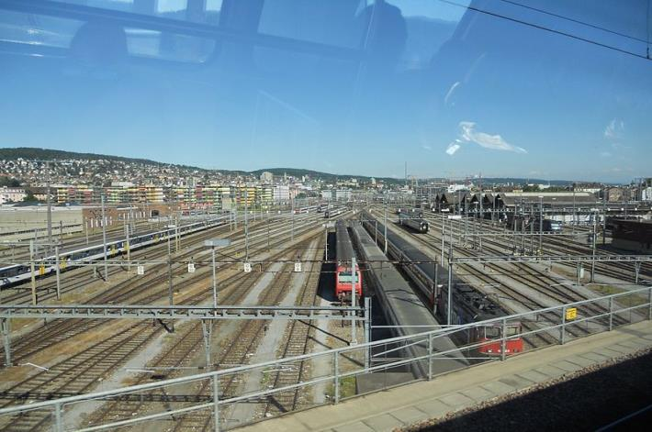
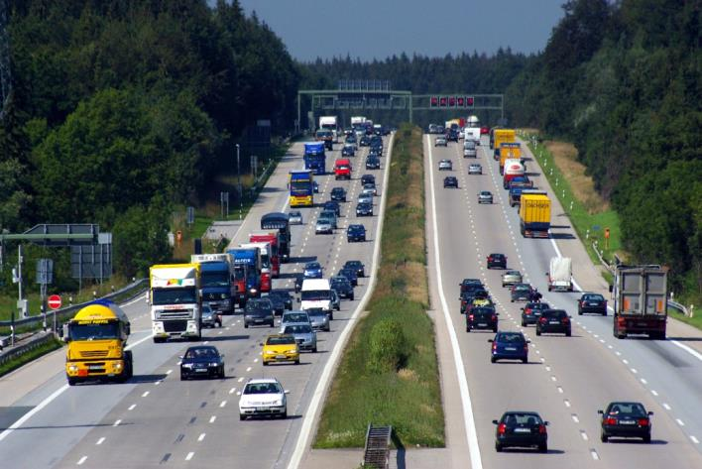
Why Railways?
Current situation in road traffic:
Very efficient use of roads
EU: 75% of freight, 82% of passengers
Many accidents, traffic jams, less energy efficient
Current situation in railways:
Very safe and energy efficient
EU: 18% of freight, 8% of passengers
Inefficient use of railways due to old and national safety system
[2]
[3]

Slide 5
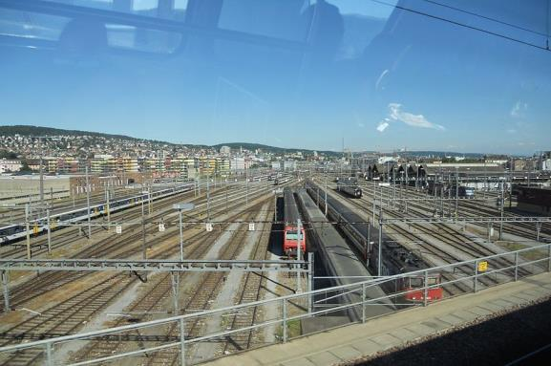
Why Railways?
Current situation in road traffic:
Large Market: 1.3 billion motor vehicles, 1.35 trillion $ trade (2015)
Current situation in railways:
Small Market: 6.2 million rail vehicles, without freight cars only 0.7 million, 167 billion $ (2015)
[2]
[3]
Society and politics: Shift traffic from road to rail [4]
➔ Need for highly efficient and safe railway operation with less infrastructure
➔ Reliable low-latency communications and ranging essential

Slide 6
Railway terms
Rail vehicle: Wagon, railcar, locomotive, …
Consist: a single vehicle or a group of vehicles that cannot be uncoupled
Train: composition of one or a set of consists or rail vehicles that can be operated as an autonomous unit

Slide 7
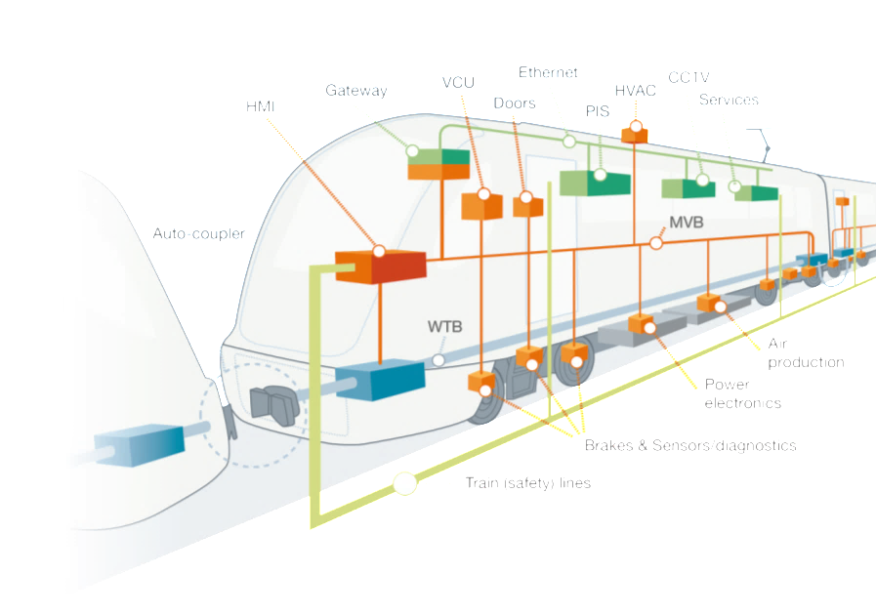
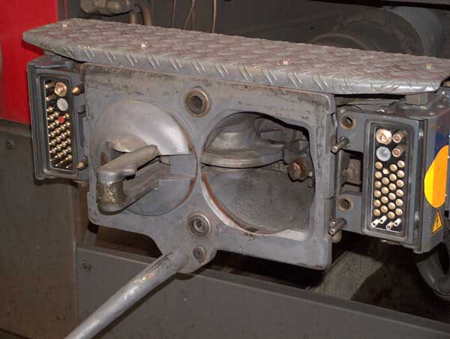
Use Case 1: Onboard Train
Train Control and Monitoring System (TCMS) state-of-the-art [5][6]
Inside rail vehicle or consist: Multifunction vehicle bus (MVB) or Ethernet consist network (ECN)
Connecting multiple vehicles: wired train bus (WTB) or ethernet train backbone (ETB)
Between consists or wagons mechanical and electrical couplers
Electrical coupler
[7]
Mechanical coupler

Slide 8
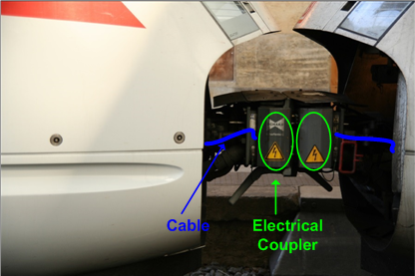
Use Case 1: Onboard Train
Train Control and Monitoring System (TCMS) state-of-the-art [5][6]
Mechanical stress at coupler
leads to many connection failures!
Electrical coupler
[7]
Mechanical coupler

Slide 9
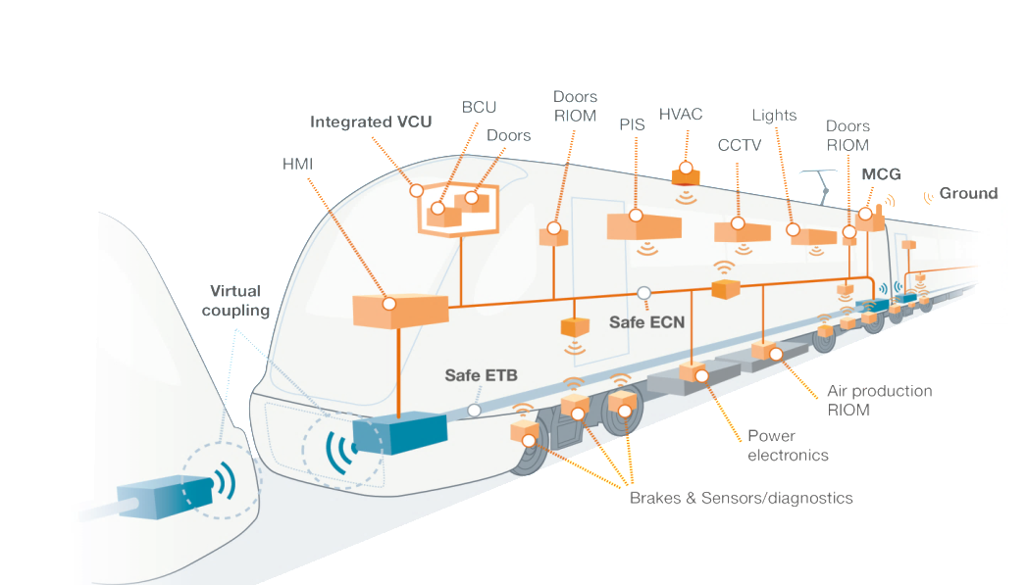
Use Case 1: Onboard Train
Wireless Train Control and Monitoring System (TCMS) [5][6]
[7]
[7]

Slide 10
Use Case 1: Onboard Train
Train Control and Monitoring System (TCMS) Data classes [6]:
Process data= small dimension data (byte or bit) that are sent periodically [8]
Message data= differ from process data for bigger size and not sent periodically [8]
Supervisory data= as message data, not periodically, used for supervision and inauguration process [8]
Stream data= big amount of data sent continuously
Best Effort data= data rate and delivery time depend on traffic load

Slide 11
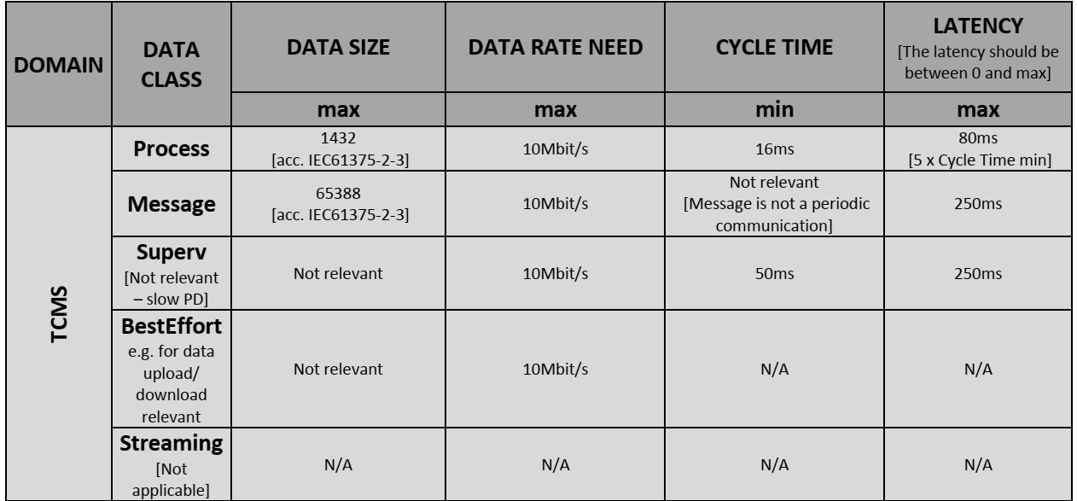
Use Case 1: Onboard Train
Train Control and Monitoring System (TCMS) [6]: Key performance attributes: Inside consist

Slide 12
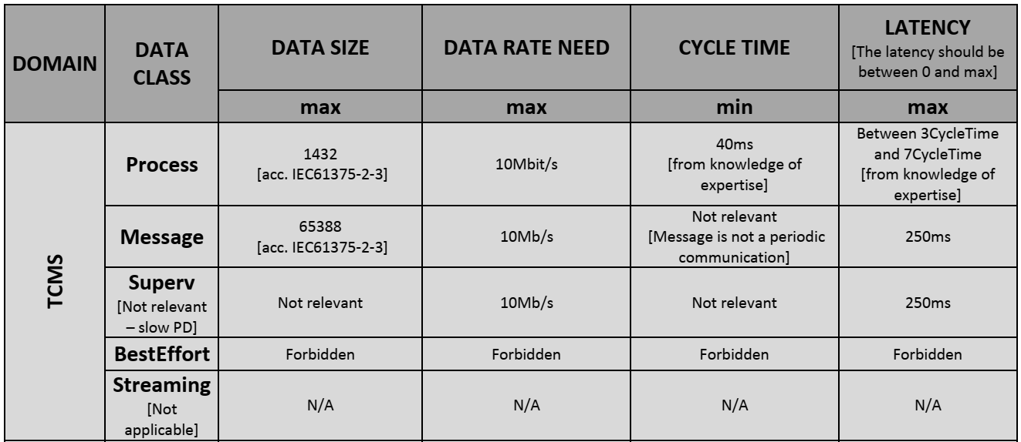
Use Case 1: Onboard Train
Train Control and Monitoring System (TCMS) [6]: Key performance attributes: Inside train

Slide 13
Use Case 1: Onboard Train
Train Control and Monitoring System (TCMS) [6]:
Required bandwidth ~ 100 Mb/s in one train
30 years innovation cycle
Operator oriented services
Improve operational parameters of train, e.g. maintenance costs, vehicle availability, closed circuit television (CCTV)
Required bandwidth ~ 1-10 Gb/s in one train
10 years innovation cycle
Customer services
Passenger comfort, e.g. public internet, passenger info portal; customer’s own devices, WiFi
Required bandwidth ~ 1-10 Gb/s in one train
5 years innovation cycle

Slide 14
Use Case 1: Onboard Train
Overview
Safety critical and for efficient operation
Wireless train control and monitoring system (TCMS)
Operator oriented services (CCTV, maintenance)
Deployment time line >2025
Requirements
For a speed of 400 km/h and distance of 500m, NGV provides at least a data rate of 100 Mbps and latency of 1 ms and supports reliability (SIL2/3)
Limitations
Communication range “onboard” train to avoid interference with other trains

Slide 15
Use Case 2: Train-to-Train Enabling Future Applications
Autonomous train protection & operation (ATP/ATO)
Remote control, automatic coupling and train integrity [10]
Virtual coupling: Platooning [11]
Collision avoidance [9]

Slide 16
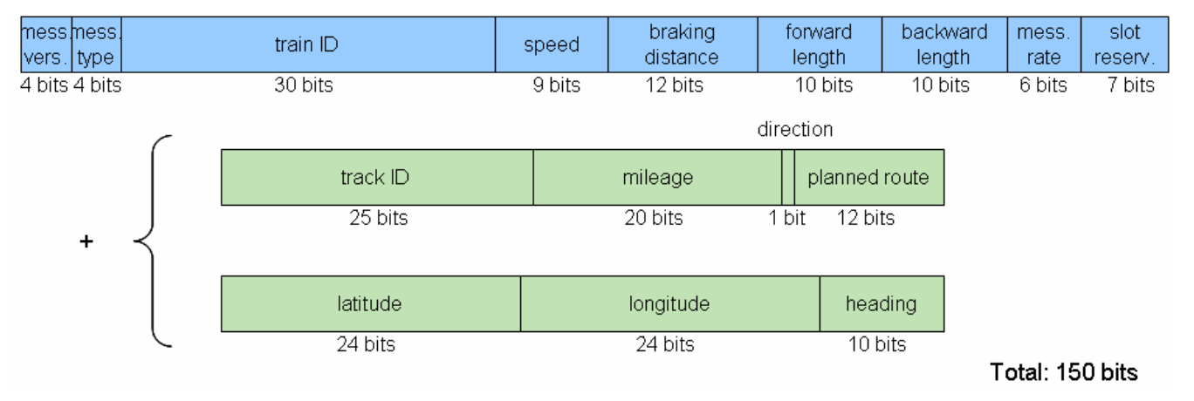
Use Case 2: Train-to-Train Enabling Future Applications
Autonomous train protection & operation (ATO): Collision avoidance [9]
150 bit message

Slide 17
Use Case 2: Train-to-Train Enabling Future Applications
Autonomous train operation (ATO): Collision avoidance [9]
150 bit message (excl. authentication and encryption)
Dense train station /shunting yard: 200 static & 25 moving trains, update rates 0.2 Hz static & 1 Hz moving train ➔ Minimum message rate = 200 ∙ 0.2 Hz + 25 ∙ 1 Hz = 65 Hz
System data rate = 150 bit ∙ 65 Hz = 9.75 kbit/s
Communication range 5 km for 2 km breaking distance of train @ 200 km/h (~125 mph)
Sufficient for informing train driver as safety-overlay in addition to other safety measures
➔ Higher rates needed to include authentication and encryption also for stand alone system or autonomous operations

Slide 18
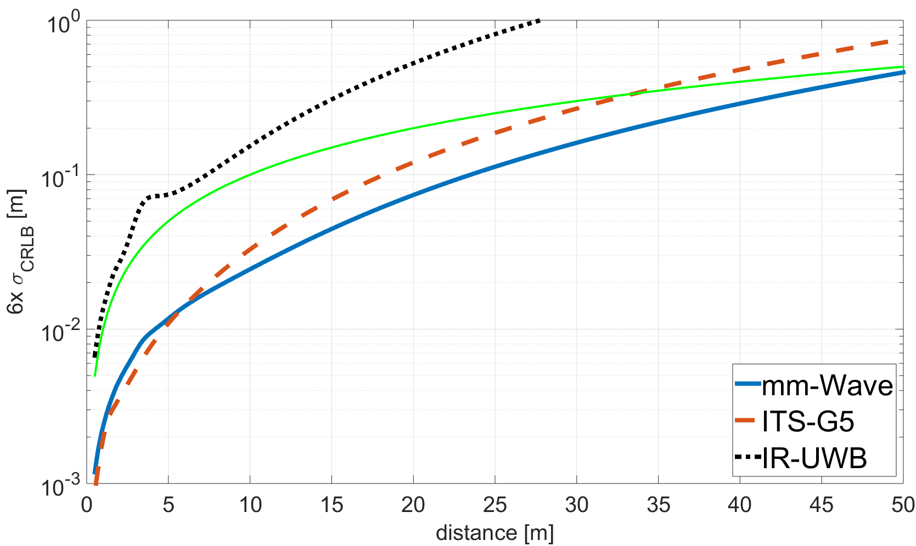
Use Case 2: Train-to-Train Enabling Future Applications
Autonomous train operation (ATO): Remote control, automatic coupling and train integrity [10]
Communication and ranging for control
Ranging accuracy 1% of actual distance
6-sigma of Cramér–Rao lower bound (CRLB)
ITS-G5 (802.11p, 10 MHz), IR-UWB and mm-Wave (both 500 MHz bandwidth)
1% of the distance accuracy threshold

Slide 19
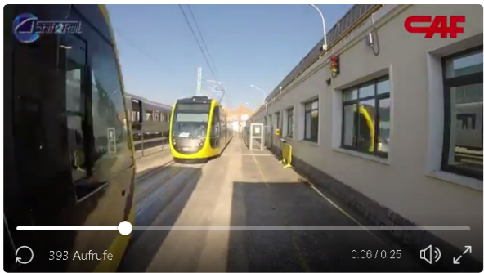
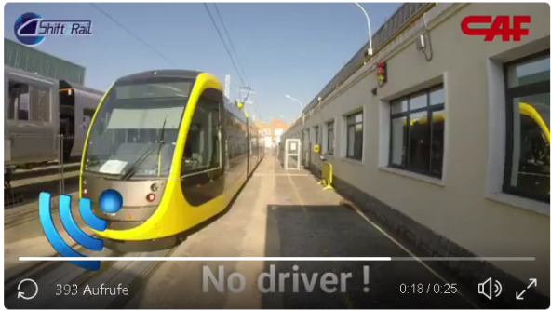
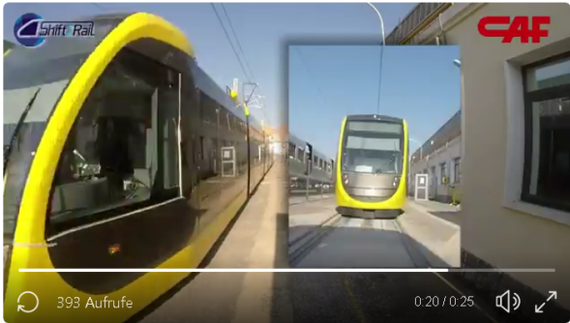
Use Case 2: Train-to-Train Enabling Future Applications
Virtual coupling: Platooning [12]
Demonstration at Innotrans 2018 by Siemens, Bombardier, CAF
[11]

Slide 20
Use Case 2: Train-to-Train Enabling Future Applications
Virtual coupling: Platooning [12]
Trains per platoon: 3/6/18 in rural/suburban/urban
Message rate 10 Hz
Message size 167 bytes
13.36 kb/s for one train broadcasting to platoon
40.08/80.16/240.48 kb/s for 3/6/18 trains per platoon in rural/suburban/urban
Update-Delay $∆t$ ($a_{max}=1 m/s^{2})$ | 0.01 s | 0.1 s | 1 s | 10 s
Position uncertainty ${\left|∆x\right|}_{max}$ | 0.5e-5 m | 0.5e-2 m | 0.5 m | 50 m
Velocity uncertainty ${\left|∆v\right|}_{max}$ | 0.01 m/s = 0.036 km/h | 0.1 m/s = 0.36 km/h | 1 m/s = 3,6 km/h | 10 m/s = 36 km/h
[10]

Slide 21
Use Case 2: Train-to-Train
Overview
Safety critical and for efficient operation
Autonomous train protection & operation (ATP/ATO): collision avoidance, remote control, automatic coupling and train integrity; virtual coupling (platooning)
Deployment time line >2030
Requirements
For a relative speed of 500 km/h (with directional antennas 800 km/h) and distance of 2000 m, NGV provides at least a data rate of 1 Mbps, a ranging accuracy of 1% of distance, and latency of 10 ms as well as supports reliability (SIL2)

Slide 22
Use Case 3: Train-to-Trackside
Signaling: Safe operation of trains
European Train Control System (ETCS)
GSM-R, future railway mobile communication system (FRMCS) using LTE/5G or WLAN
FRMCS traffic analysis [13]: ETCS, ATO, telemetry, remote control, critical video transmission
Positive Train Control (PTC) [14]
Communication Based Train Control (CBTC) [15]
Application standard
802.11b/g or LTE @ 1.8 GHz as well as proprietary solutions @ 5.9 GHz, e.g. based on 802.11a with 5MHz channels
Scenario for Reference Train | Train-to-Trackside (Uplink) |  | Trackside-to-Train (Downlink)
Critical Video Transmission | Yes | No | Yes | No
Future Evolution [Mbps] | 7.42 | 3.46 | 4.38 | 0.42
Co-Existence / Mitigation [Mbps] | 3.49 | 0.19 | 3.50 | 0.20

Slide 23
Use Case 3: Train-to-Trackside
Signaling: Safe operation of trains
European Train Control System (ETCS)
GSM-R, future railway mobile communication system (FRMCS) using LTE/5G or WLAN
Positive Train Control (PTC) [14]
Communication Based Train Control (CBTC) [15]
Application standard
802.11b/g or LTE @ 1.8 GHz as well as proprietary solutions @ 5.9 GHz, e.g. based on 802.11a with 5MHz channels
Remote train operation in degraded mode for autonomous train operation (ATO)
Issues:
In urban areas capacity problems
Dedicated links (link setup, link loss) to access points/base stations
➔ Broadcast to multiple access points for redundancy, lower latency

Slide 24
Use Case 3: Train-to-Trackside
Overview
Safety critical and for efficient operation
Signaling of European Train Control System (ETCS), Positive Train Control (PTC), Communication Based Train Control (CBTC), Remote train operation in degraded mode for autonomous train operation (ATO)
Deployment time line >2025
Requirements
For a speed of 400 km/h and distance of 2000 m, NGV provides at least a data rate of 100 Mbps (50 Mbps without critical video), absolute position accuracy of 2 m cross and 0.5 m along track with at least 99% reliability, and latency of 100 ms as well as supports reliability (SIL4)

Slide 25
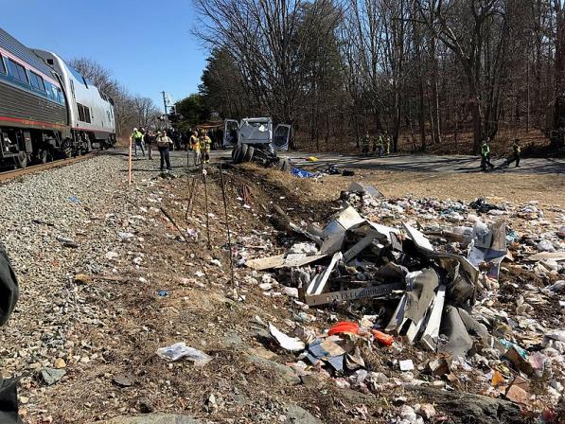
Use Case 4: Vehicle-to-Train
[16]
Shared space: Level crossings
Basic safety message/ CAM
Long breaking distance of trains compared to cars, e.g. 250m @ 100 km/h (62 mph) compared to 50m
Need for increased communication range
Shared spectrum
EC Mandate for regulation:
Shared spectrum use of 5.9 GHz ITS band between V2X and urban rail communications
Spectrum segregation not an option

Slide 26
Use Case 4: Vehicle-to-Train
Overview
Safety critical and for efficient operation
Shared space at level crossings, shared spectrum for 5.9 GHz ITS band between V2X and urban rail communications
Deployment time line >2020
Requirements
For a relative speed of 500 km/h and a distance of 2000 m, NGV provides at least a data rate of 1 Mbps, a ranging accuracy between 5% and 10% of distance, and a latency of 100 ms, as well as supports reliability (SIL2)
Limitations
Interference between V2X and T2X limited while enabling safe cooperation

Slide 27
Summary
Railway use cases also relevant to NGV besides road vehicle use cases:
Use Case 1: Onboard Train
Wireless train control and monitoring system (TCMS), operator oriented services, customer services (passenger information services, connection to mobile hot spot for public internet)
Use Case 2: Train-to-Train
Autonomous train protection & operation (ATP/ATO): collision avoidance; remote control of automatic coupling and train integrity; virtual coupling (platooning)
Use Case 3: Train-to-Trackside
Signaling, operator oriented services, customer services (passenger information, …)
Use Case 4: Vehicle-to-Train
Shared space in level crossings & shared spectrum

Slide 28
References
Source wikipedia https://en.wikipedia.org/wiki/Vehicle
Souce wikipedia https://commons.wikimedia.org/wiki/File:Autobahn_A8_bei_Holzkirchen.JPG
Source wikipedia https://commons.wikimedia.org/wiki/File:Gleise_zu_Z%C3%BCrich_HB_2010.jpg
Shift2Rail https://shift2rail.org/
Juan Moreno García-Loygorri, Javier Goikoetxea, Eneko Echeverría, Aitor Arriola, Iñaki Val, Stephan Sand, Paul Unterhuber, del Rio, Francisco (2018) The Wireless Train Communication Network: Roll2Rail Vision. IEEE Vehicular Technology Magazine. 2018. DOI: 10.1109/MVT.2018.2844408 ISSN 1556-6072
Roll2Rail. (2015). D 2.1 Specification of the Wireless TCMS. Public deliverable. [Online]. Available: http://www.roll2rail.eu/Page.aspx?CAT=DELIVERABLES&IdPage=45291e18-8d8f-4fd6-99f8-5d4b7a519b9c
Source CONNECTA Report Summary https://cordis.europa.eu/result/rcn/200968_en.html
IEC 61375-2-3:2015 Train Communication Network (TCN) – Part 2-3:Train Communication Profile
Lehner, Andreas und Rico Gracía, Cristina und Strang, Thomas (2011) A multi-broadcast communication system for high dynamic vehicular ad-hoc networks. International Journal of Vehicle Information and Communication Systems, Vol. 2 (No. 3/4), Seiten 286-302, Inderscience Publishers, DOI: 10.1504/IJVICS.2011.044267, ISSN 1471-0242. https://www.inderscienceonline.com/doi/pdf/10.1504/IJVICS.2011.044267

Slide 29
References
Soliman, Mohammad und Sand, Stephan und Schmidhammer, Martin und Staudinger, Emanuel (2017) Effect of Non-Integer Delay on Ranging Accuracy for Ultra-Reliable Systems. ICL GNSS 2017, 27-29 June 2017, Nottingham, England. http://elib.dlr.de/114201/
Unterhuber, Paul und Sand, Stephan und Soliman, Mohammad und Siebler, Benjamin und Lehner, Andreas und Strang, Thomas und Gera, Damini (2017) Wide Band Propagation in Train-to-Train Scenarios - Measurement Campaign and First Results. EUCAP 2017, 19.-24.März 2017, Paris, Frankreich. http://elib.dlr.de/111876/
Source Javier Goikoetxea’s tweet https://twitter.com/goikotrains/status/1038396656507670528
Nooijen, Jos (2018) Future Railway Mobile Communication System (FRMCS) Traffic Analysis V2 https://www.cept.org/Documents/fm-56/46006/fm56-18-065_frmcs-traffic-analysis-v220
M. Hartong, R. Goel and D. Wijesekera, "Communications Based Positive Train Control Systems Architecture in the USA," 2006 IEEE 63rd Vehicular Technology Conference, Melbourne, Vic., 2006, pp. 2987-2991.
IEEE 1474.1-2004 - IEEE Standard for Communications-Based Train Control (CBTC) Performance and Functional Requirements, P1474.1 - Standard for Communications-Based Train Control (CBTC) Performance and Functional Requirements
Source wikipedia https://commons.wikimedia.org/wiki/File:2018_Crozet,_Virginia_train_crash_2.jpg

Slide 30
Straw Poll
Question: use cases relevant for NGV?
Y/N/Need more information:
27/0/18

Slide 31
Straw Polls
Question: Do you agree to adopt the “Onboard Train” use case on slide 14 as one of NGV use cases?
Y/N/A: 10/8/15
Question: Do you agree to adopt the “Train-to-Train” use case on slide 21 as one of NGV use cases?
Y/N/A: 21/2/7
Question: Do you agree to adopt the “Train-to-Trackside” use case on slide 24 as one of NGV use cases?
Y/N/A: 12/4/14
Question: Do you agree to adopt the “Vehicle-to-Train” use case on slide 26 as one of NGV use cases?
Y/N/A: 24/0/10

