Slide 1
TG ax
Spatial Reuse DSC and TPC
Date: 2018-07
Authors:

Slide 2
Background
Previous presentations have analyzed DSC and the various scenarios:
By Graham Smith
Dynamic Sensitivity Control 13/1012r4, 13/1290r1
Dense Apartments 13/1487r2, 14/0328r2
Airport capacity 13/1489r5
Pico Cell 14/0058r1
E_Education 14/0045r2
Enterprise Scenario 15/0548r0
DSC and Roaming 15/0025r0
DSC Practical Usage 14/0779r2
DSC Channel Select and Legacy sharing 14/0294r0
Outdoor Enterprise Scenario and DSC 15/0804r0
DSC Summary 15/0807
Adjustment of Sensitivity and/or CCA 16/0121
Enterprise Scenario DSC and Color 16/0212
Enterprise scenario TPC and DSC 16/0350
Indoor Enterprise Scenarios, Color, DSC and TPC 16/0597
Proposal for DSC, ATPC Inter_BSS with responses to Comments 16/1567
DSC as OBSS_PD 17/0163
OBSS_PD/TPC Examined 17/0582
By Others
MAC Simulation Results for DSC and TPC 14/0523, Laurent Cariou (Orange)
DSC and Legacy Coexistance 14/0854, William Carney (Sony)
UL & DL DSC and TPC MAC Simulations 14/1171 Johan Soder (ericsson)
DSC Simulation Results for Scenario 3 14/1171 Masahito Mori (Sony)
Performance Analysis of B SS Color and DSC, 14/1403, Masahito Mori (Sony)
DSC and legacy coexistence 14/1426 Gustav Wikstrom (Ericsson)
DSC Performance 14/1427, Gustav Wikstrom (Ericsson)
Simulation based Evaluation DSC in residential scenario, 15/0027, M Shahwaiz Afaqui (UPC)
Impact of TPC coupled to DSC for legacy unfairness issue, 15/0319 Masahito Mori (Sony)
Proposal and simulation based evaluation of DSC-AP Algorithm 15/0371, Eduard Garcia-Villegas (UPC)
Discussion on the Receiver Behavior for CCAC DSC with BSS Color, 15/0595 Yasuhiko Inoue (NTT)
Reference Simulation Model for Dynamic CCA / DSC calibration 15/0652, Masahito Mori (Sony)
DCCA/DSC Reference Simulation Results. 15/0801, Masahito Mori (Sony)
DSC/DCCA Calibration with Tgax Agreed Scenarios
DSC calibration results with NS-3, 15/1316 Eduard Garcia-Villegas (UPC)
Simulation Based evaluation of DSC in Enterprise scenario, 16/0604, Tanguy Ropitault, (NIST)

Slide 3
I came across a Technical Paper on Spatial Reuse that is worthwhile sharing.
“Improving spatial reuse in future dense high efficiency Wireless Local Area Networks”
CITE:
Imad Jamil. Improving spatial reuse in future dense high efficiency Wireless Local Area Networks. Networking and Internet Architecture [cs.NI]. INSA de Rennes, 2015. English. <NNT : 2015ISAR0033>.
<tel-01329810>
I will present excerpts from this together with observations.

Slide 4
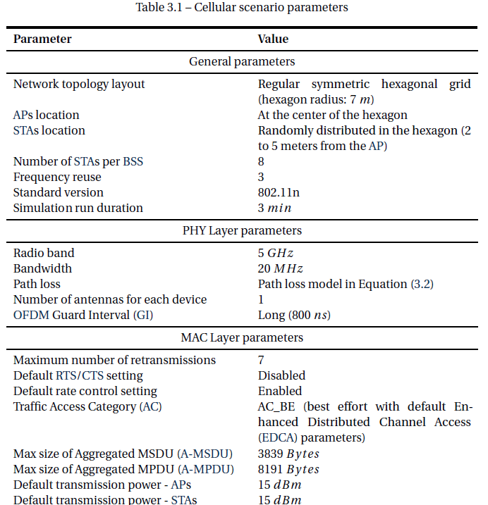
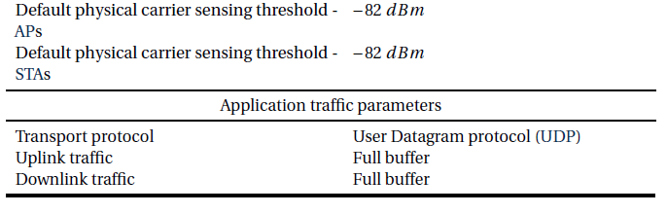
Cellular Scenario
International Telecommunication Union (ITU) UrbanMicro (UMi) model defined by the ITU-R SG [87]?
for hexagonal cell layout as follows:
PL(dTR) = 22.7+36.7log(dTR)+26log( fc )
A modified version of this model is used within the cellular simulation scenario
PL(dTR) = 23.3+36.7log(dTR)+21log(fc / 0.9)

Slide 5
Challenges of Transmit Power Control (TPC) in WLAN systems
Clause 4.4.2
“It is interesting to note that TPC is standardized since 2003 by the IEEE 802.11h amendment but it has hardly found its way to the production stage. Although, for networks with centralized controllers, TPC is relatively simple to implement, it was only applied on APs but never on Station (STA)s. In such situations, the APs that are connected to a common controller apply TPC to reduce their transmit power, however the STAs associated to these APs still transmit with their full power. The main reason behind this is related to the nature of TPC which is selfless. If a node reduces its transmission power by applying the TPC, that will promote the neighboring transmissions because they are no more bothered by the transmissions of that node. Consequently, the other nodes will benefit directly and not the node that applied the TPC.”

Slide 6
Challenges of Transmit Power Control (TPC) in WLAN systems
“Moreover, in networks which lack a central regulator, power control proves to be much
more difficult to implement and apply. Since centralized coordination between nodes
is very difficult, it is necessary for each node to regulate its own transmission power autonomously. This behavior creates an asymmetric application of TPC and hence different transmission powers for different nodes. Again, the selfless feature of TPC will prevent real networks from taking this approach. The detrimental effect of this asymmetry is argued by many researchers. It has been proven that in such situation, TPC leads to the starvation of the unprivileged nodes. Actually, TPC is more problematic to achieve in a distributed manner because it will foster higher power transmitters, that are not applying power control, at the expense of lower power transmitters that are applying it.”

Slide 7
Dynamic physical carrier sensing adaptation
“Physical Carrier Sensing Adaptation (PCSA)”
“In order to confirm the efficiency of PCS in enhancing spatial reuse in dense deployments and hence increasing the aggregate throughput of the network, a dynamic adaptation algorithm is proposed here and evaluated.”
….each device adapts its PCS threshold in terms of the power received from its communication peer. For instance, in an infrastructure BSS, all the communications are held between an AP and a STA. In such a case, the STA adapts its PCS threshold according to the power level received from its AP and vice-versa.
Therefore the PCS threshold of each device is obtained as follows
PCSth[dBm] = Rxp[dBm]−M[dB]”
NOTE: This is the DSC formula where PCSth is OBSS_PD

Slide 8
STA and AP setting of Rxp
STA uses a moving average of received Beacon frames
AP uses the minimum reception power from its associated STAs.
NOTE : Again as proposed for DSC
Example:
Rxp = -55dBm, M = 20dB PCSth = -75dBm

Slide 9
Cellular Scenario All PCSA STAs
M=20dB
“…all the transmitters are configured to transmit using the MCS7
(64-QAM modulation scheme and 5/6 coding rate).”
“…the application of PCSA leads to a gain of 126 % in aggregate throughput (from 45 Mbps to 102 Mbps).”

Slide 10
PCSA - With Rate Control
Restricting the MCSs
Best is restricting to MCS 5-7 and 4-7.
In all cases PCSA has gain
260% to 500%

Slide 11
PCSA – With Rate Control
The aggregate throughput only tells half the story. It is interesting to look at the worst case throughput performance represented by the central AP…
This AP, belonging to the central BSS, experiences the greater amount of interference from the surrounding BSSs
Best is MCS 4-7 about 375% gain

Slide 12
TPC Algorithm
“…a new TPC algorithm that is fairly comparable to the PCSA described above. Each node adapts its transmit power so that its transmission is received at a margin above the traditional PCSth (−82 dBm) by the intended receiver. In that way, the shrinking ratio of the sensitivity range is maintained the same as the PCSA case. This adaptation algorithm is used to compare the performance of TPC versus PCSA.”
Example:
Rxp = -45dBm, hence received signal is (82-45)= 37 dB above threshold
If M= 30dB, then TXPWR can be reduced by 37-30=7dB
Thus TXPWRtpc = 15 – 7 = 8dBm
Formula is:
TXPWRtpc = TXPWR – (Rxp-PCSth) +M Where PCSth = -82dBm
Note this can be expressed as
TXPWRtpc = TXPWR – (OBSS_PD – PCSth)
where PCSth = -82 dBm and OBSS_PD = Rxp - M
NOTE: This is what was proposed in linking DSC and TPC

Slide 13
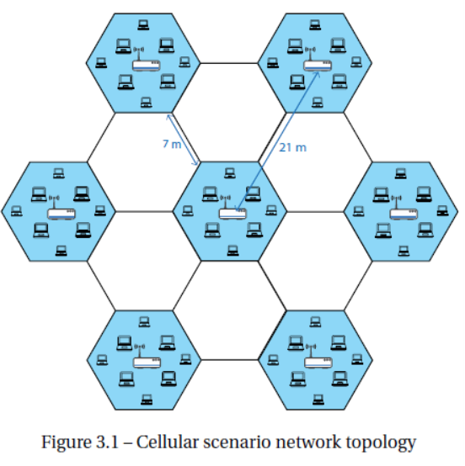
Signal Levels
STA randomly placed between 2 and 5m from AP
AP to AP = -73 dBm (21m)
AP to STA = -35 to -55 dBm (2m, 5m)
TPC, M=30
Outer STA TXPWR = 15-(-55+82)+30= +18 dBm ?
Inner STA TXPWR = 15-(-35+82)+30= -2 dBm
AP TXPWR = +18 dBm ? (So no TPC?)*
Closest OBSS STA to STA = -63dBm (11m)
Furthest OBSS STA to STA = -79 dBm (31m)
So overlap even with TPC
DSC, M=20
Outer STA PCSth = -75dBm (OBSS_PD)
Inner STA PCSth = -55dBm (OBSS_PD)
overlap
3
3
6
3
3
Expect center to be shut out
Legacy
3
3
Notes:
*For TPC if M< 27, then we have a circular condition if TPC is applied to AP – outermost STA reduces power based on beacon power, which reduces AP power, which reduces beacon power etc.
Not able to confirm if TPC was applied to AP – suspect it can’t be.

Slide 14
Cellular Scenario All TPC STAs
Gain of 93 % in aggregate throughput
Higher M means less TXPWR reduction.
M=30dB
M=25dB
“…all the transmitters are configured to transmit using the MCS7
(64-QAM modulation scheme and 5/6 coding rate).”
TPC, M=30
Outer STA TXPWR = 15-(-55+82)+30= +18 dBm (i.e. no TPC)
Inner STA TXPWR = 25-(-35+82)+30= -2 dBm
AP TXPWR = +18 dBm ? (So no TPC?)

Slide 15
Presence of Legacy devices
1 legacy STA per cell
For the PCSA approach, the maximum
aggregate throughput is decreased by 10 % compared to the case where there are no legacy devices
in the case of TPC, …we can see that the presence of 7 legacy STAs causes more
than 35 % of aggregate throughput decrease
“It is clear that PCSA shows greater ability to tolerate the presence of legacy devices than TPC.”

Slide 16
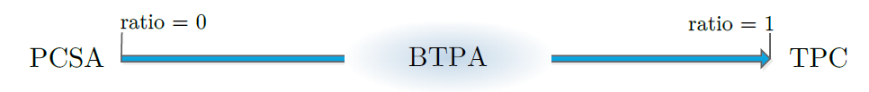
Balanced Transmit power control and Physical carrier sensing Adaptation
“…in the presence of a given number of legacy devices, the aggregate throughput decreases by 10 % when applying PCSA while it decreases by 35 % when applying TPC (see Section 4.8.4 for details). It is true that in the presence of legacy devices, the PCSA overall performance does not suffer from serious degradation as that of TPC. However, the fairness between the contending nodes is altered.”
Propose a scheme, BTPA, that combines both PCSA and TPC
PCSth = Rxp[dBm]−M[dB]
Δx [dB] = PCSth − PCSdefault [dBm] (-82dBm)
Δtpc = ratio x Δx Δpcs = Δx - Δtpc
TXPWR = TXPWR - Δtpc PCSth = PSCth + Δpcs
Example: Rxp = -45dBm, M=20, ratio 0.5
PCSth = -45 – 20 = -65dBm
Δx = -65 + 82 = 17 dB
Δtpc = 17 x 0.5 = 8.5dB, TXPWR = 15 – 8.5 = 6.5 dBm
Δpcs = 17 – 7.5 = 9.5dB, PCSth = -65 – 8.5 = -73.5 dBm

Slide 17
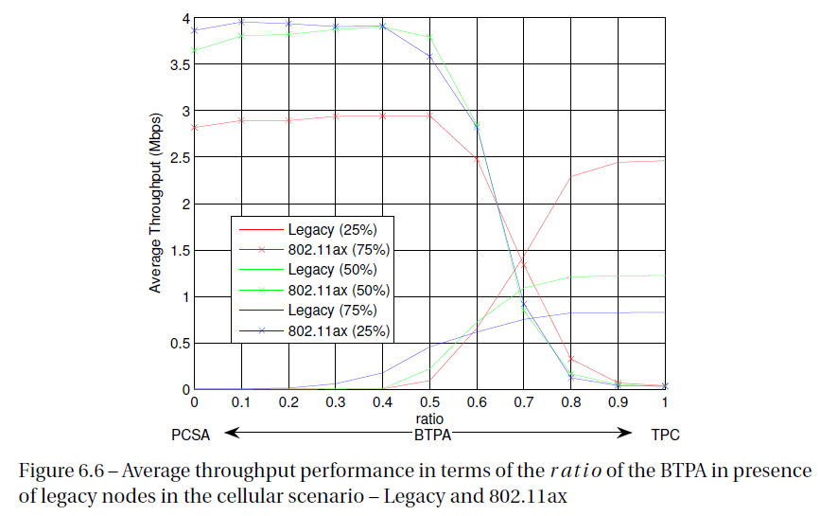
For all of the three configurations, when the BTPA’s ratio is below 0.4 the average throughput achieved by the 802.11ax STAs is quite stable at its maximum attained level.
The legacy STAs are almost not able to transmit for these values of BTPA’s ratio. This observation is reasonable recalling the fact that PCSA favors the 802.11ax nodes.
Increasing the ratio above 0.5 increases the average throughput achieved by the legacy STAs.
For a ratio around 0.7, the averaged throughputs achieved by all the nodes are very close.
TPC kills the 802.11ax traffic

Slide 18
Points on this work
Not my work and I had several questions, BUT, the following points may be taken away from this work:
Implementation of the TPC scheme which we have in the 11ax Draft is probably a bad move:
    Legacy devices kill 11ax devices
    No rule is imposed so different 11ax devices can use different TPC so even if all 11ax, still problems
Implementation of PCSA (DSC) can be unfair to legacy devices
    11ax DSC devices win.
If all STAs are 11ax, then DSC is the better result.

Slide 19
Conclusions
TPC will have a problem being implemented
DSC has clear advantages
A mix of TPC and DSC shows promise
DSC should be added to the 11ax Draft
  As proposed in 18/0617r2
  OBSS_PD_{level} = RSSI_ beacon – OBSS_PD_Margin
  With OBSS PD_{min} <OBSS_PD_{level} < OBSS_Pd_{max}
  This allows a mix of DSC and TPC

Slide 20
Straw Poll
Resolve CID 15652 along the lines of accepting to allow an AP to include the OBSS_PD Margin and to allow a STA to adjust its ODSS_PD level in accordance with
  OBSS_PD_{level} = RSSI_ beacon – OBSS_PD_Margin
  With OBSS PD_{min} <OBSS_PD_{level} < OBSS_Pd_{max}

