Slide 1
Real-time Console Game Network Profile
Date: 2018-09-04
Authors:

Slide 2
Abstract
The purpose of this presentation is to bring to light the problems faced by online console games. Popular FPS games encounter challenges when connected through Wi-Fi. Gamers have an especially bad view of Wi-Fi for online gaming. From this study, we can learn how Real-time applications are impacted due to generalized packet prioritization.

Slide 3
Real-time FPS Console Gaming
Multiple Gaming Consoles connecting to a dedicated server to play together in a single game session
It is real-time because the feedback must be present on the screen while the user plays the game
A good gameplay is where the players don’t notice any latency
Synchronized game state among all players is a key factor multiplayer FPS

Slide 4
Why should the IEEE focus on improving Wi-Fi
Wi-Fi has an especially bad reputation among the gaming community. As an example one of the top gaming magazines published the following article.
“Here's how playing on Wi-fi hurts your game”^{[1]}
Other online articles such as:
5 steps to reduce lag and increase your internet speed for gaming^{[2]}
Step 4: Get off Wi-Fi
There are also numerous Reddit gaming threads littered with complaints about Wi-Fi

Slide 5
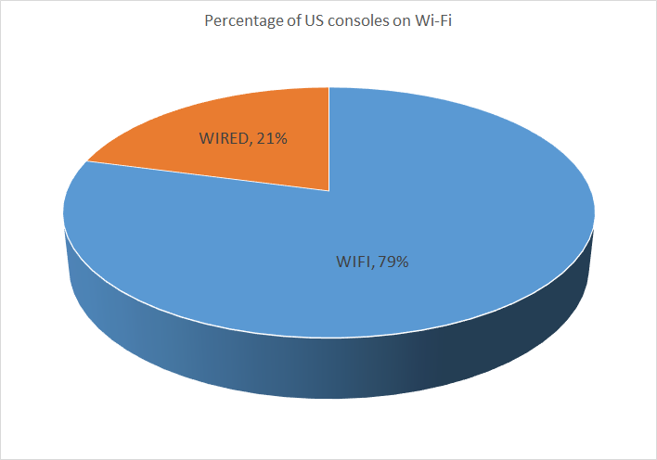
Percentage of consoles using Wi-Fi
According to a top selling online console game in the US the following represents game consoles playing the game on Wi-Fi:

Slide 6
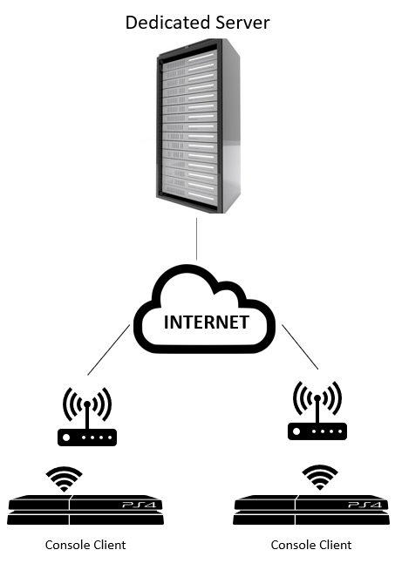
FPS Network Architecture
Dedicated Server
This model has many servers spread to cover as many geographical locations possible depending on the traffic. Dedicated server’s main purpose apart from hosting the game is to host the game matchmaking with the best network paths.

Slide 7
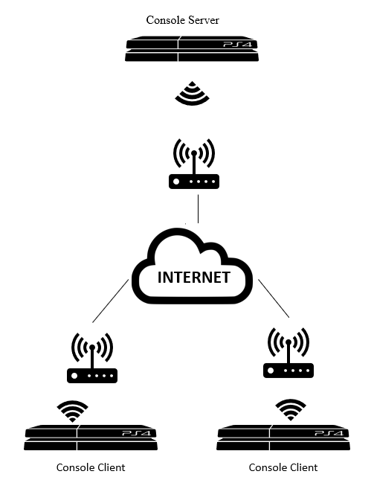
FPS Network Architecture
Local Server
A console is elected to host the game to the local players. Statistics are managed by the centralized servers, but most of the network traffic is managed by this console. It helps in reducing the dedicated servers to host all the games.

Slide 8
Game Play Terminology
Gateway: Using WLAN to connect WAN with a Wi-Fi router.
Lagging in a game: Lag is noticeable in an FPS game when there is some streaming device used in the same network.
In-game ping: It is the round trip time from the console to the server and back. A player would not be added or disconnected the game if the ping is too high for a particular server
Jitter: It refers to variation in the lag of a given connection. It usually occurs due to different routes taken by different packets. It can be reduced by setting up fixed playout delays on routers.
Dead Reckoning: Approximating the next move based on the previous move due to packet loss.^{[3]}

Slide 9
Packet flow of an FPS console game
Packet Protocol: Uses UDP Data packets for gameplay updates to and from the server and TCP for matchmaking
Packet Size: Frame size of 100-200 bytes depending on the size of data sent
Packet flow Rate: Approximately 60 packets/sec from a console to server and 15 packets/sec from a server to console depending on the pace of gameplay
Bandwidth Between console and Server: 0.2 - 1 Mbps
Game Data: Carries users’ instructions during uplink and result of those instructions in a downlink.

Slide 10
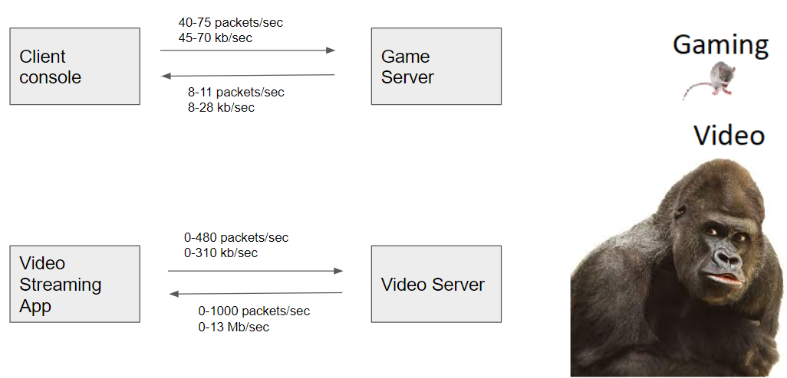
Traffic Modelling

Slide 11
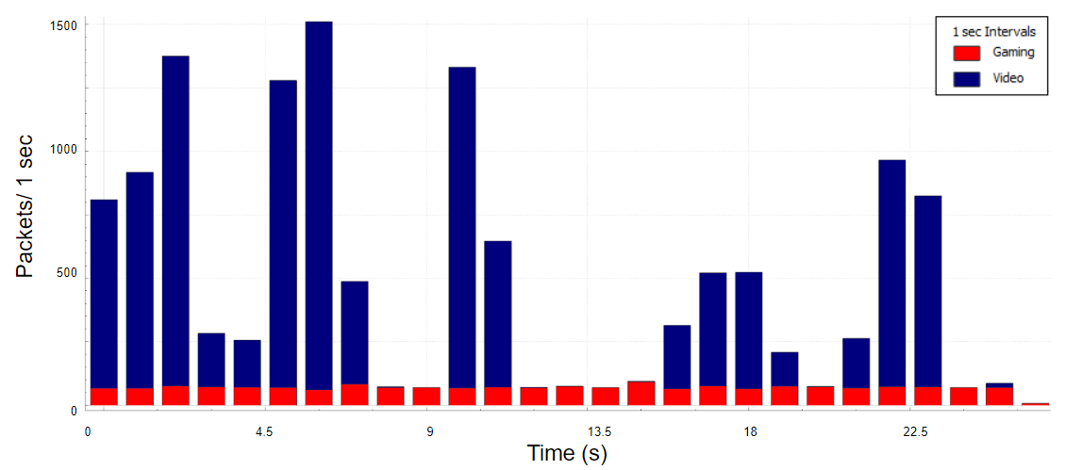
Network Capture

Slide 12
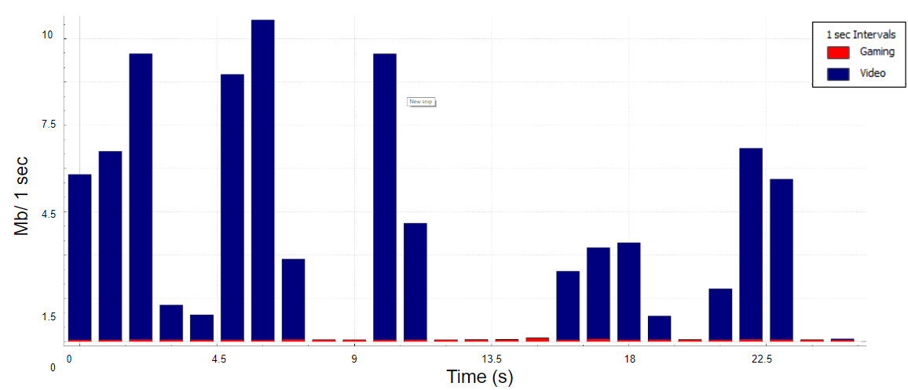
Overall Network Bandwidth

Slide 13
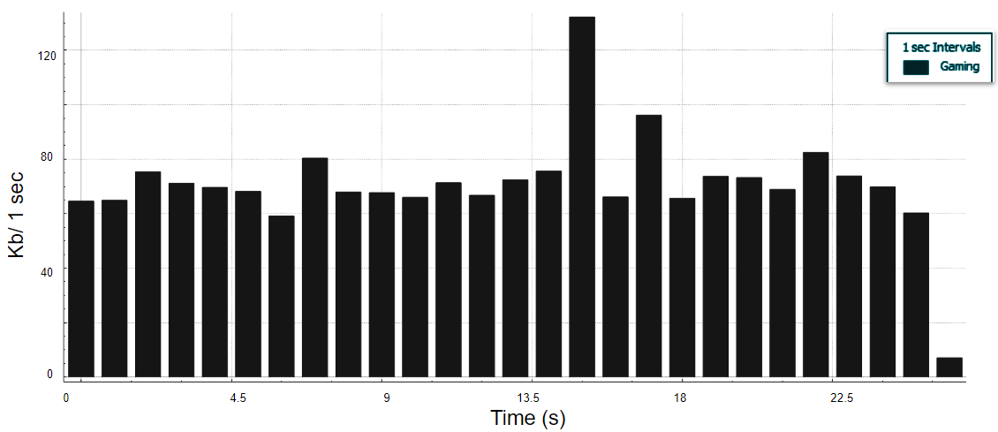
Game data Bandwidth

Slide 14
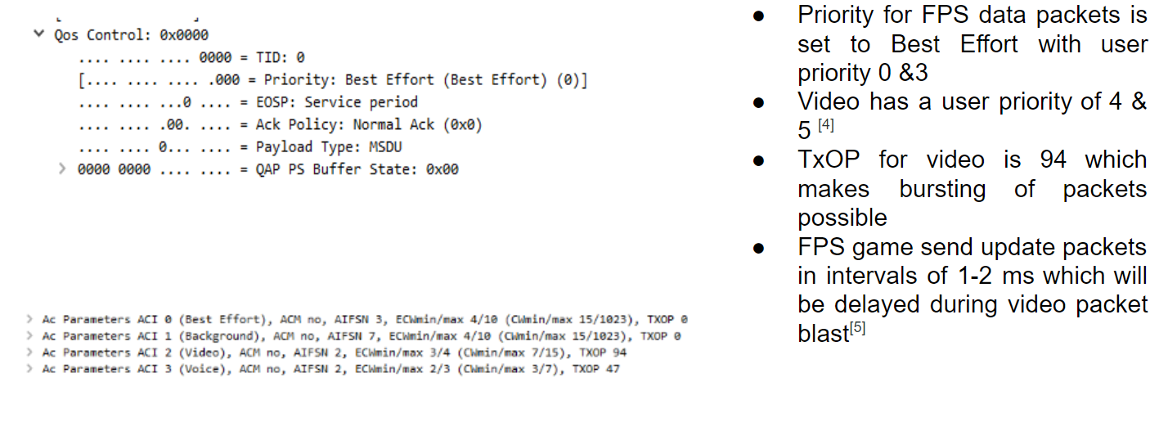
QoS Tags on the Access Point

Slide 15
Problems due to priority scheme
As number of video streams increase, the contention also increases. In order to keep latency low the total throughput of the Channel is decreased.
Voice and Video streams have priority over data due to Enhanced Distributed Channel Access (EDCA)
EDCA/WMM in attempt to contain the higher priority streams and offer protection to streams already in progress^{[6]}
These factors impact the smoothness of Best-effort UDP packet blasts during an intense gameplay

Slide 16
Wireless gaming challenges
Lag spike during gameplay lasting for 1-3 seconds
Limited bandwidth availability due to high streaming devices
Channel interference with other networks
Packet loss compensated by dead reckoning
Rubber banding in a multiplayer FPS game
Kicked out of the public match mostly due to high ping
Headshots don’t count
Goal oriented Multiplayer game not achieving the goal

Slide 17
eSports
It is an annual worldwide online gaming competition where players win a prize pool of up to $100 million. ^{[7]}
The initial stages of the competition are played on the open Internet.
Playing on Wi-Fi for this competition could be a bad decision for a Pro gamer.
Gaming is a career for many and a Wi-Fi issue could spoil their A game
Ultimately spoiling the team’s game which will lead to losing the positioning in the leaderboard

Slide 18
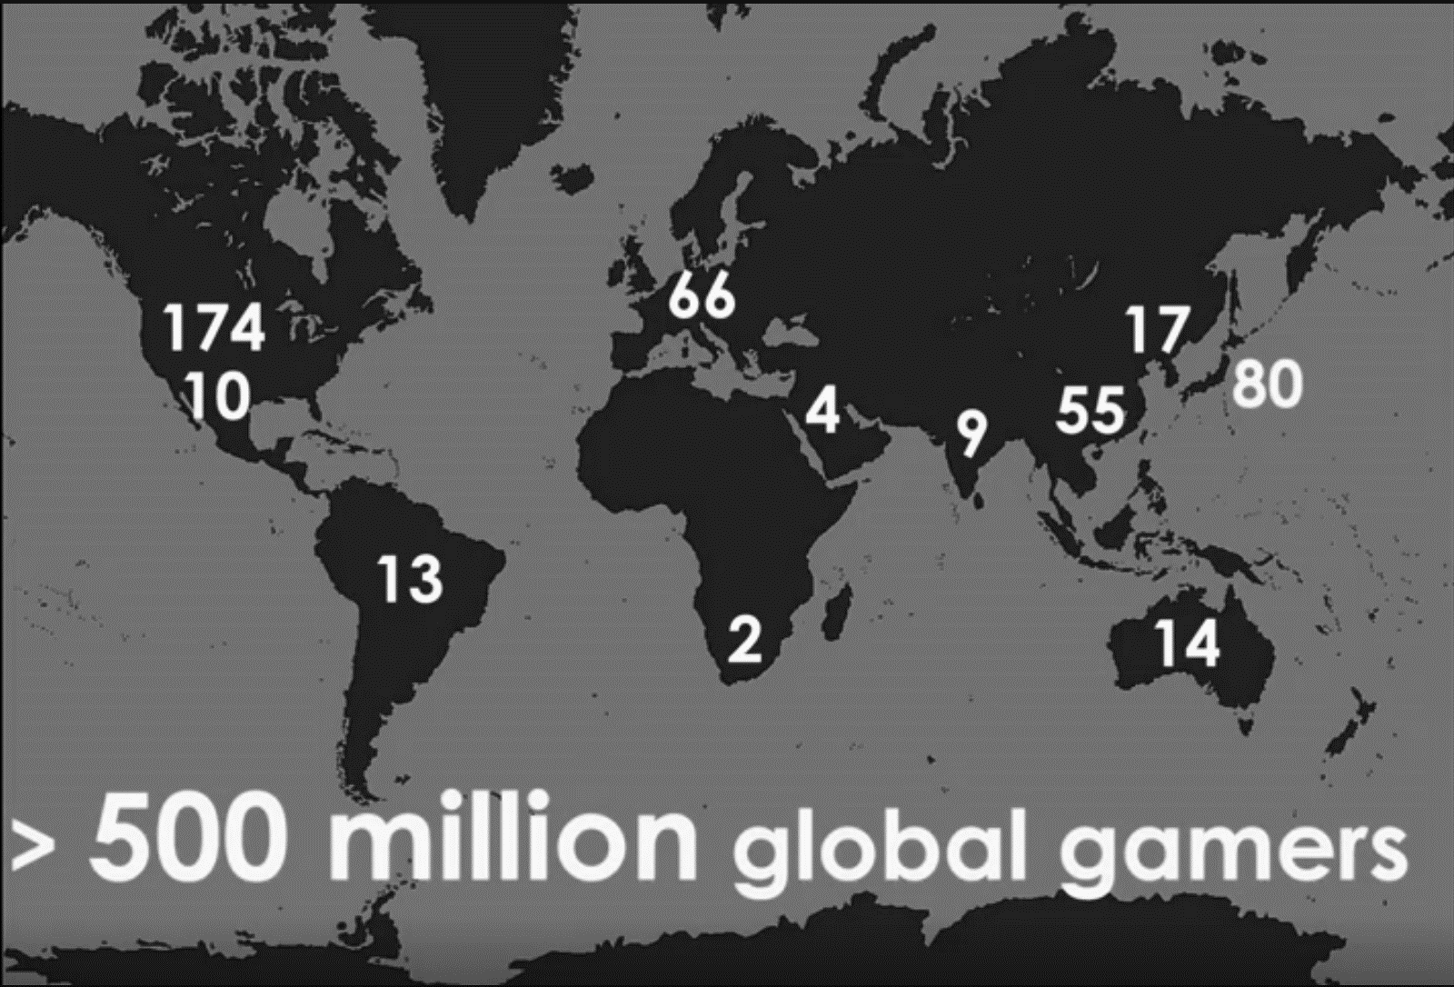
Gaming Population
500 million people worldwide play video games at least 1 hour/ day
174 million people just in the United States alone are gaming
3 billion hours of online gaming a week [8]

Slide 19
Summary
Wi-Fi has a challenging reputation in the gaming community
Lag can be extremely detrimental to FPS gaming
It has real impact in potentially changing the outcome of competitions
We want to look for potential solutions to improve RTA using Wi-Fi

Slide 20
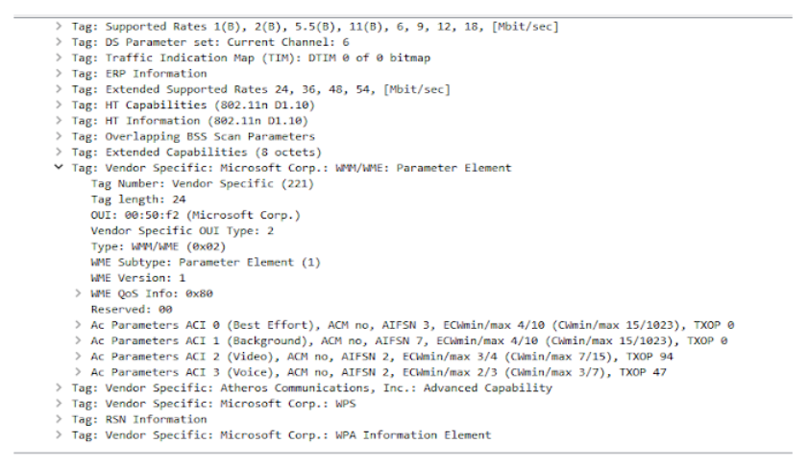
Appendix: AP beacon

Slide 21
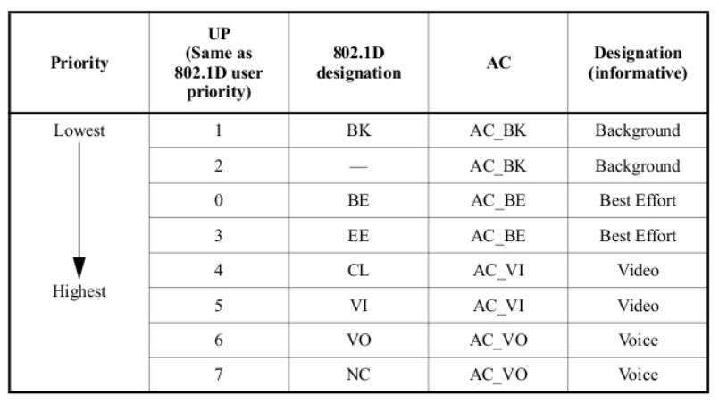
Appendix: Packet Priority Table
[9]

Slide 22
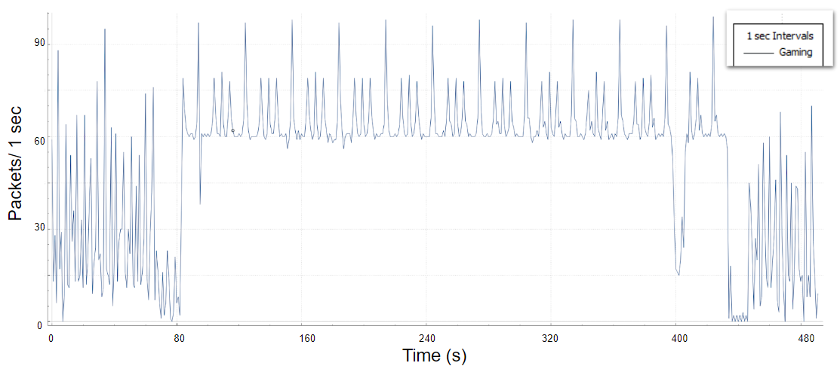
Appendix: Network capture of 1 full game

Slide 23
Appendix: Articles on Wi-Fi gaming problems
“Why Wi-Fi Sucks!”- A thread on Reddit where people are talking about their Wi-Fi issues on PC and PS4^{[10]}
“Lag spikes when playing online video games?!”- A Customer of Shaw Cable in Canada complaining about his wifi gaming problem^{[11]}
“Ethernet vs. WiFi: Ping, Packets, & Playing Better”- A top gaming company comparing its gameplay on Ethernet and Wi-Fi with detailed statistics^{[12]}
“Poor WiFi with Nintendo Switch”- Video game console users facing Wi-Fi problem^{[13]}

Slide 24
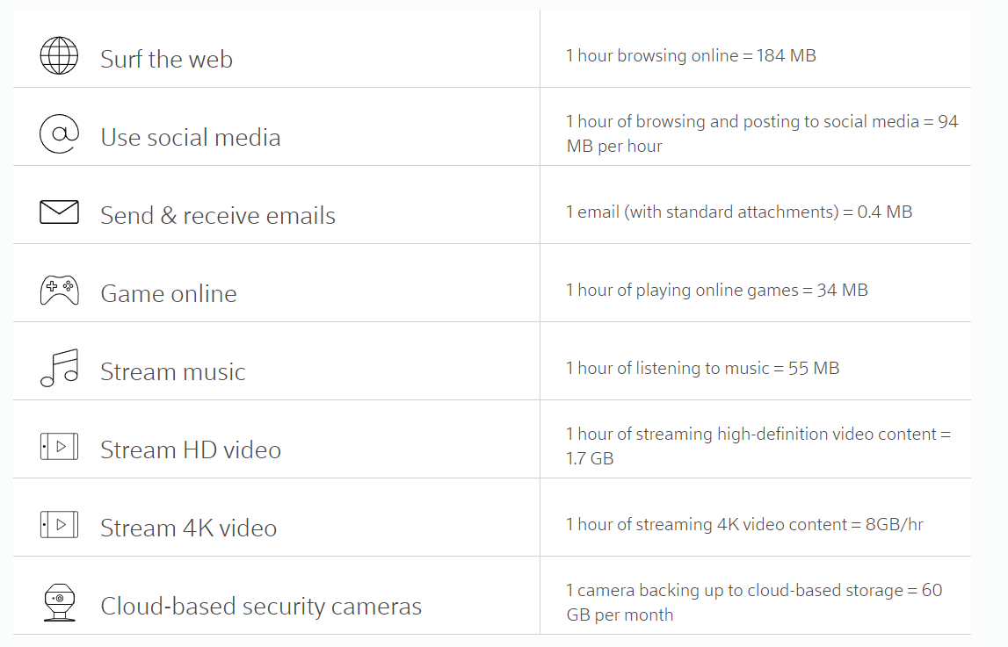
Appendix: Estimated data usage
^{[14]}

Slide 25
References
[1] Jonas DeMuro, “Here’s how playing on Wi-Fi hurts your game” - April 06, 2017; https://www.pcgamer.com/heres-how-playing-on-wi-fi-hurts-your- game/
[2] “5 steps to reduce lag and increase your internet speed for gaming” - January 28, 2016; https://www.simplifydigital.co.uk/guides/5-steps-to-reducing-lag- and- increase-your-internet-speed-for-gaming/
[3] Alex Spurling, “QoS Issues for Multiplayer Gaming” - July 12, 2004; http://users.cs.cf.ac.uk/O.F.Rana/data-comms/gaming.pdf
[4] Cisco, “Cisco Wireless ISR and HWIC Access Point Configuration Guide” - December 2006; https://www.cisco.com/c/en/us/td/docs/routers/access/1800/wireless/ configuration/guide/awg/s37qos.pdf
[5] Gabriele Cecchetti, Anna Lina Ruscelli, Antonia Mastropaolo, and Giuseppe Lipari “Providing Variable TXOP for IEEE 802.11e HCCA Real-Time Networks”; https://www.iris.sssup.it/retrieve/handle/11382/389124/5911/CameraReady.pdf
[6] Graham Smith, Ganeth Venkatesan, Ed Reuss, Osama Abdul-Magd, Alex Ashley, Naven Kakani and Brian Hart “802.11 QoS Tutorial” - November 10, 2008; http://www.ieee802.org/1/files/public/docs2008/avb-gs-802-11-qos-tutorial-1108.pdf
[7] Tae Kim (CNBC), “Epic makes ‘Fortnite’ biggest esport in the world with $100 million in prize money” - May 21, 2018; https://www.cnbc.com/2018/05/21/epic- makes-fornite-biggest-esport-with-100-million-in-prize-money.html

Slide 26
References
[8] Jane McGonigal, “Gaming can make a better world” – February 2010; https://www.ted.com/talks/jane_mcgonigal_gaming_can_make_a_better_world
[9] Ramapriya Rajamani, “802.11” - July 26, 2013; http://riya80211.blogspot.com/2013/07/qos-packets.html
[10] Truen1ght, “Why Wifi Sucks”; https://www.reddit.com/r/StreetFighter/comments/5yd2l8/why_wifi_sucks_in_depth_article/?st=jliao28c&sh=437e6617
[11] johnsonjin, “Lag spikes when playing online video games?!” - August 18, 2017; https://community.shaw.ca/thread/36825
[12] Nancymon, “Ethernet vs. WiFi: Ping, Packets, & Playing Better”; https://na.leagueoflegends.com/en/page/ethernet-vs-wifi-ping-packets-playing-better
[13] Crasheffort, “Poor WiFi with Nintendo Switch” - March 13, 2017; https://en-americas-support.nintendo.com/app/social/questions/detail/qid/49133/~/poor-wifi- with-nintendo-switch
[14] XFINITY, “Estimate your average monthly data usage”; https://dataplan.xfinity.com/estimator/

