Slide 1
Real-time Mobile Game vs Wi-Fi
Date: 2018-07-09
Authors:

Slide 2
Abstract
This presentation describes Real-time Mobile Game performance on Wi-Fi systems, describes requirements and additional work to further improve system performance.

Slide 3
Outline
➢ Background
➢ Game experience of real-time mobile game under Wi-Fi
Problems under Wi-Fi
Requirements for Wi-Fi
➢Explorations and cooperation
➢Summary
Notes:
Here is the outline. Basically there are four topics of my slides
First, I would introduce the background including global mobile game market revenue and amount of gamers we have now
Second is the game experience of real-time mobile game under Wi-Fi, including the problems and requirements.
Thrid, it is the explorations and corporations we engage in currently.
Last is the take-aways.

Slide 4
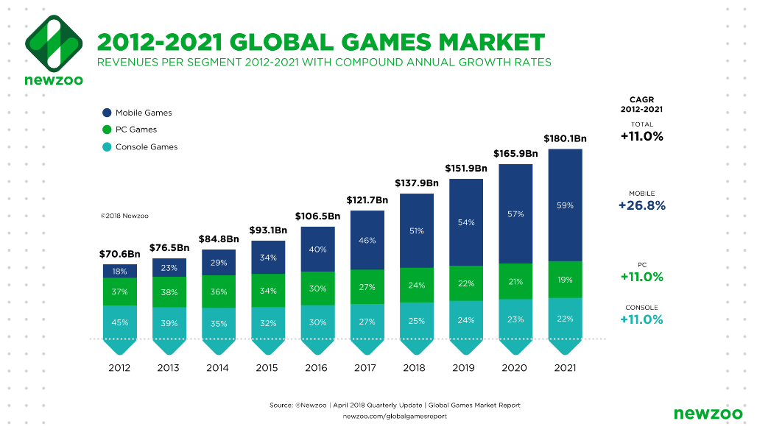
Background – Global Market Revenues
CAGR would be 10.3% between 2017 and 2021
Mobile games will take half revenues in 2018
Mobile games is expected to take 59% revenues by 2021
CAGR is Compound Average Growth Rate
Ref: https://newzoo.com/insights/articles/global-games-market-reaches-137-9-billion-in-2018-mobile-games-take-half/
Notes:
Compound annual growth rate (CAGR) is a metric that smoothes annual gains in revenue, returns, customers, etc., over a specified number of years as if the growth had happened steadily each year over that time period.
Nowadays as the development of internet and the increase of smartphone user penetration rate, the market of real-time mobile game is kept booming, among so many game categories, moba and the derivative esports are pushing the whole industry to another peak.
Now let’s take a look at the global market revenues. Accordingly to report from NewZoo, the game market is expected to have a rapid increase from 2012 to 2021. And mobile game will continue to be the largest segment.
what we can from the report is
the game industry would have a yearly increase of 10.3% between 2012 and 2021.
Mobile game would take half of all game revenues in 2018 and 60% by 2021.
Which is remarkable.

Slide 5
Mobile games of Tencent chosen by 2018 Asian Games as demonstration games
Notes:
Recently, there is headline about 3 games of Tencent are chosen as demonstration games in Asian Olympic holding in Jarkata in the coming August. 2 of the 3 games are mobile games, one is clash royale and the other one is AoV. This is a remarkable milestone for game industry which means the recognition from mainstream even Olympics.

Slide 6
Background – Global Market Users
DAU: daily active users
Notes:
As for the amount of game users around the world, there are 260 million gamers according to Newzoo. And the data I got from my colleague is that, for HOK one game only, we have 100 million daily active users already in 2017. And it is more in 2018, the number is unreleased to public. But it is more.
Another super mobile game in 2018 is PUBG mobile, the pre-registered users alone is 18 million. And it is in the top download list in the app store of over 100 regions.
So from both contribution to revenue and amount users-wise, real-time mobile game is in lead position.

Slide 7
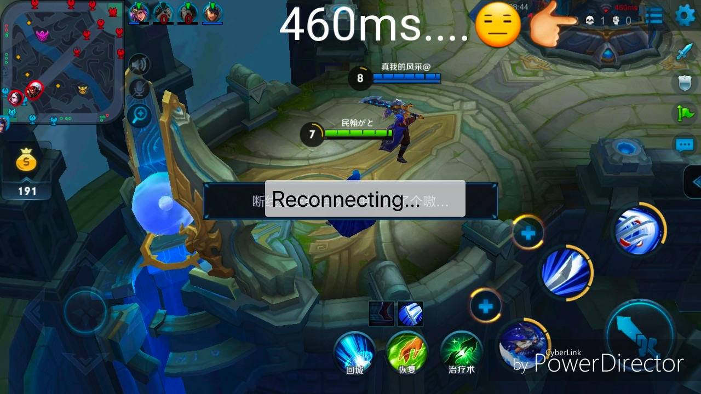
Game experience of real-time mobile games under Wi-Fi
Mode | Chance of lagging
Wi-Fi | 23%
4G | 15%
Notes:
Well, The stunning numbers not only bring us joy, but also problems.
First of all, 60% users connect to mobile game via Wi-Fi. That would-be millions of users, a huge amount. Why wifi is preferred? Because it is cheaper and more bandwidth. However game experience is not always satisfying. According to our data analysis, 23% users experience lagging, high ping spike during game. While the number under 4G is 15%. So real-time mobile gamers tend to specially switch 4G before they start the game.

Slide 8
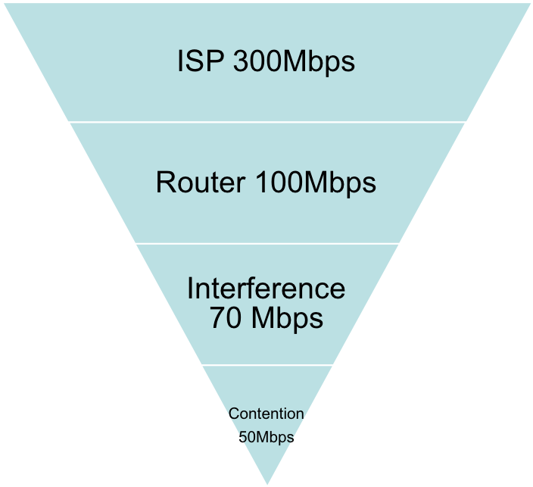
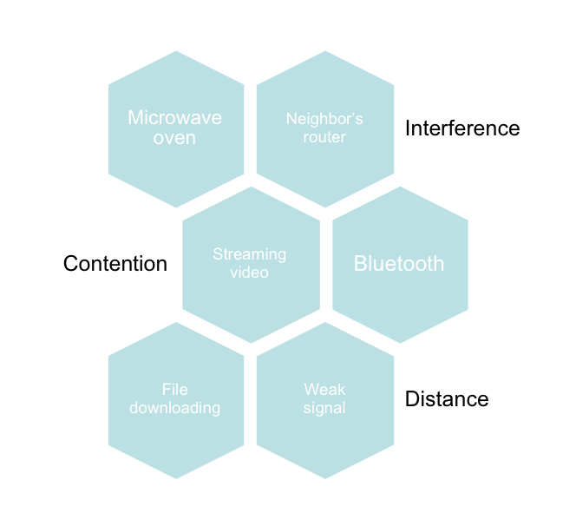
Game experience of real-time mobile game under Wi-Fi
Notes:
Why this happen? When we look into it, we can see there are multiple reasons.
First is the drain on Wi-Fi bandwidth. If you are using a bandwidth of 300Mbps which is very fast speed internet. But you are using a router which can deal with 100Mbps traffic maximum, then you would be capped as 100Mbps. Then comes to the interference of other electronics like microwaves, neighbors’ routers, Bluetooth. You got 70 percent which is 70Mbps. Last, contention, basically different devices in the house fight for Wi-Fi signal. Image this, when you start a moba game, you sister is watching streaming video and your little brother is downloading a large file. Certainly you would be impacted. Lagging and high ping spike are expected.

Slide 9
Game experience of real-time mobile games under Wi-Fi
Lagging problem root cause distribution
A considerable portion of problem resides between client and router
Province Level Switch
Game server
>30%
>25%
Backbone network problem
<4%
<5%
Weak Wi-Fi signal
Interference, contention, router loading, etc
*Weak signal: less than 2 bars.

Slide 10
Requirements for Wi-Fi
*Below numbers are referred based on game operation
*Below numbers are referred based on game operation experience
Item | Requirements
Bandwidth | 0.5-1Mbps
Latency | <100ms from client to game server <10ms from client to AP
Stability | <50ms jitter <3 continuous packet loss
* Game servers would send to client all the calculation results, even delayed. So you would see fast forward in game when your phone recovers from lagging.

Slide 11
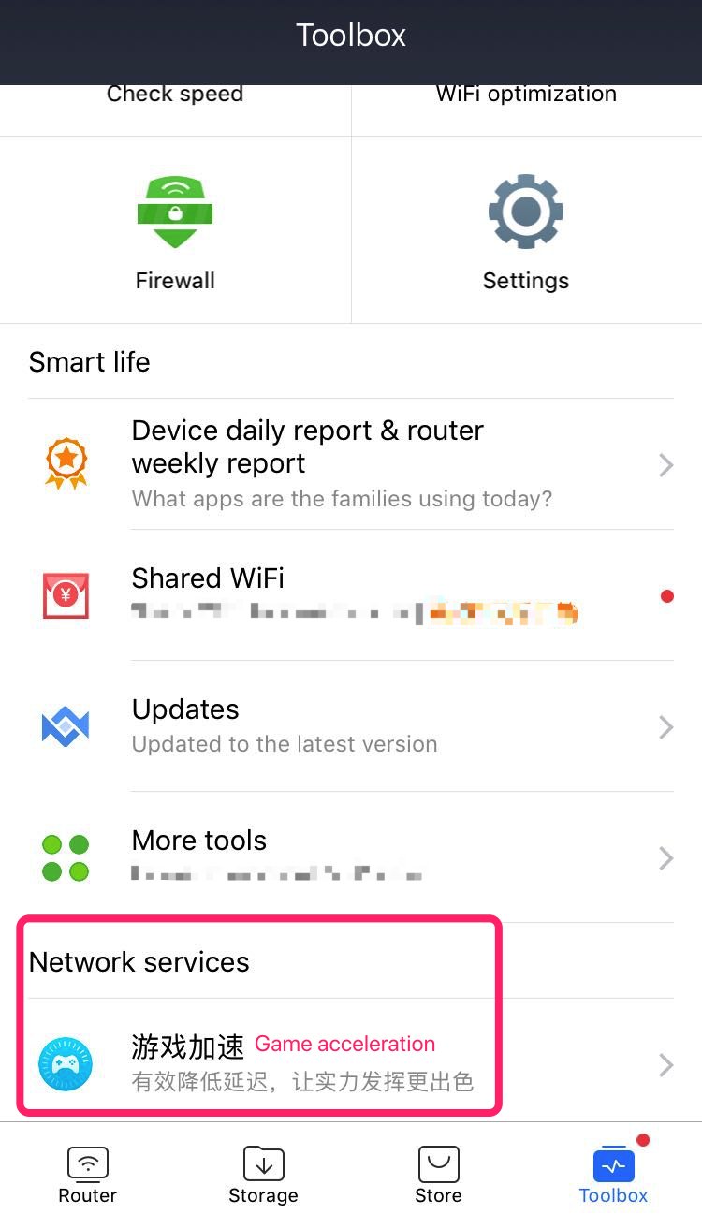
Explorations and cooperation
Integrate Game Mode in router
• Restrain bandwidth to avoid single app taking all
• Disconnect devices with weak signal
• Selective Automatic Repeat-request
• Pre-download game packages

Slide 12
Explorations and cooperation
Data Free SIM card for Tencent APP
• No data limit
• No speed limit (downgrade to 3G when exceed 40GB)
• No time limit

Slide 13
Explorations and cooperation
There should be a solution for latency sensitive applications like real-time mobile game
• Service prioritization
- Same priority as voice defined in WMM
• Fast switching between different bands and APs with better performance

Slide 14
Summary
• Mobile games play an important role in whole game industry
• Mobile game experience under Wi-Fi coverage needs optimization
• Service classification is a trend
• Latency-sensitive service calls for solution

Slide 15
References

