Slide 1
Clock Attack Threat Model for 11az
Date: 2018-07-02
Authors:

Slide 2
Abstract
11az FRD [1] describes Type A and Type B adversaries that are characterized according to attacker’s response time.
  Type A: 1 ms response time.
  VHT/HE Type B: 1 μs response time.
  DMG/EDMG Type B: 10 ns response time.
  A few security threat models are listed in [2][3][4].
Another threat model, “clock attack” is presented in this submission.
  We consider an I-STA which attempts to estimate the frequency offset between its own clock and that of R-STA and uses this estimate to correct timing information reported by R-STA.
  Attacker exploits the estimation and correction process performed by the I-STA to decrease the estimated range between I-STA and R-STA.

Slide 3
Round Trip Time (RTT)
RTT = (t₄’ - t₁’) - (t₃ - t₂)
t₄’ , t₁’: determined by I-STA from (t₄, t₁) reported by R-STA.
  R-STA reports (t₄, t₁) based on its clock and time-of-arrival and departure of packets (see figure).
  Transformation of (t₄, t₁) to (t₄’ , t₁’) requires an estimate of clock difference between R-STA and I-STA.
  I-STA can reduce the ranging error by utilizing the clock difference in certain cases.

Slide 4
Clock Attack (1)
Method of attack:
  I-STA and R-STA involved in FTM are isolated.
    Either opportunistically as in figure below.
    Or by amplifying the modified signal relative to original transmission.
  Attacker relays the signal it receives from R-STA after intentionally mixing it to a slightly different frequency.
    Analog mixing can be used, beyond the response time of Type B adversary, but it is easy for an attacker to implement.
  Introduced frequency offset may affect estimated range if I-STA tries to correct for the detected frequency offset between center frequencies into ranging calculations.

Slide 5
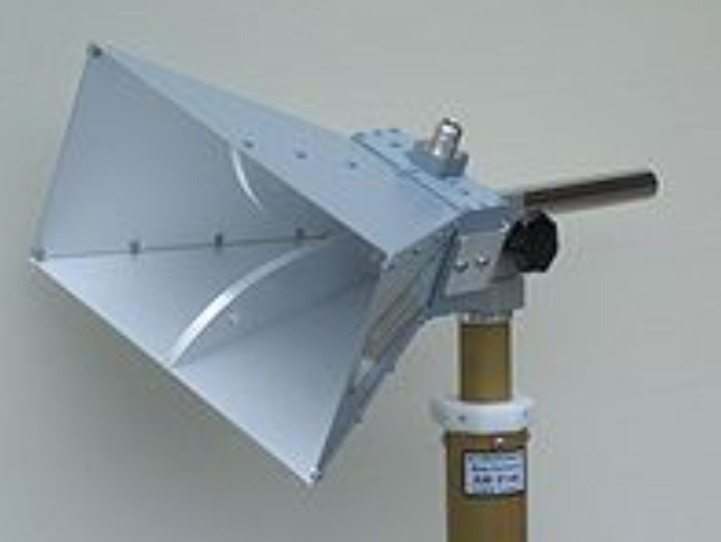
Clock Attack (2)
Attacker capability:
  Signal mixing:
    Commercial, off-the-shelf wideband RF mixer (up to multiple-gigahertz bandwidth) and evaluation kits are available, for example: http://www.analog.com/en/products/rf-microwave/mixers.html
    Mixing can be performed by analog components with nanosecond delay. As a result, we ignore the processing delay introduced by the mixer.
  Duplex mode:
    Attacker does not necessarily have to operate in full-duplex mode.
    It can use two co-located hardware equipped with high-directional antennas, e.g., for Rx and Tx, respectively, for example, horn antennas: https://en.wikipedia.org/wiki/Horn_antenna

Slide 6
Clock Attack (3)
Definitions
  T_{1->4} = SIFS + Duration_{FTM_pkt} + 2 x propagation_delay.
    True time between FTM is transmitted and ACK is received.
  T_{2->3} = SIFS + Duration_{FTM_pkt}.
    True time between FTM is received and ACK is transmitted.
  f_{R-STA}: Clock at R-STA.
  f_{I-STA}: Clock at I-STA
  Δf_{spoof}: Spoofed clock offset, i.e., the amount of frequency offset introduced by attacker.
  Duration_{FTM_pkt}: Depends on MCS and payload size.
T_{2->3}
T_{1->4}
Note: The attack is illustrated using the FTM packet sequence, but it is also applicable to HEz and VHTz.

Slide 7
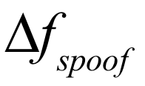
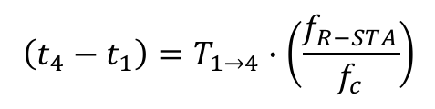
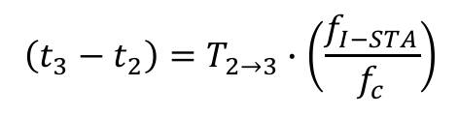
Clock Attack (4)
Relationship between reported and true elapsed time:
  The following expressions represent the relationship between true and reported values (on the left hand side):
  When a device’s clock is operating at a lower rate than nominal value, the reported elapsed time is smaller than true elapsed time.
I-STA estimates the frequency offset ( Δf ) between the received R-STA waveform and its own clock:
  is the amount of frequency offset introduced by attacker.
$$\left(t_{4}−t_{1}\right)=T_{1→4}∙\left(\frac{f_{R−STA}}{f_{c}}\right)$$
$$\left(t_{3}−t_{2}\right)=T_{2→3}∙\left(\frac{f_{I−STA}}{f_{c}}\right)$$
$$Δf≈{(f}_{R−STA}+Δf_{spoof})−f_{I−STA}=(f_{R−STA}−f_{I−STA})+Δf_{spoof}$$

Slide 8
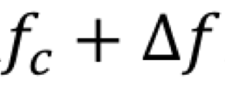
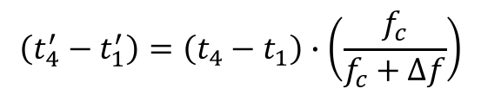
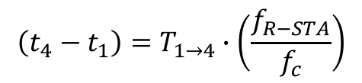
Clock Attack (5)
I-STA ‘corrects’ the timing reported by R-STA assuming its own clock is perfect (i.e., equal to f_{c} ):
  Since true value of elapsed time is related to reported time as:
  And estimated R-STA clock frequency by I-STA is:
By substitution:
  is the amount of frequency offset introduced by attacker.
$$\left(t_{4}^{′}−t_{1}^{′}\right)=\left(t_{4}−t_{1}\right)∙\left(\frac{f_{c}}{f_{c}+Δf}\right)$$
$$\left(t_{4}−t_{1}\right)=T_{1→4}∙\left(\frac{f_{R−STA}}{f_{c}}\right)$$
$$\left(t_{4}^{′}−t_{1}^{′}\right)=T_{1→4}∙\left(\frac{f_{R−STA}}{f_{c}}\right)∙\left(\frac{f_{c}}{f_{c}+Δf}\right)=T_{1→4}∙\left(\frac{f_{R−STA}}{f_{c}+(f_{R−STA}−f_{I−STA})+Δf_{spoof}}\right)$$

Slide 9
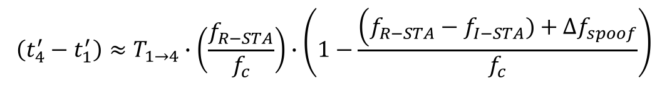

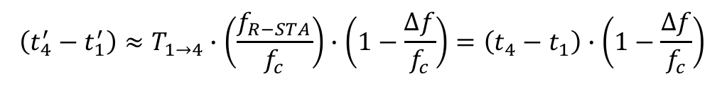
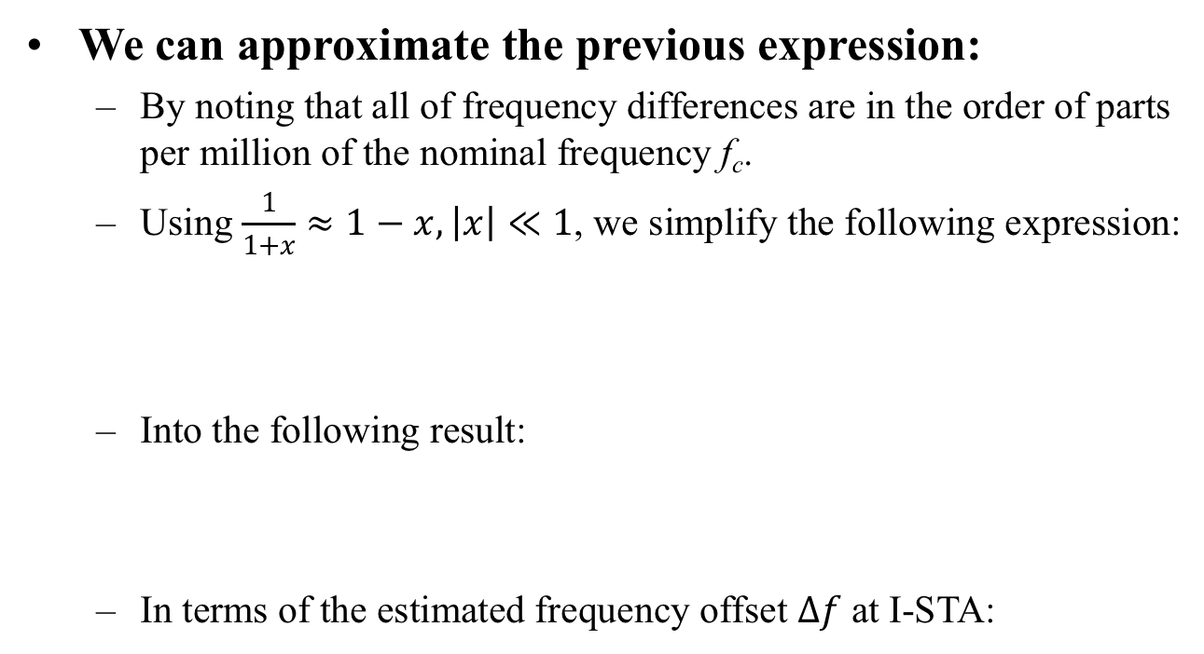
Clock Attack (6)
We can approximate the previous expression:
  By noting that all of frequency differences are in the order of parts per million of the nominal frequency f_{c}.
  Using $\frac{1}{1+x}≈1−x, \left|x\right|≪1$, we simplify the following expression:
  Into the following result:
  In terms of the estimated frequency offset $Δf$at I-STA:
$$\left(t_{4}^{′}−t_{1}^{′}\right)=T_{1→4}∙\left(\frac{f_{R−STA}}{f_{c}}\right)∙\left(\frac{f_{c}}{f_{c}+Δf}\right)=T_{1→4}∙\left(\frac{f_{R−STA}}{f_{c}+(f_{R−STA}−f_{I−STA})+Δf_{spoof}}\right)$$
$$\left(t_{4}^{′}−t_{1}^{′}\right)≈T_{1→4}∙\left(\frac{f_{R−STA}}{f_{c}}\right)∙\left(1−\frac{\left(f_{R−STA}−f_{I−STA})+Δf_{spoof}\right.}{f_{c}}\right)$$
$$\left(t_{4}^{′}−t_{1}^{′}\right)≈T_{1→4}∙\left(\frac{f_{R−STA}}{f_{c}}\right)∙\left(1−\frac{Δf}{f_{c}}\right)=\left(t_{4}−t_{1}\right)∙\left(1−\frac{Δf}{f_{c}}\right)$$
$$Δf≈{(f}_{R−STA}+Δf_{spoof})−f_{I−STA}$$

Slide 10
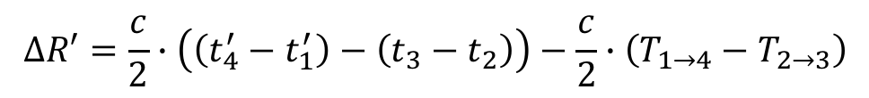
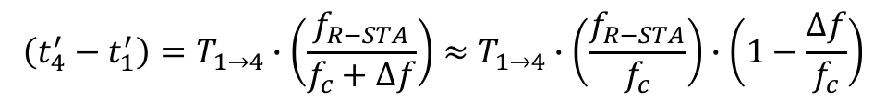


Clock Attack (7)
Error in estimated range ($ΔR′$) due to I-STA ‘correction’ attempt under clock attack:
  Attacker’s goal is to make the range error negative so that R-STA appears closer to the I-STA than it actually is.
  $\left(t_{4}^{′}−t_{1}^{′}\right)$ is open to manipulation, and attacker will try to make this as small as possible to reduce range.
  It is possible to do so by introducing a large (but tolerable) positive frequency offset on R-STA transmissions ($Δf_{spoof})$.
$$ΔR′=\frac{c}{2}∙\left(\left(t_{4}^{′}−t_{1}^{′}\right)−\left(t_{3}−t_{2}\right)\right)−\frac{c}{2}∙\left(T_{1→4}−T_{2→3}\right)$$
$$\left(t_{4}^{′}−t_{1}^{′}\right)=T_{1→4}∙\left(\frac{f_{R−STA}}{f_{c}+Δf}\right)≈T_{1→4}∙\left(\frac{f_{R−STA}}{f_{c}}\right)∙\left(1−\frac{Δf}{f_{c}}\right)$$
$$Δf≈{(f}_{R−STA}+Δf_{spoof})−f_{I−STA}$$

Slide 11
Numerical Results (1)
Range error= range_{est}-range_{true}
  Note: Attacker wants to induce a large negative range error.
HT (11n), 20MHz.
Assumption:
  Case 1: f_{I-STA}=f_{c}.
  Case 2: f_{I-STA} – f_{c} = 25 ppm.
  Case 3: f_{I-STA} – f_{c} = -25 ppm.
Packet duration:
  MCS-1: worse-case scenario.
  Distance=20m. propagation delay is negligible.
  Case 1: without option fields, Duration_{FTM pkt}=64 μs
  Case 2: with LCI=44Bytes, DurationFTM pkt=120 μs

Slide 12
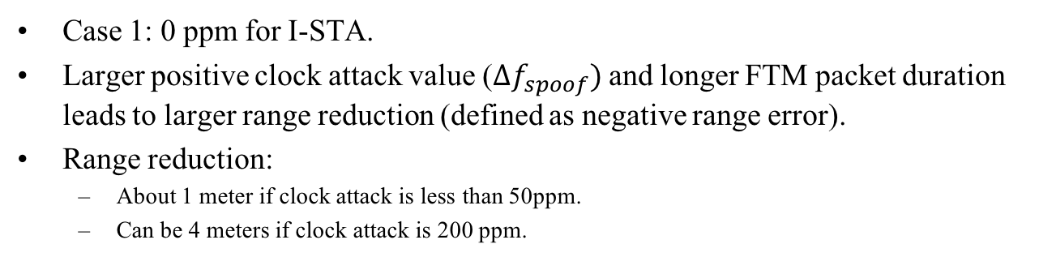
Numerical Results (2)
Case 1: 0 ppm for I-STA.
  Larger positive clock attack value ($Δf_{spoof})$ and longer FTM packet duration leads to larger range reduction (defined as negative range error).
  Range reduction:
  About 1 meter if clock attack is less than 50ppm.
  Can be 4 meters if clock attack is 200 ppm.

Slide 13
Numerical Results (3)
Case 2: 25 ppm for I-STA.
Similar observations as in Case 1: 0 ppm for I-STA.

Slide 14
Numerical Results (4)
Case 3: -25 ppm for I-STA.
Similar observations as in Case 1: 0 ppm for I-STA.

Slide 15
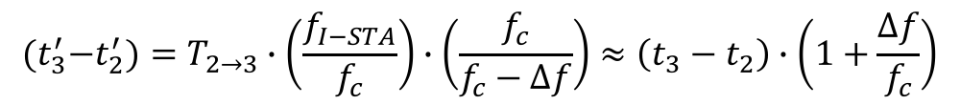
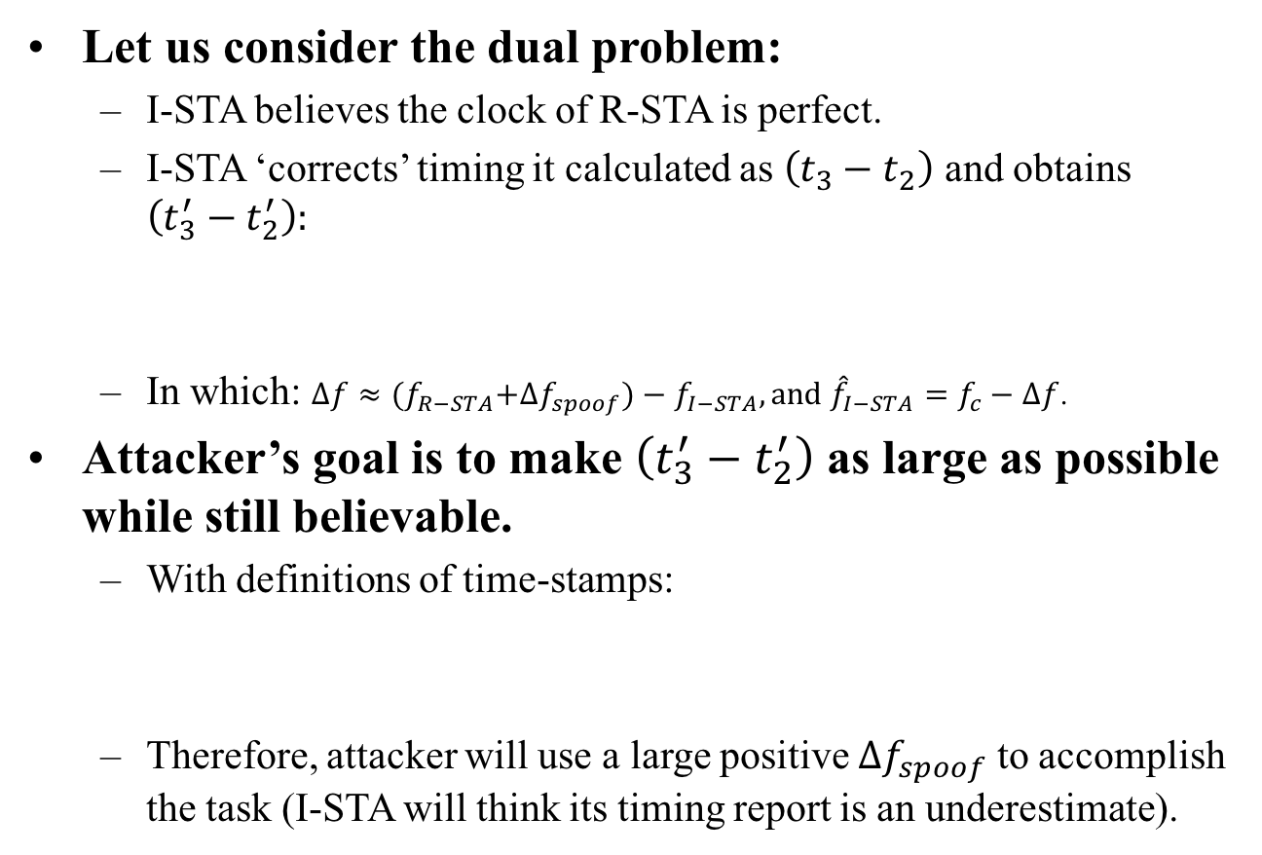
Clock Attack (8)
Let us consider the dual problem:
  I-STA believes the clock of R-STA is perfect.
  I-STA ‘corrects’ timing it calculated as $\left(t_{3}−t_{2}\right)$ and obtains $\left(t_{3}^{′}−t_{2}^{′}\right):$
  In which: $Δf≈{(f}_{R−STA}+Δf_{spoof})−f_{I−STA}, and {\hat{f}}_{I−STA}=f_{c}−Δf$.
Attacker’s goal is to make $\left(t_{3}^{′}−t_{2}^{′}\right)$ as large as possible while still believable.
  With definitions of time-stamps:
  Therefore, attacker will use a large positive $Δf_{spoof}$ to accomplish the task (I-STA will think its timing report is an underestimate).
$\left(t_{3}−t_{2}\right)=T_{2→3}∙\left(\frac{f_{I−STA}}{f_{c}}\right)$ $→$ $\left(t_{3}^{′}−t_{2}^{′}\right)=\left(t_{3}−t_{2}\right)$ $∙\left(\frac{f_{c}}{f_{c}−Δf}\right)$
$${(t}_{3}^{′}−t_{2}^{′})=T_{2→3}∙\left(\frac{f_{I−STA}}{f_{c}}\right)∙\left(\frac{f_{c}}{f_{c}−Δf}\right)≈\left(t_{3}−t_{2}\right)∙\left(1+\frac{Δf}{f_{c}}\right)$$

Slide 16
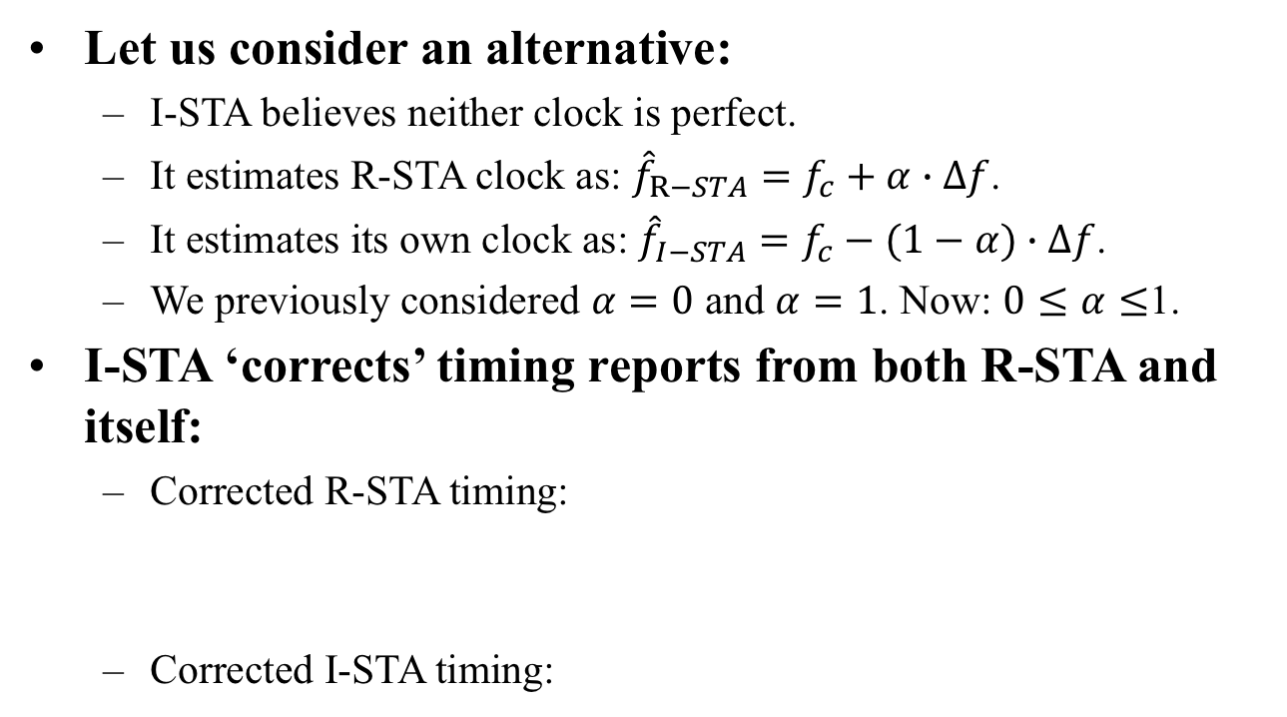
Clock Attack (9)
Let us consider an alternative:
  I-STA believes neither clock is perfect.
  It estimates R-STA clock as: ${\hat{f}}_{R−STA}=f_{c}+α∙Δf$.
  It estimates its own clock as: ${\hat{f}}_{I−STA}=f_{c}−(1−α)∙Δf$.
  We previously considered $α=0$ and $α=1$. Now: $0≤α≤$1.
I-STA ‘corrects’ timing reports from both R-STA and itself:
  Corrected R-STA timing:
  Corrected I-STA timing:
$${(t}_{4}^{′}−t_{1}^{′})=T_{1→4}∙\left(\frac{f_{R−STA}}{f_{c}}\right)∙\left(1−\frac{α∙Δf}{f_{c}}\right)≈\left(t_{4}−t_{1}\right)∙\left(1−\frac{α∙Δf}{f_{c}}\right)$$
$${(t}_{3}^{′}−t_{2}^{′})=T_{2→3}∙\left(\frac{f_{I−STA}}{f_{c}}\right)∙\left(1+\frac{(1−α)∙Δf}{f_{c}}\right)≈\left(t_{3}−t_{2}\right)∙\left(1+\frac{(1−α)∙Δf}{f_{c}}\right)$$

Slide 17
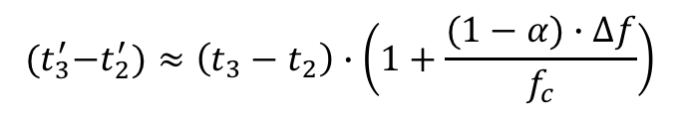
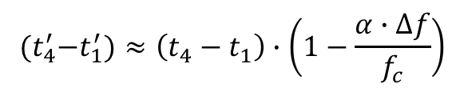
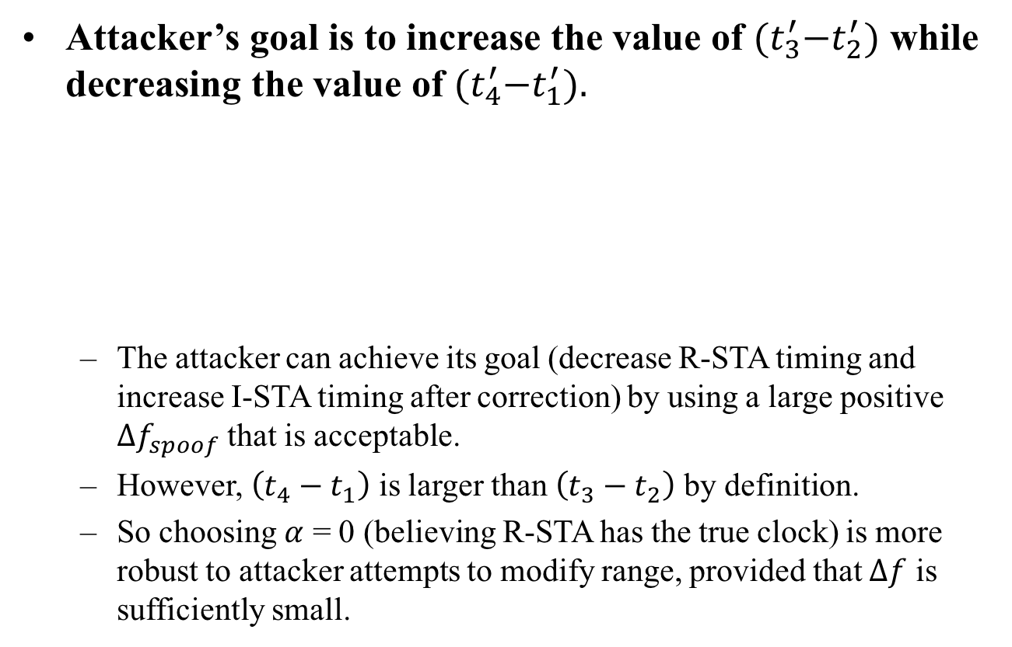
Clock Attack (10)
Attacker’s goal is to increase the value of ${(t}_{3}^{′}−t_{2}^{′})$ while decreasing the value of ${(t}_{4}^{′}−t_{1}^{′}).$
  The attacker can achieve its goal (decrease R-STA timing and increase I-STA timing after correction) by using a large positive $Δf_{spoof}$ that is acceptable.
  However, $\left(t_{4}−t_{1}\right)$ is larger than $\left(t_{3}−t_{2}\right)$ by definition.
  So choosing $α$ = 0 (believing R-STA has the true clock) is more robust to attacker attempts to modify range, provided that $Δf$ is sufficiently small.
$${(t}_{4}^{′}−t_{1}^{′})≈\left(t_{4}−t_{1}\right)∙\left(1−\frac{α∙Δf}{f_{c}}\right)$$
$${(t}_{3}^{′}−t_{2}^{′})≈\left(t_{3}−t_{2}\right)∙\left(1+\frac{(1−α)∙Δf}{f_{c}}\right)$$

Slide 18
Discussion
Range reduction vs. Clock attack:
  Range reduction is <1m if clock attack is <50ppm.
  Range reduction is ~4m if clock attack is 200ppm.
Discussion:
  25ppm: 802.11 spec requirement for carrier frequency accuracy (for 2.4GHz, 20ppm for 5GHz).
  If I-STA believes that the clock difference cannot be large than 25x2=50ppm,
  Then I-STA can detect the clock attack and range reduction is about 1.5 meters.
Question: Can I-STA discard measurements if estimated clock difference is beyond a threshold?

Slide 19
Summary
Clock attack is possible if attacker relays received signal with frequency offset intentionally added.
We presented a threat model titled as “Clock Attack” and showed that spoofed range can be large if there is a wide range of valid clock difference.
Clock attack can be detected and avoided if there is stringent requirement on carrier frequency offset.
  I-STA can discard measurement if the estimated clock difference is beyond a specified threshold.

Slide 20
Recommendation to 11az
Add an informative note on receiver behavior in 802.11az spec.
To state that an I-STA should discard ranging measurements or terminate a range session when it detects an unacceptable amount of clock error.
Suggested text:
  “Note: It is recommended that a device discards ranging measurements when it detects that its ranging peer’s clock drift considering its local clock, exceeds the allowed tolerance from the values specified by the 802.11 requirements. See section 21.3.17.3 for VHTz, 28.3.18.3 for HEz, and 20.3.3.2.1 for DMGz/EDMGz.”

Slide 21
Strawpoll
Do you support to add the following recommended note in the 11az spec?
  “Note: It is recommended that a device discards ranging measurements when it detects that its ranging peer’s clock drift considering its local clock, exceeds the allowed tolerance from the values specified by the 802.11 requirements. See section 21.3.17.3 for VHTz, 28.3.18.3 for HEz, and 20.3.3.2.1 for DMGz/EDMGz.”
Y: N: A:
Absent:

Slide 22
References
[1] IEEE 802.11-16/424r11, 11az FRD.
[2] IEEE 802.11-17/0120r2: “Intel secured location threat model”, B. Abramovsky, O. Bar-Shalom, and C. Ghosh, January 2017.
[3] IEEE 802.11-17/0612r0: “CP-replay attack threat model”, M. Xu, J. Dogan, K. Brogle, AJ Ringer, SK Yong, and Q. Wang, June 2017.
[4] “Secure LTF processing”, C. Berger, N. Grandhe, and L. Chu, February 2018.

