Slide 1
Multi-band Discovery Assistance
Date: 2018-03-08
Name | Affiliation | Address | Phone | Email
Mohamed Abouelseoud | Sony | 1730 N. First Street, San Jose CA 95112 | +1-408-352-4027 | Mohamed.Abouelseoud@sony.com
Kazuyuki Sakoda | Sony | 1730 N. First Street, San Jose CA 95112 | +1-408-352-4405 | kazuyuki.Sakoda@sony.com
Dana Ciochina | Sony |  |  | Dana. Ciochina @sony.com

Slide 2
Agenda
Overview
Problem Description
Proposed Solution
Conclusion

Slide 3



Overview
In [1], we proposed distribution network like topology and TDD mode for consumer devices
Home (indoors) distribution network like topology provides more reliable connections
TDD mode is an attractive solution for consumer devices
  Reduce latency by the removal of BHI
  Reduce channel blocking for beamforming by distributing the beamforming frames across the scheduled slots
  Add more flexibility for scheduling by controlling the slots structure and size
In [2], we proposed to use the multi-band capability for discovery triggering in TDD mode distribution network like topology
This contribution presents details on a proposed solution to use the multi-band operation defined in the standard for triggering mmW devices discovery

Slide 4


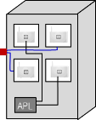
Problem Description
For a new DN STA joining an existing Distribution Network [3]:
  System Admin scans Bar-code of the new STA and transfer the information using out-of-band (OOB) signals
  The message is transferred to other DN STAs nearby through a controller
  DN-A and New DN STA exchange beamforming frames, starts authentication and association
Controller
Provider
Network
  WTTB
DN A
Fiber PoP
(cabinet)
fiber
mmWave DN
mmWave link
DN B
New DN STA
  DN-B and New DN STA repeats the same sequence
A proper discovery trigger signaling enables successful onboarding of a new DN STA to TDD mode network is needed to enable the use of TDD mode for consumer devices.

Slide 5
Jan 2018 Contribution[2] Recap
Jan 2018 straw polls
  Do you think additional signaling for discovery triggering is needed for the TDD mode described in [3] to support consumer devices?
  Yes (16), No(3), Need more information (11), Don’t care (0)
  Do you think the use of Multi-Band operation would be feasible approach for off-60GHz discovery signaling?
  Yes (20), No (0), Need more information (8), Don’t care (0)
  Which of the options described in [2] would you prefer?
  Option 1 (0), Option 2 (6), Need more information(14), Don’t care(0)

Slide 6
Proposed Solution:
Discovery Assistance Flow Example
Indication is sent on Sub-6GHz of multi-band capability and discovery assistance capability
Request and response frames are exchanged on sub-6GHz to request mmW discovery assistance and accept/reject the mmW discovery assistance
If discovery assistance is accepted, mmW beamforming frames or beacons are sent to the new multi-band STA

Slide 7
Discovery Assistance Capability Announcement on the Sub-6GHz Band
A Multi-band capable device advertises the Multi-band capability by including the Multi-band element in the Beacon and Probe Response frames
1-bit is needed in the Multi-band element to indicate that STA supports discovery assistance for the BSS identified by the BSSID field on the defined frequency band and channel
Propose to use 1 bit out of the 3 reserved bits in the Multi-band Control field
 | B0 B2 | B3 | B4 |  | B5 | B6 B7
 | STA Role | STA MAC Address Present | Pairwise Cipher Suite Present | Discovery Assistance Enabled |  | Reserved
Bits: | 3 | 1 | 1 |  | 1 | 2
Multi-band element

Slide 8
Multi-band Discovery Assistance Request frame
Propose a new Action frame of category FST Action
After receiving the multi-band element (from a Beacon or a Probe Response frame for example) on the sub-6GHz band, new STA is aware of the Multi-band capability of peer STA and the discovery assistance offering on the other band (60GHz)
New STA sends a Multi-band Discovery Assistant Request frame on the sub-6GHz band
The frame carries the following
  DMG Capabilities on the 60GHz band
  STA MAC address on the 60GHz band
  Scanning mode requested on the 60GHz band
  Operating frequency/channel on the 60GHz band
  BSS information on the 60GHz if available

Slide 9
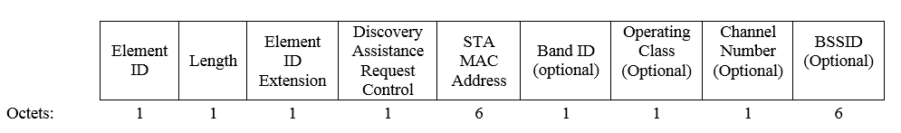
Multi-band Discovery Assistance Request frame format
Category | FST Action | DMG Capabilities IE | Multi-band Discovery Assistance Request IE
 | B0 | B1 B2 | B4 B7
 | BSS Information Present | Scanning Mode | Reserved
Bits: | 1 | 2 | 5

Slide 10
Multi-band Discovery Assistance Response frame
Propose a new Action frame of category FST Action
Peer STA receives the Multi-band Discovery Assistance Request frame on the Sub-6GHz band and generates Multi-band Discovery Assistance Response Frame
Peer STA sends Multi-band Discovery Assistant Response frame on the Sub-6GHz band
The frame carries the following
  Discovery assistant response (accept/reject)
  STA MAC address on other band (60GHz)
  Discovery Assistant Window Length on the 60GHz band
  BSS information on the 60GHz
  Scanning mode on 60GHz

Slide 11
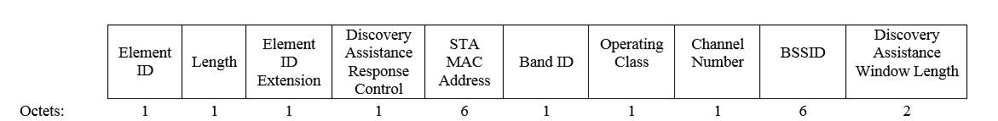
Multi-band Discovery Assistance Response frame format
Category | FST Action | Multi-band Discovery Assistance Response IE
 | B0 B1 | B2 B3 | B4 B5 | B6 B7
 | Discovery Assistance Response Map | Reserved | Scanning Mode | Reserved
Bits: | 2 | 2 | 2 | 4

Slide 12
60 GHz Discovery Assistant
Peer STA is informed about the new node on the 60 GHz channel and its capabilities
Peer STA starts sending BF frames or more beacons on the 60 GHz channel
New STA is informed about peer STA on the 60 GHz channel and its capabilities
New STA starts listening for TDD BF frames, beacons on the 60 GHz channel
STA capability is used by peer STA to estimate the periodicity and rate of sending BF frames , beacons or switching the receive beams

Slide 13
Non-TDD mode 60GHz Discovery Assistant
Same procedure can be used for non-TDD mode operation
Beacon transmission on 60GHz is reduced
Announce MB Discovery Assistant on sub-6GHz
Once Discovery Assistant requested and accepted on sub-6GHz, send more beacon in all directions on 60GHz band

Slide 14
Multi-band Discovery Assistance Procedure

Slide 15
Conclusion
Discovery Assistance procedure is proposed for DMG multi-band capable devices to trigger mmW discovery and mmW beamforming
Proposed modification to the Multi-band element
2 new elements for requesting discovery assistance and responding to discovery assistance request are proposed
2 new Action frames for requesting discovery assistance and responding to discovery assistance request are proposed

Slide 16
References
[1] IEEE 802.11-18/194r1, “Distribution network use case for
consumer devices”, Kazuyuki Sakoda, et.al.
[2] IEEE 802.11-18/199r2, “MMWave Distribution Network Discovery”, Mohamed Abouelseoud, et.al.
[3] IEEE 802.11-17/1321r0 “Features for mmW Distribution Network Use Case”, Djordje Tujkovic, et.al.

Slide 17
Device Provisioning Protocol (DPP)
AP
New STA
Wi-Fi Alliance defined protocol
Provides a secure method for on- and off-boarding devices with limited user interface on a Wi-Fi network.
AP discovery and STA scanning are beyond what DPP is offering
DPP
Scanning
Authentication
Association

