Slide 1
Discussion of (how to specify) some TX and RX requirements for 802.11ba
Date: 2018-01-15
Authors:

Slide 2
Abstract
When working on the PHY specification text, we realized we don’t have many agreements on TX and RX requirements
We also realized that also within this small group we did not have the same view
The purpose of this presentation is to discuss some of the key TX and RX requirements and get feedback from the group

Slide 3
Outline
Transmitter
Spectrum mask
Modulation accuracy
Receiver
Receiver sensitivity
Adjacent channel rejection
Maximum input level

Slide 4
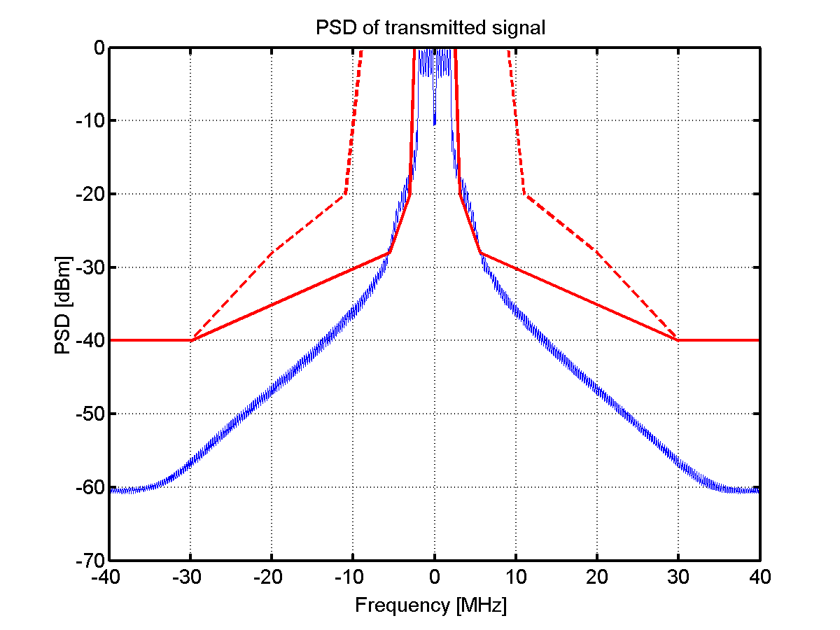
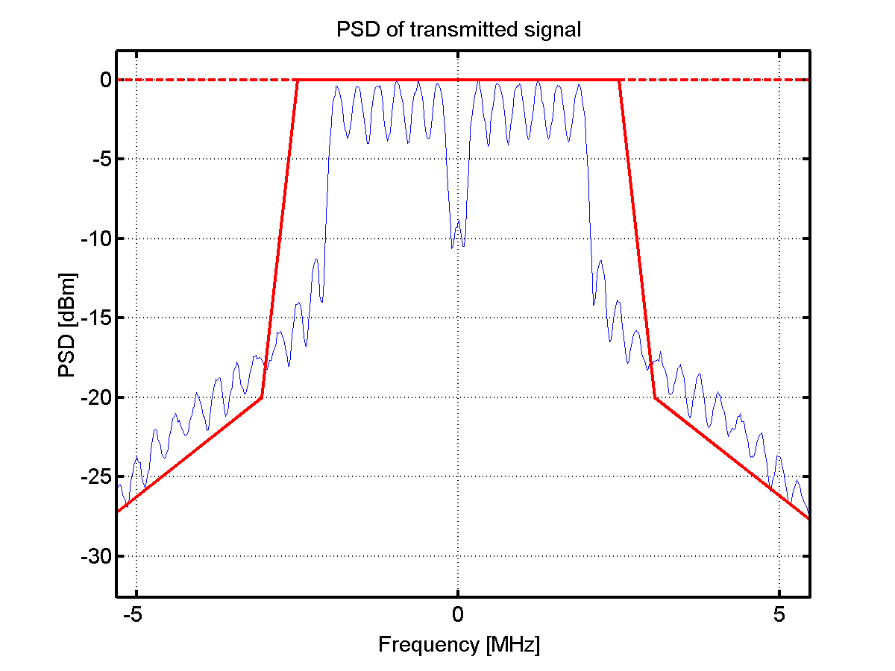
Transmitter: Spectrum mask
The first question is whether it suffice to fulfill the 20 MHz TX mask for the PCR – If the answer is yes, we are done…
The figures above are just for illustration (OBO = 3 dB, windowing applied (1 sample at 20 MHz))

Slide 5
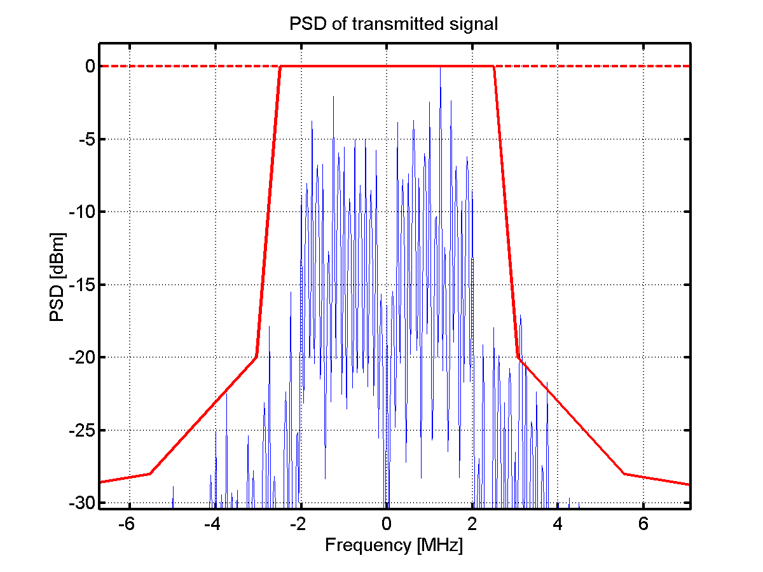
Transmitter: Spectrum mask
The spectrum becomes dependent on the selected waveforms selected for the ON part of the signal, above is one example
Should we have different spectrum masks for MCS0 and MCS1, or just one that should be fulfilled for both? MCS1 expected to generate wider spectrum
Details TBD once the waveforms are decided

Slide 6
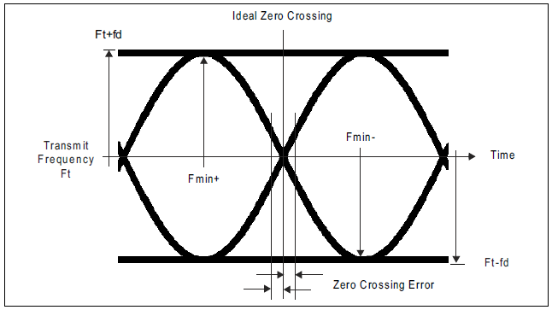
Transmitter: Modulation accuracy
This is where EVM is used in e.g. 802.11ac
Since the receiver is non-coherent, one may use a similar measure as is done to test an FSK transmitter, i.e., considering an ideal eye-diagram
The figure above is taken from the Bluetooth spec.

Slide 7
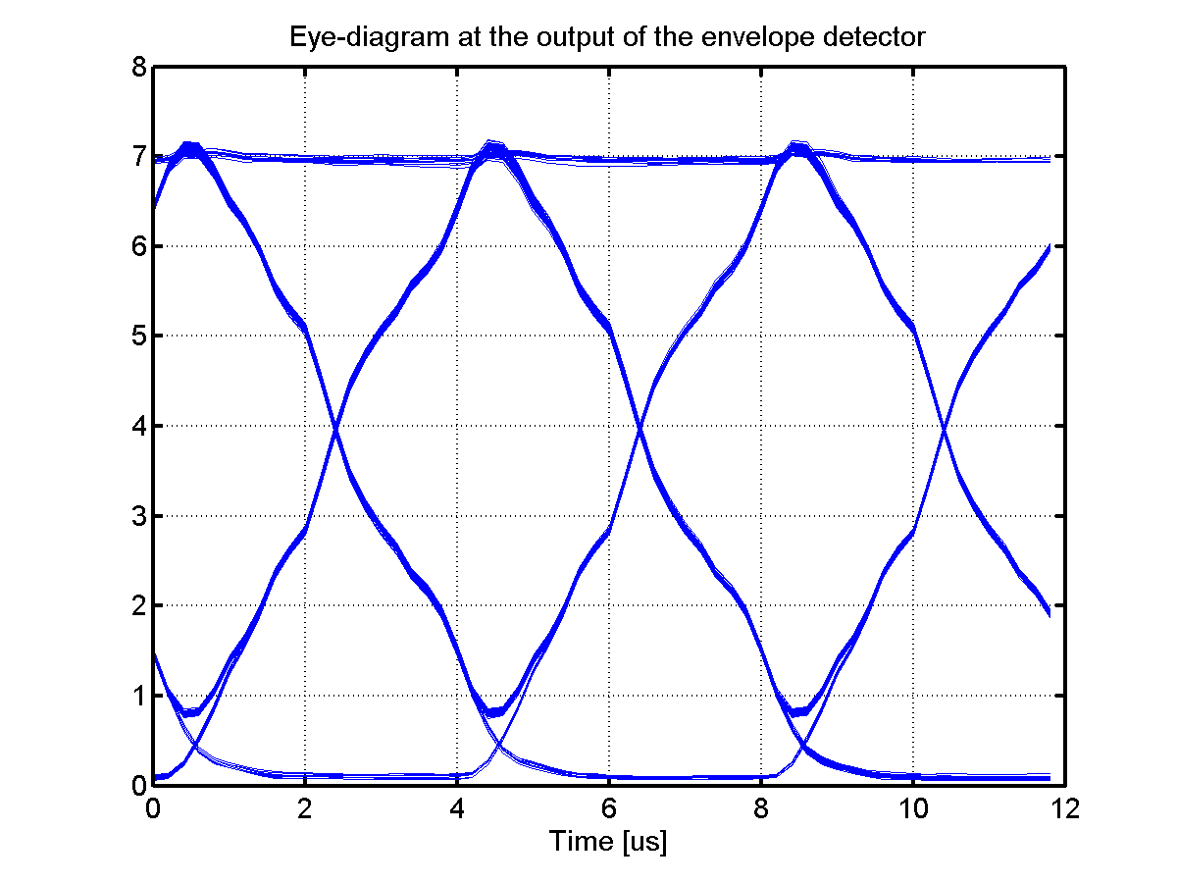
Transmitter: Modulation Accuracy
Possible requirements for modulation accuracy:
Zero-crossing error (TBD us)
Max eye-opening ( > TBD % of ideal eye-opening)

Slide 8
Transmitter: Modulation Accuracy
The transmitter should be tested with an “ideal receiver”. Possible requirements for such a receiver:
Operating at 20 MHz
Using a CSF of 2.5 MHz (LPF)
Digital detector using a FIR filter
Ideal frequency generation (no frequency offset and no phase noise)

Slide 9
Receiver: Sensitivity
According to the PAR “The WUR is a companion radio to the primary connectivity radio and meets the same range requirement as the primary connectivity radio“
Because of different regulatory rules in different regions of the world, the maximum allowed TX power may be different than that of the PCR [1]
To achieve the same range when the TX power is less for the WUR, a better sensitivity is required

Slide 10
Alternative 1:
Just consider AWGN. To have the same range, the sensitivity requirements must take a reduced TX power into account. PCR requirement is -82dBm
TX power may be 7 dB less in 5 GHz => WUR sensitivity should be -89 dBm

Slide 11
Alternative 2:
Just consider AWGN. To have the same range, the sensitivity requirements must take a reduced TX power into account. PCR requirement is -82dBm
The PAR does not say that the WUR must use the same band, so the WUR may use 2.4 GHz instead
TX power may be 4 dB less in 2.4 GHz => WUR sensitivity should be -86 dBm
Note: Arguing that PCR is in 5 GHz and WUR may be in 2.4 does not seem appropriate. There may be a reason why PCR is not in 2.4 GHz…

Slide 12
Alternative 3:
When range is discussed in the PAR, one should interpret this as the range for a functional link, i.e., there must also be an UL using the PCR
Assuming that the TX power for the non-AP is considerably less, the UL may anyway set the limit
WUR TX power is 16 dBm, if the non-AP STA does not have more than this, WUR may also have -82dBm as sensitivity
Note 1: This would effectively mean that we start differentiating between APs and non-AP STAs, similar to cellular system.
Note 2: This relies on different TX power, but this does not have to be the case…

Slide 13
Alternative 4:
The requirement in the specification is one thing, what is achieve in products something else…
Say all products on the market have a sensitivity of at least -92dBm
Specifying WUR sensitivity to -89 is then no issue if we are serious with that the products should have the same range. In fact the WUR must be better than -89 dBm anyway

Slide 14
Alternative 5:
The real world is not AWGN, but a 4 MHz signal will have a disadvantage because of worse frequency selectivity
If the same sensitivity is intended to mean same range for the end user, one may want to introduce means to address this
Specifying for something else than AWGN is not done in 802.11, but then the whole set-up with a companion radio with a different bandwidth has never been discussed before
One can still test for AWGN, but agree on a addition fading margin that is needed for the WUR

Slide 15
Receiver: Sensitivity
Note that if one would target -82 dBm, the whole exercise done up until now regarding MCS is missing the target.
-82dBm likely means that 62.5 kb/s is not needed

Slide 16
Receiver: Adjacent channel rejection
If the Wake-up signal would be transmitted in the center of the 20 MHz channel, it seems ACR would refer to suppressing an adjacent standard Wi-Fi channel 20 MHz away
If the Wake-up signal also can be located elsewhere in the 20 MHz channel, the ACR should be specified with a Wi-Fi channel correspondingly closer

Slide 17
Adjacent channel rejection
The main radio has ACR = 16dB (ACI = -16dB) for MCS0
The requirement of the ACR should be selected such that it can withstand the same interference power
If the received power of the wake-up signal is less than that of the PCR signal, the ACR must be improved correspondingly
If the TX power of the wake-up signal e.g. is 7 dB less, then the ACR must be increased by 7 dB, i.e., ACR = 23 dB

Slide 18
Adjacent channel rejection: illustration
TX power
23 dBm
TX power
Pathloss
Pathloss
RX power
C/I
RX power
C/I
Interference
PCR
WUR

Slide 19
Maximum input level
The 802.11 specification requires -30dBm
OOK would typically be less sensitive to compression in the front-end
Unless there is a use case that require more stringent requirements, the suggestion is to also have -30 dBm for the WUR

Slide 20
Straw Poll 1
Do you believe the transmitter spectrum mask should be the same as today used for 20 MHz 802.11ac (The alternative is one that is more matched to the 4 MHz wake-up signal)?
Y/N/A:

Slide 21
Straw Poll 2
Do you support the idea of specifying the transmitter accuracy by means of an eye-diagram? Exactly how is TBD, but a possibility would be to specify zero-crossings and max eye-opening as discussed in this presentation
Y/N/A:

Slide 22
Straw Poll 3
Do you believe only one sensitivity requirement should be specified, even if this means different relative sensitivities for the PCR and the WUR in different parts of the world?
Y/N/A

Slide 23
Straw Poll 4
If only one sensitivity requirement is specified, what is the number you prefer?
-82dBm/-86dBm/-89dBm/<-89 dBm/No opinion

Slide 24
Straw Poll 5
Assume that ACR is specified independent of what maximum TX power can be used. What do you believe the ACR for MCS0 should be?
16dB/20dBm/23dBm/No opinion

Slide 25
References
[1] S. Shellhammer and B. Tian, “Regulations and noise figure - Impact on SNR”, IEEE 802.11-17/0365r0.

