Slide 1
WUR dual sync performance
January 2018
Date: 2018-01-15
Authors:
Name | Affiliation | Address | Phone | Email
Jinyoung Chun | LG Electronics | 19, Yangjae-daero 11gil, Seocho-gu, Seoul 137-130, Korea |  | jiny.chun@lge.com
Dongguk Lim |  |  |  | dongguk.lim@lge.com
Eunsung Park |  |  |  | esung.park@lge.com
Jinsoo Choi |  |  |  | js.choi@lge.com

Slide 2
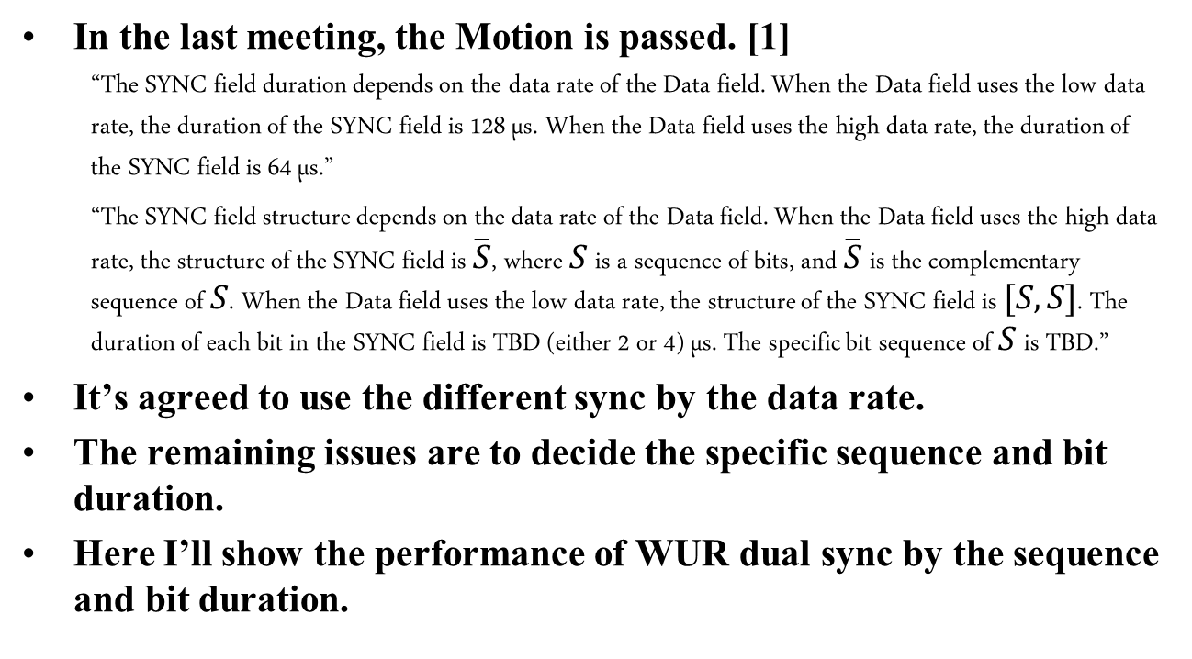
Introduction
In the last meeting, the Motion is passed. [1]
  “The SYNC field duration depends on the data rate of the Data field. When the Data field uses the low data rate, the duration of the SYNC field is 128 µs. When the Data field uses the high data rate, the duration of the SYNC field is 64 µs.”
  “The SYNC field structure depends on the data rate of the Data field. When the Data field uses the high data rate, the structure of the SYNC field is $\overline{S}$, where $S$ is a sequence of bits, and $\overline{S}$ is the complementary sequence of $S$. When the Data field uses the low data rate, the structure of the SYNC field is $[S,S]$. The duration of each bit in the SYNC field is TBD (either 2 or 4) µs. The specific bit sequence of $S$ is TBD.”
It’s agreed to use the different sync by the data rate.
The remaining issues are to decide the specific sequence and bit duration.
Here I’ll show the performance of WUR dual sync by the sequence and bit duration.

Slide 3
The simulation scenarios to check WUR dual sync performance
January 2018
Simulation case 1
  STA knows which sync is transmitted. That is, long/short sync is detected based on long/short sync threshold, respectively.
  It’s proper to compare the performance of sync sequence and bit duration by itself.
Simulation case 2
  STA doesn’t know which sync is transmitted. That is, a criterion to determine long or short sync is needed as well as long/short sync threshold. The details may be implementation issues but here I try to show how well the dual sync is detected.

Slide 4
Threshold and detection criteria
January 2018
Long/short sync threshold
  The values are chosen based on [2] when false alarm is 10%
Detection criteria
  In simulation case 1,
    Find maximum correlation value of long sync length during several hundreds us*.
    If the value is larger than long sync threshold, the long sync is detected.
    Calculate FER under 2nd condition.
    In case of short sync, find minimum correlation value of short sync length and compare -1.*short sync threshold, and others are same.
  In simulation case 2,
    Find maximum correlation value of long sync length and minimum correlation value of short sync length during several hundreds us* .
    If the maximum value is larger than long threshold and the value/2 is larger than abs(the minimum value), long sync is detected.
    Else if the minimum is smaller than -1.*short sync threshold, short sync is detected.
    Calculate FER under 2nd condition if long sync and under 3rd condition if short sync, respectively.
    Need one more criterion to distinguish long sync or short sync like the underline.
    * WUR packet length+ front/end guard time (192us)

Slide 5
Simulation assumption
January 2018
WUR packet structure
  Preamble field: L-preamble + a BPSK symbol (24us)
  Sync field: Sync sequence ‘S’ [3]
    16 sequence with 4us bit duration : [0,1,0,0,0,1,1,1,1,0,1,0,1,1,0,0]
    32 sequence with 2us bit duration: [1,1,1,1,1,0,1,0,0,0,1,1,1,0,0,1,1,1,0,0,1,0,0,1,0,0,0,0,1,0,1,0]
  Data field: 32 bits with 62.5kpbs for long sync, 250kpbs for short sync
Sync detection method
  Cross-correlation with undersampled ED value and sync sequence (‘0’ to ‘-1’ and ‘1’ to ‘1’)
Other parameters
  2.4GHz bandwidth, Sampling rate: 4MHz, SNR is defined considering 20MHz
  2nd order butterworth filter, No CFO & no phase noise*
  TGnD and UMi NLOS channel
  * The performance with CFO and PN is in Appendix.

Slide 6
Simulation case 1
January 2018
Long/short sync performance in TGnD
  It shows the FER and sync miss detection rate with 2/4us bit duration, respectively.
    FER: data packet error rate when sync is detected.
    MD to noise: the rate that sync is missed not to satisfy the sync criteria.
    ➔ FER with 2us bit duration is slightly better than FER with 4us, especially in case of short sync.

Slide 7
Simulation case 1
January 2018
Long/short sync performance in UMi
  It shows the similar trends with performance in TGnD.

Slide 8
Simulation case 2
January 2018
Long/short sync performance in TGnD
  MD to sync2: the rate that sync is detected to other sync (long/short sync -> short/long sync).
  ➔ The performance is not bad in comparison with case1. That is, WUR packet is well detected whatever the sync is long or short.
    ➔ FER with 2us bit duration is slightly better than FER with 4us, especially in case of short sync.

Slide 9
Simulation case 2
January 2018
Long/short sync performance in UMi
  It shows the similar trend with the performance in TGnD except FER of long sync.
  FER with 2us is worse than FER with 4us in higher SNR in long sync. But it’s not big issue because long sync is operated in lower SNR.

Slide 10
Summary
January 2018
  About “Dual sync performance”
  The detection performances are similar of Simulation case 1 and case 2. Therefore the sync is detected well in the mixed environment of long and short sync.
  About “Sync Sequence S”
  In this simulation, “S” is chosen under the condition of the same number of ‘0 and ‘1’ because it’s easy to compare the threshold values.
  The performance is not changed to use other sync sequence [4][5].
  About “Bit duration”
  FER with 2us bit duration is slightly better than FER with 4us.
  The trend of the simulation results with CFO and PN is similar. [See Appendix].

Slide 11
Straw Poll #1
January 2018
Do you agree that in the SYNC field, 𝑆 is a sequence of 32 bits and the duration of each bit is 2 µs?
  Y
  N
  abs

Slide 12
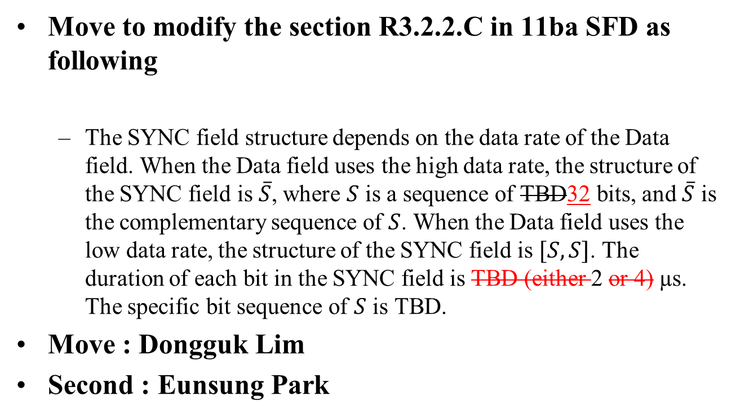
Motion #1
Move to modify the section R3.2.2.C in 11ba SFD as following
  The SYNC field structure depends on the data rate of the Data field. When the Data field uses the high data rate, the structure of the SYNC field is $\overline{S}$, where $S$ is a sequence of TBD32 bits, and $\overline{S}$ is the complementary sequence of $S$. When the Data field uses the low data rate, the structure of the SYNC field is $[S,S]$. The duration of each bit in the SYNC field is TBD (either 2 or 4) µs. The specific bit sequence of $S$ is TBD.
Move : Dongguk Lim
Second : Eunsung Park

Slide 13
References
January 2018
[1] IEEE 802.11-17/1781r1 Sync Structure Motion
[2] IEEE 802.11-17/1352r0 Consideration on WUR sync preamble
[3] IEEE 802.11-17/0991r0 Preamble Design and Simulations
[4] IEEE 802.11-17/0997r0 Preamble Options
[5] IEEE 802.11-17/1343r0 WUR Preamble SYNC Field Design

Slide 14
Appendix

Slide 15
Results with CFO 200ppm and PN 20uW
January 2018
Simulation case 1

Slide 16
Results with CFO 200ppm and PN 20uW
January 2018
Simulation case 2

