Slide 1
Preparation for IMT-2020 (5G) Candidate Submission
Date: 2017-11-20
Authors:

Slide 2
Background Information (ITU, ITU-R, SGs and WP5D)
The International Telecommunication Union (ITU)
UN’s specialized agency for information and communication technologies – ICTs.
ITU allocates global radio spectrum and satellite orbits and develop technical standards.
The ITU Radiocommunication Sector (ITU-R)
Global management of the radio-frequency spectrum and satellite orbits.
Ensure rational, equitable, efficient and economical use of the RF spectrum
Creating the conditions for harmonized development and efficient operation of existing and new systems
The ITU-R Study Groups (SGs)
Develop the technical bases for decisions taken at WRC and develop global standards (Recommendations).
Working Party 5D (WP 5D)
Responsible for the overall radio system aspects of International Mobile Telecommunications (IMT) systems, comprising the IMT-2000, IMT-Advanced and IMT for 2020 and beyond.

Slide 3
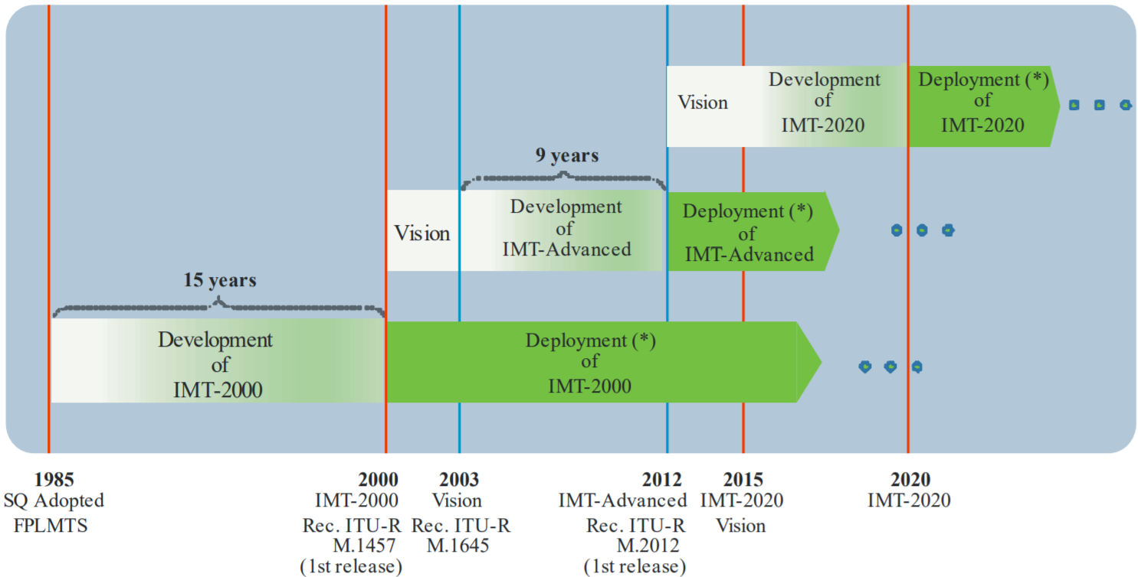
IMT development and deployment timeline
5G
4G
Source: Recommendation ITU-R M.2083-0
3G

Slide 4
WP 5D’s IMT-2020 Status (in a nut-shell)
Recommendation ITU‑R M.2083:
Defines the framework and overall objectives of the future dev. of IMT for 2020 and beyond
WP 5D has completed several key drafts
"Minimum requirements related to technical performance for IMT-2020 radio interface(s)" (Doc. 5/40)
"Guidelines for evaluation of radio interface technologies for IMT-2020" (Doc. 5/57)
"Requirements, evaluation criteria and submission templates for the development of IMT-2020" (Doc. 5/56)
Doc. on "Submission, evaluation process and consensus building for IMT-2020" (Doc. IMT-2020/2(Rev.1) )
WP 5D held a workshop on IMT-2020.
Step 3 of the IMT-2020 developing process "Submission/Reception of the RIT and SRIT proposals and acknowledgement of receipt" will start in accordance with Doc. IMT-2020/2(Rev.1).

Slide 5
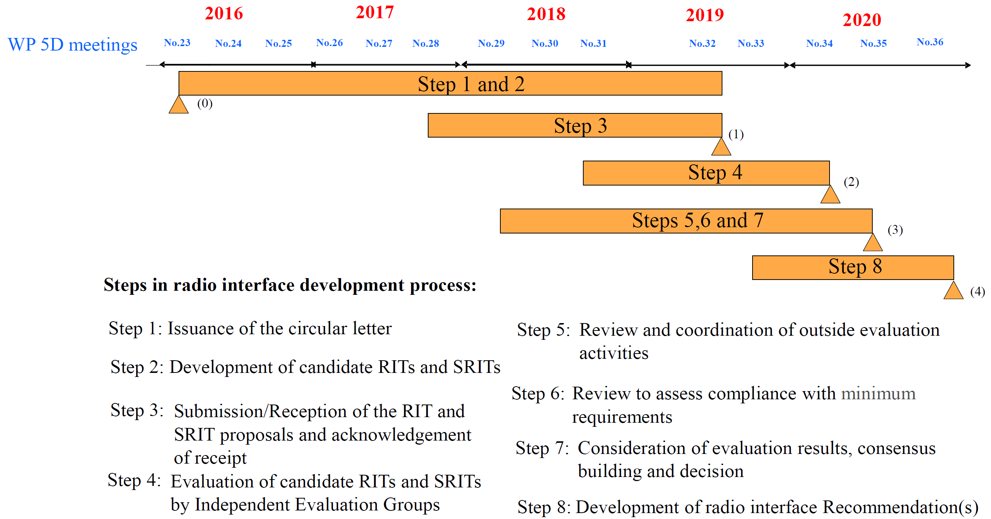
The Radio Interface Technology (RIT) Development Process
Source: IMT 2020/2(Rev.1)

Slide 6
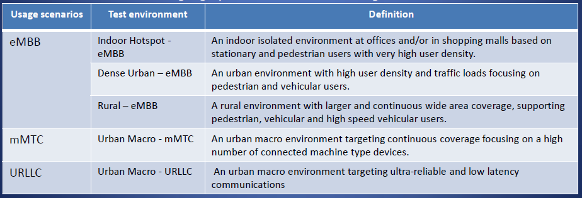
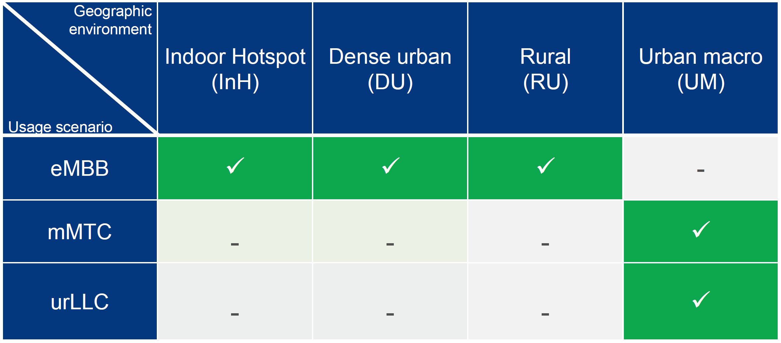
Usage Scenarios & Test Environments
Source: IMT-2020 WS (4th Oct 2017)

Slide 7
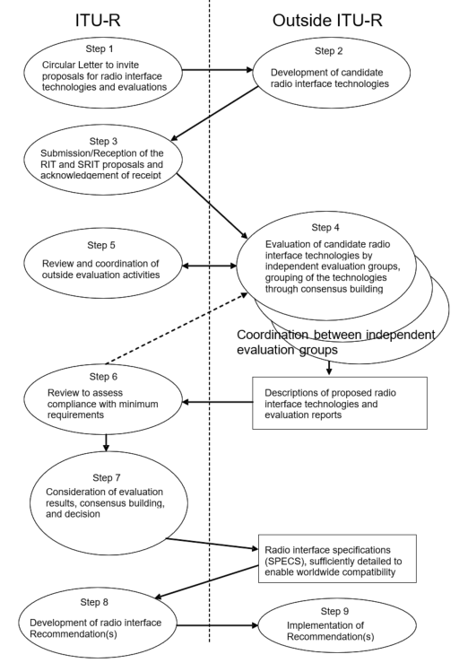
IMT-2020 Radio Interface Tech. development process
Input Submission Summary
Source: IMT 2020/2(Rev.1)
Evaluation Reports Summary
Report
M.[IMT-2020.OUTCOME]
Recommendations
M.[IMT-2020.SPECS]

Slide 8
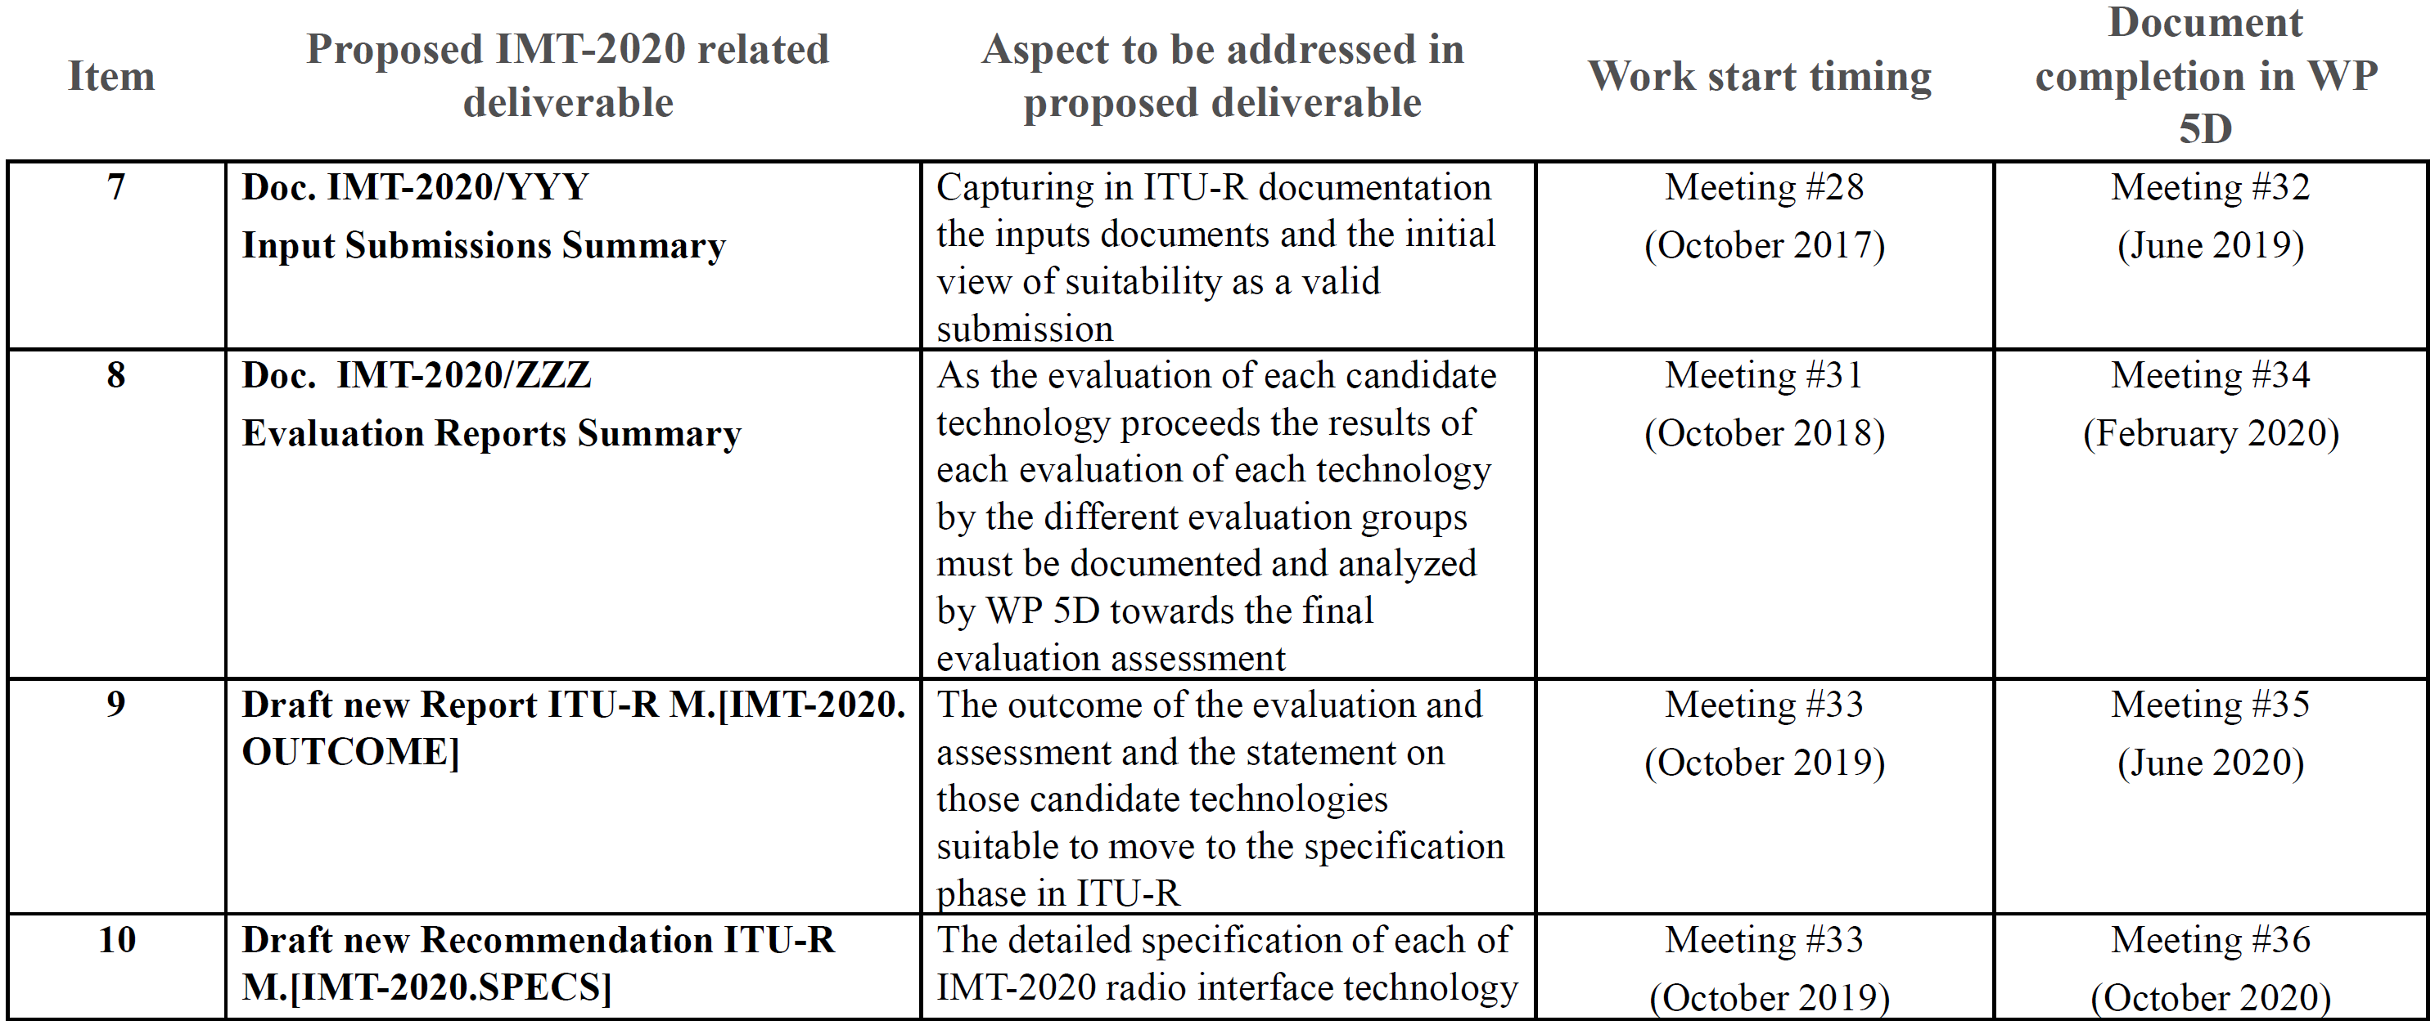
IMT-2020 Deliverables and Timelines
Source: IMT-2020 Anticipated Schedule

Slide 9
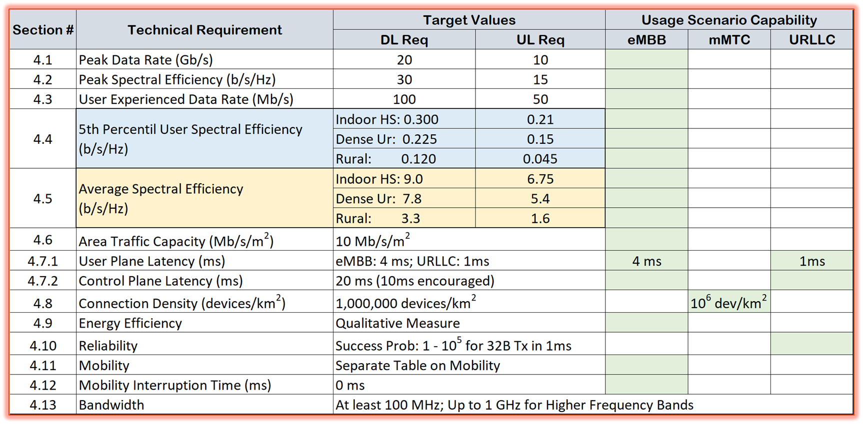
IMT-2020 Requirements for (S)RIT

Slide 10
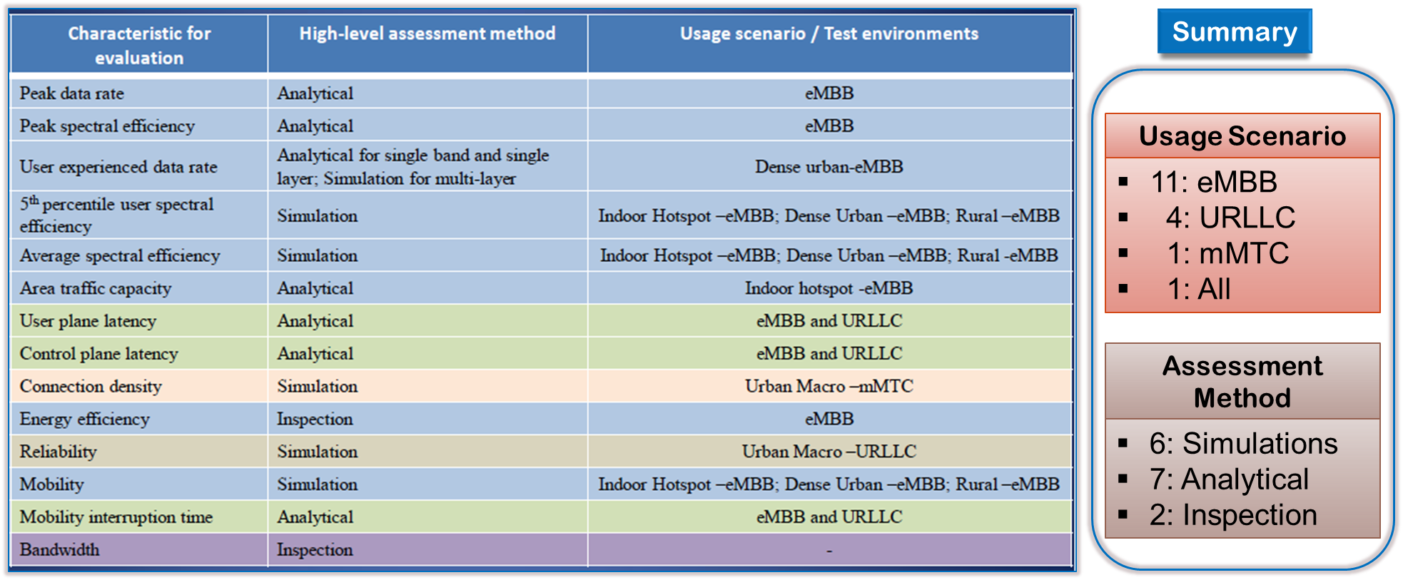
IMT-2020 Evaluation methodology
Source: IMT-2020 WS (4th Oct 2017); WP 5D Doc 5/57

Slide 11
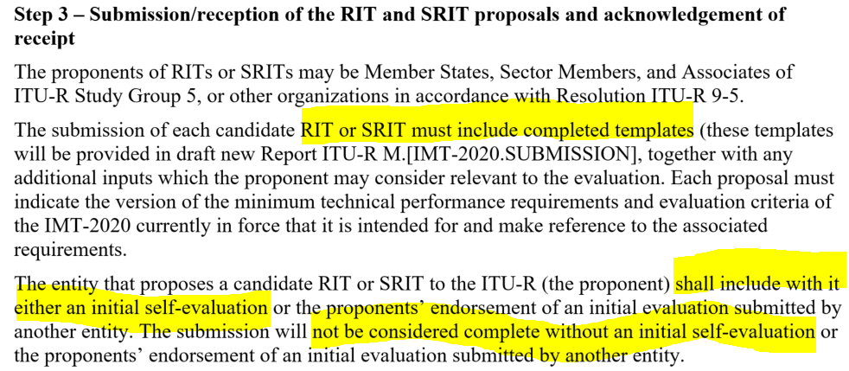
We are in “Step 3”
Source: IMT 2020/2(Rev.1)

Slide 12
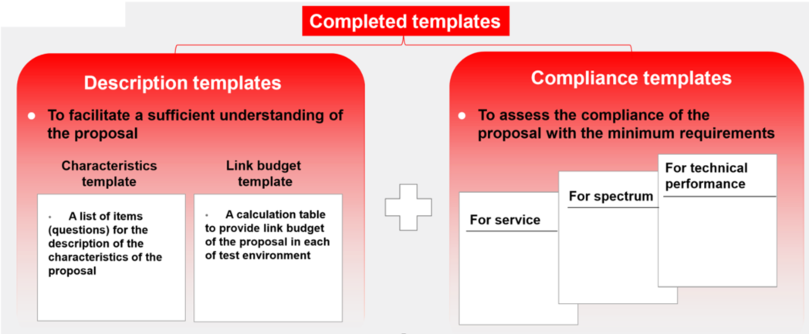
These are the documents that need to be submitted
Source: IMT-2020 WS (4th Oct 2017); Wu Yong
Uploaded a skeleton framework
Description Template (11-17-1812r0)
Uploaded a skeleton framework
Compliance Template (11-17-1813r0)

Slide 13
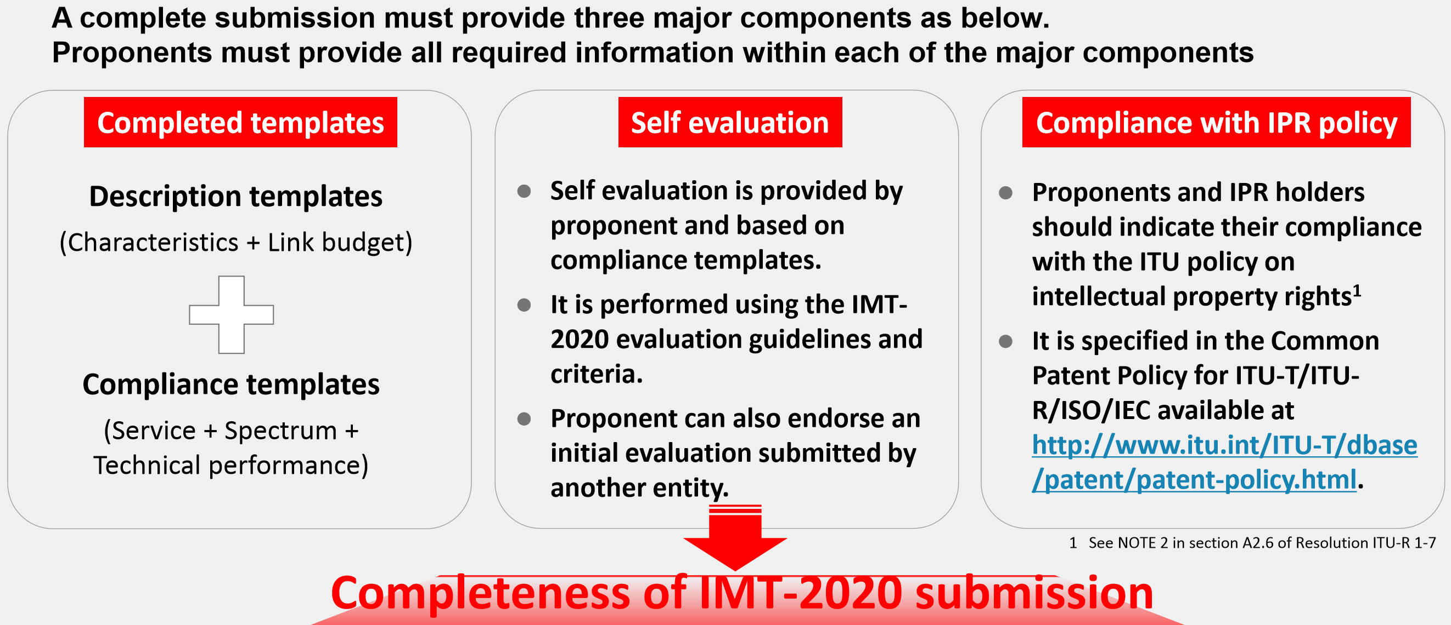
Completeness of Submission
Source: IMT-2020 WS (4th Oct 2017); Wu Yong

Slide 14
Suggested Actions
Goal: Deliver templates and self-evaluation documents to 802.18 no later than 12/22 (6 full weeks)
Assign tasks
Assign AHG leads driving completion of the various sections in
Description Templates
Compliance Template
Self evaluation document
802.18 to take up preparatory effort and draft a plan:
Compliance templates
IPR policy
Driving the process in 802 (WG approval, EC approval etc.)
Establish contact points to work with thet evaluation groups (see slide in Appendix)
WP 5D Meeting attendance

Slide 15
Appendix

Slide 16
Registered Independent Evaluation Groups
5G Infrastructure Association (5GPPP-EU)
​ATIS WTC IMT-2020 Evaluation Group (WTSC-USA)
​China Evaluation Group (ChEG-China)
​​Canadian Evaluation Group (CEG-Canada)
​Wireless World Research Forum (WWRF)
​Telecom Centres of Excellence (TCOE-India)
​5GMF IMT-2020 Evaluation Group (5GMF-Japan)
​TTA 5G Technology Evaluation Special Project Group (TTA SPG33-Korea)
​Trans-Pacific Evaluation Group (TPCEG/ITRI-USA)

