Slide 1
802.11 November 2017 Closing Reports
Date: 2017-11-14
Authors:

Slide 2
Abstract
This document is a digest of the closing reports of all 802.11 sub-groups for presentation at the November 2017 closing plenary meeting. Attendance information and liaison reports (including liaison reports from the mid-week plenary) are also included.
R1: correction to slides 52, 88 (document versions), addition of OmniRAN report (slides 113-116)

Slide 3
Attendance
Data as of 2017-11-09
16:30

Slide 4
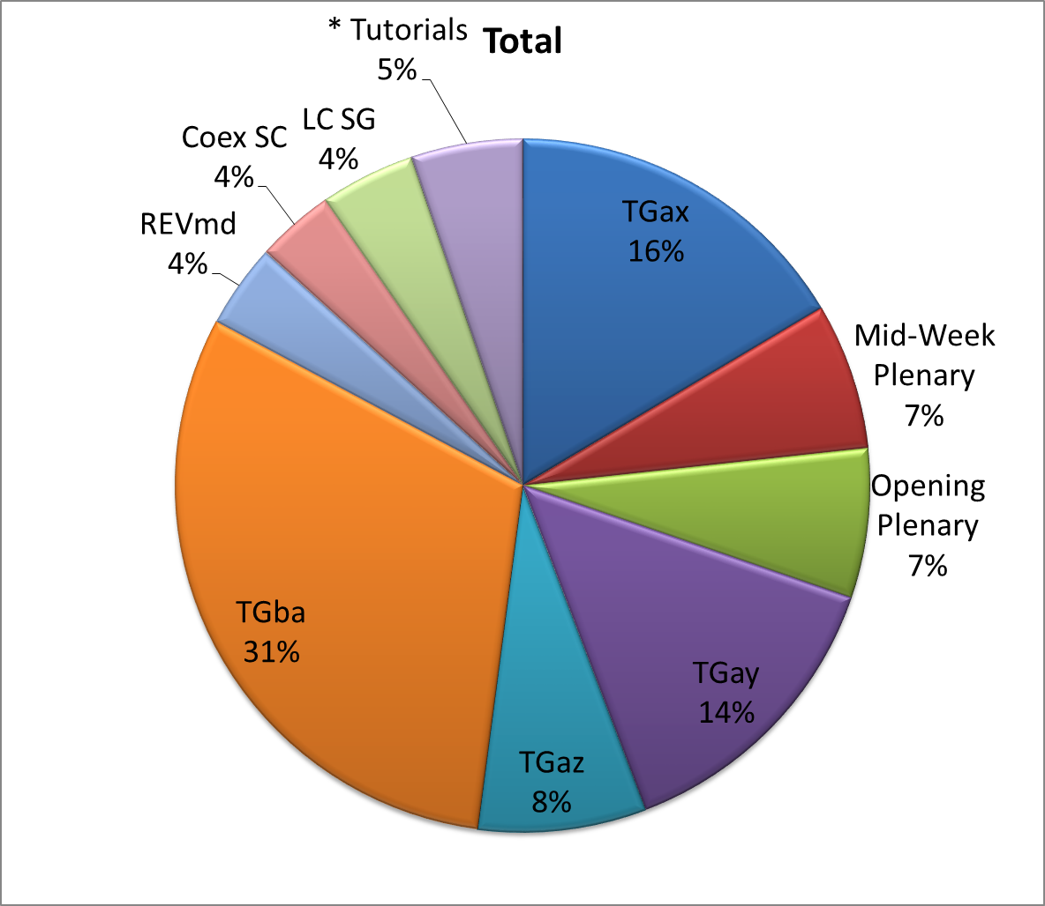
Attendance Total

Slide 5
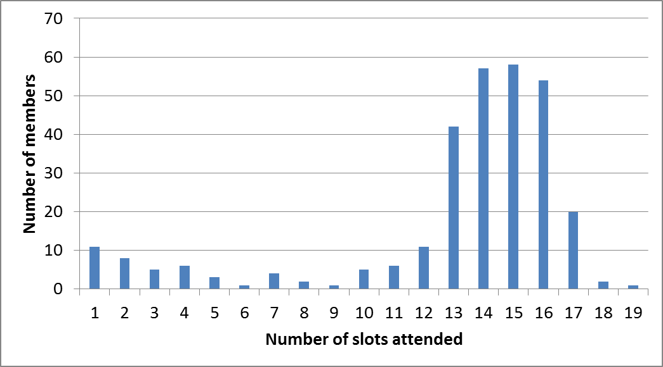
Attendance Histogram

Slide 6
Attendance by Country

Slide 7
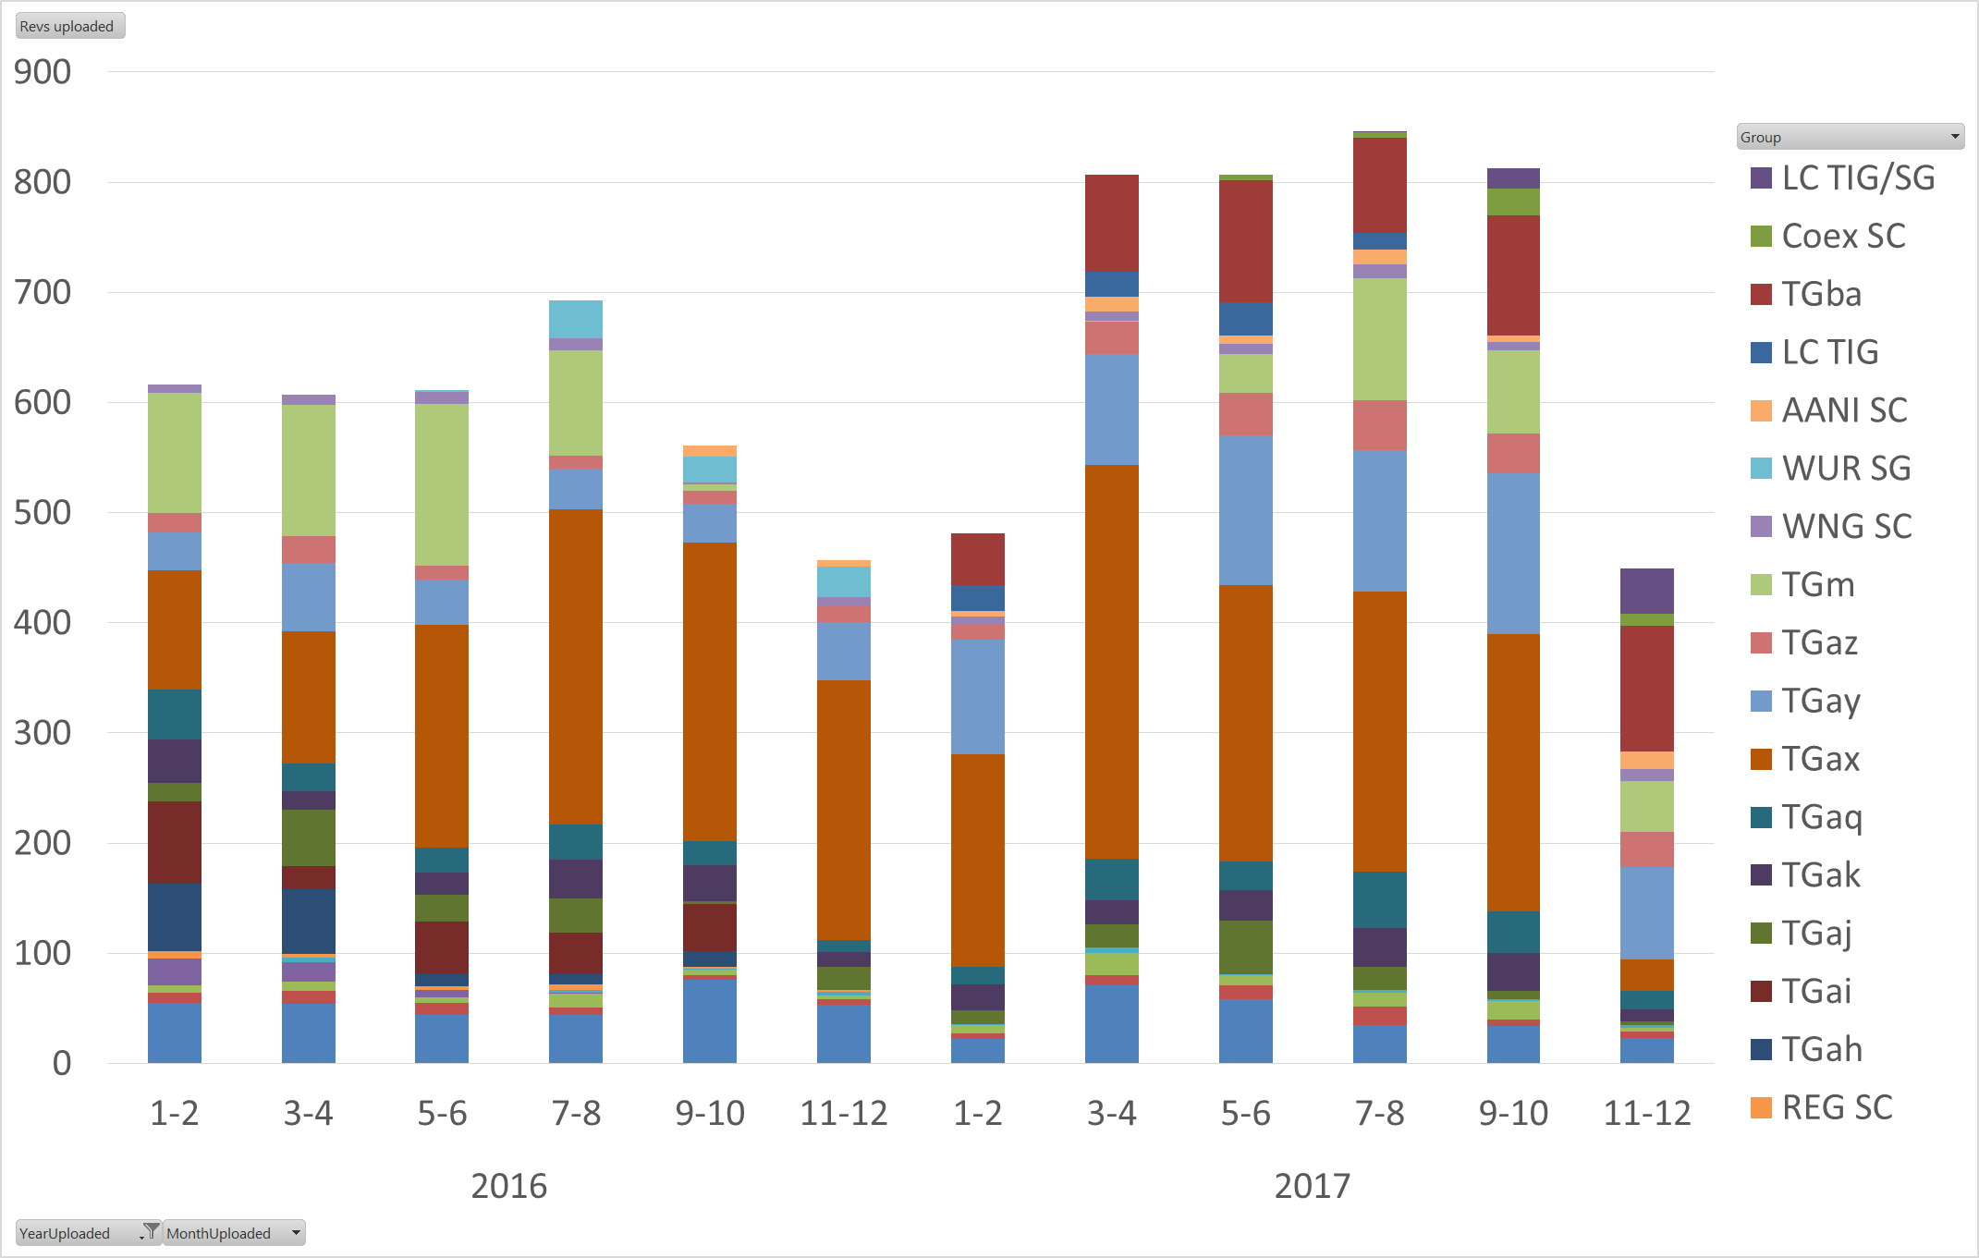
Doc Revision uploads by meeting (month #)

Slide 8
802.11 WG Editor’s Meeting (Nov 2017)
Date: 2017-11-09
Authors:
from slide 1/6 of 11-17-1563 by Peter Ecclesine (Cisco Systems)
Notes:
July 2007

Slide 9
Volunteer Editor Contacts
TGaj – Jiamin CHEN – jiamin.chen@mail01.huawei.com , Shiwen He – shiwenhe@seu.edu.cn
TGak – Donald Eastlake – d3e3e3@gmail.com
TGaq – Lee Armstrong – LRA@tiac.net
  TGax – Robert Stacey – robert.stacey@intel.com
  TGay – Carlos Cordeiro – carlos.cordeiro@intel.com
  TGaz – Chao Chun Wang – chaochun.wang@mediatek.com
  TGba – Po-kai Huang – po-kai.huang@intel.com
REVmd –Emily Qi – emily.h.qi@intel.com, Edward Au – edward.ks.au@huawei.com,
  Editors Emeritus:
  TGaa – Alex Ashley – alex.ashley@hotmail.co.uk
  TGac – Robert Stacey – robert.stacey@intel.com
  TGad – Carlos Cordeiro – carlos.cordeiro@intel.com
  TGae – Henry Ptasinski – henry@LOGOUT.COM
  TGaf – Peter Ecclesine – petere@ieee.org
  REVmc – Adrian Stephens – adrian.p.stephens@ieee.org , Edward Au – edward.ks.au@huawei.com, Emily Qi – emily.h.qi@intel.com
  TGai - LRA@tiac.net, Ping FANG Ping.FANG@huawei.com
  TGah – Yongho Seok yongho.seok@gmail.com, Alfred Asterjadhi – aasterja@qti.qualcomm.com
  TGaq – Dan Gal – ddrgal@gmail.com
from slide 2/6 of 11-17-1563 by Peter Ecclesine (Cisco Systems)
Notes:
July 2007

Slide 10
802.11 Style Guide
See 11-09-1034-12-0000-wg11-style-guide.doc
  We updated 802.11 WG Style Guide based on 2012 IEEE Standards Style Manual and consistency changes in final publication of the 802.11 standard
Editor’s responsibility includes checking the 2014 IEEE Standards Style Manual when creating or updating drafts. https://development.standards.ieee.org/myproject/Public/mytools/draft/styleman.pdf
Submissions with draft text should conform to both the WG11 Style Guide and IEEE Standards Style Manual
Note that the Style Guide evolves with our practice, expect a revision in March
from slide 3/6 of 11-17-1563 by Peter Ecclesine (Cisco Systems)

Slide 11
Editor Amendment Ordering
Data as of November 2017
See http://grouper.ieee.org/groups/802/11/Reports/802.11_Timelines.htm
In Nov 2017, Editors discussed REVmd schedule and possible completion in 2020, and expect only amendments 1 to 5 in REVmd. We will revisit the running order in July.
Amendment Number | Task Group | Projected REVCOM Date
802.11-2016 Amendment 1 | TGai | Dec 2016
802.11-2016 Amendment 2 | TGah | Dec 2016
802.11-2016 Amendment 3 | TGaj – 292 | March 2018
802.11-2016 Amendment 4 | TGak – 91 | March 2018
802.11-2016 Amendment 5 | TGaq – 76 | March 2018
802.11-2016 Amendment 6 | TGax – 596 | Jul 2019
802.11-2016 Amendment 7 | TGay – 419 | Dec 2019
802.11-2016 Amendment 8 | TGaz | Mar 2021
802.11-2016 Amendment 9 | TGba | Jul 2020
Amendment numbering is editorial! No need to make ballot comments on these dynamic numbers!
from slide 4/6 of 11-17-1563 by Peter Ecclesine (Cisco Systems)
Notes:
July 2007

Slide 12
Draft Development Snapshot
Nov 2017
Changes from last report shown in red.
Most current doc shaded green.
TG | Published or Draft Baseline Documents |  |  |  |  |  |  |  |  |  | Source | MDR | Style Guide | Editor | Snapshot Date
 | Published | mc | aq | ak | aj | md | ax | ay | az | ba
mc | Y | Y |  |  |  |  |  |  |  |  | Frame 12.0 | Yes | 2012 | Adrian Stephens Edward Au, Emily Qi | 17-Jan
aq | Y | Y | 13.0 |  |  |  |  |  |  |  | Frame 12.0 | Yes | 2012 | Lee Armstrong | 29-Oct
ak | Y | Y | 12.0 | 5.0 |  |  |  |  |  |  | Word | Yes | 2012 | Donald Eastlake Norm Finn | 29-Oct
aj | Y | Y | 7.2 | 3.0 | 8.0 |  |  |  |  |  | Frame 10.0 | Yes | 2012 | Jiamin Chen Shiwen He | 07-Nov
md |  |  |  |  |  | 0.4 |  |  |  |  | Frame |  |  | Emily Qi Edward Au | 07-Nov
ax | Y | Y | 10.0 | 4.0 | 6.0 |  | 2.0 |  |  |  | Frame 12.0 | No | 2012 | Robert Stacey | 07-Nov
ay | Y | Y | 13.0 | 5.0 | 8.0 |  | 2.0 | 0.8 |  |  | Word | No | 2012 | Carlos Cordeiro | 27-Oct
az |  |  |  |  |  |  |  |  |  |  |  |  |  | Chao Chun Wang | 07-Nov
ba |  |  |  |  |  |  |  |  |  |  |  |  |  | Po-Kai Huang | 11-Jul
from slide 5/6 of 11-17-1563 by Peter Ecclesine (Cisco Systems)
Notes:
July 2009
July 2007
Peter Ecclesine (Cisco Systems)
Page 12

Slide 13
MIB style, Visio and Frame practices
I’m going to suggest going forward we use a single style with appropriately set tabs, and use leading Tabs to distinguish the syntax and description parts. (Adrian Stephens Feb 9, 2010)
Two ways to format a figure & its caption in frame:
  Insert a table. Insert anchored frame inside table cell to hold graphics. Use table caption as figure caption.
  Insert an anchored frame. Insert caption inside a text frame inside the anchored frame. Insert graphics inside the anchored frame.
Keep embedded figures using visio as long as possible
  Near the end of sponsor ballot, turn these all into .emf (windows meta file) format files (you can do this from visio using “save as”). Keep separate files for the .vsd source and the .emf file that is linked to from frame. There is likelihood we should use .emf
Frame templates for 11aa, 11ac, 11af
from slide 6/6 of 11-17-1563 by Peter Ecclesine (Cisco Systems)

Slide 14
AANI SC Closing Report 2017
Date: 2017-11-09
Authors:
from slide 1/5 of 11-17-1780 by Joseph Levy (Interdigital)

Slide 15
Abstract
Abstract
This Document is the closing report for AANI SC,
November 2016 Meeting in San Antonio, TX
This Document is the closing report for AANI SC,
November 2017 Meeting in Orlando, Florida, USA
from slide 2/5 of 11-17-1780 by Joseph Levy (Interdigital)

Slide 16
802.11 AANI SC – November 2017
Meeting Goals:
  Generate Reply LS to Incoming LS from NGMN (11-17/1569r0)
  Generate Reply/Comments to “IEEE 5G AND BEYOND TECHNOLOGY ROADMAP WHITE PAPER”
Agenda: See 11-17/1222r4 , met for 3 hours
Meeting Activity:
  Reviewed AANI SC Status
  Generated a reply LS to NGMN ( )
  Generated an LS to IEEE 5G ( )
  Called for contributions related to 3GPP SA 3GPP core network and 802.11 interworking
  Discussed way forward for the 802.11 ITU IMT-2020 framework submission
from slide 3/5 of 11-17-1780 by Joseph Levy (Interdigital)

Slide 17
Call for Contributions
To progress the work in AANI SC contributions are requested:
Related to 3GPP SA TSG
  Reviews/tutorials on the 3GPP core network and/or 802.11 interworking
  Reviews/tutorials on the completed 3GPP SA studies for 5G: TR 23.799, TR 33.899
  Reviews/Tutorials on 3GPP SA R15 (5G) Activity: TS 23.501, TS 23.502, TS 33.501
  Any other 3GPP nextGen Core network and 802.11 interworking
Related to NEND ICA
  Related to Industrial Networking
  Related to Future Data Centre Networks
  Other
Related to the 802.11 IMT-2020 Proposal
  Work plan and/or work description
  Draft Document(s)
  Any other related content
from slide 4/5 of 11-17-1780 by Joseph Levy (InterDigital)

Slide 18
Future Session Planning
Teleconference: Weekly on Mondays @ 11:00am ET (with some exceptions)
  11/20, 11/27, 12/4, 12/11, 12/18, 1/8 - TBC
14-19 January 2017 F2F, Irvine, California, USA:
Goals:
  Contributions on 3GPP SA/802.11 interworking: 2G/3G/4G
  Contributions on 3GPP SA/802.11 or RAN/802.11 interworking 5G
  Continue discussions on NEND IC and report NEND IC activity.
  Complete IEEE 802.11 IMT-2020 Framework documentation for approval
Meeting time: 4 sessions - Monday PM1, Tues PM1, Wednesday PM2 and Thursday AM2 - TBC
from slide 5/5 of 11-17-1780 by Joseph Levy (Interdigital)

Slide 19
ARC Closing Report
Date: 2017-11-08
Authors:
from slide 1/7 of 11-17-1777 by Mark Hamilton, Ruckus/Brocade

Slide 20
Abstract
This document is the closing report for ARC SC,
November 2017 Meeting in Orlando, Florida, USA
from slide 2/7 of 11-17-1777 by Mark Hamilton, Ruckus/Brocade

Slide 21
Work Completed
Agenda is here: 11-17/1562r3
MIB Design Pattern work item
  Reviewed document capturing patterns envisioned: 11-15/0355r12.
  Agreed to forward and present to the 11WG, for review/comment and approval in January.
  Request to Working Group members to preview the document, toward a discussion and decision in January.
IETF/802 coordination
  Believe IETF DetNet have determined that 802.11 is not deterministic, so not included in Use Case document. Discuss input to mention 802.11ax features that add determinism; also monitor/contribute to 802.11 Study Group on time sensitive networking using 802.11, if formed.
from slide 3/7 of 11-17-1777 by Mark Hamilton, Ruckus/Brocade

Slide 22
Work Completed (cont)
YANG/NETCONF
  No progress this session.
  Hope to have input in January.
  Anybody with experience on these, please come help us out!
“What is an ESS?”
  No discussion this time.
11ba architecture implications
  Agreed to defer, until TGba has some more stability, and experts there have more time to consider architecture concepts – maybe January?
from slide 4/7 of 11-17-1777 by Mark Hamilton, Ruckus/Brocade

Slide 23
Work Completed
802.1AS-rev use of Fine Timing Measurement
  Being worked directly by 802.11 experts, with 802.1AS
AP/DS/Portal architecture, 802/802.1 mappings
  No progress this session.
  Need to consolidate agreements, and provide input to REVmd.
Noted status of IEEE 1588 mapping to IEEE 802.11
  No changes. Ongoing balloting. No action needed.
  Related activity: 802.1AS REVision use of FTM
Noted IEEE 802 activities relevant to 802.11/ARC
  No change: 802.1AC is now published, 802.1Q revision underway.
from slide 5/7 of 11-17-1777 by Mark Hamilton, Ruckus/Brocade

Slide 24
Teleconference(s)
None planned
from slide 6/7 of 11-17-1777 by Mark Hamilton, Ruckus/Brocade

Slide 25
January 2018 Plans
Three standalone meeting slots planned:
Support WG consideration of Design Patterns for MIB attribute usage
Consider IETF DetNet/time-sensitive networking input
Recommendation on 802.11’s use of YANG/NETCONF
If ready, resume discussion of 11ba architecture implications, prepare proposal to TGba
Consider other “split” PHYs (?) – perhaps LC, 28 GHz
Discussion of 802.1ASrev use of FTM, if needed
DS/AP/Portal architecture discussions, and “what is an ESS?”
Status updates on other IETF work, IEEE 1588 work
from slide 7/7 of 11-17-1777 by Mark Hamilton, Ruckus/Brocade

Slide 26
PAR Review - Meeting Agenda and Comment slides - Nov 2017 - Orlando
Date: 2017-11-06
Authors:
from slide 1/23 of 11-17-1538 by Jon Rosdahl (Qualcomm)

Slide 27
Responses From 802 WGs
from slide 14/23 of 11-17-1538 by Jon Rosdahl (Qualcomm)

Slide 28
Response from 802.15
Hi all
Attached is 802.15's responses to the comments received on the 802.15.10a PAR and CSD.
They were a good set of comments and we accepted or revised most everything.
I think the result is better PAR/CSD so thanks for taking the time to provide input.
The finished results can be found at:
https://mentor.ieee.org/802.15/dcn/17/15-17-0566-01-0000-802-15-10a-csd.docx
https://mentor.ieee.org/802.15/dcn/17/15-17-0565-01-0000-802-15-10a-par.pdf
Best
Bob
from slide 15/23 of 11-17-1538 by Jon Rosdahl (Qualcomm)

Slide 29
PAR – 802.15 response to 802.11 Comments
4.2 and 4.3 the time between dates should be at least 6 months. Suggest going to sponsor July 2018, or to REVcom in April/May (out of March Plenary). Resolution: Accept. Change will be made
5.2b As a recommended practice, this should recommend routing modes that exist rather than define them. Resolution: Reject. This is a bit of a style issue. We are really defining them for the purposes of the Recommended Practice. It would appear sufficient that as part of a Recommended Practice these definitions are not in the shall category. Besides, using the word “recommending” feels awkward and redundant for the above reason
The paragraph seems to be redundant and ambiguous as to if we are adding new modes or modifying the existing ones. One possible way to clarify the paragraph may be to make the suggested changes: This amendment adds new routing modes to completely define addressing for the routing modes currently defined in the standard, including at least the following: Resolution: Revised. Change proposed to address the RAC Chair comment appears sufficient to address this comment
from slide 16/23 of 11-17-1538 by Jon Rosdahl, (Qualcomm)

Slide 30
802.15 Comment from RAC Chair-Resolution
The Scope is imprecisely stated. The actual addressing (assigning of addresses, types of addresses used, etc) is not changing at all. It is the use of these addresses (how they are used and conveyed) for the different modes that is being more fully defined.
Changing the first sentence of the scope to: This amendment adds routing modes to completely fully defines how the addressing and route information (already defined in the standard) are to be used by the routing modes (also currently defined in the standard), including at least the following:
Changing 1.2.1b of the CSD to: This amendment allows for the use of the addressing and route information used in non-storing routing modes to be completely specified, permitting full support for all of the non-storing routing modes defined in the initial standard. This expands the use environment for the base standard in the very large Internet of Things (IoT) market.
Changing PAR Title to: Amendment to fully define use of addressing and route information currently in the standard
from slide 17/23 of 11-17-1538 by Jon Rosdahl, (Qualcomm)

Slide 31
CSD- 802.15 Comment response to 802.11
1.2.1a: Change “capabity” to “capability” and “Interenet” to “Internet” Resolution: Accept. Corrections made
1.2.3: Change “801.15.10” to “IEEE Std 802.15.10” Resolution: Accept. All instances changed
1.2.4a: Change the sentence to “Route handling of dynamically changing networks are being implemented today using the IEEE STD 802.15.10-2017 Recommended Practice.” Resolution: Accept. Sentence replaced with the above.
from slide 18/23 of 11-17-1538 by Jon Rosdahl, (Qualcomm)

Slide 32
802.11 response to resolutions
Nothing further to add.
Thanks for addressing our comments.
from slide 19/23 of 11-17-1538 by Jon Rosdahl, (Qualcomm)

Slide 33
Response from 802.1CBcv
No response received by Wednesday deadline.
Updated P802.1CBcv PAR documentation in
http://www.ieee802.org/1/files/public/docs2017/cv-draft-PAR-1017-v03.pdf
Updated CSD documentation in http://www.ieee802.org/1/files/public/docs2017/cv-draft-CSD-0917-v01.pdf
Comment – the Scope is still too broad and allows for any maintenance change throughout the draft unrelated to YANG definition.
from slide 20/23 of 11-17-1538 by Jon Rosdahl, (Qualcomm)

Slide 34
Final Report to 802.11
from slide 21/23 of 11-17-1538 by Jon Rosdahl (Qualcomm)

Slide 35
Motion To Approve Report
Move to accept 11-17/01538r2 as the report from PAR Review SC for the November 2017 plenary.
Moved: Dorothy STANLEY
2nd: Mike MONTEMURRO
Results: Unanimous
from slide 22/23 of 11-17-1538 by Jon Rosdahl (Qualcomm)
Notes:
This Document

Slide 36
References:
IEEE 802 PARs Under consideration Webpage:
  http://grouper.ieee.org/groups/802/PARs.shtml
Minutes:
Previous Plenary: 11-17/1092r0:
    < https://mentor.ieee.org/802.11/dcn/17/11-17-1092-00-0PAR-minutes-july-2017-session.docx >
  Current Meeting: 11-17/1715r0:
  < https://mentor.ieee.org/802.11/dcn/17/11-17-1715-00-0PAR-minutes-november-2017-session.docx >
from slide 23/23 of 11-17-1538 by Jon Rosdahl (Qualcomm)

Slide 37
IEEE 802.11 Coexistence SC closing report in Orlando in November 2017
10 November 2017
Authors:
Name | Company | Phone | email
Andrew Myles | Cisco | +61 2 84461010 +61 418 656587 | amyles@cisco.com
from slide 1/3 of 11-17-1795 by Andrew Myles, Cisco

Slide 38
IEEE 802.11 Coexistence SC achieved its goals as an effective discussion forum for coexistence issues
IEEE 802.11 Coex SC achievements in Orlando in Nov 2017 (agenda)
  Discussed relationship issues
    Need to continue following 3GPP activities, including NR-Unlicensed
    May consider interactions with MulteFire Alliance
    Will focus on ETSI BRAN
  Focused on EN 301 893 related issues
    ED thresholds for 802.11ax
    Neutral preambles, Spatial Reuse for 802.11ax
    References to 802.11 in EN 301 893
    Energy blocking (reservation signals)
    Latest version of deterministic backoff proposal
  Reviewed IEEE 1932.1 WG goals
from slide 2/3 of 11-17-1795 by Andrew Myles, Cisco

Slide 39
IEEE 802.11 Coexistence SC will continue its work in Irvine in Jan 2018 after ETSI BRAN in Dec 2017
ETSI BRAN is meeting in Brussels in Dec 2017
  IEEE 802.11 WG will have no official position at the ETSI BRAN meeting beyond the previous LS asking for 802.11ax to have access to the traditional ED/PD mechanism
  It is likely that participants who happened to be here is week will have a more informed view of the issue as a result of this week’s discussions
IEEE 802.11 Coexistence SC will meeting in Irvine in Jan 2018
  Continue to act as a forum for discussion of coexistence issues between IEEE 802.11 and non IEEE 802 technologies
  Review any relevant 3GPP/MulteFire Alliance activities
  Review the outcome of ETSI BRAN meeting in December
  Continue technical discussions
from slide 3/3 of 11-17-1795 by Andrew Myles, Cisco

Slide 40
WNG SC Closing Report
Date: 2017-11-10
Authors:
from slide 1/3 of 11-17-1788 by Jim Lansford, Chair (Qualcomm)

Slide 41
Abstract
Closing report for WNG SC for November 2017 in Orlando (Florida, USA)
from slide 2/3 of 11-17-1788 by Jim Lansford, Chair (Qualcomm)

Slide 42
Final Agenda
https://mentor.ieee.org/802.11/dcn/17/11-17-1554-02-0wng-agenda-for-wng-2017-november.ppt
Presentations at November 2017 meeting
  "Broadcast Service on WLAN“ - Hitoshi Morioka (SRC Software)
    https://mentor.ieee.org/802.11/dcn/17/11-17-1736-02-0wng-broadcast-service-on-wlan.pptx
    Two straw polls, no motions
  “Wi-Fi Time Sensitive Networking” – Evgeny Khorov (NRU HSE; IITP RAS)
    https://mentor.ieee.org/802.11/dcn/17/11-17-1734-01-0wng-wtsn.pptx
    One straw poll, no motions
Minutes
  https://mentor.ieee.org/802.11/dcn/17/11-17-1762-00-0wng-wng-meeting-minutes-of-2017-november-orlando-meeting.docx
Plans for January 2018
  TBD
No motions, no conference calls
from slide 3/3 of 11-17-1788 by Jim Lansford, Chair (Qualcomm)

Slide 43
IEEE 802 JTC1 Standing Committee
November 2017 (Orlando) closing report
10 November 2017
Authors:
Name | Company | Phone | email
Andrew Myles (Chair) | Cisco | +61 2 84461010 +61 418 656587 | amyles@cisco.com
Peter Yee (Vice Chair) | AKAYLA | +1 415 215 7733 | peter@akayla.com
from slide 1/3 of 11-17-1796 by Andrew Myles, Cisco

Slide 44
IEEE 802 JTC1 SC focused on executing PSDO process & reviewing SC6 work in Orlando in Nov 2017
IEEE 802 JTC1 SC achievements in Orlando in Nov 2017
  Processed PSDO submissions
    Noted status of 50 standards in the PSDO pipeline
  Reviewed past and upcoming activities in SC6
    SC6 was meeting in Korea in late Oct 2017
    Not a great deal of interest to IEEE 802
    The proposal for a Security ad hoc in SC6 was revised & approved
      Only operating until the next SC6 meeting – no longer ongoing
      Limited to identifying security issues – no longer in scope to change 802 standards
  Recommended withdrawal of various documents (on EC agenda)
    ISO/IEC TR 8802-1:2001
    ISO/IEC 15802-1:1995
    ISO/IEC 15802-3:1998
    IEEE 802.5 based ISO/IEC standards
from slide 2/3 of 11-17-1796 by Andrew Myles, Cisco

Slide 45
The IEEE 802 JTC1 SC will execute the PSDO process in Irvine in Jan 2018
November 2017
IEEE 802 JTC1 plans for Irvine in Nov 2017
  Execute PSDO process
  Monitor SC6 Security ad hoc activities
from slide 3/3 of 11-17-1796 by Andrew Myles, Cisco

Slide 46
TGmd November 2017 Closing Report
Date: 2017-11-09
Authors:
from slide 1/6 of 11-17-1794 by Dorothy Stanley, HP Enterprise

Slide 47
Abstract
This presentation contains the IEEE 802.11 TGmd closing report for the November 2017 session.
from slide 2/6 of 11-17-1794 by Dorothy Stanley, HP Enterprise

Slide 48
Work completed this week
Continued Comment resolution (368 total)
  Approximately 30 CIDs resolved this week; another 20 discussed
  Approximately 140 CIDs remain
Agenda, includes motions
  https://mentor.ieee.org/802.11/dcn/17/11-17-1556-07-000m-november-2017-tgmd-agenda.pptx
Reminder: Call for contributions response to 3GPP Liaison 11-17-0315
  Call will be open through November 2017
  Approved contribution criteria in 11-17-806r1
from slide 3/6 of 11-17-1794 by Dorothy Stanley, HP Enterprise

Slide 49
TGmd schedule - unchanged
January 2018 – Initial WGLB
September 2018 –D2.0 WGLB Recirculation LB
February 2019 – Form SB Pool
March 2019 – MEC/MDR done
April 2019 – Initial SB
October 2019 – Recirculation SB
July 2020 – Final WG/EC approval
September 2020 – Revcom/SASB approval
from slide 4/6 of 11-17-1794 by Dorothy Stanley, HP Enterprise

Slide 50
Plans for Nov - Jan
Teleconferences planned for Friday December 1, 15, Jan 5 10am Eastern 2 hour
  Continued comment resolution
Ad-hoc meeting December 7-8, 2017 in Piscataway NJ for the purposes of comment resolution
from slide 5/6 of 11-17-1794 by Dorothy Stanley, HP Enterprise

Slide 51
References
https://mentor.ieee.org/802.11/dcn/17/11-17-0004-03-0000-revision-par-proposal-tgmd.doc
Approved PARs: https://standards.ieee.org/about/sba/index.html
from slide 6/6 of 11-17-1794 by Dorothy Stanley, HP Enterprise

Slide 52
TGaj Chair’s Report
During Tuesday Editors meeting, TGaq and TGak agreed to swap amendments publication order with TGaj. Therefore TGaj is no longer dependent on TGaq and TGak.
TGaj did not meet F2F this week.
Motions on Thursday teleconference call
  Approved generating D9.0 for editorial changes caused by swapping publication order and a 10-day recirculation on it.
  And request the IEEE 802 Executive Committee to conditionally approve forwarding P802.11aj to RevCom
Hopefully to have WG’s approval of the report to EC and the request of EC’s approval to conditionally forward 802.11aj to RevCom.
Will not meet F2F in January interim session.
Will schedule teleconference with 10-day notice in advance.
from Jiamin Chen

Slide 53
TGak November Closing Report
Date: 2017-11-09
Authors:
Abstract
Closing Report of the 802.11 TGak meeting November 2017 in Orlando, Florida, USA.
from slide 1/3 of 11-17-1784 by Mark Hamilton, Ruckus/Brocade

Slide 54
TGak Closing Report
Accomplishments
  Reviewed comments received so far, on the P802.11ak Sponsor Ballot recirculation.
  Agreed speculative resolutions to all comments except 2, and suggested resolution for those 2. To be finalized on first teleconference.
  Noted amendment re-ordering
  TGak agenda is in 11-17/1535r4.
  TGak minutes are in 11-17/1746.
from slide 2/3 of 11-17-1784 by Mark Hamilton, Ruckus/Brocade

Slide 55
TGak Closing Report
Teleconferences
  Scheduled 1 hour teleconferences until the January 2018 802.11 meeting on Mondays November 27th, December 11th, and January 8th at 9am Eastern US Time.
January 2017 Plans
  Resolve all first recirculation comments on teleconference, and issue next recirculation and subsequent ‘clean’ recirculation
  Prepare EC report
  Approve draft for forwarding to RevCom.
from slide 3/3 of 11-17-1784 by Mark Hamilton, Ruckus/Brocade

Slide 56
TGaq Closing Report
Date: 2017-11-09
Authors:
from slide 1/4 of 11-17-1779 by Stephen McCann, BlackBerry

Slide 57
Abstract
Closing report for TGaq (Pre-Association Discovery) for November 2017, Orlando, Florida, USA.
from slide 2/4 of 11-17-1779 by Stephen McCann, BlackBerry

Slide 58
Summary
  4 meeting slots this week
  6th re-circulation sponsor ballot comment resolution
    15 comments, 12T, 3E
    All comments resolved
    Discussions with 802.1 regarding 802.11aq, 802 and 802c
  Will start 7th re-circulation sponsor ballot with D14.0 when it has been prepared by the technical editor
  Proceed with conditional request to forward D14.0 to RevCom
    Motion later
  Change to the timeline
    RevCom date – March 2018
from slide 3/4 of 11-17-1779 by Stephen McCann, BlackBerry

Slide 59
Waiver request
  Received 9 mandatory coordination comments from IEEE RAC
  Not been able to satisfy all of these comments
  A waiver request is required to proceed to RevCom
  The waiver request is in document 11-17-1704r2
  Motion for 802.11 WG approval
Plans for January 2018
  Possibly will not meet, depending on outcome of Conditional request to forward D14.0 to RevCom
from slide 4/4 of 11-17-1779 by Stephen McCann, BlackBerry

Slide 60
TGax November 2017 Closing Report
Date: 2017-11-09
Authors:
from slide 1/6 of 11-17-1789 by Osama Aboul-Magd (Huawei Technologies)

Slide 61
Abstract
This document is the closing report for the TGax for the November 2017 session.
from slide 2/6 of 11-17-1789 by Osama Aboul-Magd (Huawei Technologies)

Slide 62
Work Completed
The TG almost completed the assignment of comments received on Draft D2.0.
  A lead is identified for various clauses of the draft. The lead is responsible for coordinating resolutions of relevant CIDs.
The TG approved resolutions to 36 CIDs
The TG updated its timeline to reflect the outcome of WG LB.
A TG motion passed to hold an ad hoc meeting in San Diego during the period January 10-12, 2018.
The agenda is available at: https://mentor.ieee.org/802.11/dcn/17/11-17-1546-04-00ax-tgax-november-2017-meeting-agenda.pptx
from slide 3/6 of 11-17-1789 by Osama Aboul-Magd (Huawei Technologies)

Slide 63
Timeline
Old Timeline
New Timeline
May 2014: start of the TG
Nov. 2014: First draft of the TG SFD was approved
Jan. 2016: proposed TG draft
March 2016: Draft D0.1 was approved and CC started
November 2016: Draft 1.0 and WG letter ballot
  LB-225: opened Dec. 1st 2016 and closed January 8th 2017
September 2017: Draft 2.0 and WG letter Ballot
  LB-230: opened at Oct. 5th 2017 and closed Nov. 4th 2017
May 2018: MDR (Mandatory Document Review)
May 2018: Formation of SB pool → Need to change the date
November 2018: Sponsor Ballot
July 2019: RevCom
May 2014: start of the TG
Nov. 2014: First draft of the TG SFD was approved
Jan. 2016: proposed TG draft
March 2016: Draft D0.1 was approved and CC started
November 2016: Draft 1.0 and WG letter ballot – Failed (57.77%)
  LB-225: opened Dec. 1st 2016 and closed January 8th 2017
September 2017: Draft 2.0 and WG letter ballot – Failed (62.84%)
  LB-230: opened Oct 5th and closed Nov 4th, 2017
May 2018: Draft 3.0 and WG letter Ballot
July 2018: MDR (Mandatory Document Review)
February 2019: Formation of SB pool
May 2019: Sponsor Ballot
December 2019: RevCom
from slide 4/6 of 11-17-1789 by Osama Aboul-Magd (Huawei Technologies)

Slide 64
January 2018 Goals
Continue with comment resolution on draft D2.0.
from slide 5/6 of 11-17-1789 by Osama Aboul-Magd (Huawei Technologies)

Slide 65
Conference Call Times
Nov. 30, Dec. 14, Jan 4 10:00 -1200 ET
Dec. 7, 21, Jan 25 20:00 – 22:00 ET
from slide 6/6 of 11-17-1789 by Osama Aboul-Magd (Huawei Technologies)

Slide 66
Task Group AY
November 2017 Closing Report
Date: 2017-11-10
Authors:
from slide 1/5 of 11-17-1633 by Edward Au (Huawei Technologies)

Slide 67
Abstract
This document is the closing report for Task Group AY for the November 2017 session.
from slide 2/5 of 11-17-1633 by Edward Au (Huawei Technologies)

Slide 68
Work Completed
44 submissions are covered during the meeting covering areas related to:
  Draft amendment
  Comment resolution for CC24
Resolution of most of the comments received on D0.3 is completed
Coexistence assurance document is approved
Passed a motion to prepare D1.0 and start a 30 day Working Group technical letter ballot
from slide 3/5 of 11-17-1633 by Edward Au (Huawei Technologies)

Slide 69
Goals for January 2018 interim
Comment resolution on D1.0
from slide 4/5 of 11-17-1633 by Edward Au (Huawei Technologies)

Slide 70
Teleconference Schedule
November 29 (Wednesday), 10:00am ET – 11:30am ET
December 6 (Wednesday), 10:00am ET – 11:30am ET
December 13 (Wednesday), 10:00am ET – 11:30am ET
December 20 (Wednesday), 10:00am ET – 11:30am ET
January 10 (Wednesday), 10:00am ET – 11:30am ET
from slide 5/5 of 11-17-1633 by Edward Au (Huawei Technologies)

Slide 71
TGaz Next Generation Positioning
Nov. Closing Report
Date: 2017-11-09
Authors:
from slide 1/5 of 11-17-1783 by Jonathan Segev, Intel corporation

Slide 72
Abstract
This document is the TGaz Next Generation Positioning closing report for the Orlando meeting, Nov. 2017.
from slide 2/5 of 11-17-1783 by Jonathan Segev, Intel corporation

Slide 73
TG Status And Work Completed
Group met for 5 time slots during this week.
SFD (Spec Framework Document):
  Approved 33 new SFD requirements with most focus on MU (Multi User) and SU (Single User) ranging operation.
Reviewed initial amendment text proposed structure.
Call for amendment text proposals based on approved SFD text will be made past the Orlando meeting for sections approved for by group.
PAR and CSD changes in process.
In total 18 submissions reviewed.
from slide 3/5 of 11-17-1783 by Jonathan Segev, Intel corporation

Slide 74
Goals For Jan. Meeting
Continue SFD development.
Consider amendment text proposals based on SFD text.
Review technical proposals.
from slide 4/5 of 11-17-1783 by Jonathan Segev, Intel corporation

Slide 75
Teleconference Schedule
Dec. 20th (Wed.) 11:00AM ET for 1hr.
from slide 5/5 of 11-17-1783 by Jonathan Segev, Intel corporation

Slide 76
TGba
November 2017 Closing Report
Date: 2017-11-09
Authors:
from slide 1/5 of 11-17-1786 by Minyoung Park (Samsung)

Slide 77
Abstract
This document is the TGba closing report for November 2017
from slide 2/5 of 11-17-1786 by Minyoung Park (Samsung)

Slide 78
Work Completed
Reviewed technical presentations
Approved TGba Spec Framework Document (SFD)
  IEEE 802.11-17/575r5
Confirmed TGba technical editor
  Po-Kai Huang
Identified subclauses in TGba D0.0 that have enough technical details to start writing draft text
Reviewed the TG timeline
Set goals for the January 2018 meeting and teleconference schedule
Agenda: see doc.: IEEE 802.11-17/1549r7
from slide 3/5 of 11-17-1786 by Minyoung Park (Samsung)

Slide 79
Goal for January 2018
Review technical presentations
Review draft text for TGba D0.1
Work on TGba task group documents
Review TG timeline
from slide 4/5 of 11-17-1786 by Minyoung Park (Samsung)

Slide 80
Teleconference Call Schedule
  Three teleconference calls (each 1 hour)
    November 27 (Monday), 10:00 ET
    December 11 (Monday), 17:00 ET
    December 18 (Monday), 23:00 ET
from slide 5/5 of 11-17-1786 by Minyoung Park (Samsung)

Slide 81
Light Communications Study Group
November 2017 Closing Report
Date: 2017-11-09
Author:
from slide 1/3 of 11-17-1790 by Nikola Serafimovski (pureLiFi)

Slide 82
Abstract
This presentation contains the IEEE 802.11 Light Communications Study Group closing report for the November 2017 session.
from slide 2/3 of 11-17-1790 by Nikola Serafimovski (pureLiFi)

Slide 83
The LC SG achieved its objective for the Orlando Meeting
  Content
  Discussed multiple use-case consideration documents
  Discussed the initial draft of the usage document (doc. 11-17/1743r0)
  Created a consolidate document to summarise the relevant key performance indicators based on the submitted use-cases (doc. 11-17/1778r1).
  Proposed draft text for the PAR and CSD were discussed and submitted for comment collection (doc. 11-17/1603r3 and doc. 11-17/1604r3)
  Minutes of the meeting are available as doc. 11-17/1711r4.
  Conference call scheduled for 30 Nov. time is TBD.
from slide 3/3 of 11-17-1790 by Nikola Serafimovski (pureLiFi)

Slide 84
RR-TAG (802.18) to 802.11 Liaison
Date: 2017-November-10
Authors:
from slide 1/7 of 11-17-1791 by Jay Holcomb (Itron)

Slide 85
Items Reviewed/Discussed in the RR-TAG
Americas updates
    New spectrum bill proposed (S.1682)
      Includes a section on rule making on the unlicensed used of 5925 to 7125MHz.
    FCC Technological Advisory Council on improving regulations
      Industry leaders continue to review rules to clean up.
    Equipment Authorization rule changes now active
      Includes SDoC, E-labeling, customs form changes, etc.
    DSRC in 5.9 GHz still being debated
      DOT continues review V2V in this band,
    FCC Mid-band spectrum NOI in Reply Comments,
      IEEE 802 was not doing
      This week changed and 802.11 and 802.15 each doing reply comments.
from slide 2/7 of 11-17-1791 by Jay Holcomb (Itron)

Slide 86
Items Reviewed/Discussed in the RR-TAG-2
EMEA updates
    ETSI TC BRAN #95 advances 6GHz SR Doc.
    ERM TG11 #52, EN 300 328 v2.1.11 is in ENAP with updated Rcvr blocking limits
    6 GHz band project going with new WIs SE45 and FM57.
    60 GHz band adjustments started to expand to 71 GHz.
APAC updates
    Australia (ACMA) consultations on Interference management and future use of 3.6GHz and 5.6GHz
    India (TRAI) consultation on M2M communications
    Singapore (IMDA) consultation on 5G mobile services.
from slide 3/7 of 11-17-1791 by Jay Holcomb (Itron)

Slide 87
RR-TAG Other
GPPC Global Public Policy Committee
  Reviewed/Revised high level position statement paper on Contiguous Allocated spectrum
    Now titled Additional Spectrum Needed
    The feedback has been sent to the EC for approval and submittal to the IEEE-SA.
  Discussed about GPPC process and they are doing IEEE -SA Position Statements.
    We do Public Comments/Communications.
from slide 4/7 of 11-17-1791 by Jay Holcomb (Itron)

Slide 88
Documents Approved
Documents Approved
  Agenda for the week
    https://mentor.ieee.org/802.18/dcn/17/18-17-0130-02-0000-orlando-meeting-agenda-november-2017.pptx
  Waikoloa minutes
    https://mentor.ieee.org/802.18/dcn/17/18-17-0119-00-0000-meeting-minutes-sep-2017-big-island.docx
  Teleconference minutes
  FCC Mid-Band NOI Reply Comments
    https://mentor.ieee.org/802.18/dcn/17/18-17-0131-04-0000-ieee-sa-contiguously-allocated-spectrum-position-1.docx
  Teleconference announcement for moving forward.
from slide 5/7 of 11-17-1791 by Jay Holcomb (Itron).

Slide 89
Next
Americas
  - Will review mid-band NOI reply comments.
  Monitor FCC Technical Advisory Council inquiry into the removal and clean up of regulation
EMEA
  6GHz license exempt sharing
  60GHz looking at the channels.
  RED – Receiver sensitivity requirements
APAC
  Anything new that comes up.
Ongoing:
  Monitor / support ITU contributions, FCC comments, etc.
from slide 6/7 of 11-17-1791 by Jay Holcomb (Itron).

Slide 90
802.18 Meeting Close
The RR-TAG adjourned in AM2 on Thursday.
Will hold weekly, as needed, teleconferences, 14:30 ET Thursdays.
  Scheduled through 26 April 2018
  Next teleconference planed for 30 November 2017, 1430et/1130pt
    Call in information: 18-16-0038-06 (or latest)
  All notices are sent through the 802.18 listserver reflector.
The next face to face meeting of the 802.18 RR-TAG will be the Interim 14 - 19 January 2018 at the Hotel Irvine Newport Beach, CA, USA
from slide 7/7 of 11-17-1791 by Jay Holcomb (Itron).

Slide 91
802.24 Vertical Applications
Technical Advisory Group
Liaison Report
Date: 2017-11-09
Author:
from slide 1/2 of 11-17-1793 by Tim Godfrey, EPRI

Slide 92
802.24 Vertical Applications TAG
802.24.1 Smart Grid TG
802.24.2 IoT TG
802.24.1 Smart Grid Task Group
  Joint meeting with 802.19 to review and discuss coexistence simulation between 802.11ah and 802.15.4g.
  Review and development of Time Sensitive Networking (TSN) for Utility Applications white paper. Latest version 24-17-0006r10
802.24.2 IoT Task Group
  Reviewed IEEE P2413 IoT Architecture draft. Liaison copy of draft available to members in TAG private area.
November Agenda: 24-17-0024r1
Closing Report 24-17-0026r0
Minutes 24-17-0028r0
from slide 2/2 of 11-17-1793 by Tim Godfrey, EPRI

Slide 93
IEEE 802.11-IETF Liaison Report
Date: 2017-11-8
Authors:
from slide 1/16 of 11-17-1557 by Dorothy Stanley, HPE

Slide 94
Abstract
This presentation contains the IEEE 802.11 – IETF liaison report for November 2017.
from slide 2/16 of 11-17-1557 by Dorothy Stanley, HPE

Slide 95
IETF Meetings
Upcoming Meetings:
  November 12-17, 2017 – Singapore
  March 18-23, 2018 – London
  July 14-20, 2018 – Montreal
  November 3-9, 2018 - TBD
http://www.ietf.org
  Newcomer training: https://www.ietf.org/edu/process-oriented-tutorials.html#newcomers
  April 2016: Wireless Tutorial (Donald Eastlake), 802.11 & 802.15 tutorials (Dorothy Stanley, Charlie Perkins), see 11-16/500, July 2016: Pat Thaler & Juan Carlos – 802.1E (Privacy Considerations) and 802.c (Local MAC address usage) https://www.ietf.org/edu/tutorials.html
  http://tools.ietf.org/dailydose/
from slide 3/16 of 11-17-1557 by Dorothy Stanley, HPE

Slide 96
IETF- IEEE 802 Liaison Activity
Joint meetings, agenda and presentations
  http://www.iab.org/activities/joint-activities/iab-ieee-coordination/
  Recent July 2017 Agenda topics included: YANG Models, Low Latency, Time Sensitive Networking/DETNET, FlexE, Networking Slicing, 48-bit and 64-bit MAC addresses interworking, 5G
  Teleconference held 2017-10-16 – no new 802.11 items
802.11 related items being discussion/tracked
  CAPWAP, one remaining experimental draft: https://datatracker.ietf.org/doc/draft-ietf-opsawg-capwap-alt-tunnel/
  Intelligent Transportation Systems (ITS)- IETF IP Wireless Access in Vehicular Environments ipwave
Also note
  March 2017 IETF presentation on 5G Security, see https://www.youtube.com/watch?v=SMh_vggVgrg&index=43&list=PLC86T-6ZTP5jo6kIuqdyeYYhsKv9sUwG1
from slide 4/16 of 11-17-1557 by Dorothy Stanley, HPE

Slide 97
IoT related work – feedback requested
IETF last call ongoing for IPv6 over Networks of Resource-constrained Nodes (6LO) draft: “An update to 6LO ND”, see https://tools.ietf.org/html/draft-ietf-6lo-rfc6775-update-10 <updated>
  6LoWPAN Neighbor Discovery for LoWPANs was initially used only for duplicate address detection.
  Now being extended as a Layer-3 association process that enables IPv6 ND proxy operations.
  Nothing prevents its use in higher power environments such as 802.11
Invitation/request for review and feedback from 802.11 members, send to any comments to 6lo@ietf.org
from slide 5/16 of 11-17-1557 by Dorothy Stanley, HPE

Slide 98
IETF BOFs IETF Nov 13-17, 2017
See https://datatracker.ietf.org/wg/bofs/ and new work summary
teep | Trusted Execution Environment Provisioning
dcrouting | Data Center Routing
Iasa2.0 | IETF Administrative Support Activity 2.0 (IASA 2.0) Virtual Workshops; The IASA 2.0 process seeks to address which administrative arrangements will best support the IETF going forward.
suit | Software Updates for Internet of Thing
from slide 6/16 of 11-17-1557 by Dorothy Stanley, HPE

Slide 99
YANG Model Catalog
YANG catalog development
  A YANG model catalog and registry that allows users to find models relevant to their use cases from the large and growing number of YANG modules being published.
  YANG Catalog was developed through a collaboration between the IETF and the Broadband Forum, and contains many data models, including from other Standards Development Organizations (SDOs) such as the IEEE, as well as some vendor-specific data models. Interest and participation from other SDOs, equipment vendors, open source projects and network operators is encouraged.
See https://www.ietf.org/blog/2017/04/yang-catalog-latest-development-ietf-98-hackathon/Insights
See https://yangcatalog.org/
from slide 7/16 of 11-17-1557 by Dorothy Stanley, HPE

Slide 100
Multicast Topics
Multicast issues were discussed at the IETF-IEEE 802 meeting Sept 29th 2015 and a presentation given at the November 2015 IETF meeting
  See https://mentor.ieee.org/802.11/dcn/15/11-15-1261-02-0arc-mulicast-performance-optimization-features-overview-for-ietf-nov-2015.ppt
  Further actions: ietf mailing list has been established for ongoing discussion, will include additional 802. wireless groups, see http://www.ieee802.org/11/email/stds-802-11/msg01838.html
  Multicast considerations Internet draft describing use cases, issues, etc. under development, see https://tools.ietf.org/html/draft-perkins-intarea-multicast-ieee802-03
  and https://www.ietf.org/id/draft-mcbride-mboned-wifi-mcast-problem-statement-01.txt
See https://www.ietf.org/proceedings/98/slides/slides-98-intarea-80211-multicast-testbed-and-results-00.pdf ;
  TGmd teleconference held with the authors 2017-05-30
from slide 8/16 of 11-17-1557 by Dorothy Stanley, HPE

Slide 101
Of Interest to Smart Grid
6LO
  Working Group website: http://datatracker.ietf.org/wg/6lo/charter/
  Focus: IPv6 over Networks of Resource-constrained Nodes
  See WNG presentation: https://mentor.ieee.org/802.11/dcn/15/11-15-1085-00-0wng-6lowpan-over-802-11.pptx and
  http://datatracker.ietf.org/doc/draft-delcarpio-6lo-wlanah/
  https://tools.ietf.org/html/draft-thubert-6lo-routing-dispatch-06
  https://tools.ietf.org/html/draft-thubert-6lo-backbone-router-02
  Unique IPv6 Prefix Per Host, https://tools.ietf.org/html/draft-jjmb-v6ops-unique-ipv6-prefix-per-host-00
    The concepts in this document were originally developed as part of a large scale, production deployment of IPv6 support for a community Wi-Fi service.
ROLL: Working Group website: http://datatracker.ietf.org/wg/roll/
  Focus: Routing over Low Power and Lossy Networks
  Of interest: https://tools.ietf.org/html/draft-ietf-6lo-ethertype-request-01
CORE : (Constrained RESTful Environments) Working Group website: http://datatracker.ietf.org/wg/core/
  Focus: framework for resource-oriented applications intended to run on constrained IP networks.
from slide 9/16 of 11-17-1557 by Dorothy Stanley, HPE

Slide 102
CAPPORT WG
CAPtive PORTal: https://datatracker.ietf.org/wg/capport/charter/
The CAPPORT Working Group will define secure mechanisms and protocols to
  allow endpoints to discover that they are in this sort of limited environment,
  provide a URL to interact with the Captive Portal, - allow endpoints to learn about the parameters of their confinement,
  interact with the Captive Portal to obtain information such as status and remaining access time, and
  optionally, advertise a service whereby devices can enable or disable access to the Internet without human interaction. (RFC 7710 may be a full or partial solution to the first two bullets)
Updates [Nov 2017]
  Updated: CAPPORT architecture: https://datatracker.ietf.org/doc/draft-larose-capport-architecture/
  Of interest: Captive Portal API: https://datatracker.ietf.org/doc/draft-donnelly-capport-detection/
from slide 10/16 of 11-17-1557 by Dorothy Stanley, HPE

Slide 103
RADEXT WG
See http://datatracker.ietf.org/wg/radext/
RADIUS Extensions
  The RADIUS Extensions Working Group will focus on extensions to the
  RADIUS protocol required to define extensions to the standard attribute space as well as to address cryptographic algorithm agility and use over new transports.
  In addition, RADEXT will work on RADIUS Design Guidelines and define new attributes for particular applications of authentication, authorization and
  accounting such as NAS management and local area network (LAN) usage.
Updates [Nov 2017]
  Of interest: RADIUS End-to-end Attribute Security, see https://datatracker.ietf.org/doc/draft-aravind-radext-endtoend-attribute-security/
  Of interest: LoRaWAN Authentication in RADIUS, see https://datatracker.ietf.org/doc/draft-garcia-radext-radius-lorawan/
from slide 11/16 of 11-17-1557 by Dorothy Stanley, HPE

Slide 104
Operations Area Working Group
http://datatracker.ietf.org/wg/opsawg/
Responded to requests from OPSAWG chairs for IEEE 802.11 review
  “Alternate Tunnel Encapsulation for Data Frames in CAPWAP” http://www.ietf.org/id/draft-zhang-opsawg-capwap-cds-02.txt , see Slide 5 in11-14-0368-01
  “IEEE 802.11 MAC Profile for CAPWAP” https://datatracker.ietf.org/doc/draft-ietf-opsawg-capwap-hybridmac/ , see 11-14-0684-01
  CAPWAP Hybrid MAC published as RFC7494, http://datatracker.ietf.org/doc/rfc7494/
  “CAPWAP extension for 802.11n and Power/channel Autoconfiguration” http://datatracker.ietf.org/doc/draft-ietf-opsawg-capwap-extension/ , see 11-14-0913-01
Updates [Nov 2017] Operations Area Working Group work group items
  Updated: Alternate Tunnel Encapsulation for Data Frames in CAPWAP, see https://datatracker.ietf.org/doc/draft-ietf-opsawg-capwap-alt-tunnel/
  Of interest: The TACACS+ Protocol, see https://datatracker.ietf.org/doc/draft-ietf-opsawg-tacacs/
  Of interest: Requirements and Architecture of Carrier IP Service Models https://datatracker.ietf.org/doc/draft-li-opsawg-carrier-ip-service-model-req-arch/
  Carrier Wi-Fi Calling Deployment Considerations: https://datatracker.ietf.org/doc/draft-pularikkal-opsawg-wifi-calling/
  Of interest: RFC6632, An Overview of the IETF Network Management Protocols, see https://tools.ietf.org/html/rfc6632
  Of Interest: RFC7548, Management of Networks with Constrained Devices: Use Cases, see https://datatracker.ietf.org/doc/rfc7548/
from slide 12/16 of 11-17-1557 by Dorothy Stanley, HPE

Slide 105
Transport Layer Security (TLS)
Transport Layer Security Working Group website: http://datatracker.ietf.org/wg/tls/charter/
Work underway on a new version of TLS (used in EAP methods): Transport Layer Security Protocol Version 1.3
Updates [Nov 2017]
  Updated: Datagram Transport Layer Security (DTLS) Protocol Version 1.3,see https://datatracker.ietf.org/doc/draft-ietf-tls-dtls13/
  Nearly complete: TLS version 1.3 https://datatracker.ietf.org/doc/draft-ietf-tls-tls13/
  Of interest: Example Handshake Traces for TLS 1.3, see https://datatracker.ietf.org/doc/draft-ietf-tls-tls13-vectors/
from slide 13/16 of 11-17-1557 by Dorothy Stanley, HPE

Slide 106
Deterministic Networking (DETNET)
DETNET: https://datatracker.ietf.org/wg/detnet/charter/
  The Deterministic Networking (DetNet) Working Group focuses on deterministic data paths that operate over Layer 2 bridged and Layer 3 routed segments, where such paths can provide bounds on latency, loss, and packet delay variation (jitter), and high reliability.
  Addresses Layer 3 aspects in support of applications requiring deterministic networking.
  The Working Group collaborates with IEEE802.1 Time Sensitive Networking (TSN), which is responsible for Layer 2 operations, to define a common architecture for both Layer 2 and Layer 3.
  Example applications for deterministic networks include professional and home audio/video, multimedia in transportation, engine control systems, and other general industrial and vehicular applications being considered by the IEEE 802.1 TSN Task Group.
Of interest:
  New: DetNet Security Considerations, see https://datatracker.ietf.org/doc/draft-ietf-detnet-security/
  Updated: DetNet Data Plane Protocol and Solution Alternatives, see https://datatracker.ietf.org/doc/draft-ietf-detnet-dp-alt/
  Updated:Deterministic Networking Architecture, see https://datatracker.ietf.org/doc/draft-ietf-detnet-architecture/
  Deterministic Networking Use Cases, see https://datatracker.ietf.org/doc/draft-ietf-detnet-use-cases/ (note 5.1.1, reference to WiFi)
  Updated: Deterministic Networking Problem Statement, see https://datatracker.ietf.org/doc/draft-ietf-detnet-problem-statement/
from slide 14/16 of 11-17-1557 by Dorothy Stanley, HPE

Slide 107
IP Wireless Access in Vehicular Environments (IPWAVE)
IPWAVE: https://datatracker.ietf.org/group/ipwave/about/
Deliverable is: document that will specify the mechanisms for
transmission of IPv6 datagrams over IEEE 802.11-OCB mode
For further information:
  Problem statement: https://datatracker.ietf.org/doc/draft-ietf-ipwave-vehicular-networking/
  Use cases: https://datatracker.ietf.org/doc/draft-ietf-ipwave-vehicular-networking/
  Draft deliverable: https://datatracker.ietf.org/doc/draft-ietf-ipwave-ipv6-over-80211ocb/
from slide 15/16 of 11-17-1557 by Dorothy Stanley, HPE

Slide 108
References
RFC 7241, “The IEEE 802/IETF Relationship” (RFC4441 update)
  https://datatracker.ietf.org/doc/rfc7241/
IEEE 802 Liaisons list is available
  http://ieee-sa.centraldesktop.com/802liaisondb/FrontPage
from slide 16/16 of 11-17-1557 by Dorothy Stanley, HPE

Slide 109
Wi-Fi Alliance Liaison Update
Date: 2017-11-08
Authors:
from slide 1/4 of 11-17-1773 by Ian Sherlock, Texas Instruments

Slide 110
The last WFA member meeting was held in the week of 23rd Oct 2017 in Bucharest, Romania.
Recent Items of note
  16th Oct 2017 Wi-Fi Alliance® security update
    https://www.wi-fi.org/news-events/newsroom/wi-fi-alliance-security-update
Ongoing technical activity at WFA leading to certification, based on IEEE programs
  60GHz
  HaLow
  Timing Measurement (TimeSync )
  Pre Association Infrastructure Service Discovery
  Optimized Connectivity Experience
  Multiband Operations
  IoT Low Power
  DSRC
  ax
from slide 2/4 of 11-17-1773 by Ian Sherlock, Texas Instruments

Slide 111
Examples of other technical work ongoing in WFA
  Neighbor Awareness Networking – low power discovery, many-to-many data connectivity, and accurate ranging
  Display
  Security
  Device Provisioning Protocol
  Passpoint
  Home Experience
Examples of WFA Activity in other areas, potentially leading to technical work
  Automotive
  Healthcare
from slide 3/4 of 11-17-1773 by Ian Sherlock, Texas Instruments

Slide 112
For more information on current areas of work see
  http://www.wi-fi.org/who-we-are/current-work-areas
If those sound like interesting topics please plan to attend the next member meeting which is scheduled for the week of 5th Feb 2018 in Hong Kong.
Further general information at http://www.wi-fi.org/
from slide 4/4 of 11-17-1773 by Ian Sherlock, Texas Instruments

Slide 113
IEEE 802.1 OmniRAN TG
Status Report to IEEE 802 WGs
2017-11-09
from slide 1/4 of omniran--17-0090-00-00TG by Max Riegel, Nokia Networks

Slide 114
IEEE 802.1 OmniRAN TG Resources
OmniRAN TG maintains a Wiki page on mentor to reflect its status and achievements
  https://mentor.ieee.org/omniran/bp/StartPage
  Also showing meeting announcements and conference call dial-in information
OmniRAN filespace on mentor is used for contributions and meeting documents
  https://mentor.ieee.org/omniran/documents
Recent P802.1CF D0.6 draft is available by
  http://www.ieee802.org/1/files/private/cf-drafts/d0/802-1cf-d0-6.pdf
FYI: OmniRAN P802.1 PAR
  https://development.standards.ieee.org/get-file/P802.1CF.pdf?t=81644900003
from slide 2/4 of omniran--17-0090-00-00TG by Max Riegel, Nokia Networks

Slide 115
OmniRAN TG Achievements
Orlando meeting, November 6th – 9th
Progressing P802.1CF
  Initial content on Information Model agreed.
    Completely covers service aspects (user sessions)
    Network setup and fault discovery and maintenance require final edits.
  Adoption of Time Sensitive Networking to 802.1CF discussed and required amendments reviewed
    Initial text proposal available, but further details required to complete text amendment.
  Review of status and agreement on moving forward to WG balloting.
    Draft specification will be completed within next teleconferences.
Estimated timeline for P802.1CF with extended scope:
  Starting WG ballot after Nov 2017, Sponsor Ballot Jul 2018
Preparation of contributions to IC NEND
  Two contributions previewed with feedback on potential enhancements for presentation in IC NEND
from slide 3/4 of omniran--17-0090-00-00TG by Max Riegel, Nokia Networks

Slide 116
Looking forward to next session in
Geneva, CH, January 22-26, 2018
Envisioned topics:
  Resolve comments received in the initial WG ballot.
  Potentially discuss contributions to the IC NEND
Upcoming conference calls:
  Nov 28th, 0930AM ET
    to progress contributions and editorial clean-up
  Dec 5th, 0930AM ET
    to agree on final additions for D0.7
  Dec 12th, 0930AM ET
    to conclude on P802.1CF-D1.0 for WG ballot
WG ballot:
  Start on Dec 18th with comment submission deadline on January 19th.
from slide 4/4 of omniran--17-0090-00-00TG by Max Riegel, Nokia Networks

