Slide 1
PAR Verification Multiple BSS Simulation Follow-up
Date: 2017-09-10
Authors:

Slide 2
Comment of 11ax D1.0
CID | Commenter | P.L | Clause | Comment | Proposed Change
5011 | Carol Ansley |  |  | I am concerned that the current draft has not been shown to provide the level of performance improvement specified in the PAR. While a lot of work has gone into this draft, it seems premature to stop work on the technical aspects if there are any other improvements that could be added to help this amendment reach its avowed goal.

Slide 3
Summary
In this presentation, throughputs of 11ac and 11ax in mixed UL/DL multiple BSS scenarios (3 BSSs) are presented
3 uplinks (3u)
2 uplinks and 1 downlink (2u1d)
1 uplink and 2 downlinks (1u2d)
Observations
11ax has better system throughputs and 5% percentile throughputs than 11ac in all 3 scenarios
In both 11ac and 11ax, the uplink BSS(s) have higher system throughput than the downlink BSS(s)
As the number of stations increases, in 11ac, downlink throughput ratio of the total throughput decreases dramatically, but in 11ax, the downlink throughput is more stable

Slide 4
Topology
Open area with 3 APs
The distance between any two APs is 30 meters
AP is at the center of 15-meter radius circle
STAs are randomly placed within the circle
Three different scales
13, 26, 52 STAs for each BSS
39, 78, 156 total STAs

Slide 5
Simulation Parameters
PHY parameters
Center frequency and BW | Operation Channel: 5GHz with 80 MHz channel
MCS | MCS5
GI | Long GI
STA TX power | 15 dBm
AP TX Power | 20 dBm
AP #of TX antennas | 1
AP #of RX antennas | 1
STA #of TX antennas | 1
STA #of RX antennas | 1
MAC parameters
Access protocol parameters | EDCA with default parameters according to the access category
UDP packet size | 100 bytes
Aggregation | 64 MPDU per AMPDU
Max # of retries | 10
RTS/CTS | enabled or disabled
Association | All STAs are associated to the designated AP

Slide 6
Simulation Setting
STA Access category (AC) setting in each BSS
1/3 STAs are AC_VO (7, 15)
1/3 STAs are AC_VI (15, 31)
1/3 STAs are AC_BE (31, 1023)
OFDMA scheduling
For each available RU, AP selects an associated STA randomly
For the BSS with UL traffic
STAs send 100 bytes UDP traffic to AP every 0.1ms
HE STAs are waiting for trigger frames to transmit UL data
For the BSS with DL traffic
AP sends 100 bytes UDP traffic to each station every 0.1ms
STAs only send acknowledgement to AP

Slide 7
System Throughputs (Mbps) RTS/CTS Enabled
39 STAs
78 STAs
156 STAs
 | 1u2d | 2u1d | 3u
11ac | 78.85 | 72.60 | 49.47
11ax | 102.36 | 104.95 | 112.14
Gain | 29.82% | 44.56% | 126.67%
 | 1u2d | 2u1d | 3u
11ac | 73.45 | 85.59 | 58.71
11ax | 95.52 | 103.23 | 116.72
Gain | 30.05% | 20.61% | 98.80%
 | 1u2d | 2u1d | 3u
11ac | 69.94 | 93.06 | 69.96
11ax | 85.75 | 101.58 | 120.58
Gain | 22.61% | 9.15% | 72.34%
11ax has ~20% to ~120% system T-put gain over 11ac

Slide 8
Downlink Throughputs (Mbps) RTS/CTS Enabled
39 STAs
78 STAs
156 STAs
 | 1u2d | 2u1d
11ac | 17.65 | 3.15
11ax | 60.16 | 24.42
Gain | 240.89% | 675.28%
Extremely low DL T-put
 | 1u2d | 2u1d
11ac | 3.15 | 0.95
11ax | 51.33 | 22.62
Gain | 1527.34% | 2286.63%
 | 1u2d | 2u1d
11ac | 2.38 | 0.38
11ax | 41.75 | 18.05
Gain | 1651.64% | 4639.08%
11ac AP has to contend
with many many UL
11ac STAs

Slide 9
Uplink Throughputs (Mbps) RTS/CTS Enabled
39 STAs
78 STAs
156 STAs
 | 1u2d | 2u1d | 3u
11ac | 61.20 | 69.45 | 49.47
11ax | 42.19 | 80.53 | 112.14
Gain | -31.05% | 15.96% | 126.67%
 | 1u2d | 2u1d | 3u
11ac | 70.30 | 84.64 | 58.71
11ax | 44.19 | 80.61 | 116.72
Gain | -37.14% | -4.76% | 98.80%
 | 1u2d | 2u1d | 3u
11ac | 67.56 | 92.68 | 69.96
11ax | 44.00 | 83.53 | 120.58
Gain | -34.88% | -9.87% | 72.34%
11ax loses in UL T-put but gets balanced DL/UL T-put

Slide 10
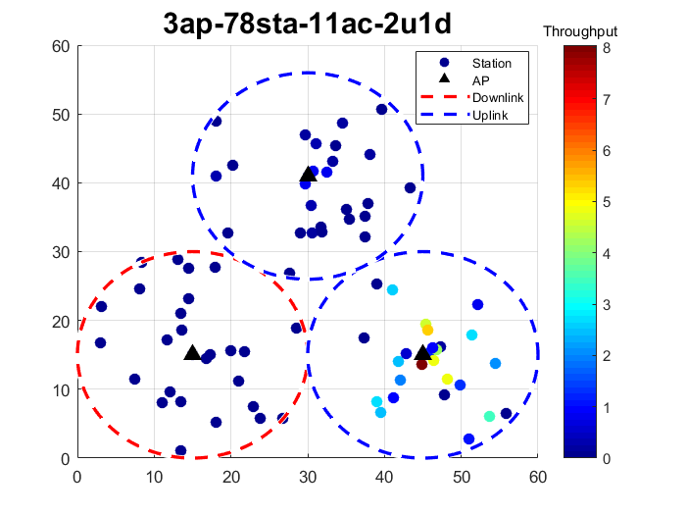
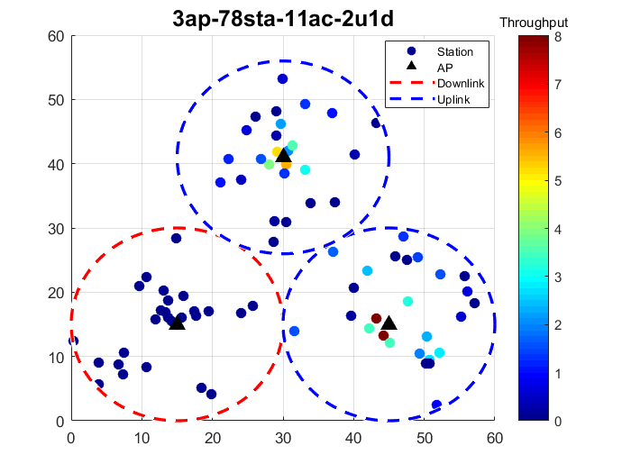
Throughput vs. Station Position (11ac)
Throughputs are dominated by some STAs
Closer to AP
Higher AC

Slide 11
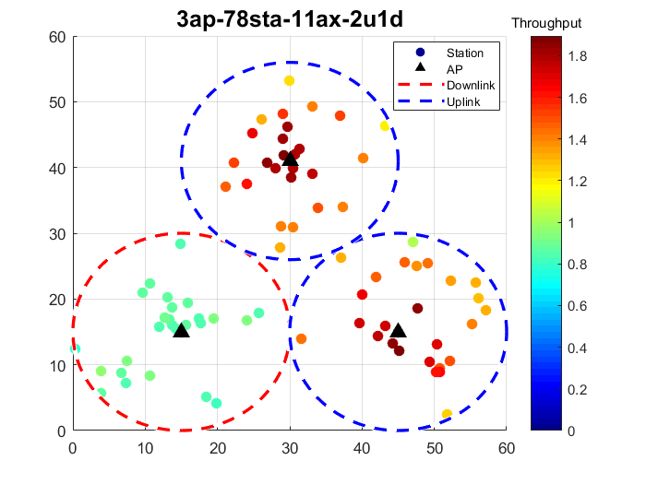
Throughput vs. Station Position (11ax)
Throughput among stations are more balanced than 11ac
Stations closer to AP have higher throughputs
UL BSSs have higher system throughputs than DL BSS

Slide 12
Uplink and Downlink Throughputs
For 11ac
UL throughputs are much higher than downlink throughput
AP has to contend with UL stations in nearby BSS
As the number of stations increases, AP has to contend with more stations
For 11ax
UL throughput and DL throughput are more balanced
UL traffic is triggered by AP
Contention happens among APs
UL Throughput is slightly higher than DL throughput
Based on the spec.[1], the contention window will not increase when there is no response to trigger frame
Sending trigger frame has lower backoff time and thus has higher chance to access the channel

Slide 13
Uplink and Downlink Ratio with different AC of AP
2u1d case
For 11ac
AP with higher priority AC has higher DL ratio to whole system throughput
If AP’s AC is BE and there are many UL STAs, the DL throughput is almost gone
For 11ax
Balanced throughputs in all cases
Higher Priority AC, lower downlink ratio
Collision among APs happens more frequently

Slide 14
System Throughput vs. RTS/CTS
RTS/CTS does help improve throughput in 11ac, but does not have strong impact on throughput in 11ax
11ac 78 STAs
11ax 78 STAs
██ RTS/CTS ON
██ RTS/CTS OFF

Slide 15
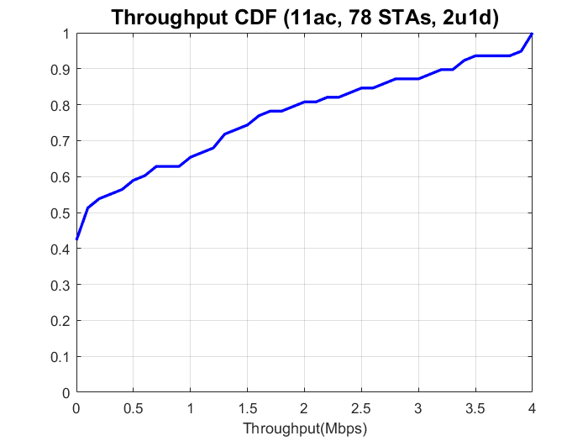
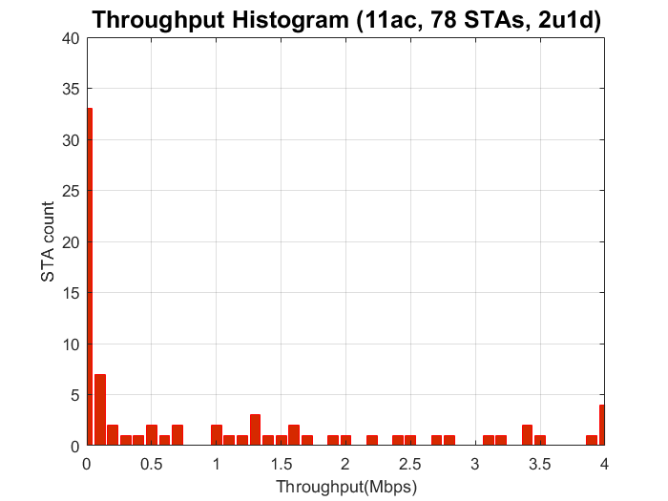
Data Analysis of 11ac (78 STAs, 2u1d)
Throughputs are dominated by some STAs
Similar behaviors are also observed in other 11ac scenarios
Throughputs are from some STAs
40% stations have very low throughputs

Slide 16
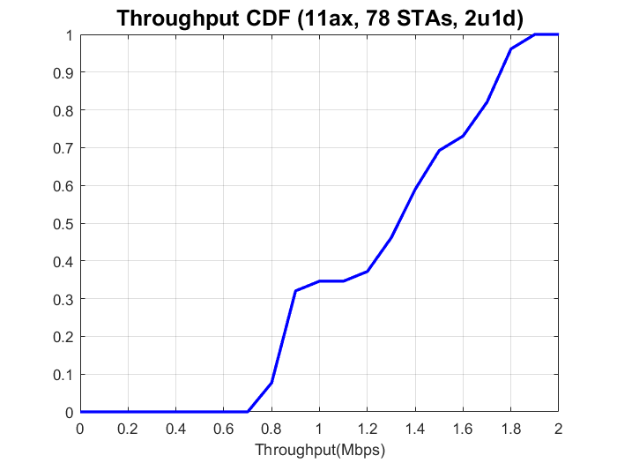
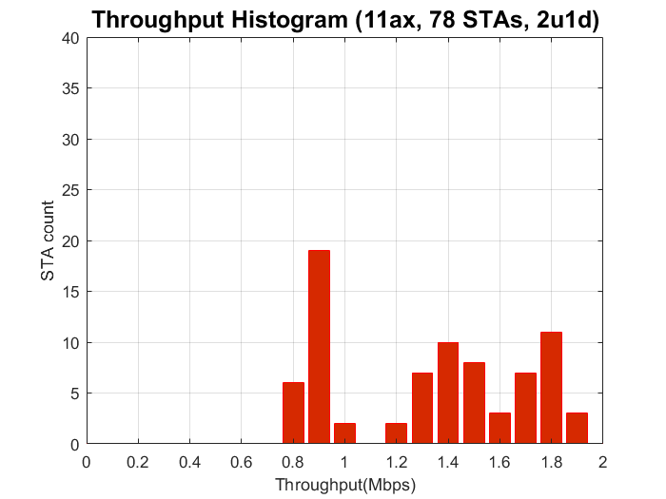
Data Analysis of 11ax (78 STAs, 2u1d)
STAs have more balanced throughputs
Small gap between uplink throughputs and downlink throughputs (AP needs to contend with other UL STAs)
Downlink
Much better 5% percentile
throughputs
Uplink

Slide 17
Discussion
System throughputs
In 11ac, some STAs dominates the system throughputs
In 11ac, RTS/CTS does help improve system throughputs when contention is serious
AP’s AC makes impact on DL throughputs
5% percentile throughputs in dense environments
Many STAs in 11ac are not able to transmit any data because they cannot access the channel
In dense environments, 11ax is able to provide more balanced throughputs
Contention only happens among APs
For both UL and DL, also much better 5% percentile throughputs

Slide 18
References
IEEE P802.11ax/D1.4, subclause 10.22.2.2

Slide 19
backup

Slide 20
System Throughputs (Mbps) RTS/CTS Disabled
39 STAs
78 STAs
156 STAs
 | 1u2d | 2u1d | 3u
11ac | 44.43 | 62.27 | 50.98
11ax | 102.50 | 105.30 | 111.07
Gain | 130.70% | 69.11% | 117.88%
 | 1u2d | 2u1d | 3u
11ac | 24.66 | 62.71 | 51.55
11ax | 96.60 | 104.69 | 116.35
Gain | 291.77% | 66.94% | 125.73%
 | 1u2d | 2u1d | 3u
11ac | 71.39 | 60.57 | 48.94
11ax | 87.61 | 102.18 | 117.02
Gain | 22.72% | 68.69% | 139.13%

Slide 21
Downlink Throughputs (Mbps) RTS/CTS Enabled
39 STAs
78 STAs
156 STAs
 | 1u2d | 2u1d
11ac | 32.01 | 5.80
11ax | 60.45 | 26.78
Gain | 88.86% | 361.51%
 | 1u2d | 2u1d
11ac | 24.64 | 1.11
11ax | 53.13 | 23.23
Gain | 115.62% | 1996.44%
 | 1u2d | 2u1d
11ac | 2.61 | 0.98
11ax | 46.44 | 19.60
Gain | 1682.76% | 1892.44%

Slide 22
Uplink Throughputs (Mbps) RTS/CTS Disabled
39 STAs
78 STAs
156 STAs
 | 1u2d | 2u1d | 3u
11ac | 12.42 | 56.47 | 50.98
11ax | 42.05 | 78.53 | 111.07
Gain | 238.55% | 39.06% | 117.88%
 | 1u2d | 2u1d | 3u
11ac | 0.02 | 61.60 | 51.55
11ax | 43.47 | 81.46 | 116.35
Gain | 258649.21% | 32.23% | 125.73%
 | 1u2d | 2u1d | 3u
11ac | 68.78 | 59.59 | 48.94
11ax | 41.17 | 82.58 | 117.02
Gain | -40.15% | 38.58% | 139.13%
Abnormal case, under investigation

Slide 23
Uplink and Downlink Ratio with different AC of AP
2u1d case

