Slide 1
Performance Evaluation of OOK Waveform Coding Schemes with Impairments
Date: 2017-07-10
Authors:

Slide 2
Abstract
In this contribution, we evaluate two waveform coding (WFC) schemes
Sequence-based on-off keying (OOK) and
Masking-based OOK
under carrier frequency offset (CFO), considering standalone, frequency domain multiplexing, and concurrent transmission with 11ax signal scenarios

Slide 3
Introduction
It has been agreed to use on-off keying (OOK) symbols for 802.11ba WUR payload [1]
Different OOK schemes with Manchester coding (WFC) are proposed for 802.11ba wake-up signal (WUS) payload [2-7]. For example,
Masking a fixed 11ac/n OFDM symbol [2,3,4]
Using sequences in frequency within 11ax OFDM symbol [7]
Using multiple 11ac/n OFDM symbol [5]
It is not trivial to determine which scheme is better for 802.11ba and other WLAN standards when different scenarios, such as frequency domain multiplexing, concurrent transmission (e.g., 11ax+11ba), or standalone operations (only 11ba) are considered
In this study, we compare masking-based OOK and sequence-based OOK under the impairment due to CFO

Slide 4
Masking-based WFC OOK Symbols
Masking-based WFC OOK Symbols are generated by applying a mask to a fixed OFDM symbol. For example, by using 11n OFDM numerology
A fixed sequence, e.g., [1 -1 1 1 1 1 0 1 -1 -1 1 1 -1] is first mapped around DC subcarrier
Time domain signal is generated via an IDFT operation of size of 64
After CP is prepended to OFDM symbol, the OFDM symbols is masked to generate Manchester coded OOK symbols
Since this method masks the OFDM symbol, the original sequence property in the frequency domain cannot be maintained and spreads across the frequency domain
4 $μ$s
CP
Mapping
IDFT
(64)
Masking for Logic 1
Logic 1 in time
Sequence
CP+
4 $μ$s
Masking for Logic 0
Data
Logic 0 in time

Slide 5
Sequence-based WFC OOK Symbols
In [1], we propose to generate the WFC OOK symbol(s) by designing sequences in frequency which remove masking operation
This method has three main benefits:
Perfect orthogonality between 802.11ax data and 802.11ba
Localized energy in the spectrum to increase coverage range of 11ba
Enables envelope detector based WURs and correlator-based WURs
An example with 3 OOK symbols are provided as below:
WFC OOK
sequence 1a (Logic 1)
Sequence 1a/1b affects the first 4 $μs$
WFC OOK
sequence 1b (Logic 0)
Sequence 2a/2b affects the second 4 $μs$
$$L$$
Sequence 3a/3b affects the third 4 $μs$
WFC OOK
sequence 2a (Logic 1)
Mapping
Amplitude
+
+
802.11ba
WFC OOK
sequence 2b (Logic 0)
$$L$$
$$L$$
IDFT
(256)
CP+
DAC
RF
$$0$$
$$T_{CP}$$
$$T_{OFDM}$$
time
WFC OOK
sequence 3a (Logic 1)
+
$T_{ook}$ (e.g., 4 $μs$)
WFC OOK
sequence 3b (Logic 0)
802.11ax
$f_{s}=20$ MHz
$12.8$ $μ$s
$$L$$
IDFT output

Slide 6
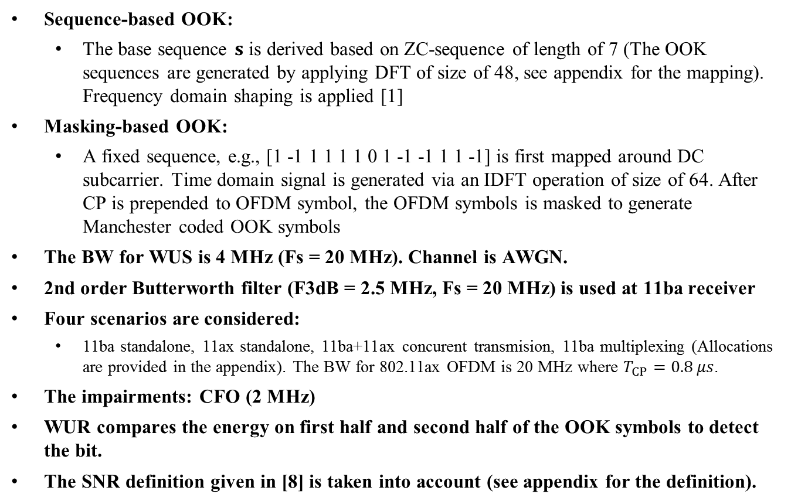
Simulation Assumptions
Sequence-based OOK:
The base sequence $s$ is derived based on ZC-sequence of length of 7 (The OOK sequences are generated by applying DFT of size of 48, see appendix for the mapping). Frequency domain shaping is applied [1]
Masking-based OOK:
A fixed sequence, e.g., [1 -1 1 1 1 1 0 1 -1 -1 1 1 -1] is first mapped around DC subcarrier. Time domain signal is generated via an IDFT operation of size of 64. After CP is prepended to OFDM symbol, the OFDM symbols is masked to generate Manchester coded OOK symbols
The BW for WUS is 4 MHz (Fs = 20 MHz). Channel is AWGN.
2nd order Butterworth filter (F3dB = 2.5 MHz, Fs = 20 MHz) is used at 11ba receiver
Four scenarios are considered:
11ba standalone, 11ax standalone, 11ba+11ax concurent transmision, 11ba multiplexing (Allocations are provided in the appendix). The BW for 802.11ax OFDM is 20 MHz where $T_{CP}=0.8 μs$.
The impairments: CFO (2 MHz)
WUR compares the energy on first half and second half of the OOK symbols to detect the bit.
The SNR definition given in [8] is taken into account (see appendix for the definition).

Slide 7
Spectral Analysis
Standalone
11ax+11ba concurrent transmission
Frequency multiplexing
Sequence-based OOK symbols are more confined than masking-based OOK symbols. This means less ACI in the case of concurrent and frequency domain multiplexing scenarios

Slide 8
BER Performance (Standalone)
Since sequence-based OOK symbols yield better accumulation after WUR filter, it yields slightly superior performance as compared to masking-based OOK symbols
CFO degrades both of schemes by 1.5 dB for standalone case

Slide 9
BER Performance (11ax-11ba Concurrent Transmission)
11ba performance
11ax performance
ACI due to
11ba
CFO
3 dB
Using 2nd order Butterworth filter causes negligible BER degradation in the case of concurrent transmission for both masking and sequence-based OOK symbols
CFO causes more degradation to 11ba BER performance in the case of concurrent transmission as compared to that of 11ba standalone scenario
While sequence-based OOK symbol do not cause interference to 11ax STAs, masking-based OOK symbols causes significant interference to 11ax STA

Slide 10
BER Performance (11ba Multiplexing in Frequency)
The interference due to WUSs in frequency is milder than that of concurrent transmission due to the increased separation between the WUS signals in frequency (see the allocation given in appendix)
Since the sequence-based OOK symbols are confined in frequency, they causes less interference to each other. It yields 2 dB gain as compared masking-based OOK symbols when there is CFO

Slide 11
Conclusions
Numerical analysis shows that
While the sequence-based OOK symbols enable concurrent transmission without interference to 11ax STAs, the masking-based OOK symbols cause more than 3 dB degradation to 11ax STAs at 1e-2 BER
Since the sequence-based OOK symbols are localized in frequency, enabling WUR is able to capture more OOK symbol energy.
This provides a slight improvement as compared masking-based method in standalone scenarios
When WUS are multiplexed in frequency domain, the sequence-based OOK symbols yield a 2 dB gain as compared to the masking-based OOK symbols when there is CFO in the case of
CFO causes more BER degradation in the case of concurrent transmission as compared to that of 11ba standalone scenario

Slide 12
References
[1] Shahrnaz Azizi et al., Intel, “Motion for the High Level PHY Design”, IEEE 802.11-17/0368r1, Mar. 2017
[2] Justin Jia Jia et al., Huawei, “Performance Investigations on Single-carrier and Multiple-carrier-based WUR”, IEEE 802.11-17/0373r1, Mar. 2017
[3] Junghoon Suh et al., Huawei, “Waveform Generation for Waveform Coding”, IEEE 802.11-17/0376r0, Mar. 2017
[4] Eunsung Park et al,. LG, “Various Symbol Types for WUR”, IEEE 802.11-17/0350r0, Mar. 2017
[5] Steve Shellhammer, Qualcomm, “WUR Modulation and Coding”, IEEE 802.11-17/0366r0, Mar. 2017
[7] Alphan Sahin et al., Interdigital, “On the Coexistence of 802.11ax and 802.11ba Signals”, IEEE 802.11-17/0659r1, Mar. 2017
[8] Shahrnaz Azizi, Intel, “IEEE 802.11 TGba Simulation Scenarios and Evaluation Methodology Document”, IEEE 802.11-17/0188r05, Jan. 2017

Slide 13
Appendix

Slide 14
Appendix - DFT Input Mapping for OOK Symbol with Manchester Coding
DFT Input Index
1
2
8
9
15
16
17
23
24
30
31
32
38
39
45
46
48
Symbol 1 = 0
0
S
0
0
0
0
0
0
0
0
1
2
8
9
15
16
17
23
24
30
31
32
38
39
45
46
48
Symbol 1 = 0
0
0
S
0
0
0
0
0
0
0
1
2
8
9
15
16
17
23
24
30
31
32
38
39
45
46
48
Symbol 1 = 0
0
0
0
0
S
0
0
0
0
0
1
2
8
9
15
16
17
23
24
30
31
32
38
39
45
46
48
Symbol 1 = 0
0
0
0
0
0
S
0
0
0
0
1
2
8
9
15
16
17
23
24
30
31
32
38
39
45
46
48
Symbol 1 = 0
0
0
0
0
0
0
0
S
0
0
1
2
8
9
15
16
17
23
24
30
31
32
38
39
45
46
48
Symbol 1 = 0
0
0
0
0
0
0
0
0
S
0

Slide 15
Appendix - Allocation
3.75 MHz (48 tones)
0
-1
Standalone
11ax:
RU1
RU2
RU3
RU7
RU8
RU9
-96
-4
-95
-70
-68
-43
-16
-121
-42
-17
4
16
43
68
70
95
17
42
96
121
$$f$$
Standalone
11ba:
-34
33
$$f$$
11ba multiplexing:
-83
82
83
$$f$$
-116
-82
-49
-34
33
49
116
11ba+11ax concurrent transmission:
RU1
RU2
RU3
RU7
RU8
RU9
-96
-34
33
-95
-70
-68
-43
-121
-42
43
68
70
95
42
96
121
$$f$$

Slide 16
Appendix – SNR Definition
3 dB
SNR: 20 dB
In [2], SNR is defined as “SNR over 20 MHz, means SNR = E[s^2] / E[n^2], where the expectation is sampling is done at 20 MHz samples”
The figure shows the temporal characteristics of sequence-based OOK symbols at 20 dB SNR.
It has also been agreed to consider full OOK symbol duration for signal power calculation

