Slide 1
AP Power Saving
Date: 2017-05-08
Authors:

Slide 2
Abstract
In this contribution, we provide simulation results of AP power saving and discuss the benefits of AP power saving.

Slide 3
Introduction
Multiple usage scenarios have been proposed that involve mobile[1]
UM 3: Cattle farm
UM 5 & 6: Wearable devices
Power consumption is a very important issue for mobile AP
Mobile APs could be cell phones or ad hoc deployed devices operating on batteries without power plugs
Power saving prolongs network lifetime; improves user experience
Other benefits: regulatory, interference, security, etc.
In this contribution, we provide simulation results on power savings for AP based on a number of scenarios
AP power saving with varying duty cycles for AP’s PCR

Slide 4
AP Power Saving Scenarios (1)
Scenario 1: AP’s PCR is always on, i.e., duty cycle 1
PCR beacons: BI: 100 ms Size: 100 bytes TX MCS: 1 Mbps/6.5 Mbps
WUR beacons: BI: 10s TX duration: 144 us [2]
UL data only;
STA behavior: transmit data to AP directly when data arrives; No need for UL WUR packet from STA to AP
AP power consumption is simulated

Slide 5
AP Power Saving Scenarios (2)
Scenario 2: AP’s PCR is on duty cycle 1/2
PCR beacons: BI: 100 ms Size: 100 bytes TX MCS: 1 Mbps/6.5 Mbps
WUR beacons: BI: 10s TX duration: 144 us [2]
AP’s PCR duty cycle: of ½; UL data only;
STA behavior: STA transmits PCR packet directly when AP is awake. Otherwise STA sends WUP to AP followed by PCR packet exch.
AP’s WUR is always on except when PCR is on
AP power consumption is simulated

Slide 6
AP Power Saving Scenarios (3)
Scenario 3: AP’s PCR is on duty cycle 1/4
PCR beacons: BI: 100 ms Size: 100 bytes TX MCS: 1 Mbps/6.5 Mbps
WUR beacons: BI: 10s TX duration: 144 us [2]
AP’s PCR duty cycle: of 1/4; UL data only;
STA behavior: STA transmits PCR packet directly when AP is awake. Otherwise STA sends WUP to AP followed by PCR packet exch.
AP’s WUR is always on except when PCR is on
AP power consumption is simulated

Slide 7
AP Power Saving Scenarios (4)
Scenario 4: AP’s PCR is always off except when being woken up or sending beacons
PCR beacons: BI: 100 ms Size: 100 bytes TX MCS: 1 Mbps/6.5 Mbps
WUR beacons: BI: 10s TX duration: 144 us [2]
AP’s PCR is off except when: 1)Transmitting beacon; 2)When woken up by a STA; AP’s WUR is always on except when PCR is on
STA behavior: When having data, always send a WUP to wake up AP before continuing on with PCR packet exchanges

Slide 8
Simulation Assumptions (1/2)
Matlab Simulations
Simulation time: 100s
Usage Model 3: Cattle farm:
1 farmer (Mobile AP)
30/50 cows (STAs)
Traffic Assumptions:
UL data only
Packet arrival interval per STA: [5:5:50] s
Packet size: 32 bytes
AP PCR Duty cycle:
[1, ½, 1/4, 0]
AP Power Consumptions simulated

Slide 9
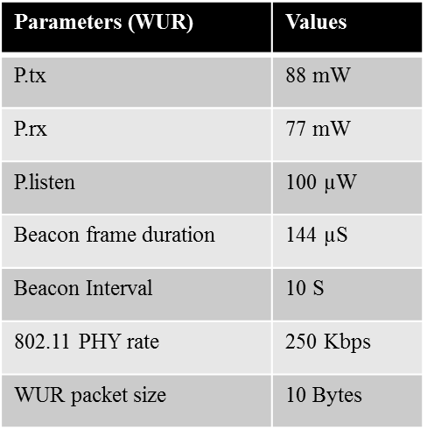
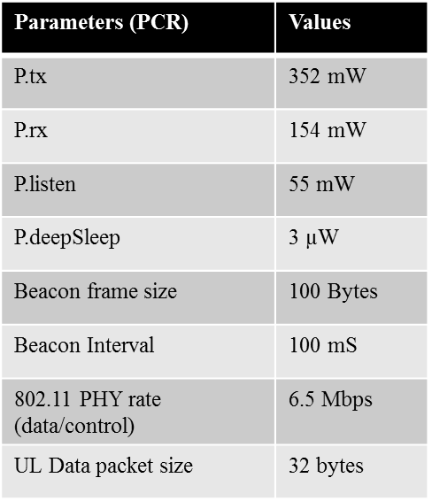
Simulation Assumptions (2/2)

Slide 10
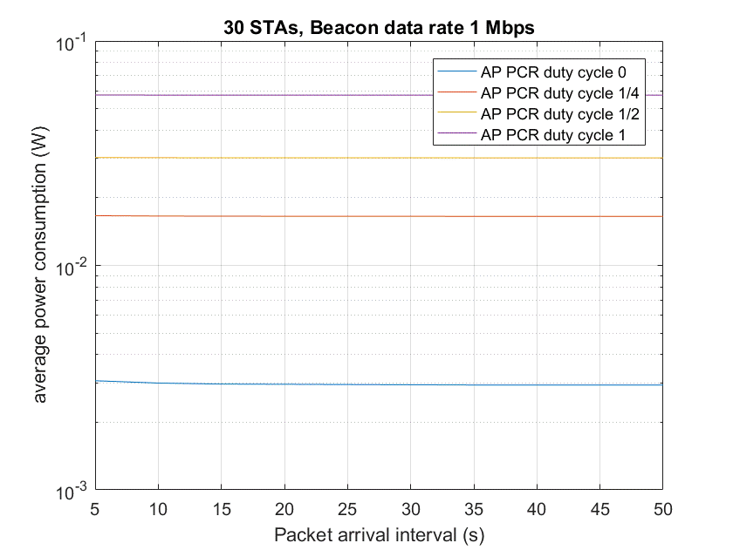
Simulation Results (1/4)

Slide 11
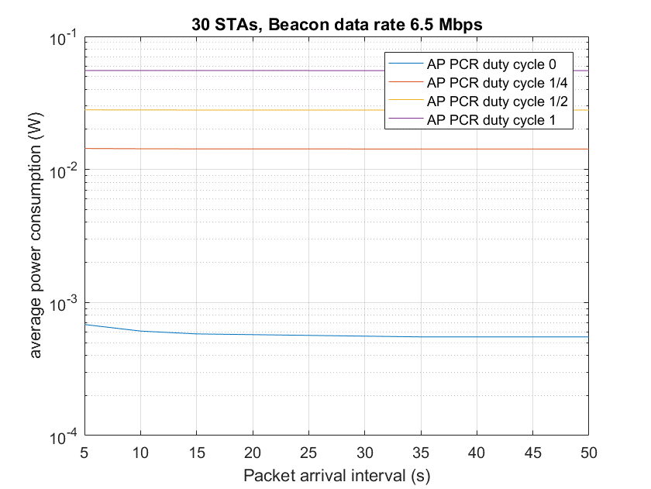
Simulation Results (2/4)

Slide 12
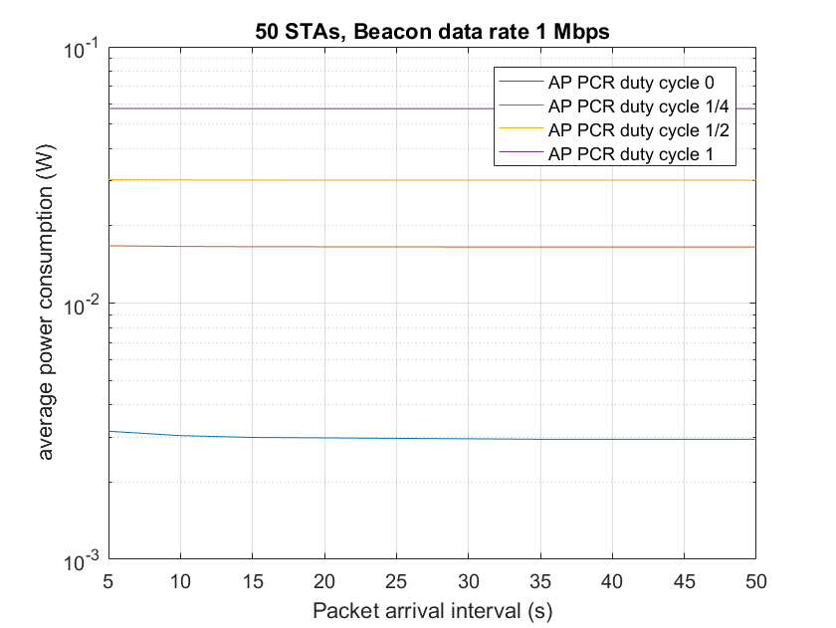
Simulation Results (3/4)

Slide 13
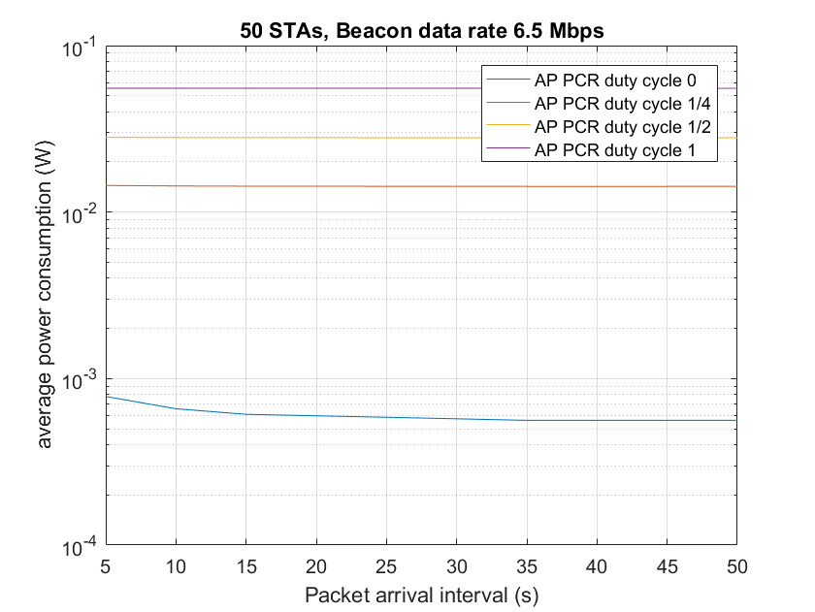
Simulation Results (4/4)

Slide 14
Observations
Impact by AP’s PCR Duty Cycle
In all scenarios with DC < 1, significant power saving is achieved
When AP’s PCR’s DC = ½, AP’s power consumption is slightly higher than 50% of that when AP’s PCR’s DC = 1
When AP’s PCR’s DC = 1/4, AP’s power consumption is slightly higher than 25% of that when AP’s PCR’s DC = 1
When AP’s PCR’s DC = 0, AP’s power consumption is around 1.2% - 5.2% (depending on PCR beacon rate) of that when AP’s PCR’s DC = 1
Impact by Packet Arrival Rate
Small impact when packet arrival interval increase 5 -> 50s except when DC = 0
Impact by Number of STAs
No significant impact when the number of STAs is increased from 30 to 50
Impact by PCR Beacon Tx Rate
Only significant when AP PCR DC = 0

Slide 15
When is AP Power Saving Desirable
When aggregated traffic in the entire network is low
It is suitable for some number of IoT usage models and scenarios
However, power saving and network lifetime may be critical in these scenarios
Wake up AP procedure may enable low latency while maintaining low power consumptions
Latency can also be critical for some of the IoT scenarios where power saving is critical as well
It may not be appropriate if:
A large number of active STAs present in the BSS
Traffic load is heavy in the BSS

Slide 16
Technical changes needed for AP Power
An AP power saving mode:
Only when scenario is appropriate
E.g., AP delivered together with a cattle monitoring sensor network
Only when all STAs associated with it are capable of handling AP power saving
Indicated by capability
An AP power saving mode with these restrictions should not violate the PAR
Cost, e.g.:
A low-cost WUR receiver at AP
Procedure for going into power saving for APs of which all associated STAs have indicated of capable of handling AP Power Saving
A wake up procedure for AP
AP Discovery process

Slide 17
Conclusions
An AP Power Save feature may enable critical functionalities for some IoT scenarios
Allow long period of low power operation of its BSS while maintaining low latency for APs that are operated on battery power
Simulation shows that AP power save provides significant energy saving benefits even with PCR DC = ½. With DC = 0, AP’s consumption could be as low as 1.2% of that when DC = 0
802.11ba should consider to optionally put 11ba APs to power saving mode when a certain set of restrictions are met

Slide 18
References
[1] 11-17/0029r5, WUR Usage Model Document, Mar. 2017
[2] 11-17/0343r3, WUR Beacon, Mar. 2017
[3] 11-17/0124r1, WUR MAC and Wakeup Frame, Jan. 2017
[4] 11-16/1400r0, Power Efficient WUR AP Discovery, Nov. 2016
[5] 11-16/0029r4, WUR Usage Model Document, Jan. 2017

Slide 19
Straw Poll
Do you agree to add to the 802.11ba SFD
“802.11ba shall consider an option for AP to go into power saving mode by turning off its PCR when certain criteria are met.”

