Slide 1
Impact of reciprocal mixing on WUR performance
Date: 2017-03-13
Authors:

Slide 2
Abstract
The importance of modeling the trade-off between power consumption and phase noise power was highlighted in [1]
Noisy oscillators may cause WUR performance degradations due to reciprocal mixing
This presentation introduces a simple analytical model to evaluate the impact of reciprocal mixing on WUR performance

Slide 3
Outline
Recap of proposed phase noise models [1]
Degradation due reciprocal mixing
Modeling reciprocal mixing
Simple model to evaluate the impact of reciprocal mixing on WUR performance
Numerical examples
Conclusions

Slide 4
Recap
The phase noise (PN) model should take into account power consumption [1]
There is a trade-off: Lowering the power consumption in the LO increases the PN power [1]
For very low power oscillators, reciprocal mixing (RM) may be non-negligible
RM may potentially degrade the WUR performance whenever a strong adjacent interferer is present

Slide 5
Impact of RM
The problem caused by RM is illustrated in the following figure

Slide 6
Modeling RM
A simple analytical model is obtained by assuming that the phase noise consists of a single spur with a power calculated by integrating the PSD of the PN over the bandwidth of the adjacent channel

Slide 7
Modeling RM
At frequency offsets of the order of the channel separation (e.g. 25 MHz), the PSD $L$of PN may be approximated [1] by $L\left(f_{m}\right)=\frac{7.33kT}{P_{min}}{\left(\frac{f_{LO}}{f_{m}}\right)}^{2}$, where
$P_{min}$: minimum power dissipation
$f_{LO}$: LO frequency
$f_{m}$: offset frequency
$k$: Boltzmann constant
$T$: temperature
Assuming the adjacent channel bandwidth to be $δf_{adj}$ [Hz] and the channel separation $∆f_{adj}\text{[}\text{Hz}\text{]}$, the PN power over the adjacent channel is
$$P_{PN}=\int_{∆f_{adj}− \frac{δf_{adj}}{2}}^{∆f_{adj}+ \frac{δf_{adj}}{2}}{L\left(f_{m}\right)df_{m}=\frac{7.33kTf_{LO}^{2}}{P_{min}}\left(\frac{1}{∆f_{adj}−\frac{δf_{adj}}{2}}−\frac{1}{∆f_{adj}+\frac{δf_{adj}}{2}}\right)}$$

Slide 8
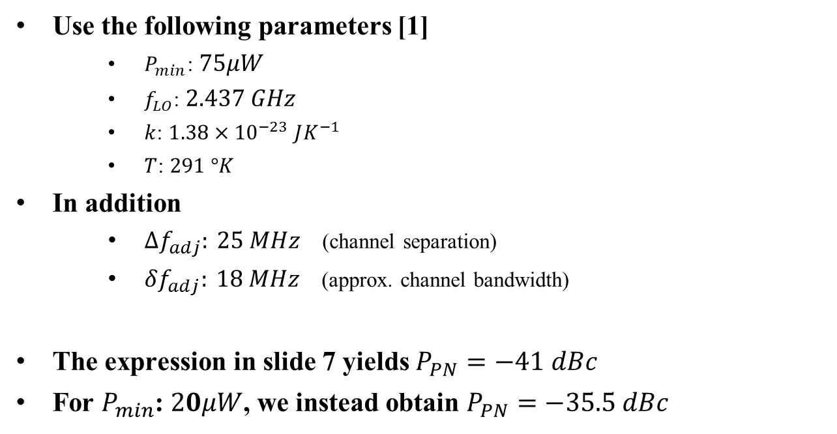
Numerical examples
Use the following parameters [1]
$P_{min}$: $75μW$
$f_{LO}$: $2.437 GHz$
$k$: $1.38{×10}^{−23}$ $JK^{−1}$
$T$: $291 °K$
In addition
$∆f_{adj}: 25 MHz$ (channel separation)
$δf_{adj}: 18 MHz$ (approx. channel bandwidth)
The expression in slide 7 yields $P_{PN}=−41 dBc$
For $P_{min}$: $20μW$, we instead obtain $P_{PN}=−35.5 dBc$

Slide 9
Evaluating impact of RM
The interference caused by RM can now be approximated as
$${\left(\frac{C}{I_{RM}}\right)}_{WUR}={\left(\frac{C}{I_{adj}}\right)}_{ant}−P_{PN}$$
Where
${\left(\frac{C}{I_{RM}}\right)}_{WUR}$= C/I at the WUR detector
${\left(\frac{C}{I_{adj}}\right)}_{ant}$= C/I at the antenna
This is conservative and simplified. The BPF would e.g. typically be < 20 MHz, reducing the RM interference

Slide 10
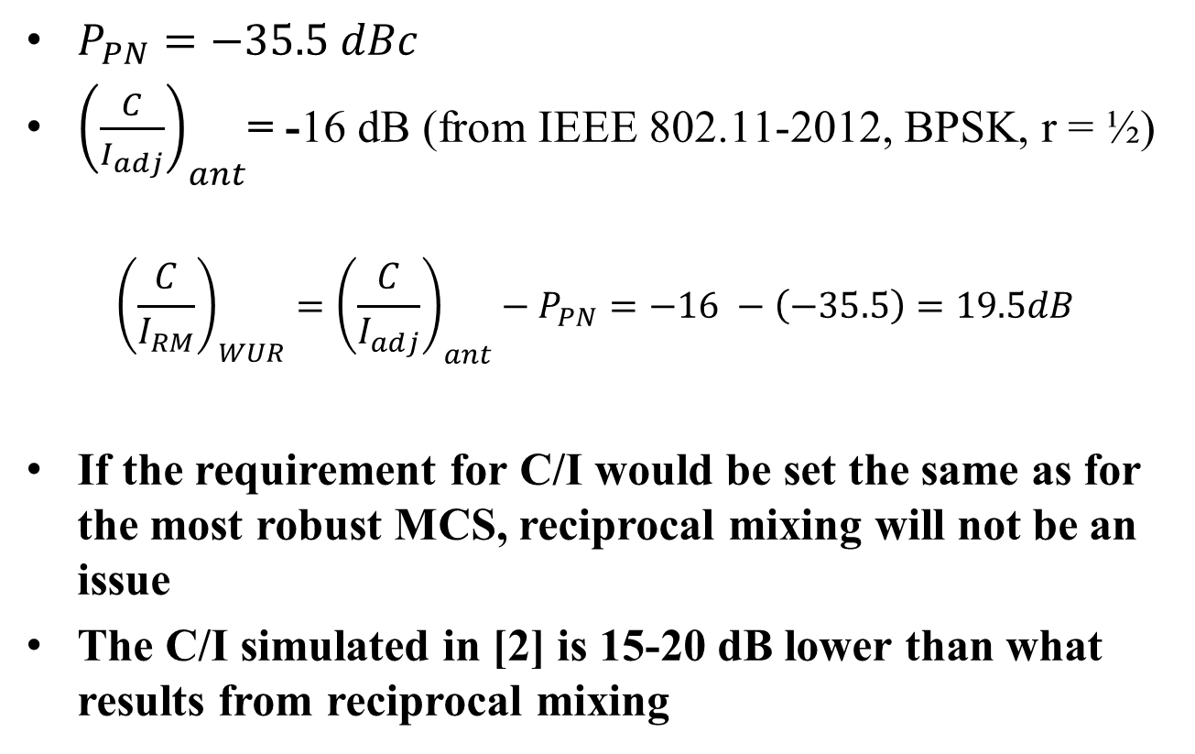
Numerical example
$P_{PN}=−35.5 dBc$
${\left(\frac{C}{I_{adj}}\right)}_{ant}$= -16 dB (from IEEE 802.11-2012, BPSK, r = ½)
$${\left(\frac{C}{I_{RM}}\right)}_{WUR}={\left(\frac{C}{I_{adj}}\right)}_{ant}−P_{PN}=−16 −\left(−35.5\right)=19.5dB$$
If the requirement for C/I would be set the same as for the most robust MCS, reciprocal mixing will not be an issue
The C/I simulated in [2] is 15-20 dB lower than what results from reciprocal mixing

Slide 11
Discussion
With a WUR sensitivity similar to MCS0, it seems to make sense to require also similar ACI performance
If this is assumed, reciprocal mixing will not be an issue. (Essentially, other problems will appear earlier)
Normally phase noise is important to include when coherent reception is used, and in particular when operating at high SNR. If OOK is used this does not seem necessary
We believe is it not necessary to include phase noise for performance evaluation

Slide 12
Straw Poll
Do you agree with the use of the model in slides 7-8 (with possible correction factors to include e.g. BW of filters before the detector ) to evaluate the impact of reciprocal mixing on WUR?
Y/N/A: X/Y/Z

Slide 13
References
M. Park et al., “WUR Phase Noise Model Study,” IEEE 802.11-17/0026r0.
L. Wilhelmsson and M. Lopez, “Concurrent transmission of data and a wake-up signal in 802.11ax ,” IEEE 802.11-17/0094r1.

