Slide 1
Concurrent transmission of data and a wake-up signal in 802.11ax – Follow-up
Date: 2017-03-13
Authors:

Slide 2
Abstract
In [1] the possibility of concurrently transmitting data and a wake-up signal(WUS) using OFDMA was discussed
The feasibility was addressed by means of simulations assuming
perfect time synchronization
“ideal” decision threshold
ax user data was sent using QPSK
power boosting by increasing psd in a single RU
In this follow-up presentation, the concerns expressed in relation to the above assumptions are addressed

Slide 3
Outline
Recap of results presented in January
Updated model for receiver processing
Addressing comments and concerns regarding
Power boosting by incresing the BW of the WUS
Modulation format used for 11ax data
Time synchronization
DC (Threshold) estimation
Brief discussion of filtering before the env. detector
Conclusions

Slide 4
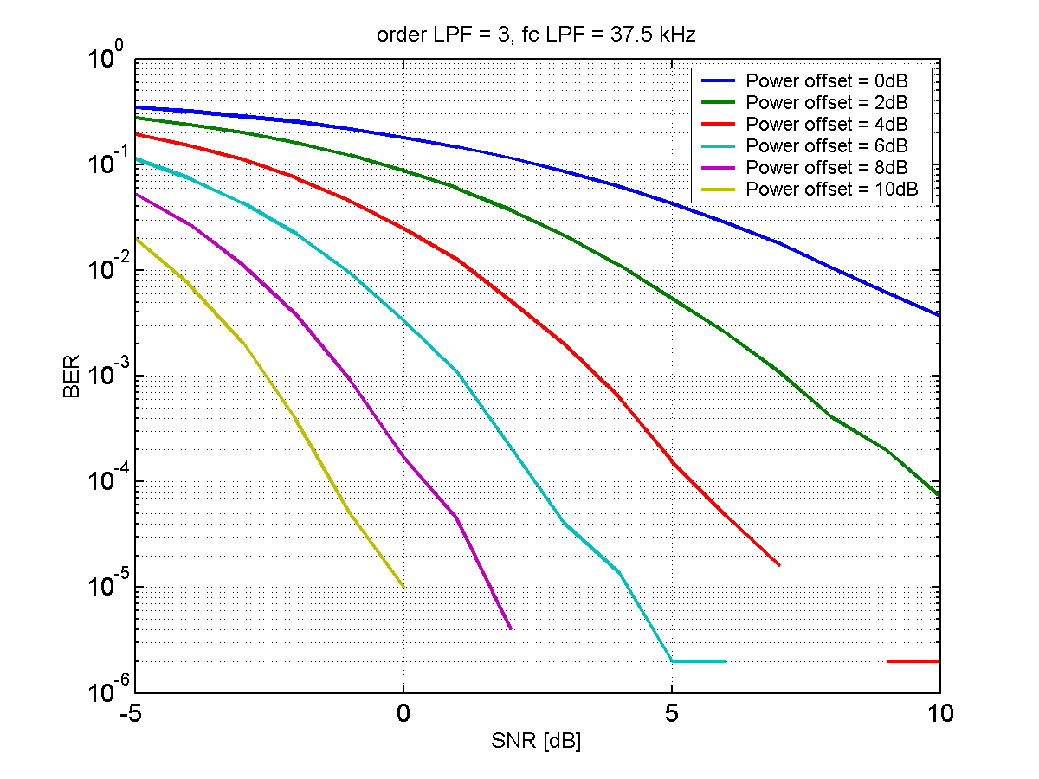
Recap from January
1
2
3
4
5
7
8
9
WUS
frequency
Envelope detector
|
.
|
LPF
DC blocker
WUS transmitted in one RU, user data in the remaining ones. Possibly power boosted. Data QPSK
Some power boost seems required to obtain good enough performance…

Slide 5
Updated model for receiver processing
-
Env. Det.
ADC
4
correlator
|
.
|
LPF
DC blocker moved from analog to digital
ADC runs at 4x oversampling relative WUS symbol rate
Correlator (coeff. +-1) operating on signal with DC bias
DC (decision threshold for OOK) estimated when timing is found (using knowledge of syncword)
DC subtracted and final down-sampling performed

Slide 6
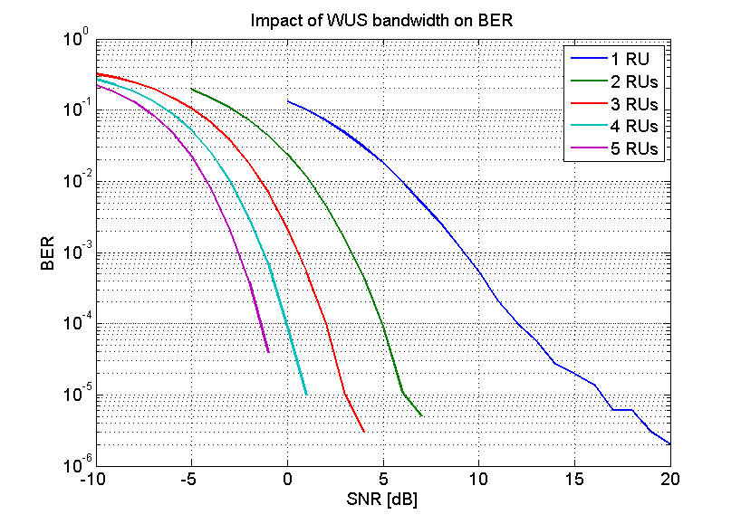
Power boosting (everything else ideal)
4 RU
2 RU
1
2
3
4
5
6
7
8
4
9
WUS
1 RU
3 RU
5 RU
Instead of increasing the psd, the power of the WUS is boosted by allocating more RUs to the WUS
First RU is 33 sub-carriers, the other are 26 sub-carriers

Slide 7
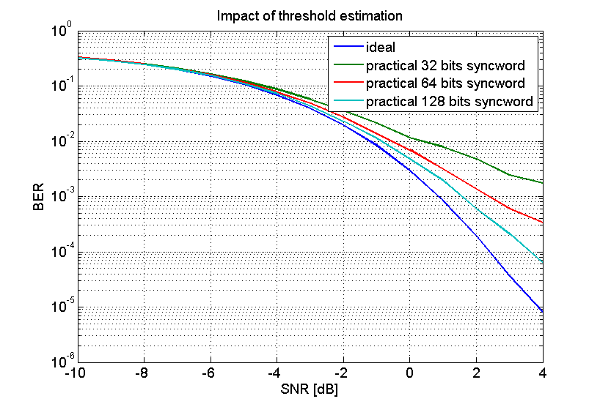
Time and threshold estimation (3RUs)
A new random syncword picked every packet => results overly conservative
Timing estimation no issue in region of interest
Degradation entirely caused by poor DC estimation
Several ways to improve this. Manchester coding perhaps the simplest…

Slide 8
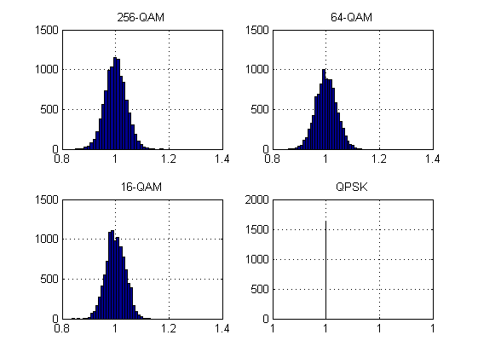
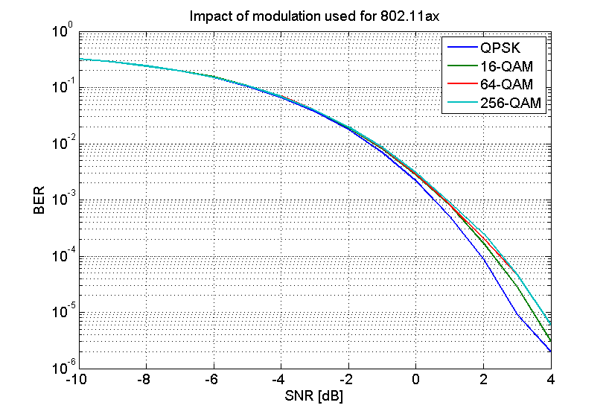
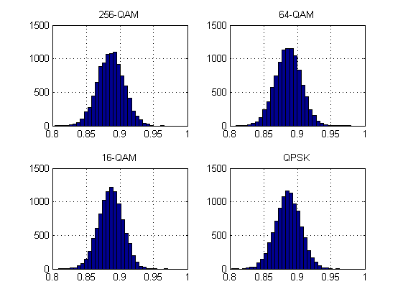
Impact of modulation used for 11ax
Average power
distribution
Average amplitude
distribution
Although the power variations on individual sub-carriers is large with large modulation alphabet, the average amplitude variation between symbols is small
The LPF effectively results in that the average is what matters. Very little impact on performance

Slide 9
Discussion of also having a BPF
-
BPF
Env. Det.
ADC
4
correlator
|
.
|
LPF
The reason for not including a BPF in the simulations was that for this to be effective, the concept of an uncertain IF architecture is not really applicable
Relaxed requirements on the LO is assumed highly desirable to obtain really low power consumption
The impact of a “small” uncertainty is discussed next

Slide 10
Impact of using a bandpass filter
BPF
1
2
3
4
5
6
7
8
4
9
WUS
Guard band
With a BPF, the amplitude variations due to data is removed or at least reduced, but filtering is not for free
Suppose the LO has an uncertainty of +-1 RU = 2 MHz
The BPF must then be 3 RU wide to ensure the WUS is in the pass band of the BPF
To ensure that no data falls in the 3 RU wide BPF, data cannot be sent in the 5 central RUs, and we may as well send a 5RU wide WUS…

Slide 11
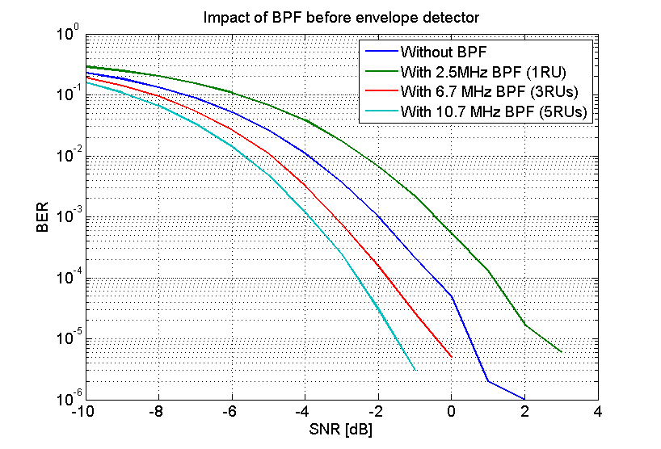
Impact of using a bandpass filter
Assuming a frequency uncertainty of 1 RU, we thus use 5 RU for sending the WUS
The performance obtained with various filter bandwidths are shown above and compared to not using a BPF at all
The gain is surprisingly(?) small

Slide 12
Conclusions
Multiplexing a wake-up signal with user data for 802.11ax using OFDMA was discussed and shown to be a feasible way to support a WUR in a efficient and flexible way
The number of RUs allocated to the WUS may be selected based sensitivity requirements, from only one RU to using the full bandwidth for the WUS
The approach allows for various architectures, including an uncertain IF without the need for a BPF

Slide 13
Straw Poll
Do you support that the wake-up signal may be transmitted using different bandwidths depending on e.g. sensitivity requirements for the WuRX?
Y/N/A: 0/0/0

Slide 14
References
L. Wilhelmsson and M. Lopez, “Concurrent transmission of data and a wake-up signal in 802.11ax ,” IEEE 802.11-17/0094r1.
L. Wilhelmsson and M. Lopez, “Discussion of a Wake-Up Receiver Front-End Model,” IEEE 802.11-17/0093r0.

