Slide 1
Concurrent transmission of data and a wake-up signal in 802.11ax
Date: 2017-01-15
Authors:

Slide 2
Abstract
One concern with supporting WURs is that the transmission of the wake-up signal(WUS) may severely impact the system capacity if the channel is used for the wake-up signal instead of data
In [1], the possibility to send the WUS using a few guard carriers in 802.11 was discussed
With the introduction of OFDMA in 802.11 ax, it is possible to multiplex the WUS with the data by using one or more RUs
This contribution addresses the feasibility of such an approach by evaluating the performance for the WUR

Slide 3
Outline
Motivation
Joint transmission of the WUS and data in 802.11ax
Reception of the WUS
Simulation Results
Conclusions

Slide 4
Motivation
One concern with supporting WURs is that the transmission of the wake-up signal(WUS) may severely impact the system capacity
We therefore consider the feasibility of concurrent transmission of the WUS and data using OFDMA
As this will decrease the performance for the WUR, we estimate by how much under different assumptions

Slide 5
Joint transmission of a WUS and data
1
2
3
4
5
7
8
9
WUS
frequency
time
The WUS is generated using OOK (similar to [2]) and is sent using an (arbitrary) RU, RU6 in the figure above
The WUS is assumed not to be longer than the data, and thus the WUS is protected in similar way as proposed in [2]
Since the WUS is generated using the IFFT, it will not interfere with the data demodulated using a FFT
L-STF
L-LTF
L-SIG
WUS + data

Slide 6
Reception of the WUS
Envelope detector
|
.
1
2
3
4
5
7
8
9
|
LPF
DC blocker
WUS
Since the WUS cannot be filtered out before the envelope detector, both data and the WUS are input to the envelope detector
Essentially, since RU6 is modulated using OOK, the full 20 MHz can be seen as being amplitude modulated at the OFDMA symbol rate

Slide 7
Reception of the WUS
Power boost
1
2
3
4
5
7
8
9
WUS
To improve the performance of the WUR, we also investigate the impact of giving the WUS a power boost
This is here done increasing the psd
In practice, due to regulatory restrictions on spectrum flatness, it may instead be achieved by allocating more RUs to the WUS
The simulations are done with the WuRX model in [3]

Slide 8
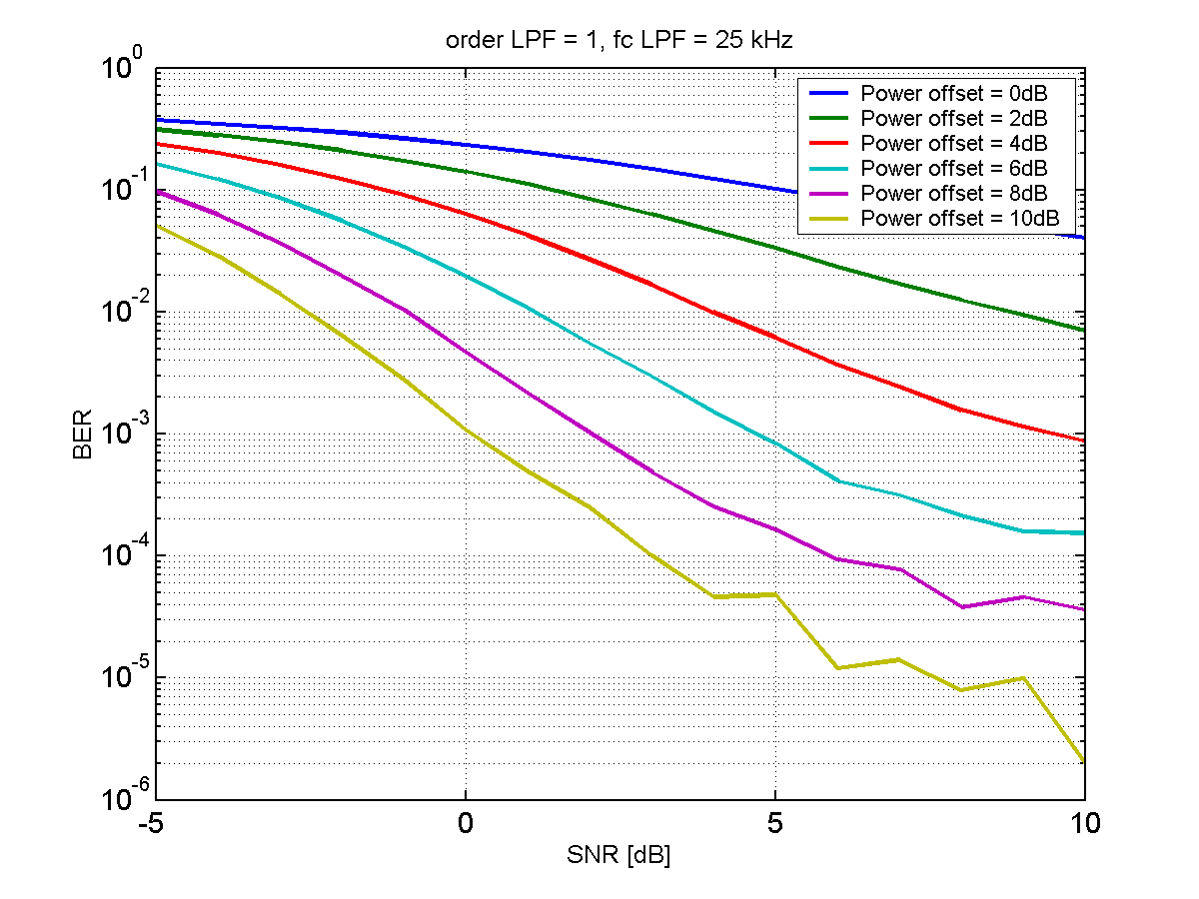
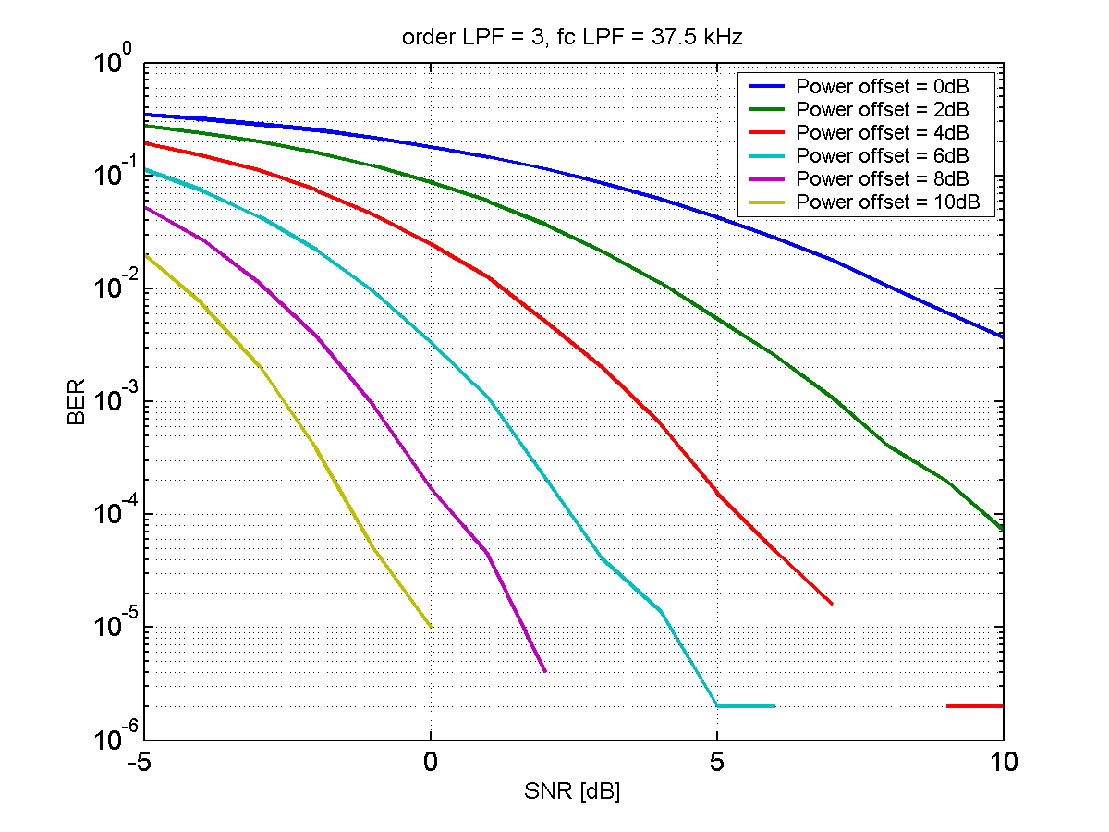
Simulation Results
Concurrent transmission will have worse sensitivity, but if the WUR is not on the edge of coverage it can still work
For good channel conditions, it may even work without power boost
For too bad conditions, one can send only the WUS…

Slide 9
Conclusions
The feasibility of spectrum efficient support of WUR in 802.11ax was addressed
The basic idea is to use OFDMA to transmit the WUS in one or more RUs, concurrent with data in the other RUs
Simulation results show that it in many cases is feasible to demodulate the WUS although the data is not filtered out before the envelope detector
There is a loss in sensitivity performance, but this is known, and can to some extent be controlled by boosting the WUS

Slide 10
Straw Poll
Do you believe the idea is interesting enough so that we should try to include support for concurrent data and WUS transmission in the 802.11ba work?
Y/N/A:

Slide 11
References
M. Lopez and L. Wilhelmsson, “Efficient support of WUR in IEEE 802.11,” Globecom 2016.
M. Park et al., “LP-WUR (Low-Power Wake-Up Receiver) follow-up,” IEEE 802.11-16/0341r0.
L. Wilhelmsson and M. Lopez, “Discussion of a Wake-Up Receiver Front-End Model,” IEEE 802.11-17/0093r0.

