Slide 1
Initial Negotiation for WUR
Date: 16/01/2017
Authors:
Name | Affiliations | Address | Phone | Email
Igor Kim | ETRI | Korea | +82-42-860-5525 | ikim@etri.re.kr
Sunghyun Hwang | ETRI | Korea | +82-42-860-1133 | shwang@etri.re.kr
Seungkeun Park | ETRI | Korea | +82-42-860-5993 | seungkp@etri.re.kr

Slide 2
Introduction
Problem statement
AP and STA have to notify each other about their WUR capability
AP and STA have to negotiate WUR parameters of their WU association
This contribution describes the initial negotiation procedures for WUR

Slide 3
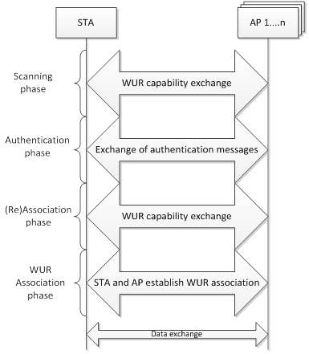
General Flow of Initial Attachment to AP
WUR capability can be notified at scanning phase using
Beacons (passive scanning)
Probe request/response (active scanning)
Such notification from AP may facilitate AP selection process for STA

Slide 4
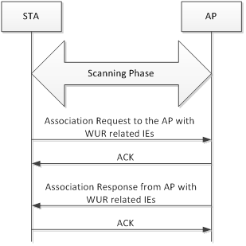
Capability Exchange at Association Phase
WUR capability may also be exchanged during association phase through Association Request/Response
Both STA and AP can notify each other that WU association is possible
Knowing STA is WUR capable may help AP to decide whether accept the STA’s request

Slide 5
Example of Capability Information
Supported bands
Information of the supported frequency bands for WUR operation (in-band, out-of-band, 2.4 GHz, 5GHz, etc.)
WUR ACK
Specifies if ACK protocol is supported by WUR signaling
Duty-cycled WUR
Specifies if duty-cycled WUR operation is supported
QoS mode
Specifies if EDCA is supported for WU frames and corresponding ACK frames
Etc.

Slide 6
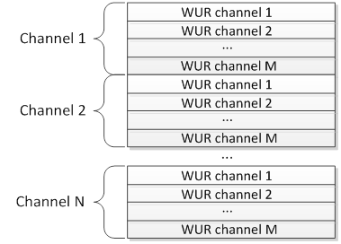
Example of WUR Supported Channels Information
AP may include supported channel information for WUR
For instance, channel information can be represented as a tuple: 20MHz channel number, WUR channel number, number of WUR channels, etc.

Slide 7
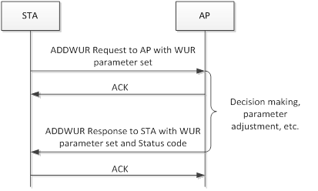
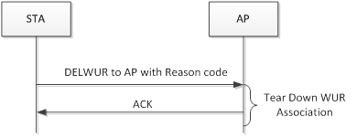
WUR Association Establishment
WUR association parameters exchange can be performed using simple 2-way handshake
Could be STA-initiated or AP-initiated
The request may include recommended parameters for the WUR association
The response carries the decision with the appropriate status and possibly adjusted parameters
The WUR association teardown can be performed through the simple notification with Reason code
Possibly new Action frame have to be defined for this purpose

Slide 8
Example of WUR Parameter Set
Operating channel
Channel to be used for WU frame transmission
WUR mode
Duty-cycled mode, continuous mode, etc.
Duty-cycle parameters
If duty-cycled mode is used then negotiation of parameters is needed (e.g. on/off duration intervals, duty-cycle period)
WUR ACK policy
WUR ACK policy used for the given association (No ACK, Immediate ACK, Delayed ACK, etc.)
Wake-up delay
Approximate transition time from OFF to ON state
Can be used for WUR ACK/PS-Poll timeout setting
Etc.

Slide 9
Conclusion
STA and AP may exchange WUR capability information during scanning or association phase
STA and AP should also have an explicit handshake procedure to establish, teardown or update WUR association and negotiate parameters

