Slide 1
AP Discovery Discussion
Date: 2017-01-16
Authors:
Name | Affiliation | Address | Email
Nan Li | ZTE Corporation | No.9 Wu Xing Section Xi Feng Road Xi’an, Shaanxi Province P.R.China | li.nan25@zte.com.cn
Kaiying Lv |  |  | lv.kaiying@zte.com.cn
Bo Sun |  |  | sun.bo1@zte.com.cn

Slide 2
Abstract
WUR usage model document[1] includes usage models about mobile AP.
Mobile APs should be power efficient and may work in duty cycle mode.
In [2], scenario about AP discovery when AP is in sleep mode is discussed.
In this proposal, we further discussed the issues of AP discovery by unassociated STA when AP is in sleep mode.

Slide 3
AP Discovery Issue Description
Background:
In a typical AP discovery scenario, an unassociated STA scans on channels listed in ChannelList parameter in the MLME-SCAN.request primitive to find a preferred AP.
Issue:
When an AP equipped with WUR module is waken up from sleep mode, it will return to the same working channel as that before it entered sleep mode.
The working channels of APs with WUR module may be various. An unassociated STA performs scanning and if no preferred AP or no AP is found, the STA sends WUR frames to wake up APs and then it needs another round of scanning on all the channels in the channel list.
Before the STA finishes scanning and selects a preferred AP, all these APs are expected to stay awake and this process is definitely NOT power efficient.
It is better for an unassociated STA to shorten the scanning procedure to reduce AP power consumption.

Slide 4
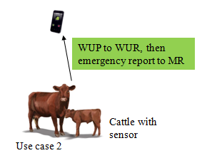
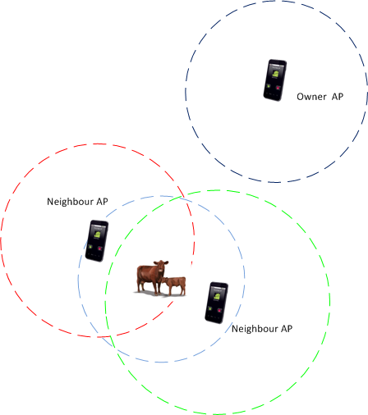
Scenario example analysis
In usage model 3, cattle are moving around randomly, thus they may move out of the coverage of their owner AP and enter an area covered by one or more neighbour mobile APs.
When the cattle has emergency or monitor data to report, and cannot find their owner AP, they are trying to communicate with other APs for service.
Each head of cattle may wake up all the APs in its coverage by using a wildcard SSID/BSSID in wake up frame.
However the STA only needs to communicate with one AP. This will cause all other surrounding mobile APs to be waken up frequently and to be kept awake for a while even without communicating with the STA, which is unexpected.

Slide 5
Proposed Wake Up procedure(1)
AP’s WUR module receives Wake up frames on WUR channel
Wake up frame may carry wake up ID(s) of specific BSS(s),the wake up ID may be:
AP’s SSID/BSSID, partial SSID/ partial BSSID
Wildcard SSID, Wildcard BSSID
WUR channel is the channel AP uses to monitor WUR frames when it enters sleep mode. AP’s WUR channel should be predefined so that an unassociated STA knows where to send WUR frames.
AP knows there are STAs trying to perform scanning/communicating with it by analyzing the Type /control ID field of the WUF.
Type /control ID field indicates the purpose of the WUR frame.
One or more bits in the Type/control ID field is used to indicate that the sender is performing network scanning.
Then the AP will turn on its primary connectivity radio.

Slide 6
Proposed Wake Up procedure(2)
Wake up frame could also carry a designated channel for awaken AP(s) to send a response frame for the wake up frame.
After turning on its primary connectivity radio, the AP sends a response frame on the designated channel.
APs designated to the same channel contend to send the response frame.
AP carries its working channel and a few key information used for network selection in the response frame.
The STA will collect the response frames on the designated channel for a time duration T after sending wake up frames.
The STA selects AP based on the response frames’ content and RSSI, etc.
The STA will ACK/respond to the selected AP. The APs which are not acknowledged will return to sleep mode instead of sending beacons on working channels.
The STA continues to perform network entry / communicate with the selected AP on its working channel.

Slide 7
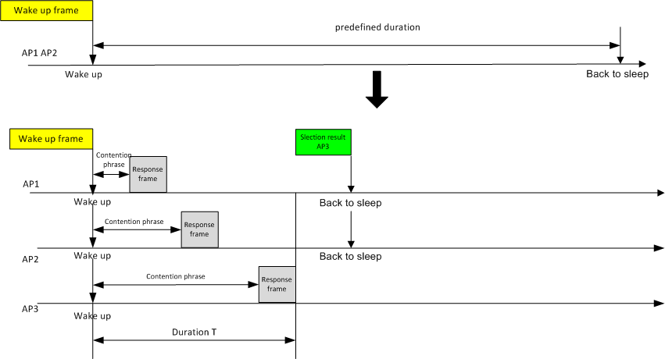
Result Analysis
According to [4],typical commercial 802.11 devices apply 20 and 40 ms to MinChannelTime and
MaxChannelTime, respectively.
Assuming 11 channels in 2.4GHz,STA scanning all the 11 channels takes : 40ms * 11=440ms
Once AP is waken up ,it will keep waiting for a predefined duration before going back to sleep if no frame is received. The value of predefined duration should be large enough for STA’s scanning. Here we assume the predefined duration >=440ms.
With the proposed procedure, STA sends selection result right after Duration T times out. AP1 and AP2 which are not selected could go back to sleep immediately without waiting till the end of the predefined duration and thus save energy.
T is much smaller than predefined duration, usually < one BI .

Slide 8
Conclusion
Possible method is discussed for AP to save energy in AP discovery procedure
Contends should be included in the wake up frame for scanning:
Wake up ID of AP
Type of the wake up frame
Designated channel for AP to notify its working channel

Slide 9
References
[1] 11-17-0029-04-00ba-wur-usage-model-document
[2] 11-16-1400-00-0wur-power-efficient-wur-ap-discovery
[3]11-16-1045-09-0wur-a-par-proposal-wur-sg
[4]A. Mishra, M. Shin, and W. Arbaugh, “Context caching using neighbor graphs for fast handoffs in a wireless network,” in Proc. IEEE INFOCOM, Mar. 2004, pp. 351–361

