Slide 1
NDP-Based Measurement Protocol
Date: 2016-12-01

Slide 2
Outline
Propose a NDP-based sounding sequence for the MU measurement protocol in 802.11az

Slide 3
Motivation
Reuse 11ax PHY architecture for simplicity
Support MU operation for improving efficiency
Support MIMO and full bandwidth for enhanced accuracy

Slide 4
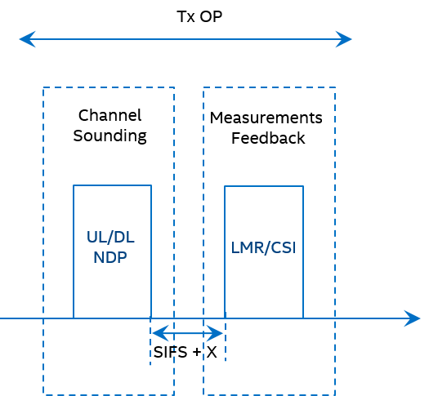
Background
Measurement protocol includes two phases
Channel sounding phase
Measurements feedback phase
These two phases can be within the same or different TxOPs

Slide 5
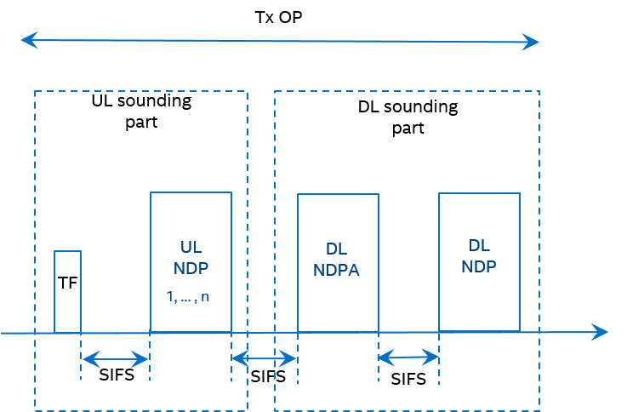
Sounding Sequence
Maximum compatibility with 11ax
NDP is reused as sounding signal
Trigger frame precedes UL transmission
NDP-A precedes NDP sounding

Slide 6
Feedback Content
CSI
Channel estimates for obtaining ToD/ToA and/or AoA/AoD (MIMO case)
Receiver calculates ToA for both UL and DL (non-critical path calculation)
LMR
ToD/ToA and AoA/AoD
Sender of the feedback pays the computing power
Feedback sender can choose either CSI or LMR

Slide 7
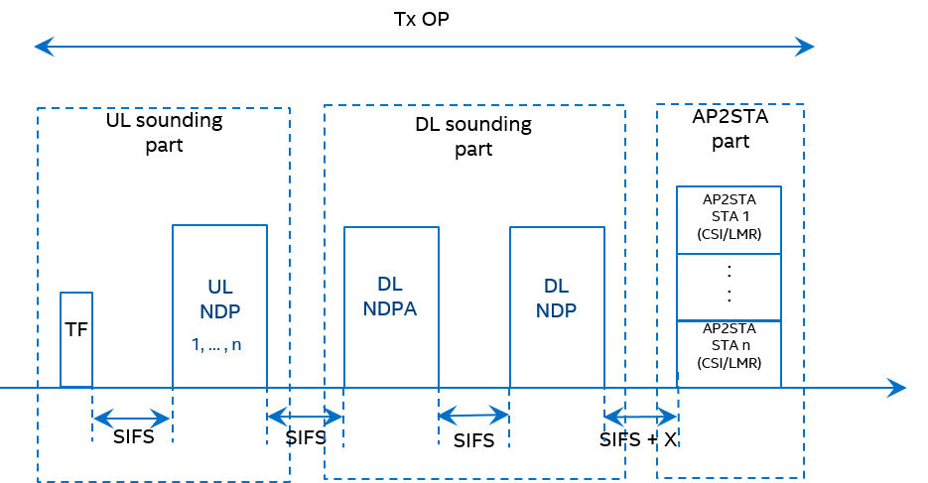
Measurement Protocol — Option 1
STA has t1 and t4
AP feeds back CSI/LMR to STA, where t2 and t3 are carried
Feedback can be in the same or another TXOP
No ACK for the feedback the same as “action no ack” CSI feedback in 11ac/ax

Slide 8
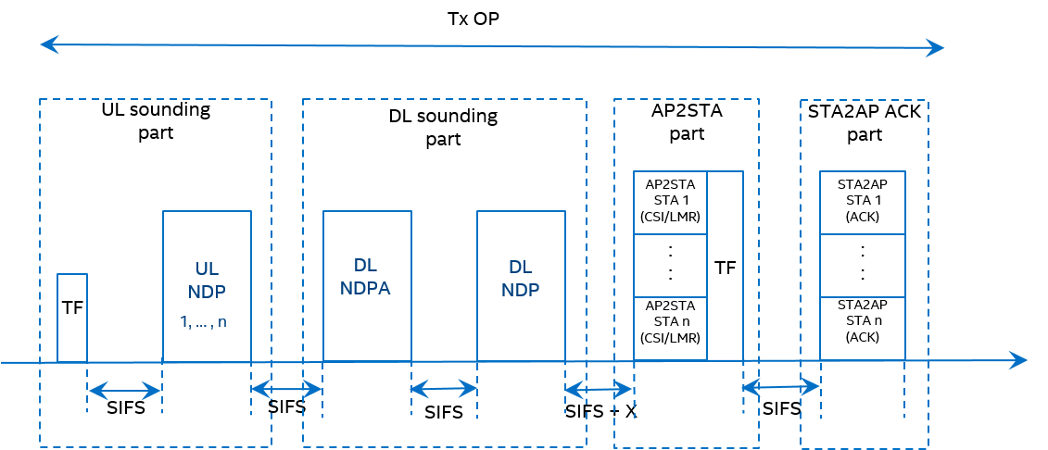
Measurement Protocol — Option 2
Same as Option 1 except the feedback is acknowledged
Trigger frame is aggregated with the feedback frame to schedule the ACK

Slide 9
Conclusion
NDP-based measurement sequence is proposed
Measurement protocol is maximally compatible with 11ax
MIMO and full bandwidth measurement are supported

Slide 10
SP #1
Do you support to use NDP for channel sounding in MU measurement protocol for 11az?

Slide 11
SP #2
Do you support that the sounding sequence of MU measurement protocol should have the structure:

Slide 12
Appendix

Slide 13
Option 1 (cont’d)
For high end AP, t2 and t3 are obtained within SIFS
AP aggregates t2 and t3 with NDP-A
Measurement finishes by 4 steps

