Slide 1
BRP Optimization in 802.11ay
Date: 2016-11-07
Authors:

Slide 2
Introduction
In 802.11ay, enhancements to the 802.11ad beamforming training procedures have been agreed on for complexity reduction, efficiency and to enable MIMO BF training [1][2][3][4].
In [6], we proposed a multi-stage, multi-resolution beamforming training (MR BFT) framework to further increase the BF training efficiency in scenarios with high resolution beams.
In [7], we studied the implementation of MR BFT by using the 802.11ad Beam Refinement Protocol (BRP) and proposed improvements to the BRP procedure to enable efficient MR BRP. The improvements concluded that :
11ay BRP protocol should allow negotiation of the value of aBRPminSCblocks <=18 [4]
11ay BRP protocol should allow negotiation of the value of the BRPIFS parameter for specific modes [7]
In this contribution, we present additional details on aBRPminSCblocks and BRPIFS adaptation.

Slide 3
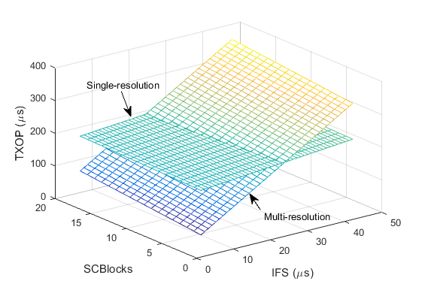
IFS Optimization
IFS has a very large effect on the efficiency of BRP feedback. As such there is a need to optimize IFS to improve efficiency of BRP [7].
Discussion was postponed on the following:
11ay BRP protocol should allow negotiation of the value of the BRPIFS parameter for specific modes [7].
There are two options to optimize the IFS for the BRP:
Negotiate the values of the IFS : Improves BRP efficiency
Restrict the IFS to SIFS only : Eliminates channel access ambiguity

Slide 4
IFS Negotiation
IFS may be selected from one of a discrete set values:
IFS may be selected from a set of pre-determined values.
The PCP/AP and STA may negotiate a set of discrete resolutions such that SIFS <= IFS <= BRPIFS.
Negotiation Procedure Details:
BRPIFS may be communicated in a capability exchange:
Transmission using Association Request/Response, Re-association Request/Response, Probe Request/Response, Beacon frames, or other type of management frame.
BRPIFS may be negotiated as part of the BRP setup negotiation.
Antenna configuration typically known at this time.
If negotiated value fails, responder may respond by transmitting one or more PPDUs to the requesting STA e.g. an ACK.
The initiator may increment the IFS value for subsequent refinements.
Initiator may announce the IFS value to allow other STAs know IFS value for channel access.

Slide 5
Restrict the IFS to SIFS only
The responder transmits a response to the initiator after a SIFs duration on reception of the BRP measurement frame.
If the response is available, the STA sends the response at a SIFS duration after the frame is received.
If the response is not available:
Option 1: The responder may respond by transmitting one or more PPDUs to the requesting STA (e.g. ACK) at a SIFS duration after the frame is received.
STA may contend for the channel at a later time
AP may poll the STA at a later time
Option 2: The STA may transmit dummy information until information is ready e.g L-STF

Slide 6
Response Transmission with SIFS only

Slide 7
Minimum Duration (aBRPminSCblocks) Negotiation
The following was agreed in the November meeting: 11ay BRP protocol should allow negotiation of the value of aBRPminSCblocks <=18 [4]
Minimum duration negotiation requires selection and signaling of the aBRPminSCblocks values.
The PCP/AP and STA may select the minimum duration values from a set of the duration values
aBRPminSCblocks = {6 12 18}, {1,2,…,18}
Signaling required for negotiation may be based on the capability of the AP/PCP and the STA.
This may be communicated in a capability exchange procedure
Transmission using Association Request/Response, Re-association Request/Response, Probe Request/Response, Beacon frames, or other type of management frame.
This may be communicated as a capability during the BRP setup procedure

Slide 8
Summary
We present details on IFS Optimization by proposing to:
Negotiate the values of the IFS : Improves BRP efficiency
Restrict the IFS to SIFS only : Eliminates channel access ambiguity
We also present further details on aBRPminSCblocks to improve BRP efficiency

Slide 9
References
IEEE 802.11-16/0100r3, MIMO BF Training Enhancements, Wang et. al., Jan 2016
IEEE 802.11-16/0316r0, Low Complexity Beamtraining for Hybrid MIMO, Fellhauer et. al., March 2016
IEEE 802.11-16/0420r1, BF Training for SU MIMO, Huang et. al., March 2016
IEEE 802.11-15/1358r5, Specification Framework for TGay, Cordeiro, August 2016
Noh, Song, Michael D. Zoltowski, and David J. Love. "Multi-Resolution Codebook Based Beamforming Sequence Design in Millimeter-Wave Systems." 2015 IEEE Global Communications Conference (GLOBECOM). IEEE, 2015.
IEEE 802.11-16/1175r0, Multi-Stage, Multi-Resolution Beamforming Training for 802.11ay, Oteri et. al., September 2016
IEEE 802.11-16/1447r1, Further Details on Multi-Stage, Multi-Resolution Beamforming Training in 802.11ay, Oteri et. al., November 2016

Slide 10
Straw Poll 1
Do you agree to add the following text to section 3.2 of the 802.11ay SFD?
11ay BRP protocol should allow negotiation of the value of the BRPIFS parameter

Slide 11
Straw Poll 2
Do you agree to add the following text to Section 3.2 of the 802.11ay SFD?
11ay BRP protocol shall transmit a response at a SIFS duration after reception of the BRP frame.
The procedure to recover feedback if the response is not ready is TBD

Slide 12
Straw Poll 3
Do you agree to add the following text to Section 3.2 of the 802.11ay SFD?
Signaling required for negotiation shall be based on the capability of the AP/PCP and the STA

Slide 13
Appendix

Slide 14
TxOP Comparison Assumptions
Tc=0.57 ns
MAC data=42 Bytes (assumes no channel measurement feedback)
Using any MCS would lead to a codeword less than the minimum block requirement
Zero padding to aBRPminSCblocks=18 (this affects BRP_training frame size)
AGC and TRN-T
Training length N:1<= N<= 32 (N~5 bits)
AGC=4N*64*5=1280N
TRN-T=(CE+TRN_subfield*4)*N=(1024+128+128*5*4)*N=3712N
IFS (Interframe spacing)
At least a SIFS interval and at most a BRPIFS interval to ensure sufficient time for the complete transmission of frames
SIFS=3 us; BRPIFS=44 us
Analysis will compare SR BRP with MR BFT
Vary number of beams and MR levels: 16 beams ( 2 level), 64 beams (3 level), 256 beams (4 level)
Note: 802.11ad BRP packet supports up to 32*4=128 beams. However, we assume 256 beams can be trained within one packet here. Otherwise, two separate BRP training packets are needed for SR’
Study effect of IFS (3 usec <= IFS <= 44 usec) and BRP_training size (1 <= SCBlock <= 18)
Assume BRP feedback frame size will stay the same

Slide 15
TxOP Comparison
Multi-resolution beamforming training
TXOP_SIFS=# of levels*(BRP_training+SIFS+BRP_feedback+SIFS)-SIFS
TXOP_BRPIFS=# of levels*(BRP_training+BRPIFS+BRP_feedback+BRPIFS)-BRPIFS
Single-resolution beamforming training
TXOP_SIFS=BRP_training+SIFS+BRP_feedback
TXOP_BRPIFS=BRP_training+BRPIFS+BRP_feedback
Observations
Multi-resolution beamforming training has a shorter training packet but a larger number of training and feedback packets
IFS, BRP_training and BRP feedback have impact on the time duration

Slide 16
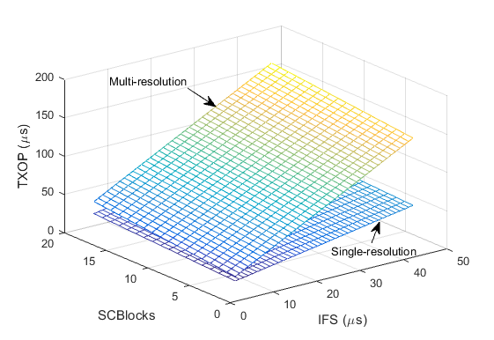
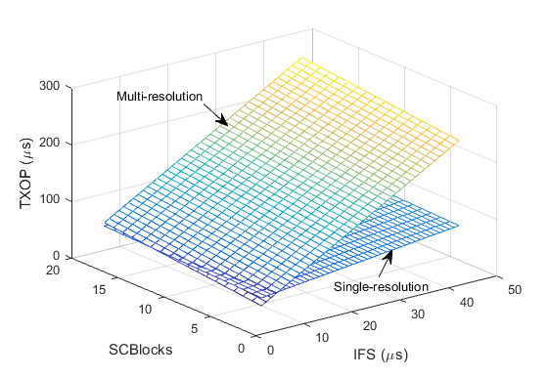
Results
2-Level Results: 16 beams
3-Level Results: 64 beams
MR BFT with existing BRP parameters
Parameters
BRP_training size: 1 <= SCBlocks <=18
IFS duration: SIFS (3) <= IFS<=BRPIFS (44)
Observation
As resolution increases, MR BFT shows improved performance over SR BFT if BRP_training size and IFS are modified
4-Level Results: 256 beams

Slide 17
Results Summary
Observations
Observation 1 (O1): Optimizing both IFS and BRP training frame size show improvements for both SR and MR BFT.
SR drops from 241 usec to 215 usec
MR drops from 381 usec to 213 usec
Observation 2 (O2): MR BFT shows improved performance over SR BFT as the beam resolution increases
Note that up to 2048 beams may be supported
O1
O2

