Slide 1
WUR Usage Model Document
Jan 2017
Authors:
Date: 2016-01-19
Ross Jian Yu, Huawei Technologies

Slide 2
Authors (cont’d):

Slide 3
Background
Jan 2017
To support the definition of a wake up radio WLAN standard, this document attempts to list several usage models.
Ross Jian Yu, Huawei Technologies

Slide 4
Terminology
Usage Model – A usage model is the combination of all the things below; not to be confused with a use case which is the specific set of steps to accomplish a particular task.
Application – A source and/or sink of wireless data that relates to a particular type of user activity. Examples are streaming video and VoIP.
Environment – The type of place in which the network of the use case is deployed, such as home, outdoor, hot spot, enterprise, metropolitan area, etc.
Traffic Conditions – General background traffic or interference that is expected while the use case steps are occurring. Overlapping BSSs, existing video streams, and interference from cordless phones are all examples of traffic conditions.
Use Case – A use case is task oriented. It describes the specific step-by-step actions performed by a user or device. One use case example is a user starting and stopping a video stream.

Slide 5
List of Usage Models
Model # | Usage Model
1 | Smart Home
2 | Warehouse
3 | Outdoor Cattle Farms
4 | Sensor Network Synchronized Wake Up
5 | Wearable Devices Unsynchronized Wake Up
6 | Wearable Devices Reconnection
7 | Moving Goods Tracking Wake Up

Slide 6
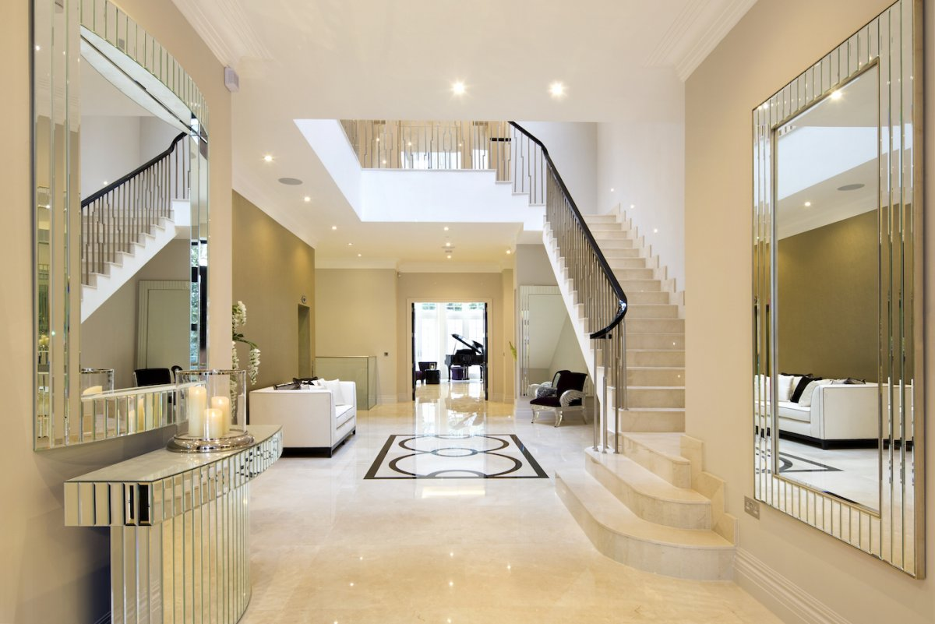
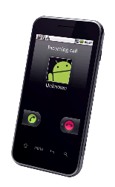
Usage Model 1: Smart Home
Environment
In a house/apartment/smart building, an AP and 8~20 devices are arranged naturally from the perspective of the house/apartment occupant per house/apartment. The smart building contains 100 apartments (5 floors * 20/floor).
Some STAs (e.g., TV) don’t need to consider the power consumption whilst some STAs (e.g., smart-curtain, smart-door) are equipped with coin batteries which expect to last for several years. Besides, a few sensors are used to collect the information of the house.
Applications
Cloud based applications supporting video streaming with 8k resolution.
Video throughput assumptions are: ~112Mbps per STA, delay is < 200ms, 1.0E-3 PER.
Online game
Cloud-based application such as big storage
Web browsing assumptions for social networking are: ~20Mbps, PER 1e-3, delay<50ms
Assisted living and healthcare
Light condition request/report
Curtain open/close command
Quick message/Incoming call notification
Smart metering, home Appliances and automation, environmental sensors, detection sensors for security and safety (e.g., smoke/fire, gas detection, water leak detection)
Traffic Conditions
Multiple video display are operational simultaneously.
Interference with Zigbee, Bluetooth.
Interference with wake up packet transmission
Light sensor

Slide 7
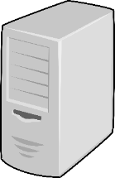
Usage Model 1: Smart Home
Light condition
Use Case
The sensor transmits the light condition to the server through the AP, which determines whether the curtain needs to be open or closed. Then the server tells the curtain the open/close command through the AP. The AP transmits a WUP to the WUR of the smart curtain. After the MR is awake, the AP transmits a message to let the smart-curtain open/close the curtains.
The owner of the house uses his mobile phone to tell the smart curtain that he wants to open/close the curtain through the AP. The AP transmits a WUP to the WUR of the smart curtain. After the MR is awake, the AP transmits a message to let the smart-curtain open/close the curtains.
The AP first transmits a WUP to wake up the smart phone. After the MR is awake, the AP transmits quick message/incoming call notification to the smart phone.
The sensors send fire/gas/safety alarm to the server through the AP.
Turning on all the lights in a hall way,
Reading of temperature in all the rooms
Message
Light condition
WUP to WUR, then message to MR
Use case 1
Message
WUP to WUR, then message to MR
Use case 2

Slide 8
Usage Model 1: Smart Home
Use case (cont’d)
Users watch the high quality video contents coming from the Internet or video contents stored in their PVR with VHD Display. There may be another video streams to be recorded in the Blu-ray deck.
People enjoy playing online games or local game machine with two or more people.
Other users are just accessing the Internet for email access, web browsing, etc.
Challenge and Requirements
The WUP transmission should enable coexistence with legacy IEEE 802.11 devices operating in the same band.
The AP should consider the case where some STAs are equipped with WURs whilst some STAs are not.
The STAs with WUR can reconnect to the AP after losing connectivity.
Quick message/incoming call notification
WUP to WUR, then Quick message/incoming call notification to MR
Use case 3

Slide 9
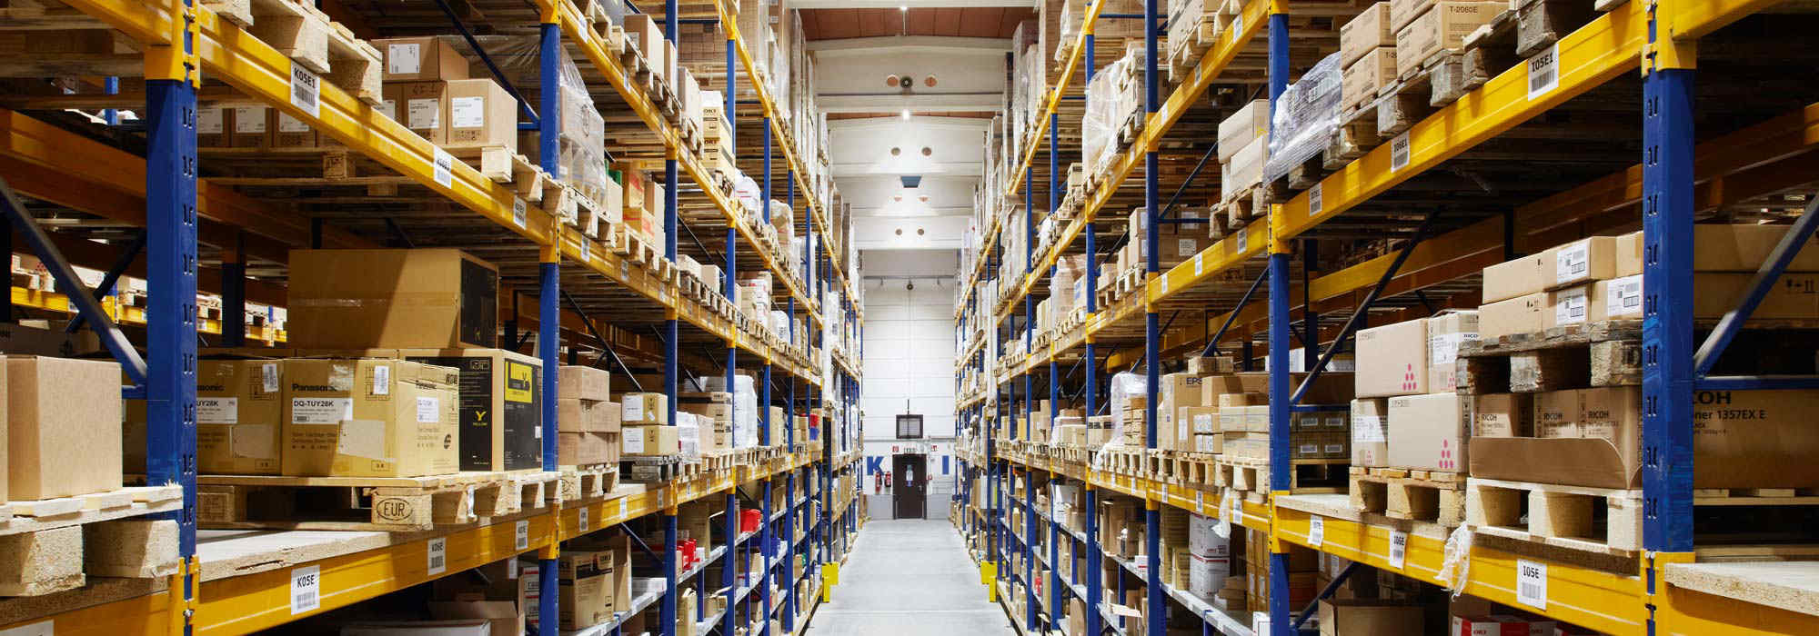
Usage Model 2: Warehouse
Environment
In a warehouse, there exists one or multiple AP (s). In each container/box or on each shelf, there are one or several sensors equipped with coin battery.
The server will frequently collect the temperature/humidity/location from the sensors through the AP. Besides, the workers are equipped with mobile phones, and may also try to collect those information with their mobile phones through the AP.
Applications
Video throughput assumptions are: ~112Mbps per STA, delay is < 200ms, 1.0E-3 PER.
Temperature/humidity/location request/report
Smart metering, home Appliances and automation, environmental sensors, detection sensors for security and safety (e.g., smoke/fire, gas detection, water leak detection)
Status query/report, configuration change request
Traffic Conditions
Multiple surveillance videos are transmitted
Interference with wake up packet transmission

Slide 10
Usage Model 2: Warehouse
Use Case
The server wants to request the status/change configuration of one box through the AP. The AP transmits a WUP to the WUR of the sensor. After the MR is awake, the AP transmits a status query command to let the sensor feedback the status.
The worker of the warehouse uses his mobile phone to request the status of one box through the AP. The AP transmits a WUP to the WUR of the sensor. After the MR is awake, the AP transmits a status query command to let the sensor feedback the status. Then the AP transmits the status to the mobile phone.
The STAs send fire/gas/safety alarm to the server through the AP.
The server collects surveillance video from the cameras and transmit the video to the computer through the AP.
Challenge and Requirements
The WUP transmission should enable coexistence with legacy IEEE 802.11 devices operating in the same band.
The system should consider the case where hundreds of STAs equipped with WURs exists.
The STAs with WUR can reconnect to the AP after losing connectivity.
Status query
WUP to WUR, then status query command to MR
status feedback
status feedback
Box with sensor
Use case 1
Status query command
Status feedback
WUP to WUR, then status query command to MR
Status feedback
Box with sensor
Use case 2

Slide 11
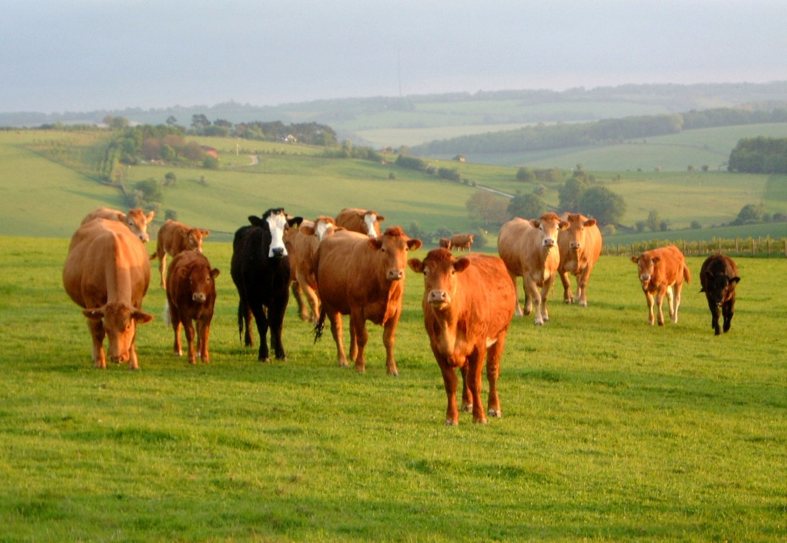
Usage Model 3: Outdoor Cattle Farms
Environment
In an outdoor cattle farms, a cattle farmer uses his mobile phone as an mobile AP. Every cow is equipped with a sensor. The cattle farmer can use his mobile phone to frequently collect the temperature/location of each cow. The sensors may also transmit some emergency report to the mobile AP. The number of cow is around 30~50.
Applications
Temperature/location request/report
Emergency report
Traffic Conditions
Interference with wake up packet transmission

Slide 12
Usage Model 3: Outdoor Cattle Farms
Use Case
The mobile AP transmits a WUP to the WUR of the sensors. After the MR is awake, the AP transmits a status query common to let the sensors feedback the status.
When some emergency/critical event happens, the sensors will transmit a WUP to the mobile AP, when the MR of the mobile AP is awake, the sensors will send the emergency/critical event to the mobile AP.
Challenge and Requirements
The WUP transmission should enable coexistence with legacy IEEE 802.11 devices operating in the same band.
The supported range of the wake-up signal will be no less than the supported range of the primary IEEE 802.11 signal of at least 20MHz payload bandwidth.
Delay should be a critical factor in case of emergency report.
The STAs with WUR can reconnect to the AP after losing connectivity.
WUP to WUR, then status query command to MR
status feedback
Cattle with sensor
Use case 1
WUP to WUR, then emergency report to MR
Cattle with sensor
Use case 2

Slide 13
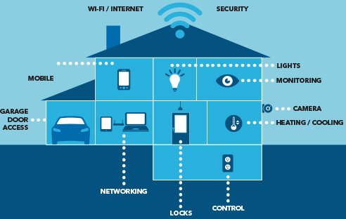
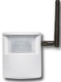
Jan 2017
Usage Model 4 : Sensor Networks
Synchronized Wake Up
Environment
In home network, tens or even hundreds of battery driven sensors (STA) are connected to home AP for security, control, heating, etc.
Sensors support real-time status checking via AP, besides periodical data reporting.
Applications
Temperature/location request/report
Traffic Conditions
Interference with wake up packet transmission
Use case
Home AP wakes up smart sensors for real-time status checking and/or configuration
Challenges and Requirements
The number of WUPs for each STA should be minimized to reduce channel occupation, considering the large number of STAs in the network.
Synchronized wake up should be supported by AP and STAs.
AP may send periodical synchronization messages to WUR.
WUR in STA may work in duty-cycle mode.
AP may send WUP during STA WUR’s ON time.
WUP to WUR, then message via main radio

Slide 14
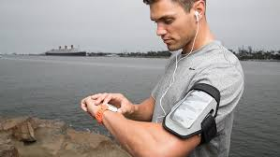
Usage Model 5: Wearable Devices Unsynchronized Wake Up
Environment
For personal network, smart watch and other wearable devices (STAs) are connected to smartphone.
A smart watch or medical sensors may make an emergency call via smartphone (rarely occur); Incoming calls or message notifications may be delivered to a smart watch.
Applications
Location/health information/message/emergency call transmission
Traffic Conditions
Interference with Zigbee, Bluetooth.
Interference with wake up packet transmission
Use case
Smartphone wakes up smart watch for incoming call or message notification.
Smart watch wakes up smartphone to make an emergency call.
AP may send multiple WUPs to wake up STA, and vice versa.
Challenges and Requirements
Both AP and STA need to be power-efficient.
Unsynchronized mode should be supported by both AP and STA.
Synchronization messages may be avoided.
WURs in AP and STA may work in duty-cycle mode.
Hiking/running
SoftAP vs STA
SoftAP with WUR
WUP to WUR, then message via main radio
STA/WD with WUR

Slide 15
Usage Model 6: Wearable Devices Reconnection
Environment
In a house, smart watch or other wearable device was connected/paired with smart phone (mobile AP/group owner).
Applications
Location/health/sports/high speed information/message transmission
Traffic Conditions
Interference with Zigbee, Bluetooth.
Interference with wake up packet transmission
Use case
User took smart watch outside, and then smart watch and smart phone was disconnected (configuration information fully /partly removed).
User took smart watch back, and would like to operate on smart phone to read the data saved in smart watch comfortably (e.g. one click to get the data).
Challenges and Requirements
WUR consumes less energy compared with Bluetooth.
STA keeps WUR ON after losing connectivity.
(Mobile) AP is able to send Reference WUR message to a disconnected smart watch’s WUR, expecting to re-establish the connection. The Reference WUR message should be verified by WUR.
Smart phone
Smart phone
Smart phone
WUP to WUR, then message to MR
disconnected
WUR signal to WUR, then re-connection
Smart watch, equipped with WUR
WUR ON
WUR ON
User took smart watch outside
User took smart watch back

Slide 16
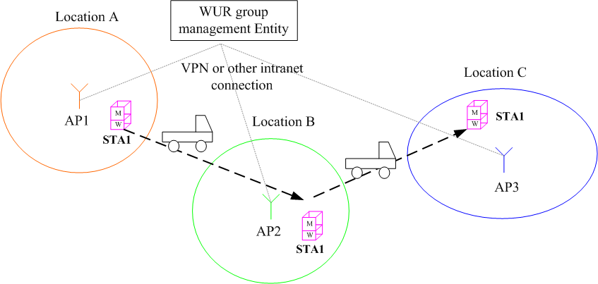
Usage Model 7:Moving Goods Tracking Wake Up
Environment
Goods equipped with sensor are transferring from one warehouse/station to another. In a warehouse/station, there is one or multiple AP(s). The transferring system needs to track the goods for tracking purpose. During freight-forwarding or express-delivery, the goods stay in sleep mode. When arriving at a transfer station/warehouse, the local APs in a warehouse/station periodically or by event send WUP to wake up WUR devices for track the goods. Hundreds of WUR devices are within one AP’s coverage.
Applications
Location request/report, wake up request/response
Traffic Conditions
Interference with wake up packet transmission
Use case
STA1 is being delivered from location A to location C passing by station B for a stop. AP1,AP2 and AP3 are within a WUR group. All APs in the group will send WUP until it wake ups and locates the goods.
Requirements
WUR device keeps WUR on and consumes less energy compared with Bluetooth.
APs are able to send WUR message periodically or by event to a WUR, expecting to locate the WUR device. WUR grouping is needed to manage tracking STAs in a number of APs coverage.
WUR device has a unique identifier within the WUR group.

Slide 17
Summary and the Next Step
Jan 2017
We include several usage models in this usage model document following the format of 11ac/11ax.
Approve this document as the draft TG Usage Models document
More usage models are welcome to be included in this document.

Slide 18
Reference
Jan 2017
11-16-1465-00-0wur-wur-usage-model
11-13-0657-06-0hew-hew-sg-usage-models-and-requirements-liaison-with-wfa
11-17-0038-00-00ba-wur-reconnection-use-case
11-17-0034-00-00ba-wur-use-cases-and-requirements
11-16-0974-00-0wur-wur-usage-scenarios-and-applications
11-16-0931-00-0wur-demand-on-roaming-for-wur

